Slide 1
CLIMATE SERVICES:
AN INTERNATIONAL VIEW
Geoff Love

Slide 2
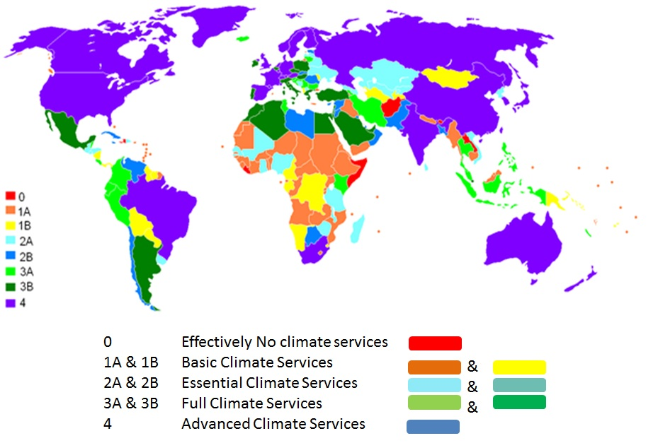
Supporting the climate service professional:
2010 Baseline
Effectively No Climate Services
6 countries
Basic Climate Services
64 countries
Essential Climate Services
56 countries
Full Climate Services
39 countries
Advanced Climate Services
24 countries
Total
189 countries

Slide 3
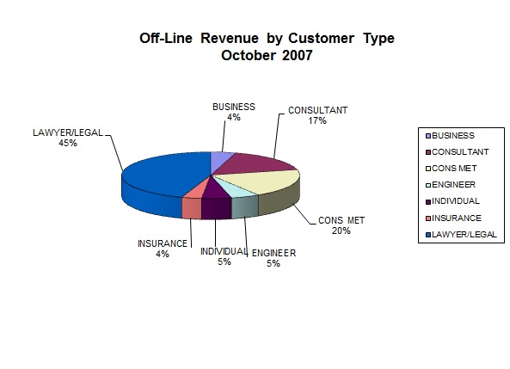
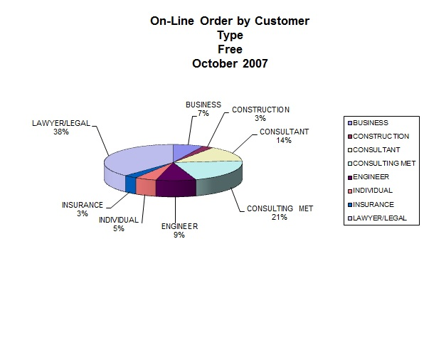
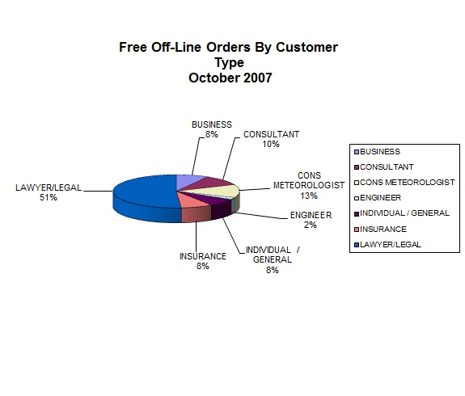

Slide 4
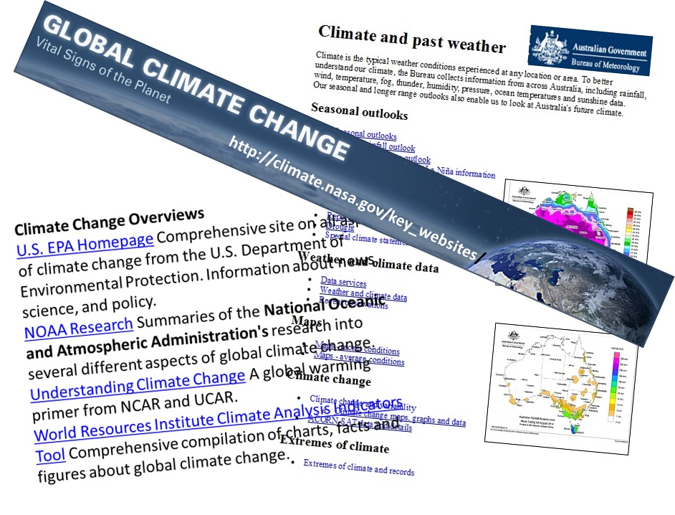

Slide 5
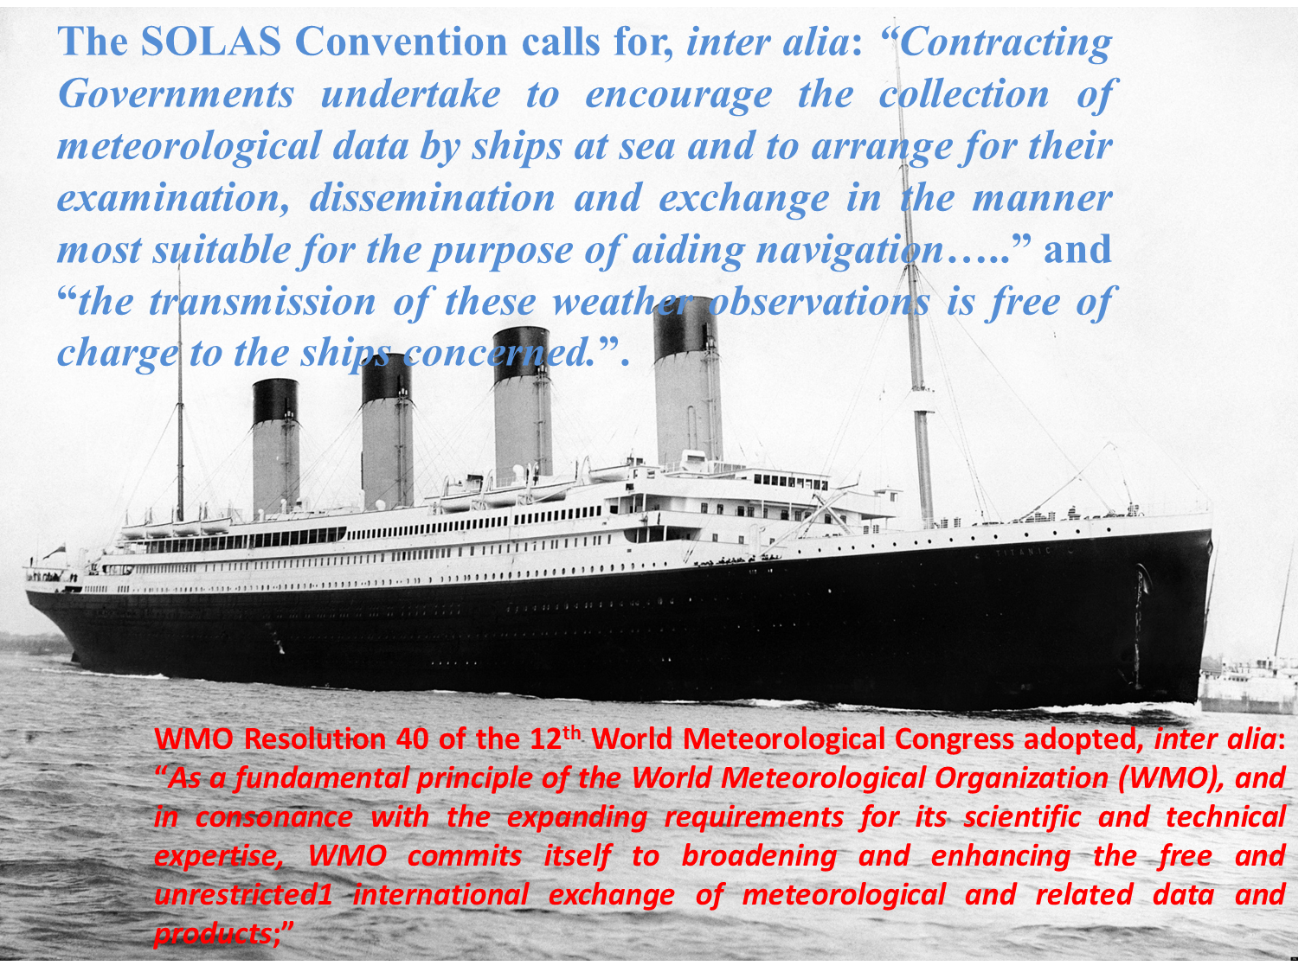

Slide 6
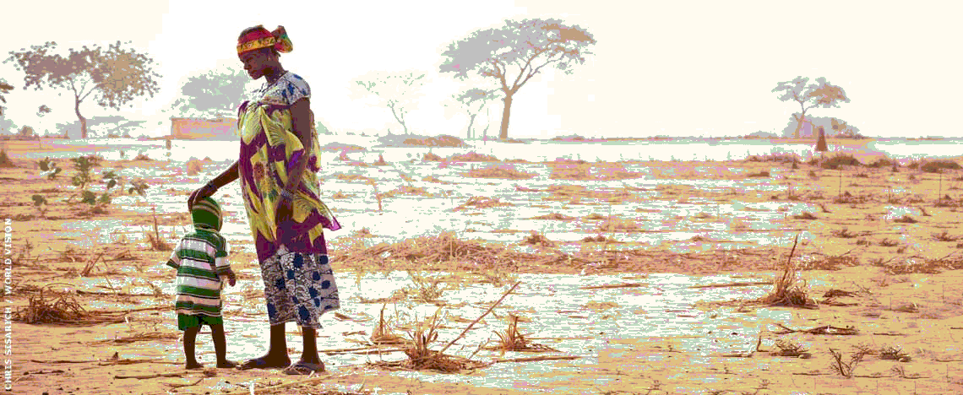
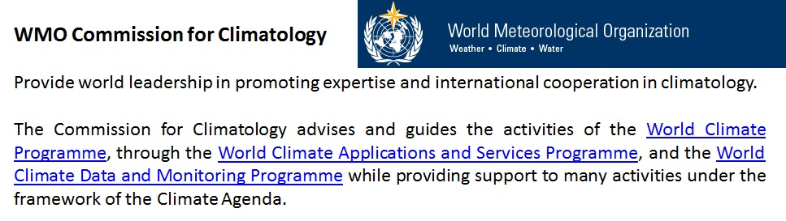
GFCS provides a worldwide mechanism for coordinated actions to enhance the quality, quantity and application of climate services.

Slide 7

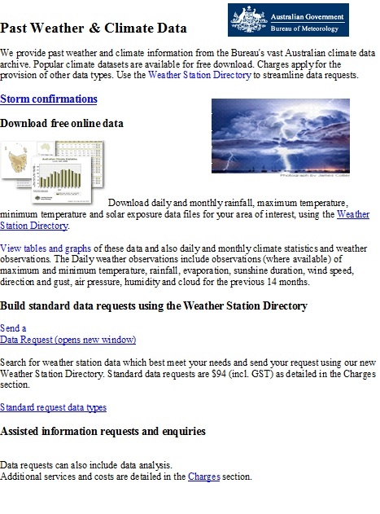
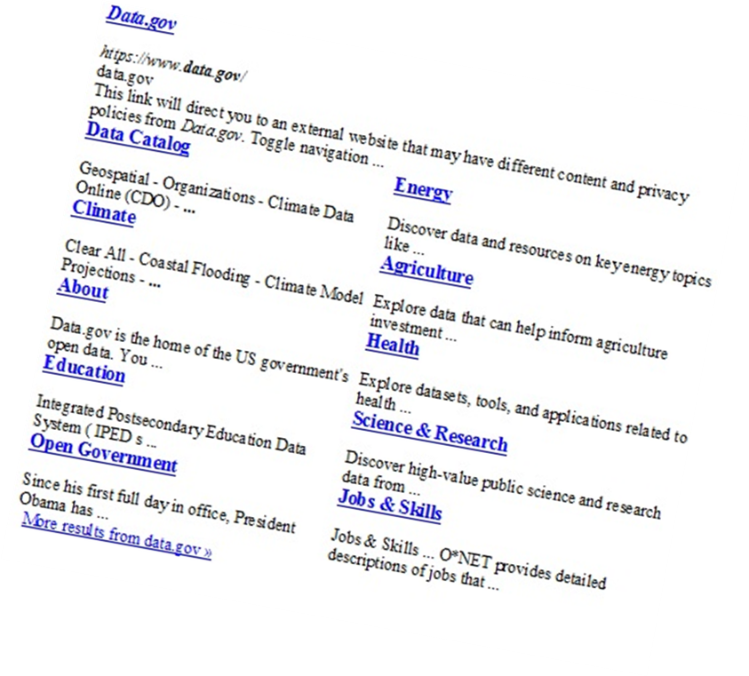

Slide 8
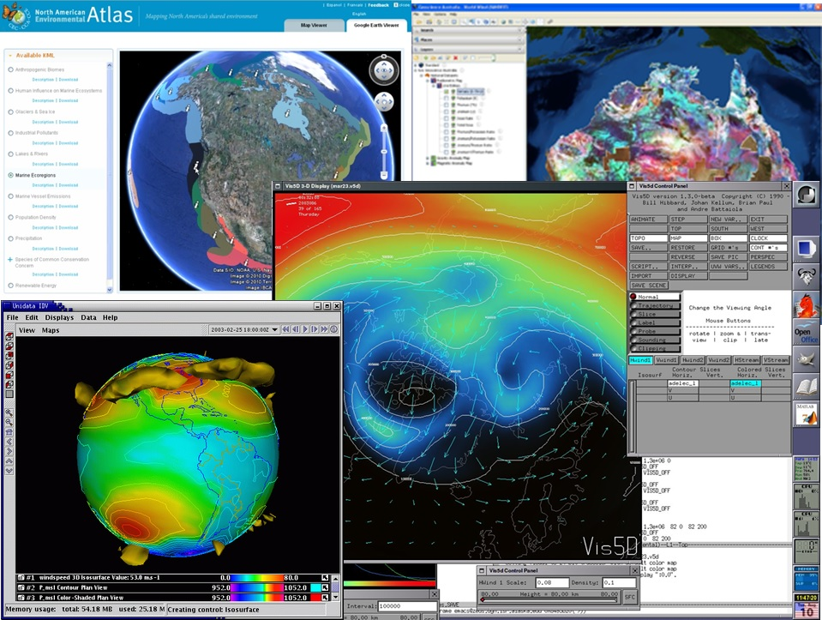

Slide 9
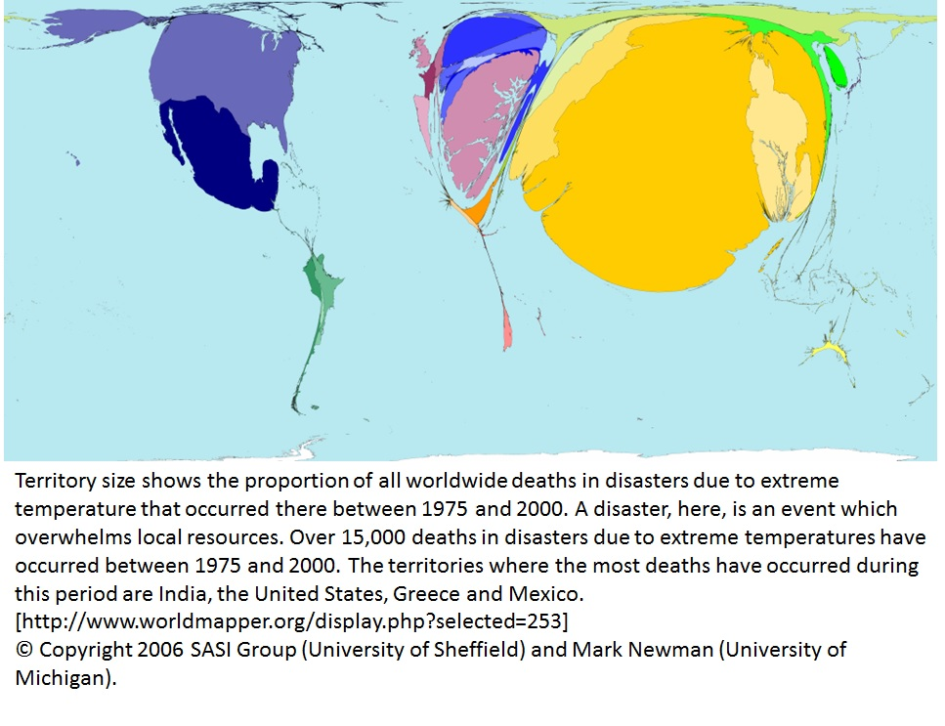

Slide 10
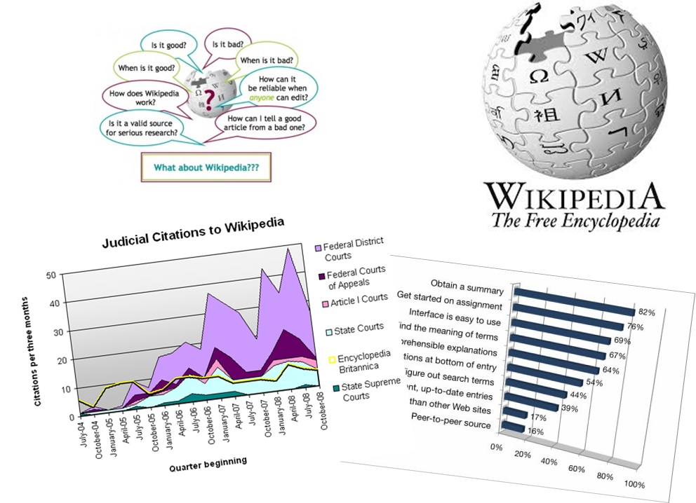
Student’s’ usage

Slide 11

“Wikipedia is the largest free source of information in the world. The sixth most widely used website in the world is not run anything like the others in the top 10. It is not operated by a sophisticated corporation but by a leaderless collection of volunteers who generally work under pseudonyms and habitually bicker with each other. It rarely tries new things in the hope of luring visitors; in fact, it has changed little in a decade. And yet every month 10 billion pages are viewed on the English version of Wikipedia alone.”
The Decline of Wikipedia, Tom Simonite,
MIT Technology Review,
November/December 2013.
“The loose collective running the site today, estimated to be 90 percent male, operates a crushing bureaucracy with an often abrasive atmosphere that deters newcomers who might increase participation in Wikipedia and broaden its coverage”.

Slide 12
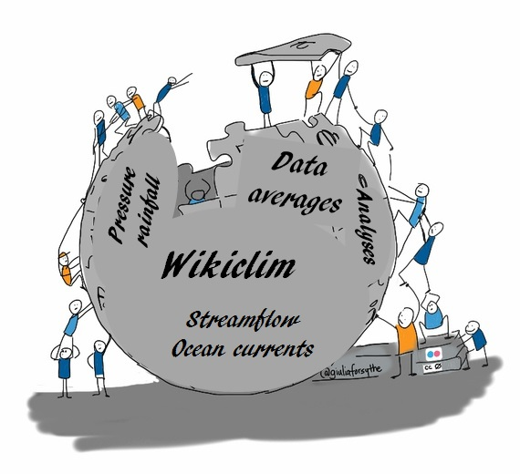
A Suggestion
Why not use the WMO’s Guide to Climatological Practices as the basis for a wiki document that could be incrementally updated by the volunteer community of interested climatologists and users of climate services?
The task would not be a simple one, but the potential reward from working with governments, national meteorological societies, the private sector, and academia to create something of high profile, of great value and desperately needed would be substantial.

