Slide 1


AMS Board on Global Strategies
State College, PA
August 14, 2014
Melinda Marquis
Board on Global Strategies (BGS) Chair

Slide 2
Meeting Purpose and Agenda
The purpose of this meeting is two-fold.
Part 1: Speakers from outside the board – their perspectives on how the board can be most useful.
Part 2: Discussion of the board’s future focus, including the proposed Climate Information Guidebook.
Desired Outcome: Concrete next steps and set of priorities to establish activities and efforts.
Agenda
8:00 Welcome and introduction – Melinda Marquis, AMS BGS Chair and NOAA/OAR
8:15 Rationale for establishing the BGS – Matt Parker, AMS CWCE and SRNL
8:30 What the private sector would like from the BGS to facilitate international opportunities – Joel Myers, Accuweather
8:45 Opportunities for BGS in the AMS future vision – Bill Gail, AMS President and Global Weather Corp.
9:00 Climate Impacts and Health: How the BGS could help most – Wendy Thomas, NOAA/NWS
9:15 International perspective on how BGS can be most helpful – Geoff Love (Formerly with Australian Bureau of Meteorology and WMO)
9:30 WMO perspective on how BGS can be most helpful –Tom Peterson, WMO Commission on Climatology and NOAA/NCDC
9:45 Discussion of ideas presented – All, moderated by Melinda Marquis
10:00 – 10:15 <BREAK>
10:15 – 12:00 Activities and Priorities for the AMS BGS - led by BGS members

Slide 3
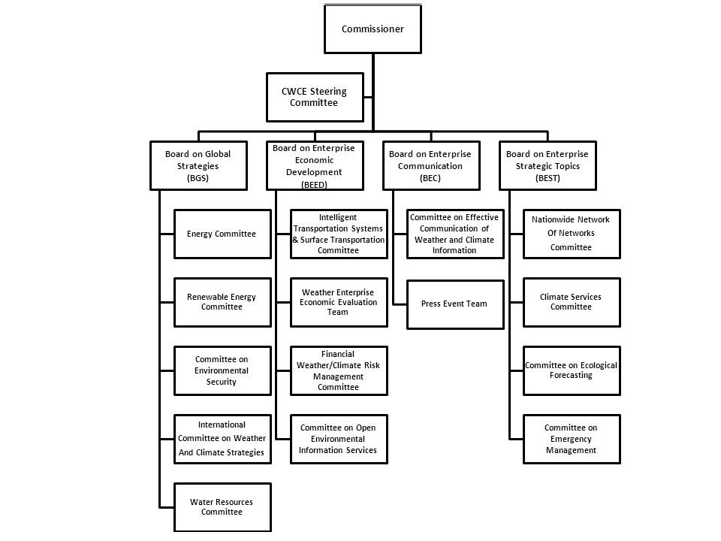

Slide 4



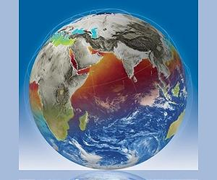
Board on Global Strategies (BGS)
… aligned with energy, renewable energy, environmental security, water resource, and international concerns as outlined by the US State Department as being critical to humanity in all parts of the globe.
The purpose is to promote development of and access to the most advanced meteorological and climatological observations, models, and predictions by all people across the globe, with particular emphasis on improving water, food, energy, and environmental security.
Committees:
  Energy
  Renewable Energy
  Committee on Environmental Security
  International Committee on Weather and Climate Strategies
  Water Resources

Slide 5
Activities (Per TOR)
Facilitate dialog among the public, private, and academic sectors in the U.S. and international communities to advance development of and access to high-quality, sustainable, long-term meteorological and climatological observations, models, and predictions around the globe.
Provide venues to engage the AMS membership and the broader national and global communities on important topics related to the intersection of weather, climate, water, food, energy and environment.
Identify opportunities to promote collaboration in the development of and access to high-quality, sustainable, long-term meteorological and climatological observations, models, and predictions around the globe.
Interact with representatives of relevant organizations, including but not limited to, the United Nations, World Meteorological Organization, United States Agency for International Development, the Intergovernmental Panel on Climate Change, the European Center for Medium-range Weather Forecasts, and the United States Global Change Research Program.
Promote training and education, especially of those in developing countries, in the use of meteorological and climatological information to enhance water, food, energy, and environmental security.
Advance understanding and use of social media and business models that support the above goals and activities.

Slide 6
Membership
 | BGS Member | Organization | Term Ends Jan. | Private | Gov’t | Acad
1 | Melinda Marquis, Chair | NOAA / ESRL | 2016 |  | X
2 | Jim Buizer | Univ. Arizona | 2017 |  |  | X
3 | Joe Casola | Center for Climate and Energy Solutions and Strategies for the Global Environment | 2017 | X
4 | Kathy Jacobs | OSTP/Climate Assessment and Adaptation | 2017 |  | X
5 | Bryan Hannegan | National Renewable Energy Lab | 2017 | X
6 | Jack Hayes | Harris Government Communications Systems | 2017 | X
7 | Wayne Higgins | NOAA Climate Program Office | 2017 |  | X
8 | Linda Makuleni | South African Weather Services | 2017 |  | X
9 | Marjorie McGuirk | Case Consulting | 2017 | X
10 | Marjorie Shepherd | Environment Canada | 2017 |  | X
11 | Kevin Trenberth | National Center for Atmospheric Research | 2017 |  |  | X
12 | Vladimir Tsirkunov | World Bank | 2017 | X
13 | Kevin Werner | NOAA/NWS | 2017 |  | X
14 | Stephen Zebiak | International Research Institute for Climate and Society/ Columbia University | 2017 |  |  | X
15 | Valerie Rountree | Univ. Arizona (Graduate Student) | 2017 |  |  | X
 | Ex Officio, Chair, Environmental Security, John Lanicci | Embry-Riddle University |  |  |  | X
 | Ex Officio, Chair, ICWCS, Angel McCoy, | DOI/BOEM |  |  | X
 | Ex Officio, Chair, Energy Committee, Heidi Centola | CME Group |  | X
 | Ex Officio, Chair, Water Resources Comm, Tim Schneider | NOAA/NWS/OHD |  |  | X
 | Ex Officio, Co-Chair, Renewable Energy Committee, Andy Clifton | NREL |  | X
 | Ex Officio, Co-Chair, Renewable Energy Committee, Jennifer Newman | University of Oklahoma (Graduate Student) |  |  |  | X

Slide 7
BGS’ Efforts to Date
We have met by phone eight times
Discussed TOR and attempted to define our priorities, and focus our activities
Two activities were proposed:
  Preparation of a Climate Information Guidebook
  Developing Curriculum for Training Expert Translators
Decided to focus on #1 only at first (Climate Info Guidebook)
This effort has stalled due to lack of funding
Thus, we are seeking input on additional priorities and activities

Slide 8

Questions to Consider
What do we aim to accomplish?
How will the board measure progress?
What is the board’s role in any project we undertake?
Are there additional guiding questions to consider?

Slide 9
Back-Up Slides

Slide 10

Climate Information Guidebook
Today there is a wealth of experience in many of the technical, practical, and institutional aspects of climate services.
For the most part, however, this knowledge has not been consolidated into standards and guidance for climate service providers, communities of practice, and policy makers.
Such guidance would be useful to organizations already engaged in climate services, and could be an invaluable resource for new initiatives.
All aspects of the production, translation, transfer, and effective uptake of climate information (i.e., decision systems) are ripe for pooling collective knowledge and distillation of good practices guidance .
Steve Zebiak (International Research Institute for Climate and Society, Columbia University; Kathy Jacobs and Jim Buizer of University of Arizona.
Notes:
At present there is considerable experience in many of the technical, practical, and institutional aspects of climate services. For the most part, however, this knowledge has not been consolidated in the form of standards and guidance for climate service providers, communities of practice, and policy makers. Collaborative efforts to compare approaches and results, and to provide guidance and information for the broader community would be of great value, and should be fostered. The guidance would be immediately useful to organizations already engaged in climate services, and could be an invaluable resource for new initiatives. All aspects of the production, translation, transfer, and effective uptake of climate information (i.e., decision systems) are ripe for pooling collective knowledge and distillation of good practices guidance.
There is demand for an authoritative source of guidance on the use of current information and resources toward robust climate risk assessment to support decision and policy making. The Climate Information Guidebook would outline the key steps and decision points in a scientifically sound assessment of past, present, and future climate. It will identify available data and information products, and discuss relevant analysis methodologies and tools, together with their strengths and limitations, in the context of application in decisions and policy.

Slide 11
Climate Info Guidebook (Cont.)
It will identify available data and information products, and discuss relevant analysis methodologies and tools, together with their strengths and limitations, in the context of application in decisions and policy. Among the topics that could be included in the guidebook are:
Problem identification and context (what we need to know about the climate for this application)
Accessing and analyzing historical climate information (observations, reanalysis products, remote sensing and merged analyses)
Monitoring of climate (remote sensing products, global analyses)
Use of seasonal forecast information (statistical models, global information products, ensembling (including multimodel), validation, probabilistic presentations and skill assessments, subjective forecasts, dynamical and statistical downscaling)
Climate outlooks at decadal scale (historical information, use of decadal predictions, use of CC projections,…)
Longer term climate projections (IPCC products, robust indicators, assessing risks at regional and local scale, ensembling, scenario generation)
Notes:
Guidance in some aspects of data collection and analysis, seasonal climate forecasts, validation, and performance metrics are already available through the WMO or other sources. These would be referenced, with new content focusing on those areas not covered by existing resources. The Guidebook could be developed as a book, or online tool, or both. The AMS BGS could launch a coordinated project toward this end, engaging leading research and climate service organizations internationally.
WMO Strategy for Service Delivery, 2009.WMO Guide to Climatological Practices. Third Edition: http://www.wmo.int/pages/prog/wcp/ccl/guide/guide_climat_practices.html;

