Slide 1
AMS’ Board on Global Strategies
Climate and Health Considerations
Wendy Marie Thomas
Meteorologist, NOAA/NWS; AMS Member; AMS Board on Environment and Health Member
14 August 2014
AMS Summer Community Meeting

Slide 2
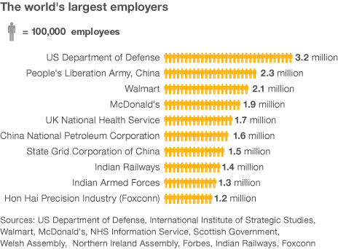
Health Sector - 101
Health Sector >> Weather Sector
  For example,
Sought us for numerical modeling experience and to understand climate
Epidemic modeling, SIR [Susceptible, Immune, Recovered]

Slide 3
Our History Together
5,000 BCE − Indus Region
460 BCE − Western Europe – Hippocrates whoever wishes to investigate medicine properly, should proceed thus: in the first place to consider the seasons of the year, and what effects each of them produces for they are not at all alike…
1700s − Influenza di freddo = influence of the cold
Late 1800s – early 1900s − World War I & II
  Health: Germ Theory/Virology
  Meteorology: War-motivated knowledge to navigate skies and oceans
  Spanish Flu − 1919
  AMS

Slide 4

Our History Together

Slide 5
Our History Together
5,000 BCE − Indus Region
460 BCE − Western Europe – Hippocrates whoever wishes to investigate medicine properly, should proceed thus: in the first place to consider the seasons of the year, and what effects each of them produces for they are not at all alike…
1700s − Influenza di freddo = influence of the cold
Late 1800s – early 1900s − World War I & II
  Health: Germ Theory/Virology
  Meteorology: War-motivated knowledge to navigate skies and oceans
  Spanish Flu − 1919
  AMS
1990s − Numerical Modeling, Climate Change, Mega Heat Waves

Slide 6
Today we are connecting…but
Are we speaking the same language?
Is there sizeable progress?
Is there momentum?
Are there obstacles that need to be addressed?

Slide 7
My Observations
Academic: Centers of Excellence; Collaborations
Private: Private sector interests and knowing its baseline needs (if any) to move forward
Public: Requirements for research and baseline operations for national and international coordination

Slide 8
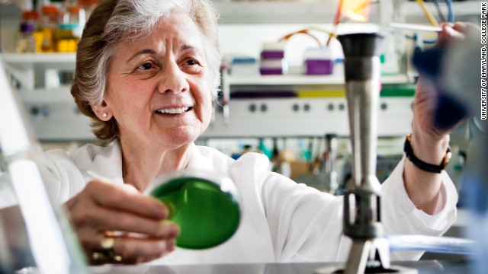
AMS’ Board on Environment and Health
Chair, Dr. Rita Colwell
  Biologist
  Special US DOS Envoy
  Pioneered SST for Cholera
22 Board Members
  Represent: IPCC, GEO, WMO, CSP, CDC, NIH, NASA, NCAR, Universities, and NOAA
  Completing an “Information Statement”
  Host Sessions at AMS Annual Meetings
  Seeking to work with other Boards and Committees

Slide 9
AMS’ STAC & CWCE
Writing
  AMS Information, Education or Policy Statements
  Op-Eds
  Journal article
Meetings
  Joint sessions at respective meetings
Other Outreach
  International or U.S. (on the Hill)

Slide 10

Olympic-like Goals
VISUALIZE
“Where there is no vision, the people perish”
Proverbs 29:18
FOCUS
Do one thing…at a time…well.
TEAMANSHIP
“Individually we are one drop. Together, we are an
ocean”
Ryunosuke Satoro, Japanese Poet
AKNOWLEDGE VICTORY
Celebrate successes before moving on…Recover

Slide 11
Let’s Go for Gold
VISUALIZE
What does success look like?
  What if the AMA and AMS had a joint program?
  What if Centers of Excellence produced novel ways of forecasting?
FOCUS
What one thing can we focus? What’s a mutually beneficial goal?
  Improving health applications via Academia, Policy, Agencies, Private Sector, etc?
TEAMANSHIP
What can our Boards accomplish together to yield more mileage?
  What if we co-wrote Op-Eds in NYT, WP, Financial Times, etc?
  Are we leveraging our members speak to the Hill, UN, World Bank
  and other decision-making bodies?
AKNOWLEDGE VICTORY
Are we recovering from hard work?
  Do we take time to celebrate together our victories?
  Are we connecting at AMS events to have a toast or dinner together?

Slide 12
DISCUSSION
There is strength in numbers…
wendy.marie.thomas@noaa.gov
301.713.0278 ext. 101

