Slide 1

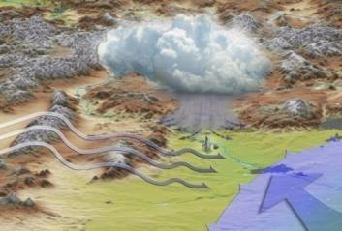


Climate Services for Water Clients: User Needs and Data Availability Existing Climate Services in the Engineering Sector
HDR Atmospheric Sciences
Sep 16, 2009
John Henz, C.C.M., SPA
Atmospheric Science Practice Leader
HDR Engineering, Inc
Denver Colorado

Slide 2

John F. Henz: “my roots”
BS, Meteorology, U Wisc.
4 yrs in Air Weather Service
MS, Atmospheric Science,
Colorado State Uni.
CCM #270
Geophysical R&D Corp
/GRD Weather Center
(1972 – 1982)
Henz Kelly & Associates
(HKA, 1983-1989)
Henz Meteorological Services
(HMS, 1990-2000)
HDR Engineering, Inc of Omaha NE purchased
HMS Nov 2000.
HDR is a top twenty Architect & Engineering firm with over 5,800 owner-employees in 42 states and over 150 offices.
> $1B in 2008 revenue.
Nat. Tech Advisor,
Hydro-Meteorology and Atmospheric Science Practice Leader

Slide 3





HDR’s Atmospheric Science Group (ASG)
Projects 2001 - 2009
Flash Flood Prediction Program, Denver, CO
Flash Flood Prediction Program, Denver, CO
Response/Hazard Mitigation Plans
Response/Hazard Mitigation Plans
Basin/Rain Calibration
Basin/Rain Calibration
Forecasting
Forecasting
Forecasting
Climate Change
Flood Detection Networks
Flood Detection Networks

Slide 4
HDR Climate Change Projects
Bay Delta CCP EIS/EIR: Climate Change Task Leader
Salina River Climate Change/Water Supply
CWCB Colorado River Basin Climate Study
North Carolina Hurricane/drought Climate Study
Flathead Reservoir Drought Management Plan and EIS
South Boulder Creek Floodplain Delineation Project – Climate task

Slide 5






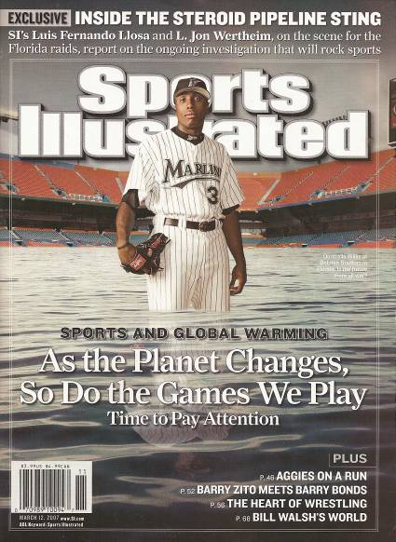
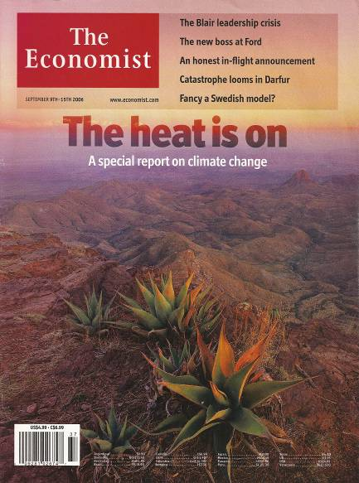
Climate Change in the News

Slide 6
Change – climate science is always changing
1970’s: Little Ice Age very likely by 2000. Running out of oil; shift to solar and nuclear.
1980’s : El Nino’s impacts “re-discovered”. Air Quality impacts become Clean Air Acts.
1990’s: Hydro-climate indices developed to reflect PDO, ENSO, NAO, AMO and related to water resource/climate fluctuations.
2000’s: Global warming, IPCC and GCM modeling

Slide 7




Navigation from Bora Bora to Hawaii
A change in perspective
Was needed
North Star
Southern Cross

Slide 8
Change – the assumption of stationary climate is dead for design
Selecting a random or preferred 20-30years of data won’t reflect the dynamic aspect of climate.
Stationarity Is Dead: Whither Water Management?
P. C. D. Milly, et al, SCIENCE VOL 319 1 FEBRUARY 2008

Slide 9
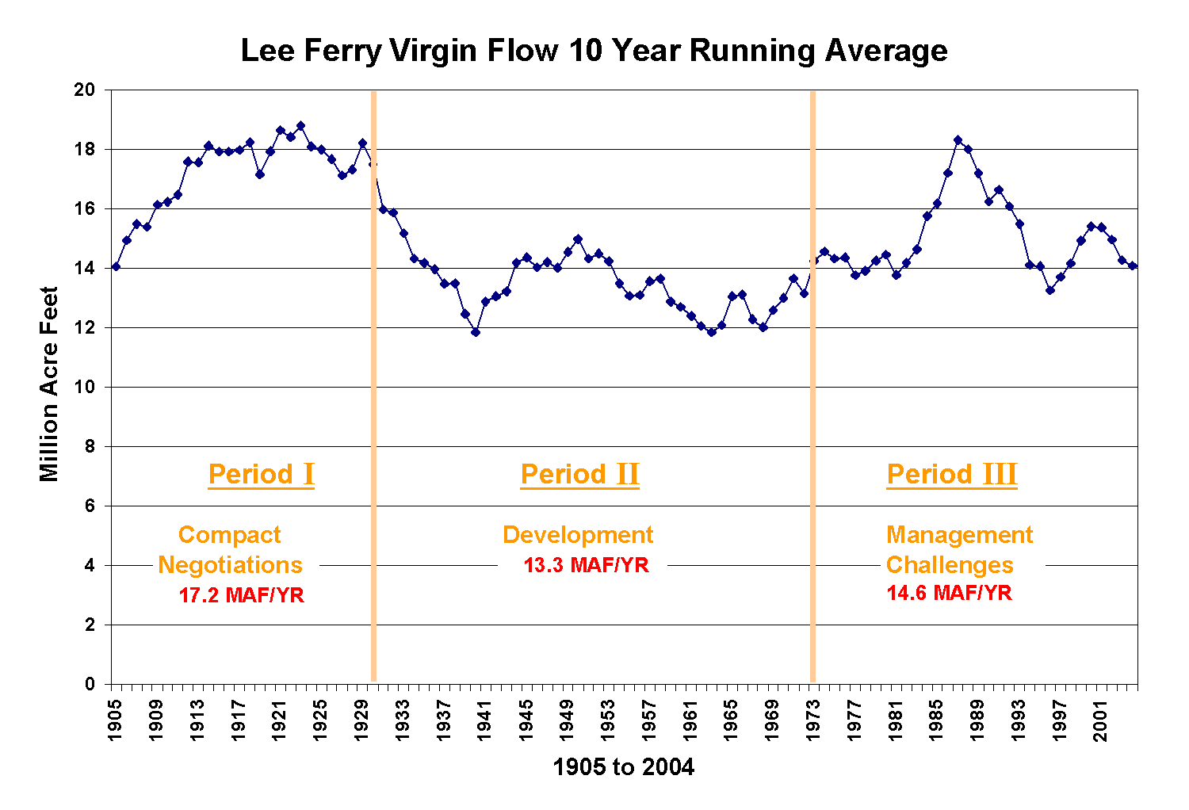
Clearly which 30 years matters
Old way

Slide 10
Clearly which 30 years matters
Old way

Slide 11
Clearly which 30 years matters
Old way

Slide 12
Dynamic – the assumption of stationary climate is dead for design
Selecting a random or preferred 20-30years of data won’t reflect the dynamic aspect of climate.
Need to define climate impact on the distribution of your observations.
Consider the impact on your projected project:
- are you entering a 25 year period of record that may favor either above or below average values?
- What is life cycle of the project? A Water year? Decades?
Can use this projection to assist in planning your project.
Stationarity Is Dead: Whither Water Management?
P. C. D. Milly, et al, SCIENCE VOL 319 1 FEBRUARY 2008

Slide 13
Navigation to future planning
A change in perspective
is needed
Dynamic
Climatology
Static Climatology

Slide 14
HDR’s Climate Change “Toolbox”
Water Supply Planning and Prediction
Use of Hydro-climate Indices (HCI)
Physical Cause-Effect Partitioning (PCEP) Historical Records: Update Design Standards
Paleo-Climatological Records
Climate Change Impact Assessment
Cyclical-Trending Analyses (CTA)
GCM Model Output Scenario Modeling
GCM-Downscaling Gridded Output using Statistical or Dynamic Methods
And “your” ASG meteorologists!!!!!

Slide 15
Atmospheric Sciences 101
Brief Methodology Overview
1. Global Circulation Model
Macro-level view of the world’s atmosphere
Balances land, air, and water dynamics and then statistically relates changes in the weather
Measured from the earth’s surface to the top of the atmosphere
2. Natural Variability
Observed interactions between the ocean and the air (using hydro-climate indices)
  Indicates whether precipitation levels are above or below normal
3. Trend Analysis
Climate has decadal patterns that trend warmer during certain cycles and colder in others
Critical to understand which trending pattern we are when making long-term predictions
Client
Outcomes

Slide 16
Climate change design impacts
Update design data base.
Consider HCI trends.
Adapt IPA design
Paleo-trend analyses
Natural variability (NV) trend analyses
Consider GCM
GCM scenarios
Down-scaled statistical or dynamical
NV trend analyses
0-30 years
30-50 years
50-100 years
Planned life cycle of infra-structure

Slide 17

The “weather enterprise solution” ?
Private sector:
client- problem interface
Providing solutions to climate change
Academic sector:
Training and research
Government sector: data and information

Slide 18
How Can We Help Clients Address Their Concerns?
Understand what resources HDR has to offer in this arena
Understand what the critical issues are and our typical approaches to solutions
Partner with the other sectors to educate clients and deliver the right solutions
This presentation focuses on providing a base level of knowledge on key client drivers and our typical solutions.
As you sell these services to your clients, engage the Atmospheric Sciences staff
early in discussions to that we can help deliver the right solution.

Slide 19
What HDR is doing
Educating engineers and clients on climate change, mitigation and adaptation options
Enhance interactions with NOAA (RISA proposal) and academic communities
Enhance our existing climate services toolbox

Slide 20

"Climate is what you expect; weather is what you get"
- Robert A. Heinlein
QUESTIONS
www.hdrweather.com – check it out!
_{Email: john.henz@hdrinc.com}

