Slide 1
2021 AWF Session 3:
Policy Impacts on Enterprise Value
an open discussion

Slide 2
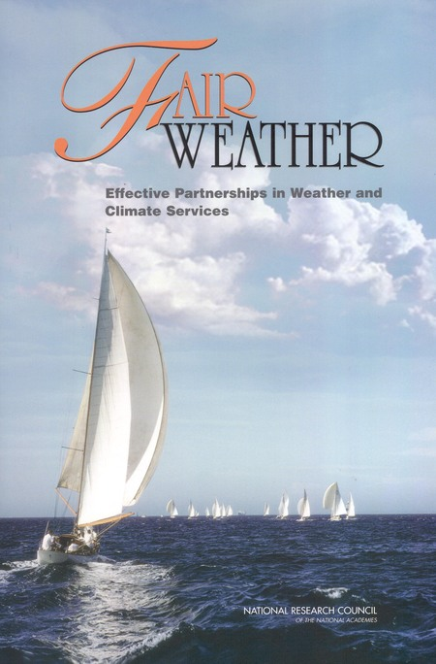
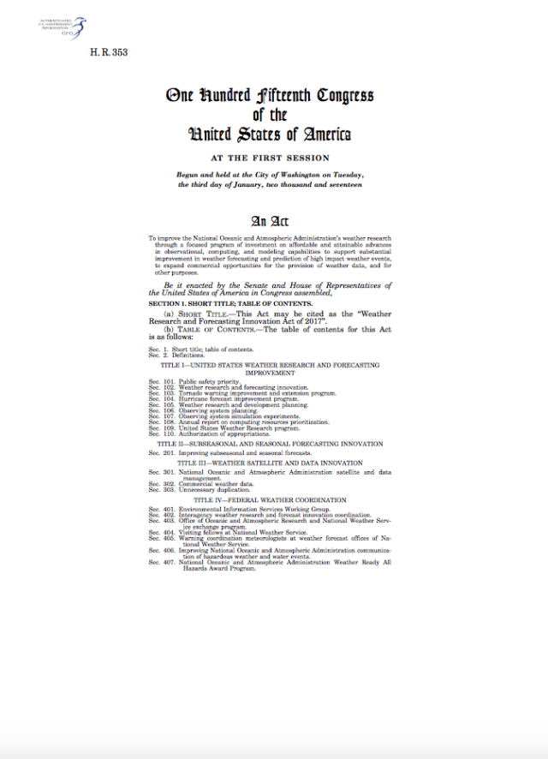
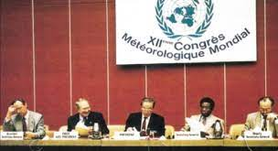
The US weather enterprise: shaped by policy: domestic and international
Fair Weather (NASEM 2003)
Weather Research and Forecast Innovation Act (2017; 2018)
(PROSWIFT Act)
_______________
WMO: Resolution 40 (under revision as Resolution 42)

Slide 3

Fair Weather:
Focus less on roles and more on process for decision making and collaboration
______________
What’s best about the current public-private-academic partnership?
What , if anything, could be improved?
Grow value/serve public good?
  Foster innovation, create/realize opportunity?
  Build equity/trust?
Useful first steps?

Slide 4
WRFIA
Sets goals and priorities for NOAA weather research and services, specifies NOAA modus operandi, and adds oversight
______________
What’s best about WRFIA in its present form?
What, if anything, could be improved?
  Grow value/serve public good?
  Foster innovation, create/realize opportunity?
  Build equity/trust?
Useful first steps?

Slide 5
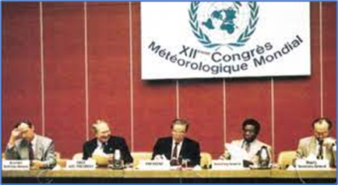
WMO resolution 40
“As a fundamental principle of the World Meteorological Organization (WMO), and in consonance with the expanding requirements for its scientific and technical expertise, WMO commits itself to broadening and enhancing the free and unrestricted international exchange of meteorological and related data and products
“Free and unrestricted” means non-discriminatory and without charge [Resolution 23 (EC-XLII) — Guidelines on international aspects of provision of basic and special meteorological services]. “Without charge”, in the context of this resolution means at no more than the cost of reproduction and delivery, without charge for the data and products themselves.

Slide 6
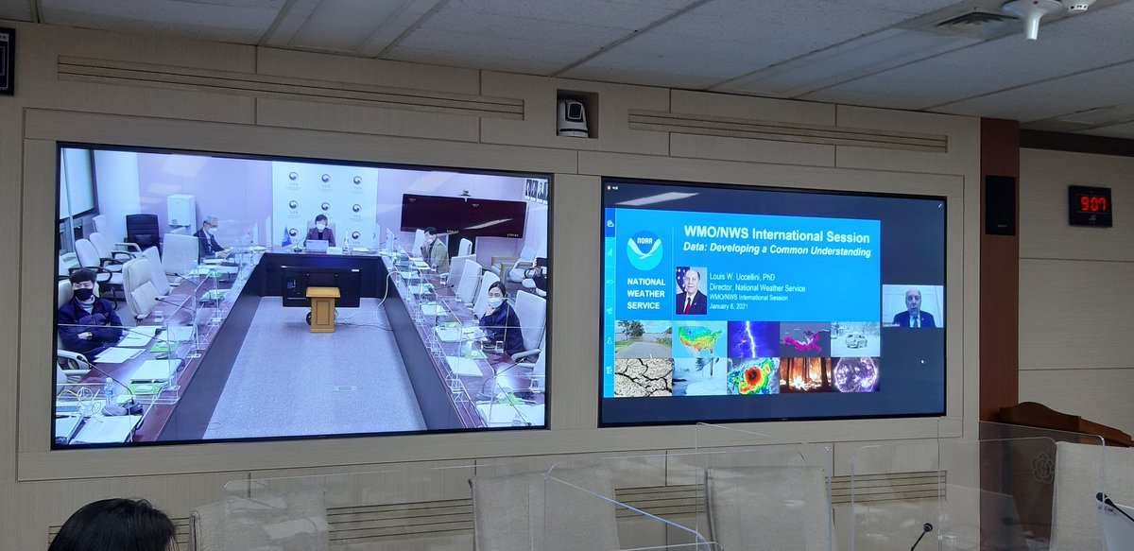
free and open exchange of data under “Resolution 42”?
Extend to cover oceanographic, hydrologic, and cryospheric data sets
Accommodate commercial data sources
No country left behind
______________
Global opportunity to
  Grow value/serve public good
  Foster innovation
US Weather Enterprise seen as both good example and concern
What steps would build global equity, trust?

