Slide 1
Edward Carr
Clark University

Slide 2
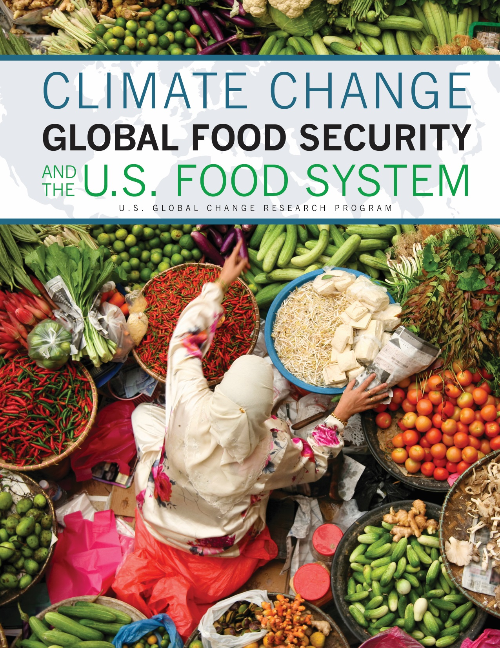

Slide 3
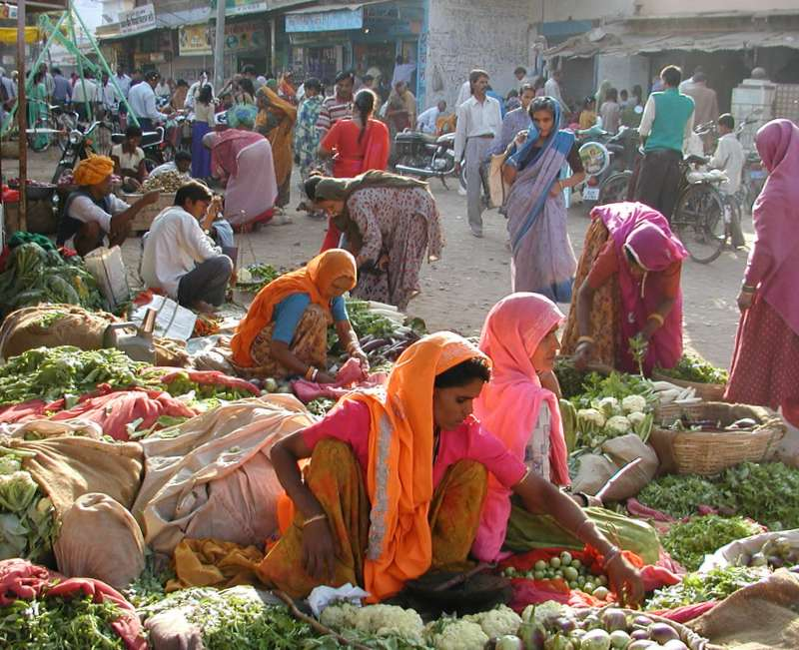
Scope
Global
U.S. role as a food importer, exporter, and source of assistance.
Not a regional treatment;
Not about U.S. food insecurity;
No policy recommendations.
Through 2100.
Produced at the request of the National Climate Assessment.
Photo: Marsh Gardiner/Creative Commons
Notes:
Meg

Slide 4

Food Security
What Is It?
Food security exists when all people, at all times, have physical, social, and economic access to sufficient safe and nutritious food that meets their dietary needs and food preferences for an active and healthy life.
- 1996 World Food Summit
(updated in 2012)

Slide 5



Key Concept:
Food Security
Does food exist?
Can you
get it?
Availability
- Production
- Distribution
- Exchange
Access
- Affordability
- Allocation
- Preference
Stability
Are these things stable over time?
Utilization
- Nutritional Value
- Social Value
- Food safety
Can you
use it?
All must occur simultaneously for food security to exist.

Slide 6
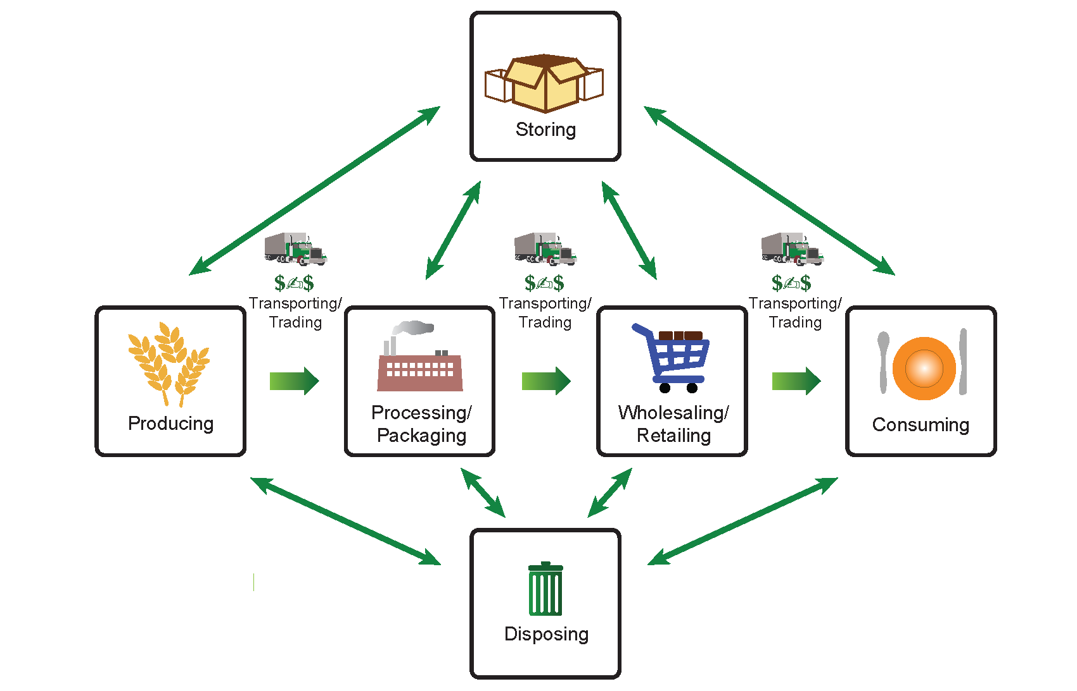
Key Concept:
Food System
An individual food system may have few, many, or all of these elements.

Slide 7
Purpose of USDA Study
To understand how global changes in food security caused by climate change interact with the US food system.

Slide 8
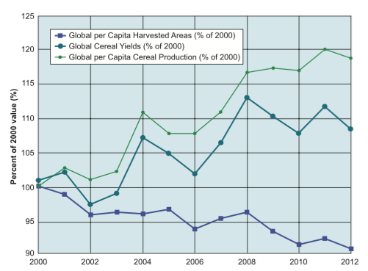
International Food Availability and Stability
Since 2000:
20% increase in global cereal production
8% increase in total per-capita cereal production
Estimates suggest that 30%–50% of total food production is lost globally as waste.
Developing: pre-retail loss
Developed: post-retail waste
Global cereal production, yield, and harvested area relative to year 2000. Global per-capita cereal yields have increased since 2000, even as the trend in per-capita harvested area has decreased. These increases have primarily been in Brazil and China since 2000. Source: FAO 2014b.

Slide 9
International Food Availability and Stability
However, more recent yield trends are measurably smaller
Global average yields for maize, rice, wheat, and soybeans are stagnating or diminishing on 24%–39% of their growing areas
Eastern Asian rice and northwestern European wheat = 31% of total global cereal production. However, yields in these regions are declining or stagnating
  Biophysical limits
  Land degradation
  Weather
  Limits on fertilizer and pesticide use
Less work has been done on the production of specialty crops such as vegetables, tree crops, fruit and ornamentals, livestock, or fish,
  Particularly important in developing countries

Slide 10
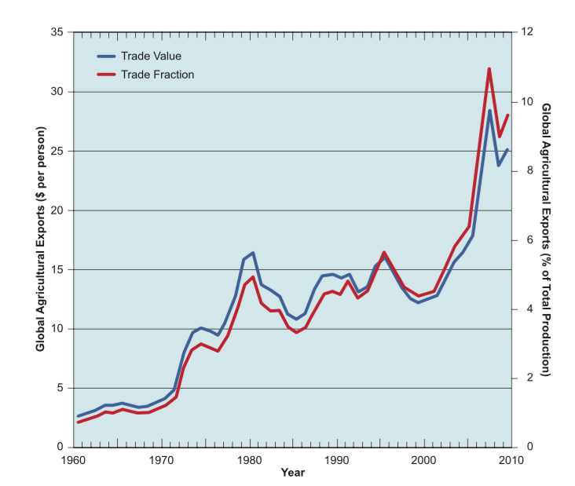
International Food availability, Food trade and Transportation
Global cereal and meat exports have climbed 27-fold since 1961
Currently worth approximately USD 192 billion a year, or 8%–10% of the total value of global production
Food transportation
International waters and rail (29% each)
Truck transport (28%)
Inland waters (10%).

Slide 11
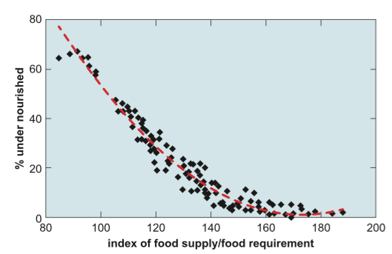
International Food Supply, Undernourishment, and Access
Estimates of undernourished population relative to food supply.
This relationship based on data from the Food and Agriculture Organization shows a correlation between the shares of undernourished individuals in the total population and the ratio of average national food supply, including imports, relative to aggregate national food requirements. Source: Fischer et al. 2005.

Slide 12
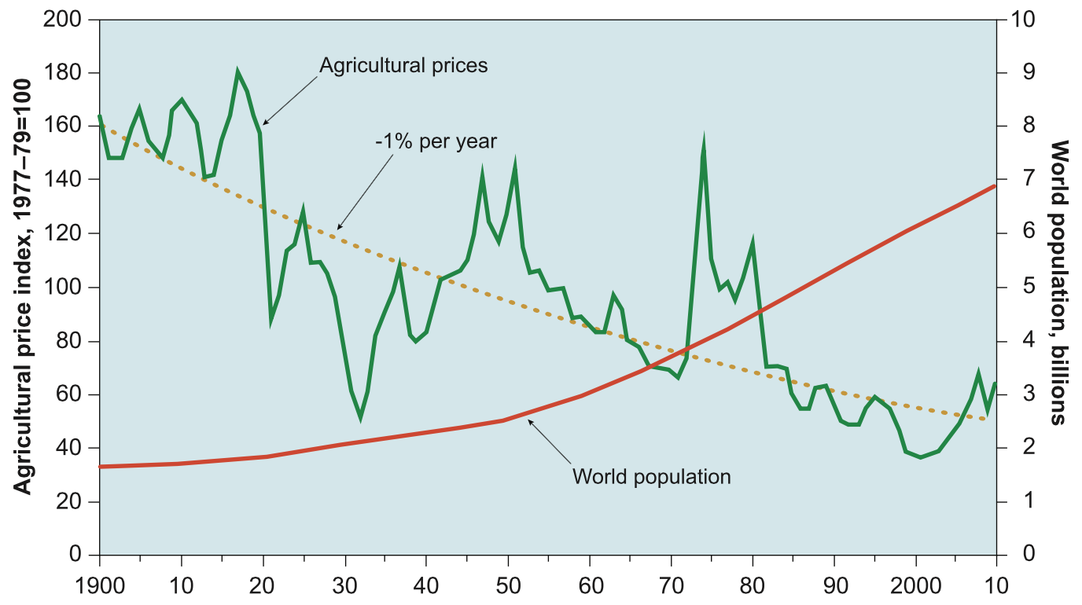
International Food Access and Stability
Component: Economic access to Food
Real food price steadily declined from the early 1960s until 2000
Since 2000, price has been on an upward trend

Slide 13
International Food Access and Stability
Food Price Stability
The volatility of global food prices has been increasing in recent years
  Widespread occurrence of extreme climate events
  Competition for land by fuel crops
  Change in the commodity markets as global demand for commodities from nonfood sectors increases
Transportation and markets critical

Slide 14
International Food Access: Knowledge Gaps
Access is about more than prices, but we have very limited data on the non-economic components of access
Data tends to be place-specific
Data tends to be population specific
Global coverage is very uneven/thin

Slide 15
International Food Utilization
Utilization Challenges
Fungal infections of crops, particularly of the genus Aspergillus, can have severe effects on human health
  Aflatoxin, produced by Aspergillus, is known to lead to cancer, as well as developmental and immune-system suppression; in severe cases it can lead to death.
  A synergistic effect between mycotoxin exposure and some critical diseases in Africa, such as malaria, kwashiorkor, and HIV/AIDS, is also suggested by several studies
Fungal contamination is a result of pre- harvest practices; timing of harvest; handling of produce; moisture levels during harvest, storage, transportation, and processing; and insect damage

Slide 16
International Food Utilization
Utilization Challenges
Food-safety issues increase when the agricultural product-processing sector lags behind broader agriculture growth, which has been the case in many food-insecure countries
  Modern packaging and storage facilities are currently deficient in most developing countries.
  Higher temperatures can affect food packaging by degrading the plastics, rubber, and wood materials over time.
  In low-income countries, lack of cold storage on farms and in wholesale and retail outlets can result in loss to pests and rotting

Slide 17
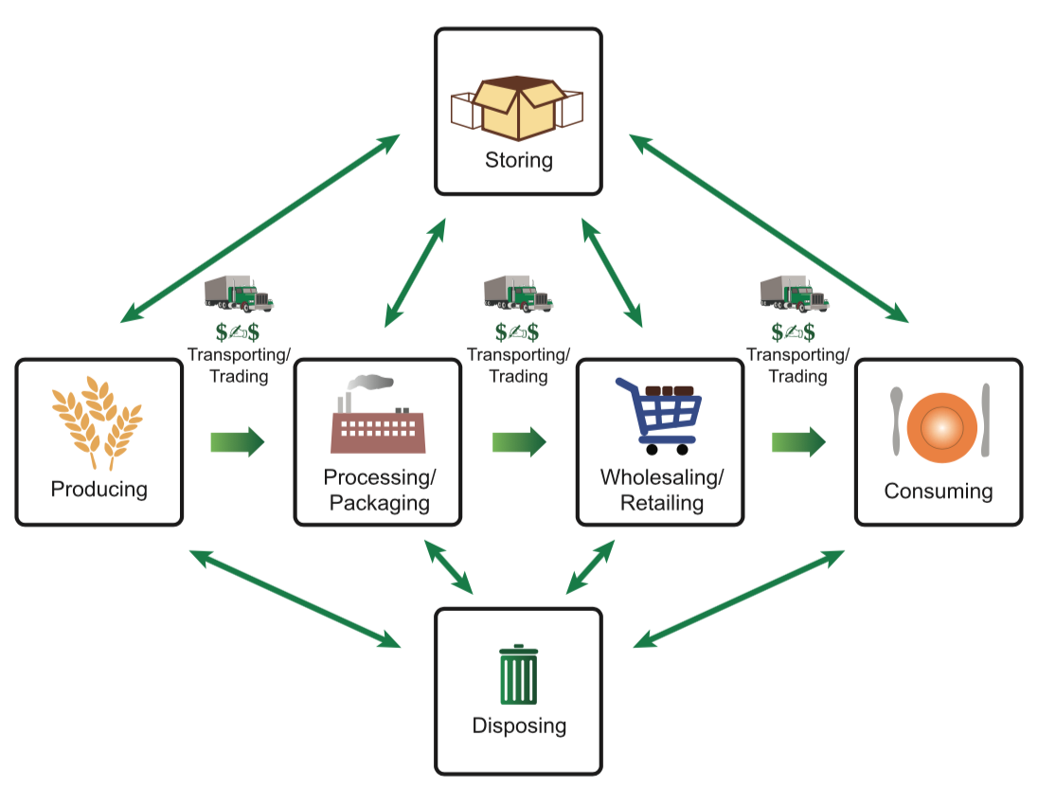
International Food Utilization
The food system chain affects food safety and the nutritional quality of food
Poor storage is a major cause of food loss, and proper packaging prevents damage and contamination.

Slide 18
International Food Utilization
Utilization Challenges
Nutritional quality of food is affected by temperature and precipitation (natural environment and storage/transportation)
  One study found that protein (a macronutrient) content in milk declined with increased temperature and humidity above threshold values
Area of needed research
  Evidence of climatic effects on nutrient content in fruits and vegetables, for example, remains limited

Slide 19
Bill Easterling
The Pennsylvania State University

Slide 20
There will be consequences of future climate change across the US food system because there were observed consequences of climate variability in the past.

Slide 21
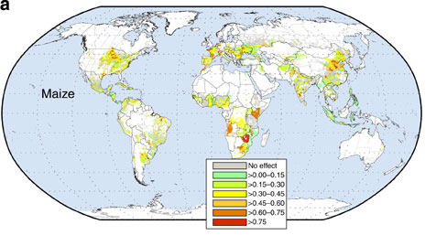
How much of recent crop yield variability might be due to climate change? (0=no effect, 1=100% of yield variability due to climate variability)
Nearly 75% of maize yield variability over past 30 yrs due to climate variability
Source: Ray et al, 2015 Nat. Comm.

Slide 22
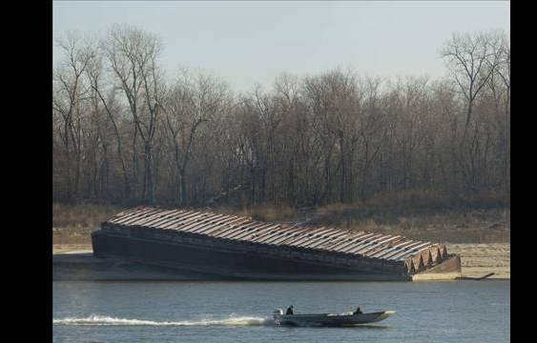
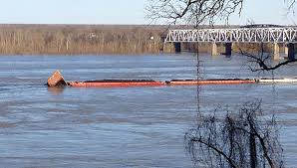
Global Food Security, Climate Change, and the United States: Transportation
45% of commodities (coal, petroleum, grain) move by barge down lower Mississippi River
Low flows beach barges, high flows greatly increase risks of accidents
Beached barge in low flow.
Sunken barges after striking bridge in 2016 flooding—coal
headed downstream

Slide 23
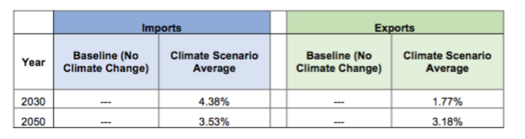
Global Food Security, Climate Change, and the United States
US trade is likely to increase due to climate change and demand
Investment in agriculture is necessary to maintain our productivity to meet this demand
Change in U.S. Agricultural Imports and Exports Relative to Constant 2005 Climate.

Slide 24
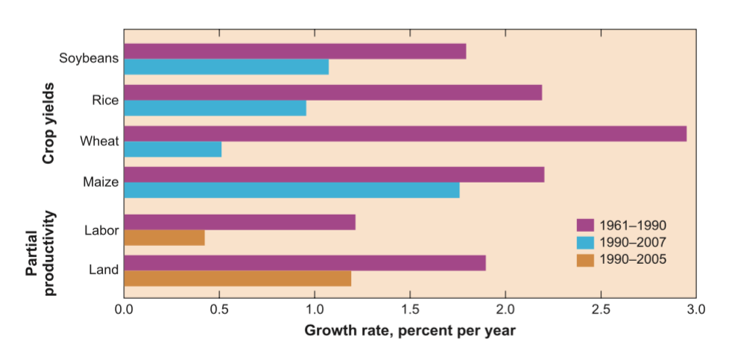
Changes in Global Agricultural productivity
Global agricultural yield and productivity growth rates, 1961–2007.
Yield is measured as metric tons per hectare. Labor and land productivity are total agricultural output per agricultural worker and agricultural area, respectively, excluding China. Total agricultural output was derived using 1999–2001 price weights. Source: Alston et al. 2009.

Slide 25
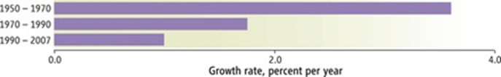
Percent annual growth of U.S. public agricultural R&D spending

Slide 26
Sonali McDermid
New York University

Slide 27
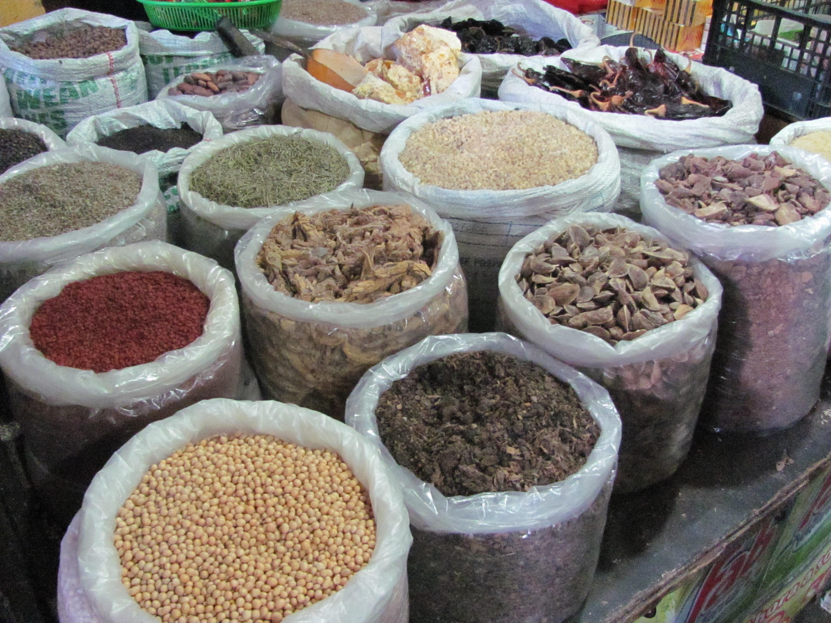
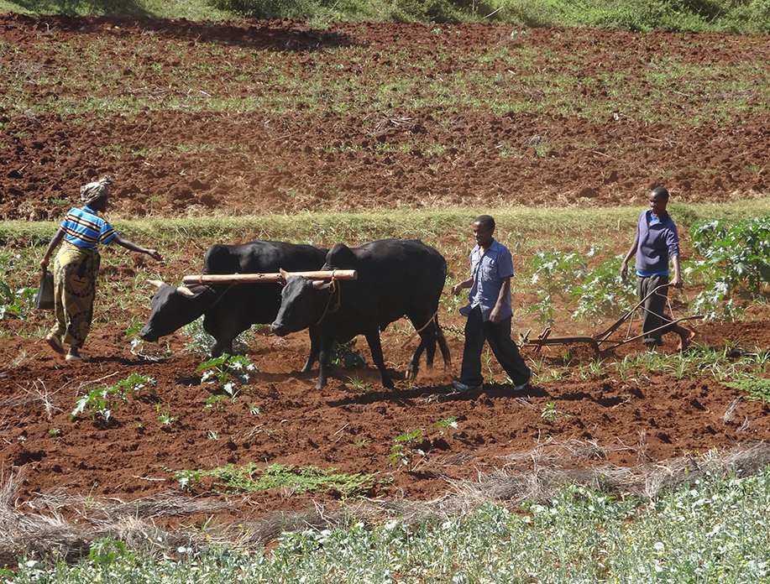
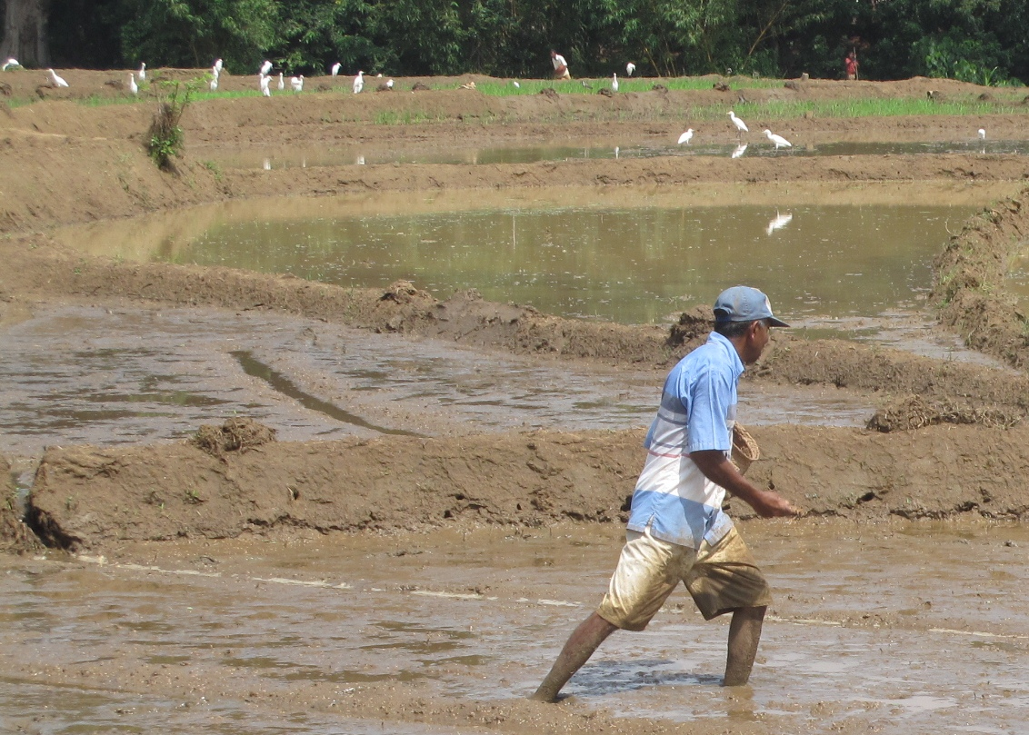
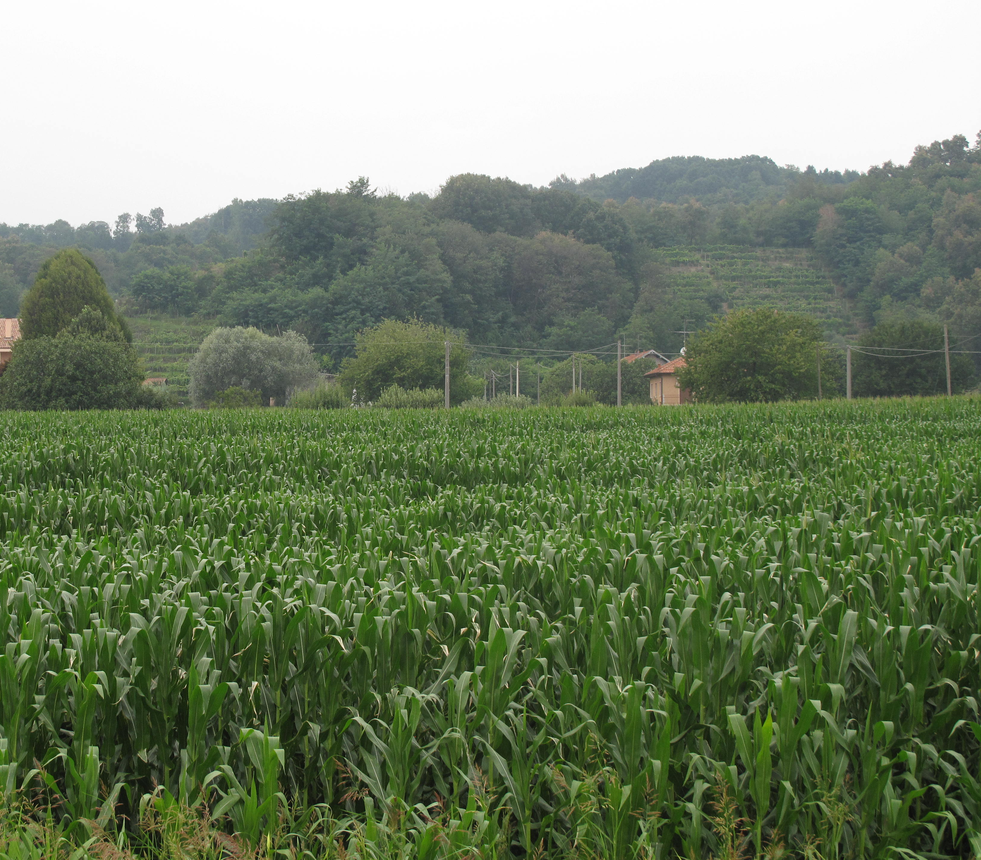
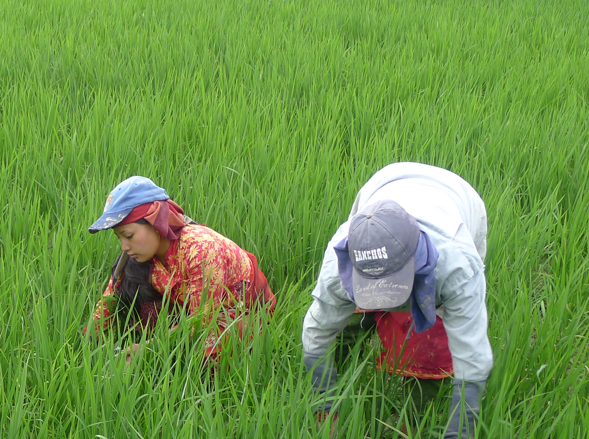
Climate Change Challenges to Agriculture,
Food Security, and Health
Cynthia Rosenzweig¹ and Sonali McDermid²
¹NASA GISS and Columbia University
²New York University and NASA GISS
Climate Change and Food Security - AMS Capitol Hill Briefing Series
Senate Russell Office Building, Washington D.C.

Slide 28
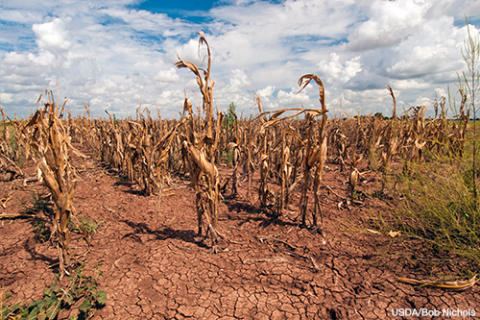
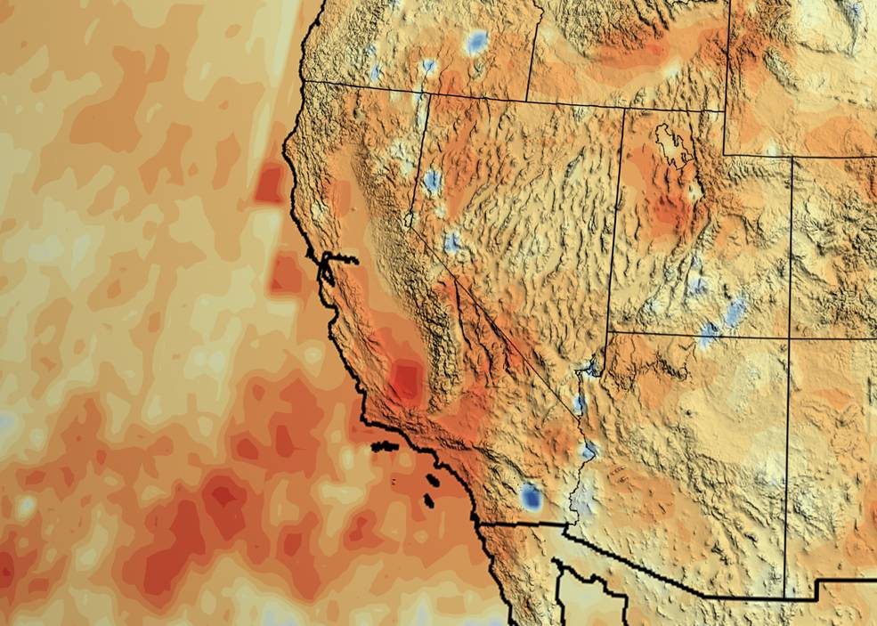
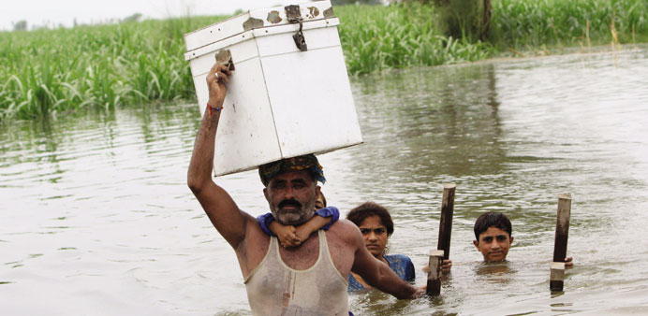
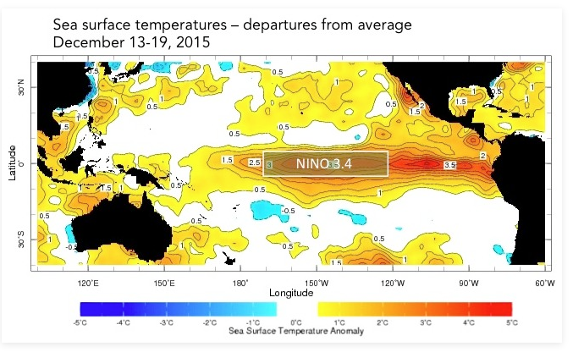
Current Climate Stresses
Corn shows the effect of the drought in Texas in August 2013
U.S. Department of Agriculture/Bob Nichols
California's accumulated precipitation “deficit” from 2012 to 2014
NASA/Goddard Scientific Visualization Studio
Severe flooding in August 2015 in Pakistan wipes out harvest
Image: Reuters/London
Strong El Niño in effect for 2015-2016
Image: IRI Columbia University
Notes:
The state had gone through one of the worst drought's in its history, causing significant economic damage to farmers and ranchers.
Satellite image of flooding in Burma (Myanmar) August 2015 has harmed crops, displaced thousands, and lead to deaths.
3. California's accumulated precipitation “deficit” from 2012 to 2014 shown as a percent change from the 17-year average based on TRMM multi-satellite observations.
Flash flooding caused by torrential monsoon rains has killed at least 28 in Pakistan - The ready to harvest major and minor crops, including cotton, paddy, chilly and vegetables worth almost Rs85 billion have been completely washed out by the rain and floods in Sindh

Slide 29
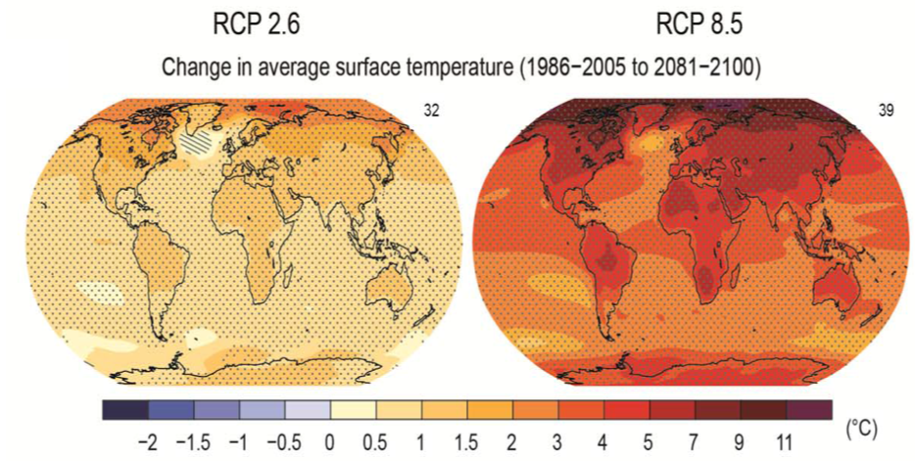
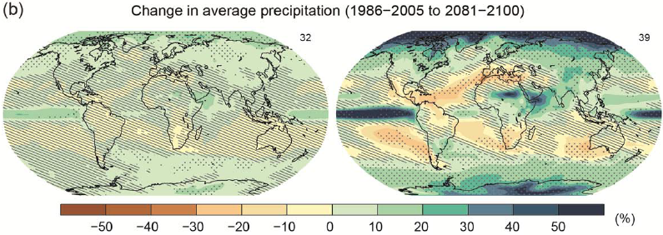
Climate Change
Stippling = Signal is large compared to noise and 90% of models agree
Hatching = Signal is small compared to noise
Notes:
Figure SPM.8: Maps of CMIP5 multi-model mean results for the scenarios RCP2.6 and RCP8.5 in 2081–2100 of (a) annual mean surface temperature change and (b) average percent change in annual mean precipitation. Changes in panels (a) and (b) are shown relative to 1986–2005. The number of CMIP5 models used to calculate the multi-model mean is indicated in the upper right corner of each panel. For panels (a) and (b),
hatching indicates regions where the multi-model mean is small compared to internal variability (i.e., less than one standard deviation of internal variability in 20-year means). Stippling indicates regions where the multi-model mean is large compared to internal variability (i.e., greater than two standard deviations of internal variability in 20-year means) and where 90% of models agree on the sign of change.

Slide 30
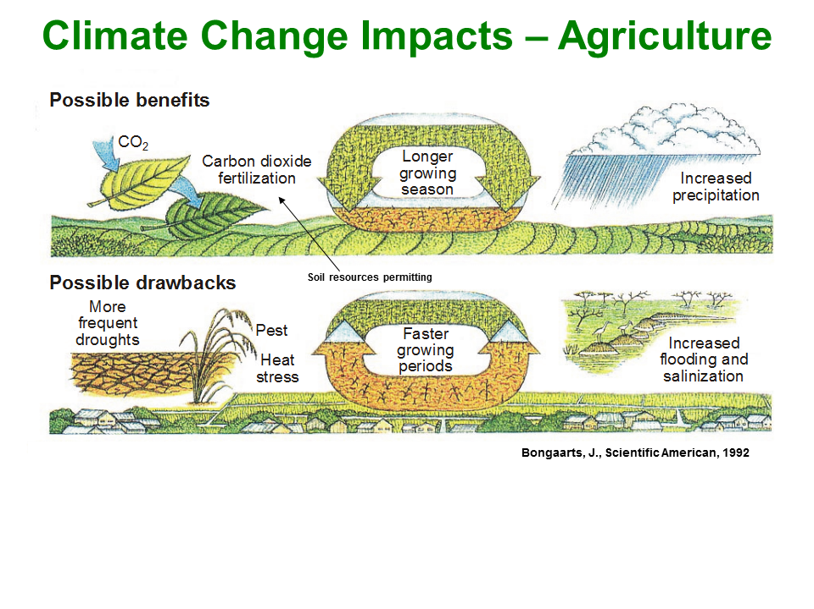
Climate Change

Slide 31
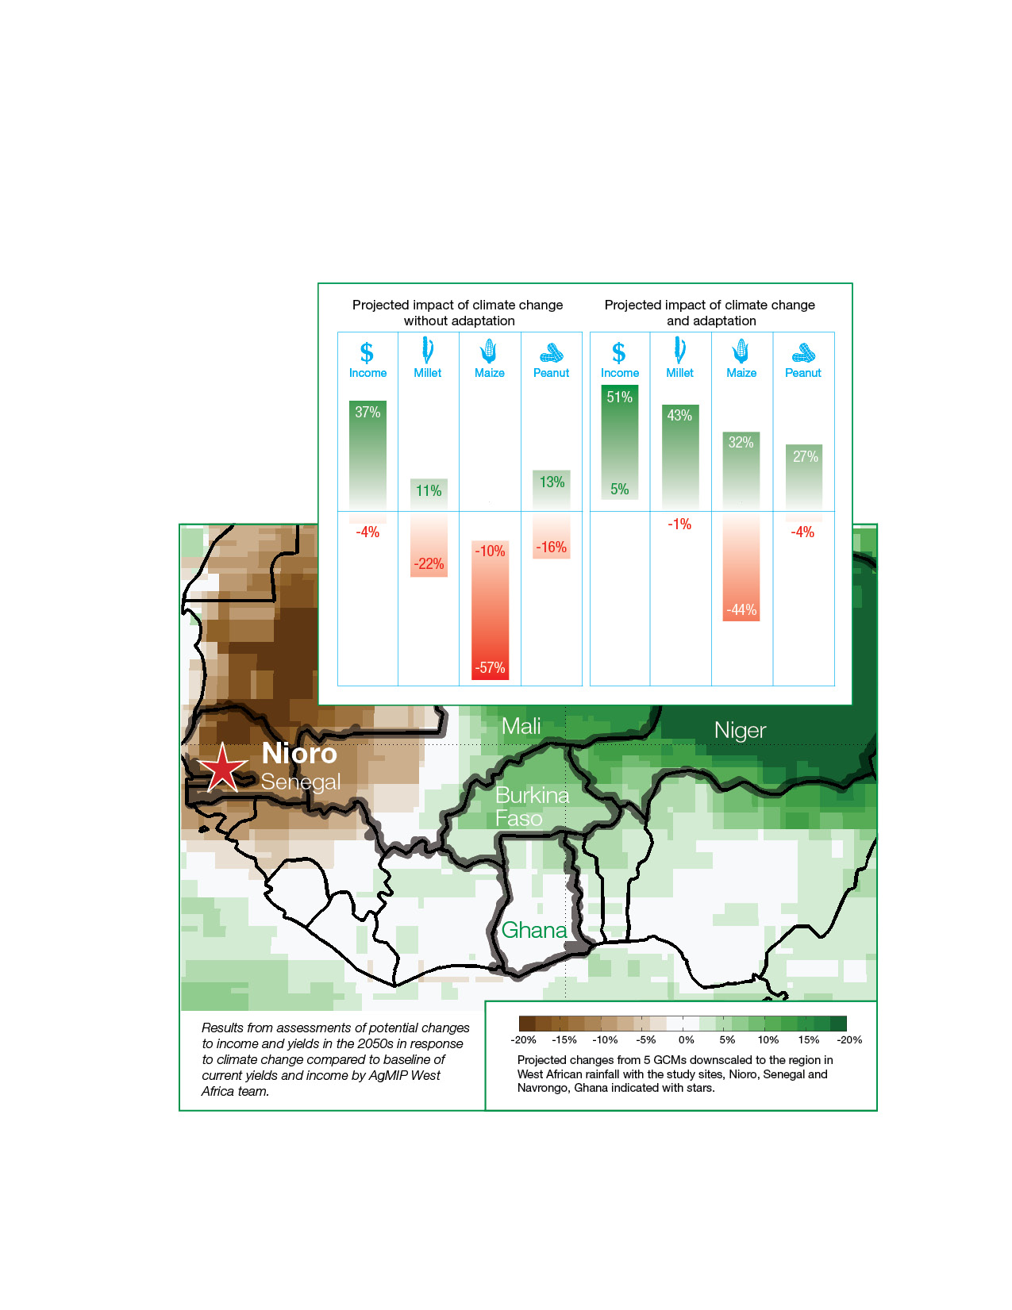
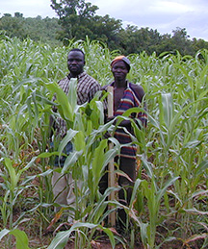
West Africa Climate Change Impacts
Adaptation packages can raise incomes and lower poverty rates,
but do not always compensate completely
Adiku et al., 2015
Ghana

Slide 32
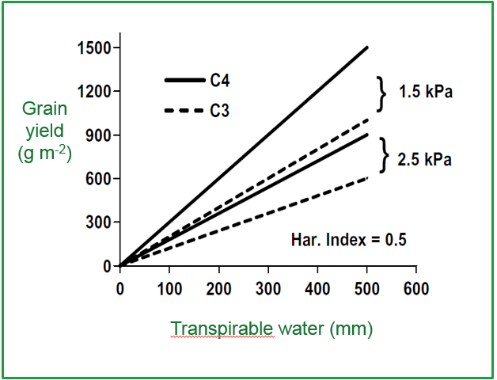
Yield Response to Water
Crops need water – through precipitation or irrigation
Drought stress affects yield during critical growth periods
Excess water can be damaging as well
C4 crops – e.g., corn and sorghum – favored at both higher and lower water stress
Sinclair 2010
Maximum grain yield plotted as a function of the amount of transpirable soil water available through the growing season. Two vapor pressure deficit environments are presented.

Slide 33
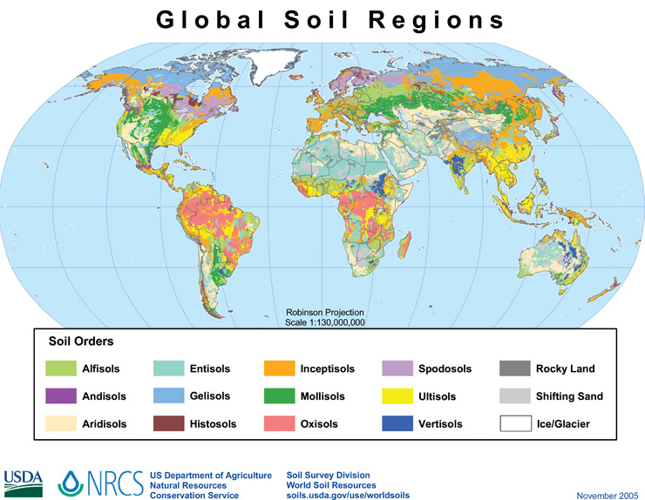
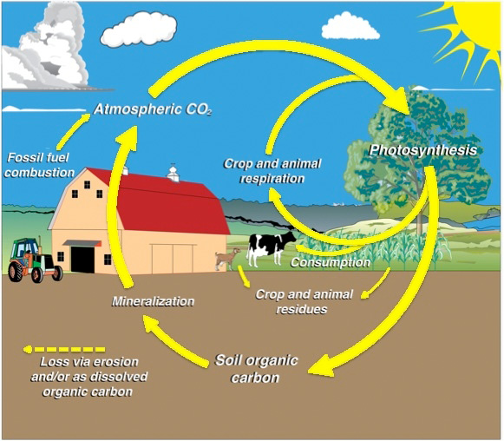
Effects on Soils
Carbon Cycling in Agroecosystems
Source: USDA
High temperature effects on soil biological and chemical processes
Water-logging from increased heavy downpours
A.Y.Y. Kong et al.
Notes:
Map of Global Soil Regions, USDA
Hillel and Rosenzweig, 2011
Carbon Cycle in Agroecosystems
Kong et al., 2011

Slide 34
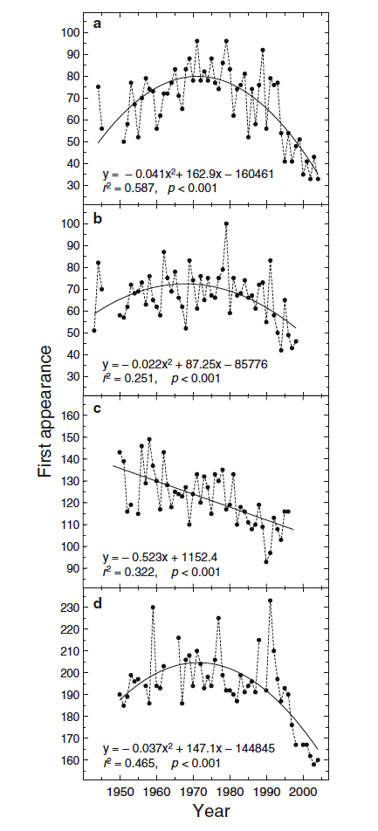
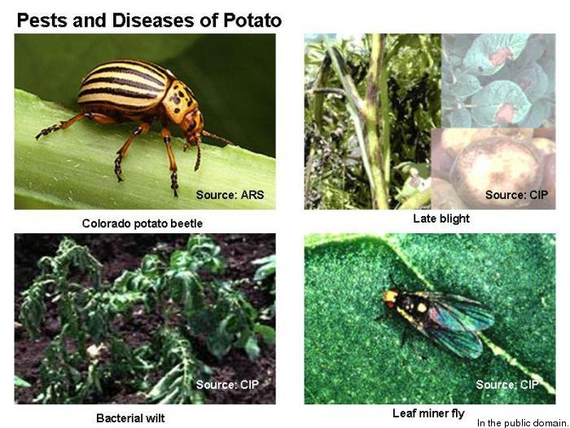
Pests and Diseases
Changes in climate and extreme events could have significant effects on the damage caused by and location of agricultural pest and diseases.
Time of first appearance of four insect species at Tortosa, Spain (1943-2004) Gordo and Sanz, 2005, Gutierrez et al., 2011
Notes:
Time of first appearance of four insect species at Tortosa, Spain (1943-2004)
Gordo and Sanz, 2005
Gutierrez et al., 2011

Slide 35
Effects on Nutrition and Health
Muller et al., Food Security: Fertilizing Hidden Hunger Nature Climate Change
Climate change alone decreases calories –
CO₂ effects restore calories but decrease nutritional content
Notes:
CO₂ levels will positively affect plant growth (especially in crops like wheat, rice and soy) and make up for some of the calorie lost due to climate change (red circles) it will also negatively affect the nutritional value of crops, reducing the amounts of essential minerals and protein (grey wedges).

Slide 36
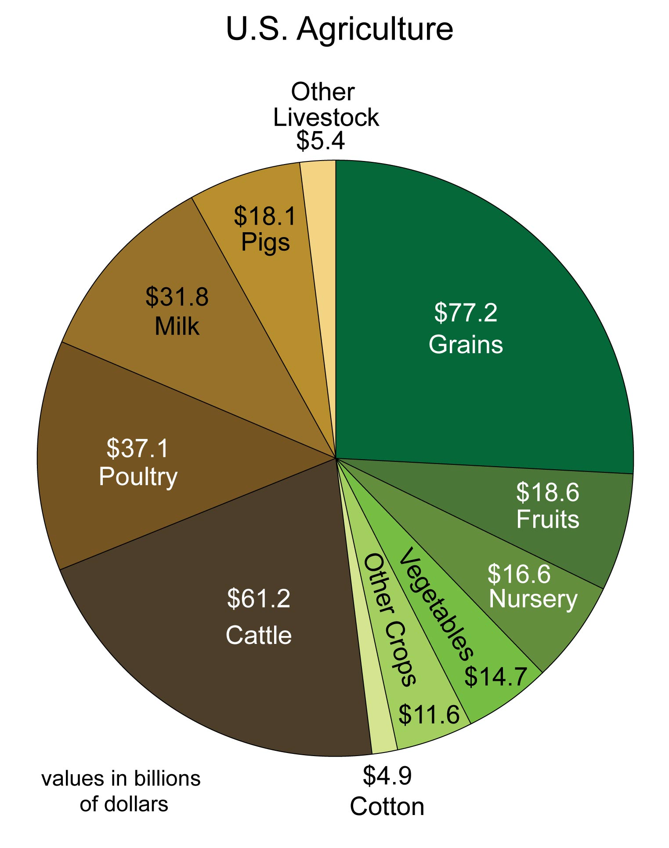
U.S. National Assessment:
Key Messages on Agriculture
1. Increasing Impacts on Agriculture. Climate disruptions to agricultural production have increased in the past 40 years and are projected to increase over the next 25 years. By mid-century and beyond, these impacts will be increasingly negative on most crops and livestock.
2. Weeds, Diseases, and Pests. Many agricultural regions will experience declines in crop and livestock production from increased stress due to weeds, diseases, insect pests, and other climate change induced stresses.
3. Extreme Precipitation and Soil Erosion. Current loss and degradation of critical agricultural soil and water assets due to increasing extremes in precipitation will continue to challenge both rainfed and irrigated agriculture unless innovative conservation methods are implemented.
4. Heat and Drought Damage. The rising incidence of weather extremes will have increasingly negative impacts on crop and livestock productivity because critical thresholds are already being exceeded.
5. Rate of Adaptation. Agriculture has been able to adapt to recent changes in climate; however, increased innovation will be needed to ensure the rate of adaptation of agriculture and the associated socioeconomic system can keep pace with climate change over the next 25 years.
6. Food Security. Climate change effects on agriculture will have consequences for food security, both in the U.S. and globally, through changes in crop yields and food prices and effects on food processing, storage, transportation, and retailing. Adaptation measures can help delay and reduce some of these impacts.
Breakdown of the monetary value of U.S. agriculture products by category.
http://nca2014.globalchange.gov/report/sectors/agriculture

Slide 37
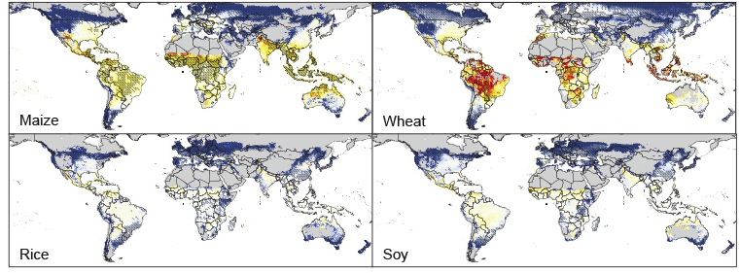
Effects on Global Crops
Rosenzweig et al., PNAS, 2013
Hatched areas indicate >70% model agreement
2080s
median of 7 GGCMs and 5 GCMs/AgMIP led agricultural contribution to ISIMIP
Lower latitudes are more vulnerable to climate change
Results comparable to AR4
Notes:
Model agreement on direction of yield changes is found in many major agricultural regions at both low- and high-latitudes; however, reducing uncertainty in sign of response in mid-latitude regions remains a significant challenge.

Slide 38
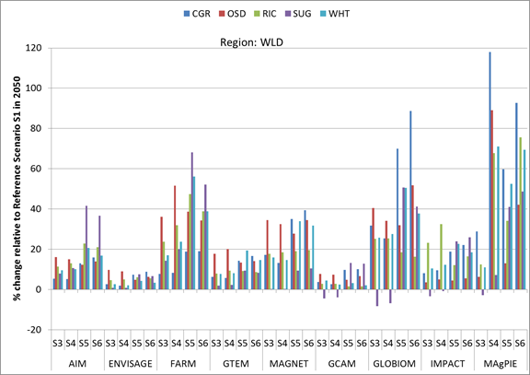
Effects on Prices
Effects of climate change on agricultural prices
Nelson, Gerald C. et al., “Agriculture and Climate Change in Global Scenarios: PNAS; Agricultural Economics, 2013
Phase 2 workshop
in Dublin
April 9, 2013
9 global economic models
Source: AgMIP model runs, December 2012
There is potential for large price increases with
climate change, although uncertainty is also large
Notes:
S1 is the reference scenario, with no climate change. The S3-S6 scenarios are combinations of 2 GCMS with 2 crop models. price changes

Slide 39
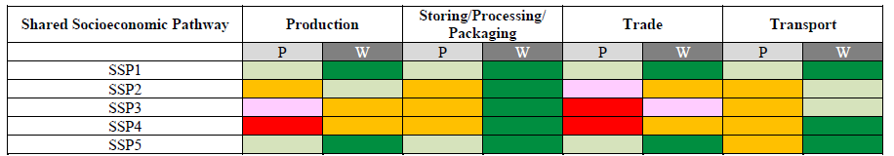
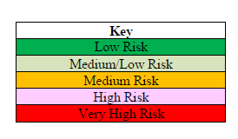
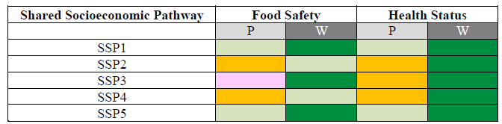
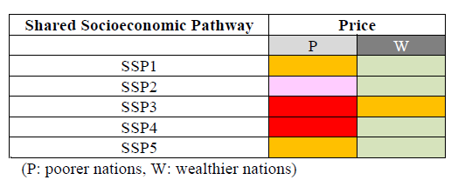
U.S. Food System Report
Relative risks to food availability
Relative risks to food utilization
Relative risks to food access
SSP1: low challenges to mitigation and adaptation
SSP2: medium challenges to both
SSP3: high challenges to both
SSP4: adaptation challenges dominate
SSP5: mitigation challenges dominate
Climate Change, Global Food Security and the US Food System, 2015

Slide 40
Progressive Levels of Adaptation
Challenges and Opportunities
Howden, 2010

Slide 41

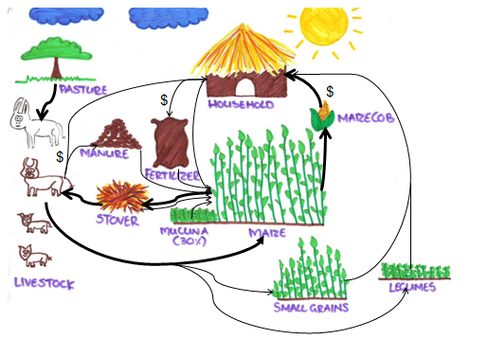
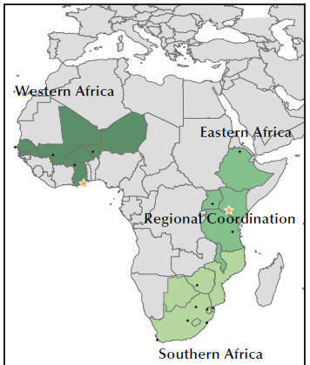
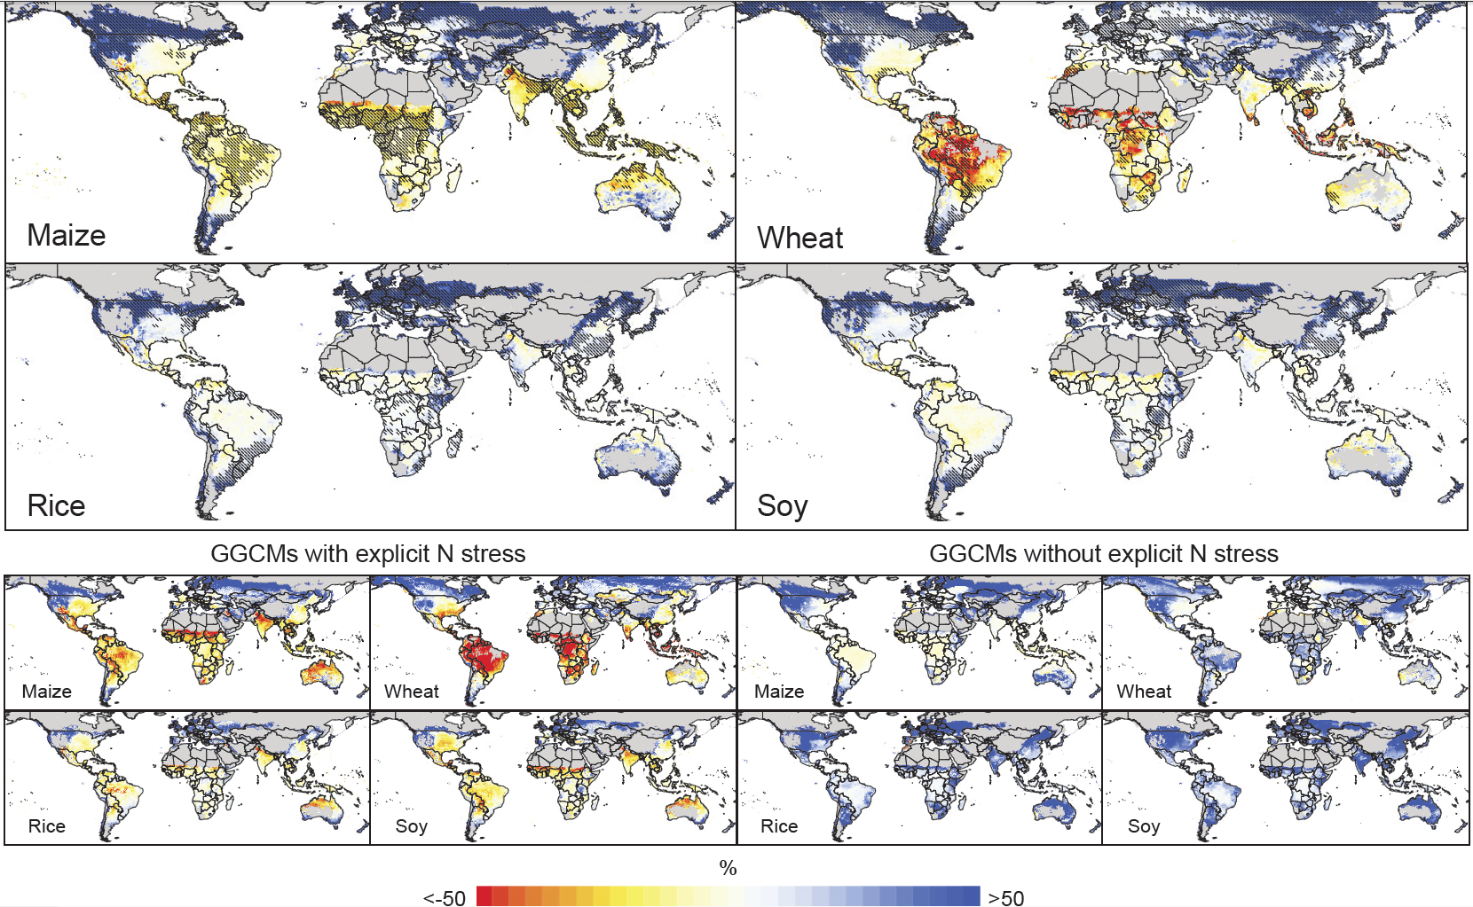

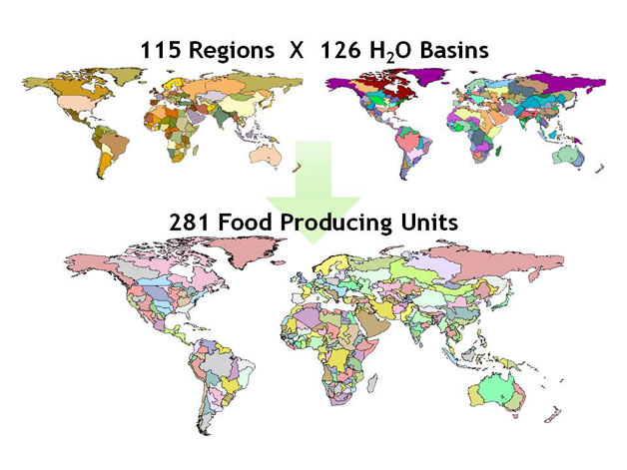
AGCI Workshop
Coordinated Global and Regional
Assessments of Agriculture and Food Security
Key Goal and Outcome
Significantly improved understanding of climate change impacts on agriculture, food security, and health
GGCMI -- High-resolution gridded crop modeling for gap-filling and aggregation in each region
RRTs – Farming systems biophysical and socioeconomic models
Production systems and regional economics respond to price changes
Global Economics – Model analysis of world and regional prices

Slide 42
Conclusions
Farmers and others in the agricultural sector are faced with the quadruple task of contributing to global reductions of carbon dioxide and other greenhouse gas emissions, coping with an already-changing climate, delivering healthy nutritious food, and sustainably managing soil and water resources.
In short, agriculture is being called upon to ensure both human and planetary health.

Slide 43
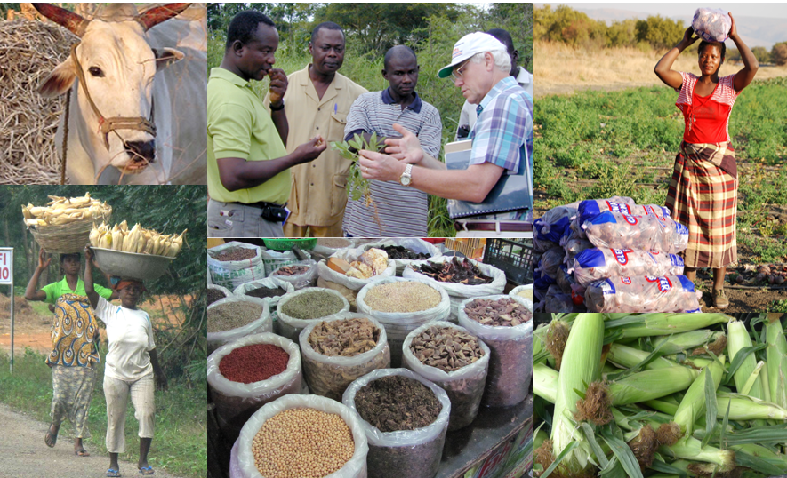
For protocols, up-to-date events and news,
and to join AgMIP listserve – www.agmip.org
Notes:
Soil carbon Sequestration – Recent model-studies of the economic potential for soil and forestry sequestration show that agriculture can sequester carbon at a cost competitive with other methods of reducing GHG emissions. http://www.c2es.org
Biofuels - With the exception of ethanol made from corn, use of biomass to produce heat, power, or transportation fuels essentially results in zero or close to zero CO2 emissions.

