Slide 1
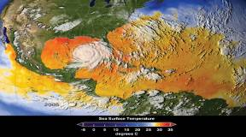
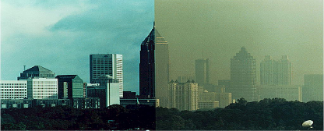
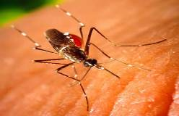
The Health Consequences
of a Changing Climate
George Luber, PhD
Associate Director for Climate Change
Climate and Health Program
American Meteorological Society
Climate Change and Infectious Disease
Capitol Hill Briefing
February 28, 2014
National Center for Environmental Health
Division of Environmental Hazards and Health Effects

Slide 2
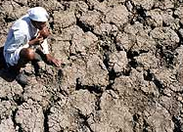
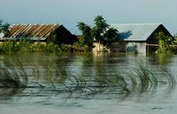
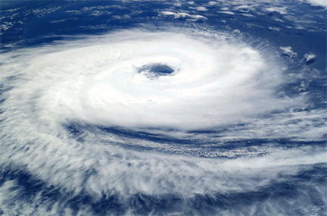
Objectives
Summarize findings from 3rd US National Climate Assessment
Review evidence for climate change and its impact on human health
Describe CDC efforts to prepare for health effects of climate change
Notes:
Local ecosystems: the behavior and health of fish and game, subsidence of ground and surface water levels, and increasingly extreme local weather patterns.
This project may provide government officials with an important early warning of local events with public health significance, and represent a network for the dissemination of informed and culturally appropriate risk communications to guide adaption planning to mitigate the impact of climate change on Alaskan population health.

Slide 3
Objectives
Summarize findings from 3rd US National Climate Assessment
Review evidence for climate change and its impact on human health
Describe CDC efforts to prepare for health effects of climate change
Notes:
Local ecosystems: the behavior and health of fish and game, subsidence of ground and surface water levels, and increasingly extreme local weather patterns.
This project may provide government officials with an important early warning of local events with public health significance, and represent a network for the dissemination of informed and culturally appropriate risk communications to guide adaption planning to mitigate the impact of climate change on Alaskan population health.

Slide 4
What is the National Climate Assessment?
Established through Global Research Act of 1990
Led by White House Office of Science and Technology Policy
  Authors from academia; local, state, and federal government; private and nonprofit sectors
Analyzes impact of global climate change on various sectors of society, including public health
Evaluates current trends in human-associated and natural global climate change
Projects major climate trends in US for next 25-100 years
Source: National Climate Assessment Development Advisory Committee, Draft Third National Climate Assessment Report, http://ncadac.globalchange.gov
Notes:
…not less frequently than every 4 years, the Council… shall prepare… an assessment which –
integrates, evaluates, and interprets the findings of the Program (USGCRP) and discusses the scientific uncertainties associated with such findings;
analyzes the effects of global change on the natural environment, agriculture, energy production and use, land and water resources, transportation, human health and welfare, human social systems, and biological diversity; and
analyzes current trends in global change, both human- induced and natural, and projects major trends for the subsequent 25 to 100 years.

Slide 5
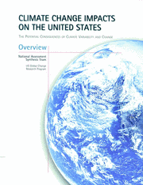
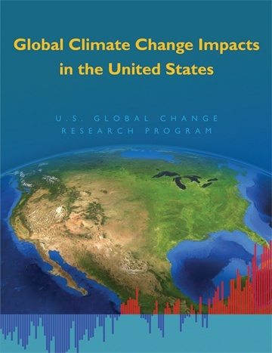
Previous National Climate Assessments
2000
2009
http://globalchange.gov/

Slide 6

3rd National Climate Assessment
3 year effort
240 authors
30 chapters
Summarizes impacts for many sectors including public health, energy, water, transportation, and agriculture
Will be published in spring 2014
Source: National Climate Assessment Development Advisory Committee, Draft Third National Climate Assessment Report, http://ncadac.globalchange.gov

Slide 7
3rd National Climate Assessment
Key Findings
Increasing Strength of the Evidence
Average US temperature has increased by about 1.5°F since 1895.
Extreme weather events, including heat waves, floods, and droughts, have become more frequent and intense.
Sea level has risen by about 8 inches since 1880, projected to rise another 1 to 4 feet by 2100.
Frost-free season has been increasing since 1980s.
Heavy downpours have increased in most US regions.
Number of Category 4 and 5 hurricanes in North Atlantic has increased since early 1980s.
Source: National Climate Assessment Development Advisory Committee, Draft Third National Climate Assessment Report, http://ncadac.globalchange.gov
Notes:
These are summaries of findings from the current National Climate Assessment draft relevant to extreme temperature, precipitation, other extreme weather events.

Slide 8
Objectives
Summarize findings from 3rd US National Climate Assessment
Review evidence for climate change and its impact on human health
Describe CDC efforts to prepare for health effects of climate change
Notes:
Local ecosystems: the behavior and health of fish and game, subsidence of ground and surface water levels, and increasingly extreme local weather patterns.
This project may provide government officials with an important early warning of local events with public health significance, and represent a network for the dissemination of informed and culturally appropriate risk communications to guide adaption planning to mitigate the impact of climate change on Alaskan population health.

Slide 9
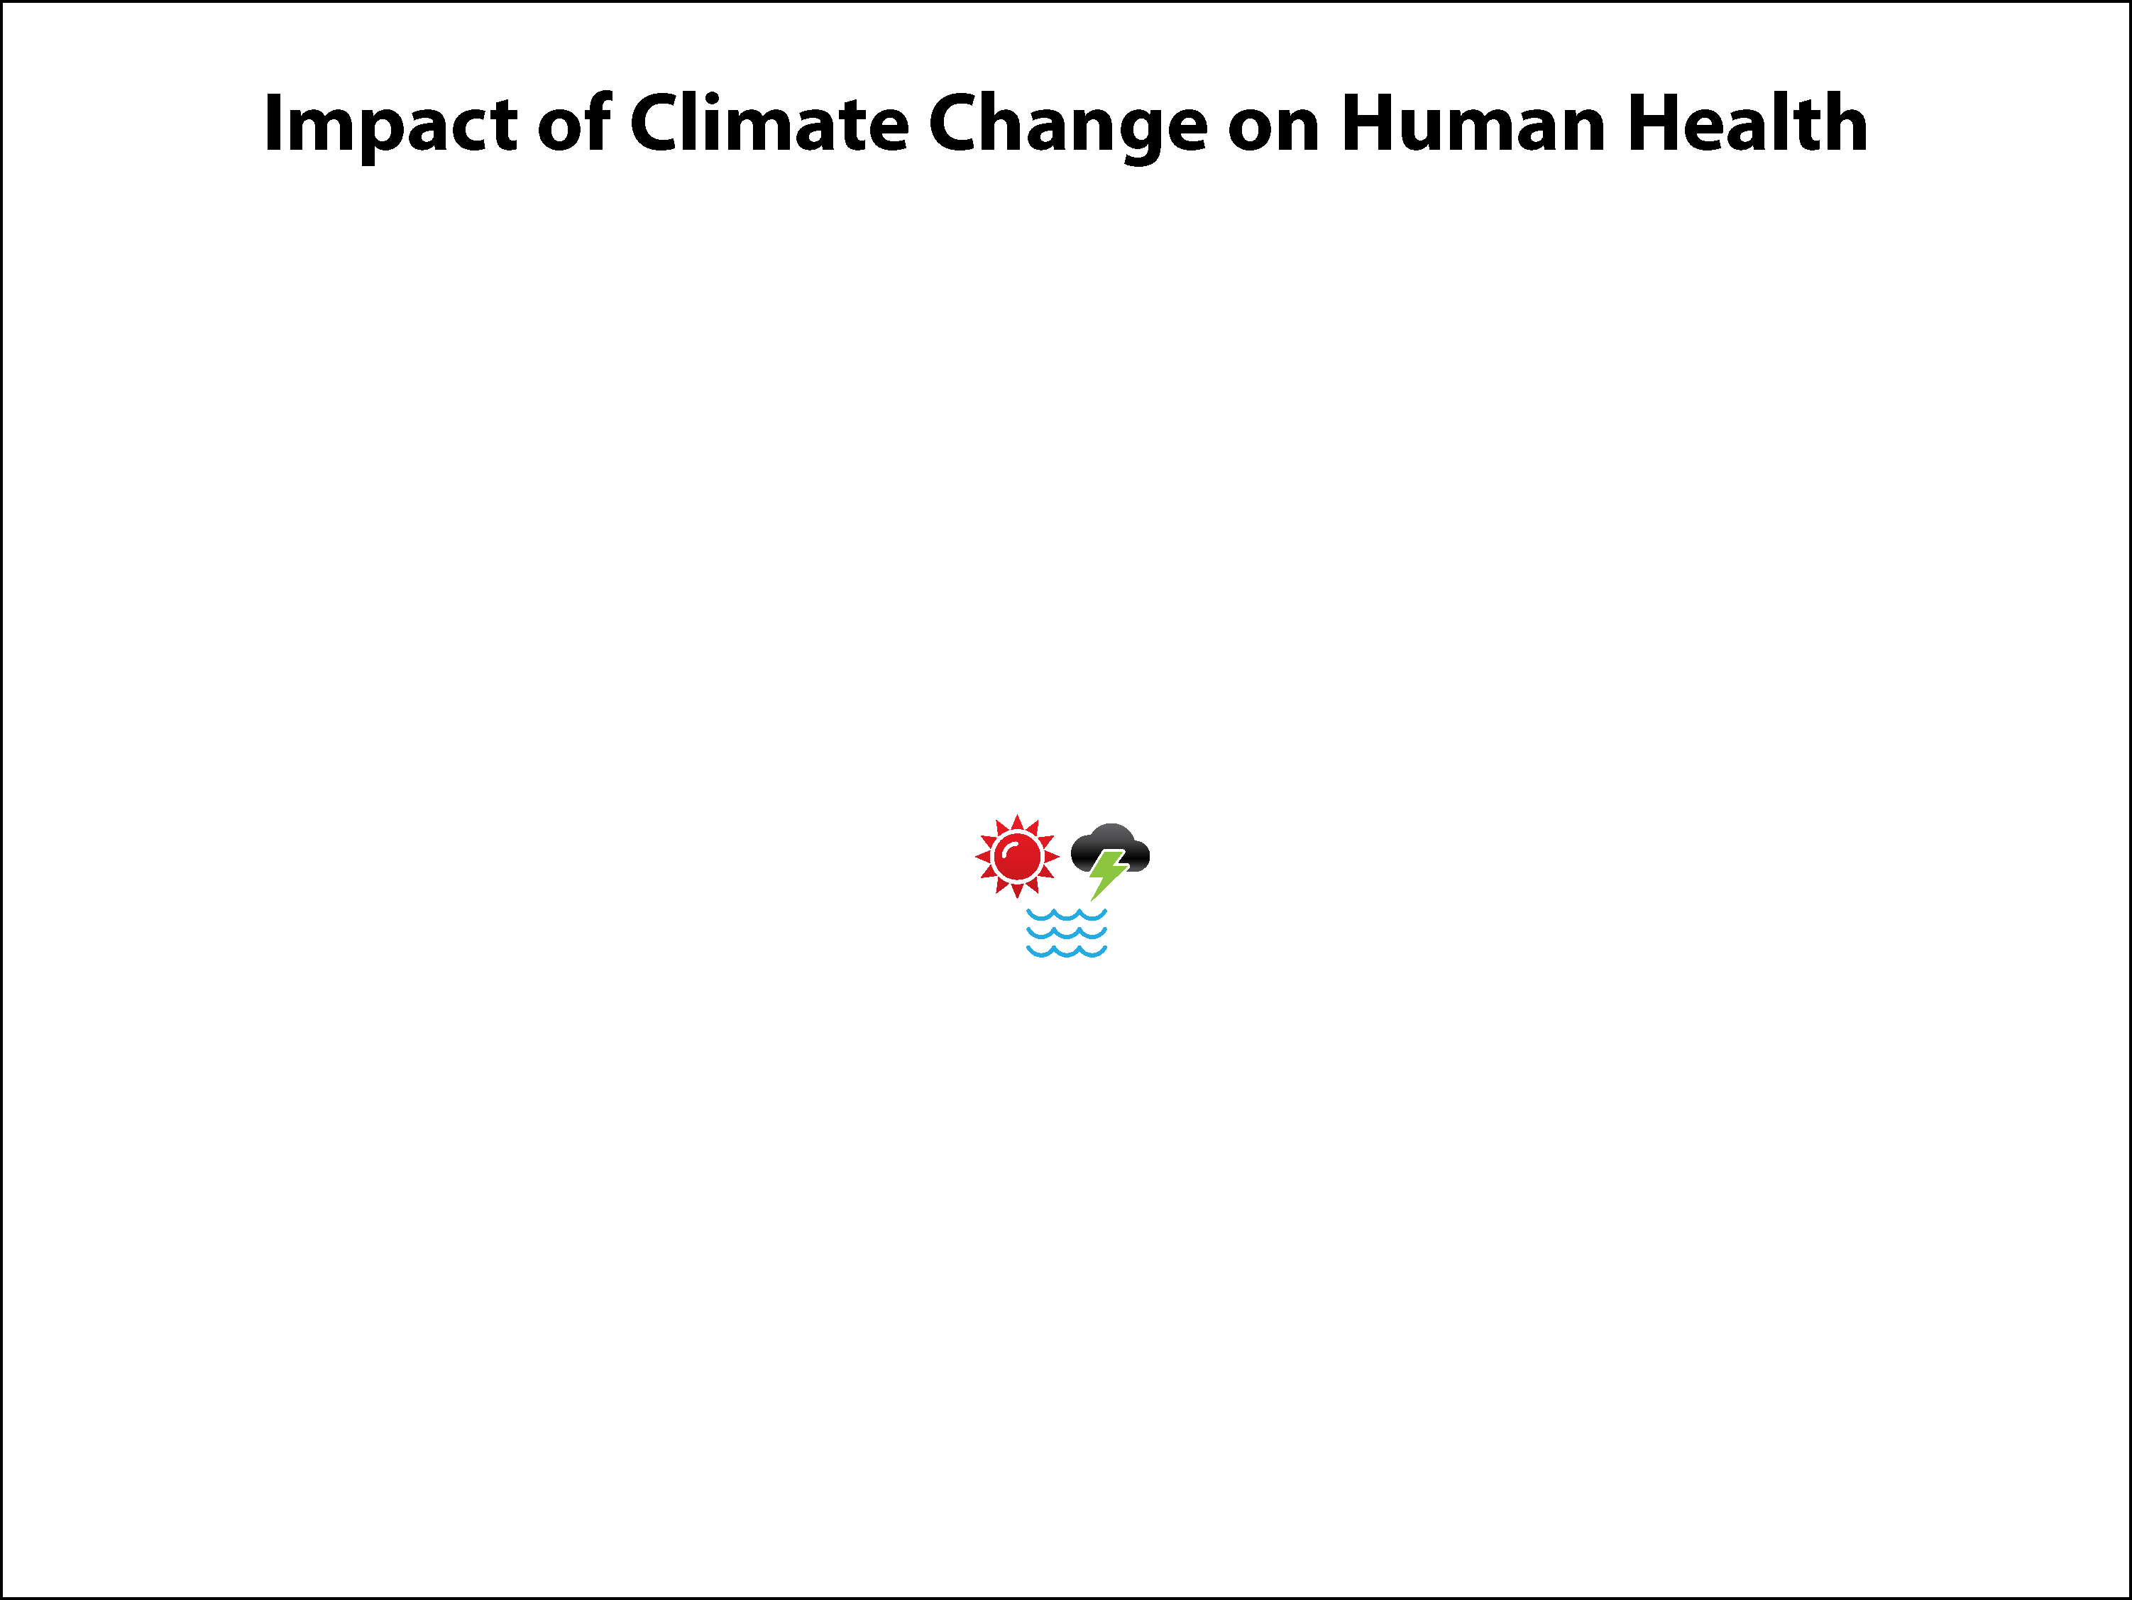
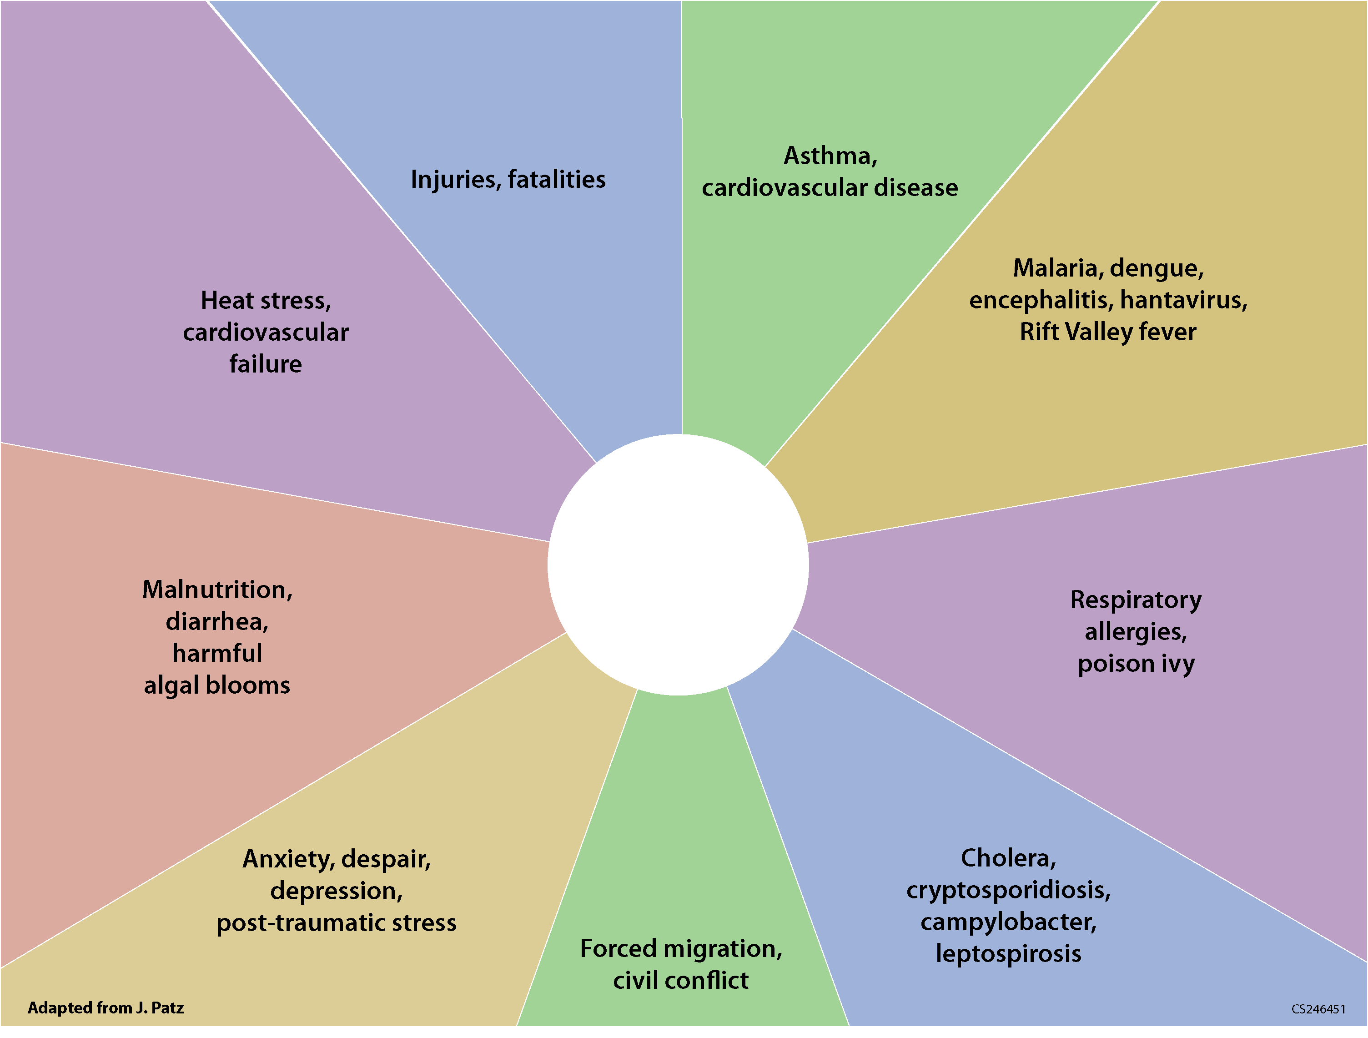
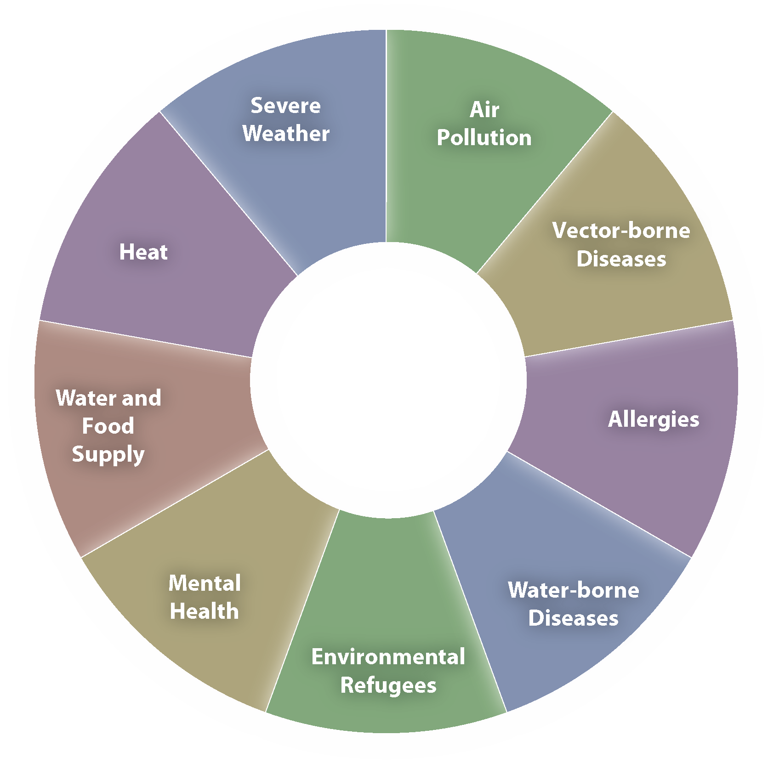
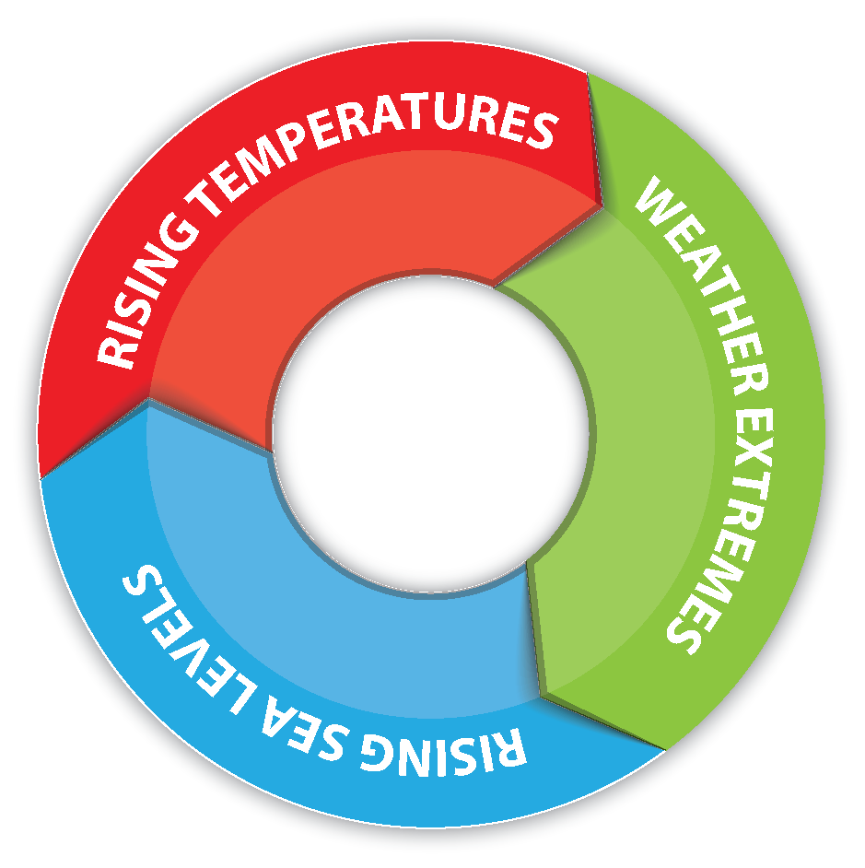
Notes:
This slide shows the complex pathways through which climate-sensitive environmental exposures can impact health.

Slide 10
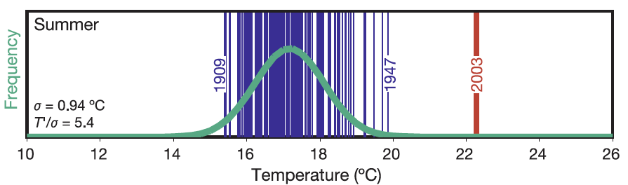
Heat Waves Impact Human Health
European Heat Wave of 2003
Excess Mortality
UK | 2,091
Italy | 3,134
France | 14,802
Portugal | 1,854
Spain | 4,151
Switzerland | 975
Netherlands | 1,400-2,200
Germany | 1,410
TOTAL | 29,817-30,617
Vandentorren et al. Am J Public Health 2004; 94(9):1518-20.
Haines et al. Public Health 2006;120:585-96.
Notes:
Heat waves generally refer to sustained periods of unusually high ambient temperatures. While single hot days are found to have adverse health outcomes, sustained heat waves that continue for more than a day have an additional health burden. Extreme weather events like the European heat wave of 2003 (when temperatures reached exceptionally high levels – red line in left graphic) have been associated with substantial excess mortality.

Slide 11

Summer Temperatures
1951–1980
0.5
Cooler than average
Baseline (1951 - 1980) mean
Average
0.4
Warmer than average
0.3
Frequency of Occurrence
0.2
0.1
0
-5
-4
-3
-2
-1
0
1
2
3
4
5
Source: NASA/GISS; Hansen, et al., “Perceptions of Climate Change,” Proc. Natl. Acad. Sci. USA 10.1073, August 2012
Deviation from Mean
Notes:
On average, recent years have experienced hotter summer days when compared to the average temperature in 1951-1980.
The following series of 4 slides indicate how the frequency of hot days during summer have increased in the last 3 decades (‘hot days’ here are defined as days when temperatures were higher than the mean summer temperature during the 1951-1980 baseline). As one goes forward in time, the frequency of occurence (y-axis) of hot days (in red and dark red) keep increasingover time, while the white areas (close to average temperature) decreases over time.
The authors of the paper (Reference at bottom of slide) chose this baseline because (i) global temperatures were relatively stable during that period, (ii) it is a climate that the natural world was adapted to, and (iii) something that the senior population (deemed vulnerable) was accustomed to while growing up.

Slide 12
Summer Temperatures
1981–1991
0.5
Cooler than average
Baseline (1951 - 1980) mean
Average
0.4
Warmer than average
Extremely hot
0.3
Frequency of Occurrence
0.2
0.1
0
-5
-4
-3
-2
-1
0
1
2
3
4
5
Source: NASA/GISS; Hansen, et al., “Perceptions of Climate Change,” Proc. Natl. Acad. Sci. USA 10.1073, August 2012
Deviation from Mean
Notes:
As you can see, the number of days when temperatures exceeded the mean (baseline of 1951-80) is increasing (indicated by red), indicating more hotter days in the 1981-91 period.

Slide 13
Summer Temperatures
1991–2001
0.5
Cooler than average
Baseline (1951 - 1980) mean
Average
0.4
Warmer than average
Extremely hot
0.3
Frequency of Occurrence
0.2
0.1
0
-5
-4
-3
-2
-1
0
1
2
3
4
5
Source: NASA/GISS; Hansen, et al., “Perceptions of Climate Change,” Proc. Natl. Acad. Sci. USA 10.1073, August 2012
Deviation from Mean
Notes:
During 1991-2001, not only are the hot days (indicated in red) increasing in freqeuncy, we also start observing more freequent ‘extremely hot days’ (defined as days when temperature were greater than 3 standard deviations of the mean).

Slide 14
Summer Temperatures
2001–2011
0.5
Cooler than average
Baseline (1951 - 1980) mean
Average
The “extreme” temperature events used to cover 0.1% of the Earth. Now they cover 10%.
0.4
Warmer than average
Extremely hot
0.3
Frequency of Occurrence
0.2
0.1
0
-5
-4
-3
-2
-1
0
1
2
3
4
5
Source: NASA/GISS; Hansen, et al., “Perceptions of Climate Change,” Proc. Natl. Acad. Sci. USA 10.1073, August 2012
Deviation from Mean
Notes:
During the last decade, the increase in frequency of ‘hot’ and ‘extremely hot’ days continues.

Slide 15
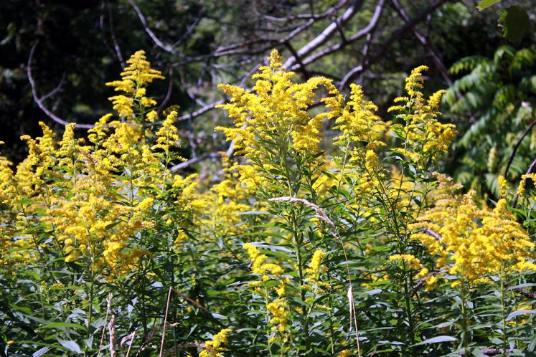
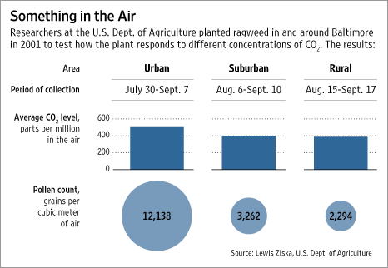
Climate Change Impacts Air Quality: Pollen
Ragweed
  ↑ CO₂ and temperature
  ↑ Pollen counts, longer growing season
Source: Ziska et al., J Allerg Clin Immunol 2003;111:290-95;
Graphic: Wall Street Journal, 3 May 2007.
Notes:
An increase in CO2 concentrations in the atmosphere combined with higher temperatures impact ambient pollen concentration by increasing pollen production and extending the growing season of allergenic plants, such as ragweed. This can lead to adverse health effects, like prolonged allergy seasons for seasonal allergy sufferers and can complicate underlying respiratory health conditions.

Slide 16
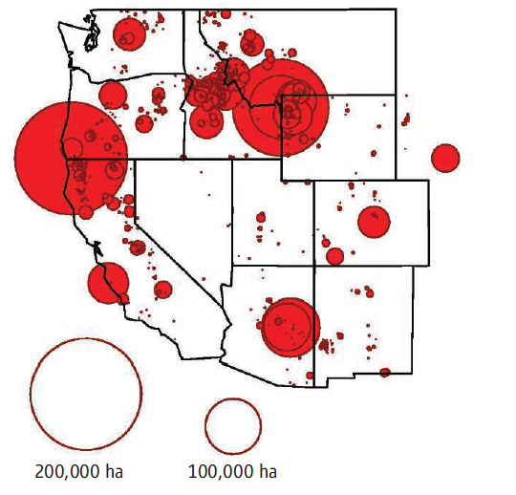
Climate Change Impacts Air Quality: Wildfire Smoke
Wildfire Activity Since 1970
Since 1970
  Western US wildfire season increased by 78 days
  Average duration of fires increased five fold
Westerling et al. Warming and earlier spring increase western U.S. forest wildfire activity Science. 2006 Aug 18;313(5789):940-3
Notes:
Climate change can bring higher summer temperatures, reduced snowpack, early spring melt, dry summers, and drought conditions, all of which can contribute to wildfires. There has been a dramatic increase in wildfire activity since 1970. This includes a higher frequency of large-wildfires, longer duration of wildfires, and longer wildfire seasons.
Smoke from wildfires is a mixture of gases and fine particles from burning trees and other plant materials. Smoke can hurt your eyes, irritate your respiratory system, and worsen chronic heart and lung diseases.

Slide 17
Climate Change Impacts Air Quality: Wildfire Smoke (cont.)
Increase of 10µg/m³ in PM₁₀ from wildfires results in about 1% increase in non-accidental mortality^{(1,2,3)}
During Australian bushfires
  Overall mortality rose 5%
  Hospital admissions for respiratory illnesses increased 3-5%⁴
¹Morgan G et al. Effects of bushfire smoke on daily mortality and hospital admissions in Sydney, Australia. Epidemiology. 2010 Jan;21(1):47-55.
²Sastry N. Forest fires, air pollution, and mortality in southeast Asia. Demography. 2002 Feb;39(1):1-23.
³Hanninen OO. Population exposure to fine particles and estimated excess mortality in Finland from an East European wildfire episode. J Expo Sci Environ Epidemiol. 2009 May;19(4):414-22
⁴Johnston F et al. Extreme air pollution events from bushfires and dust storms and their association with mortality in Sydney, Australia 1994-2007. Environ Res. 2011 Aug;111(6):811-6.
Notes:
Climate change can bring higher summer temperatures, reduced snowpack, early spring melt, dry summers, and drought conditions, all of which can contribute to wildfires. There has been a dramatic increase in wildfire activity since 1970. This includes a higher frequency of large-wildfires, longer duration of wildfires, and longer wildfire seasons.
Smoke from wildfires is a mixture of gases and fine particles from burning trees and other plant materials. Smoke can hurt your eyes, irritate your respiratory system, and worsen chronic heart and lung diseases.

Slide 18
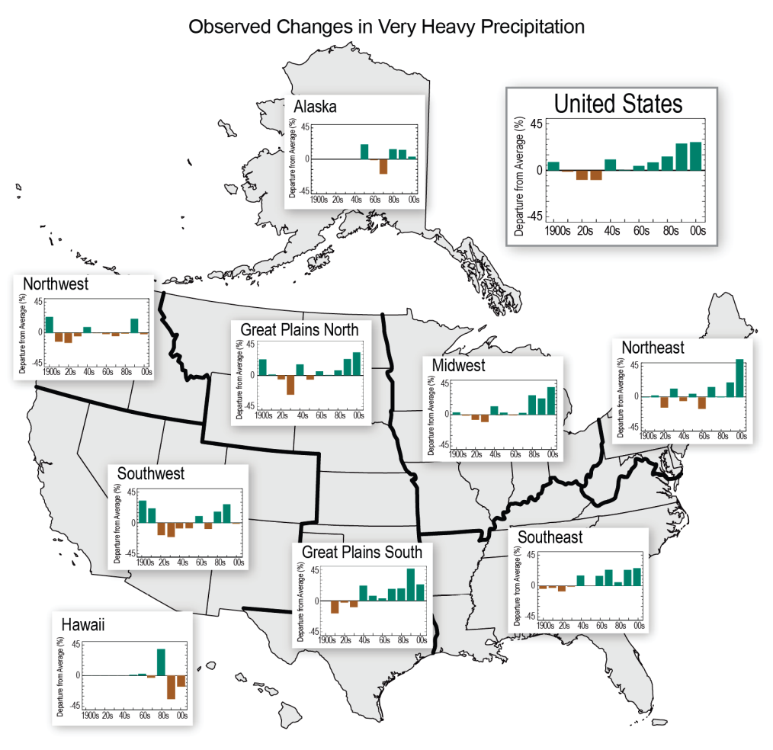
Extreme Precipitation Events Impact Human Health: Waterborne Disease
67% of waterborne disease outbreaks preceded by precipitation above 80th percentile (across 50 year climate record)
Heavy precipitation events projected to occur more frequently
Observed Increases in Very Heavy Precipitation (heaviest 1% of all events) 1901 to 2011
Curriero, Patz, et al, 2001.
Source: Walsh et al. 2013: Draft NCA Report, Chapter 2
Notes:
Unusually high rainfall events increases the likelihood of waterborne diseases by contaminating drinking water sources or recreational water use.
This slide draws information from a study that linked waterborne disease outbreaks with high precipitation events.

Slide 19
Precipitation, Humidity, and Temperature Changes Impact Human Health: Lyme Disease
Spread of Lyme disease factors
  Climate
  Ecological
  Social
Range of suitable conditions for Ixodes scapularis, the Lyme disease tick
2020
2050
2080
2012
Constant suitability
Expanded suitability
Source: Brownstein JS, Holford TR, Fish D. A climate-based model predicts the spatial distribution of the Lyme Disease vector Ixodes scapularis in the United States. Environ Health Persp 2003;111(9):1152-57.
Notes:
The spread of Lyme disease is a function of social, ecological and climate factors. Unknown before the 1970s, Lyme disease began as a highly regionalized disease. In the decades since it was first clinically identified, more and more cases of Lyme disease have occurred outside of New England. As you can see from the animation, the range of suitable conditions for the Lyme disease vector is projected to spread even more from now to 2080.
The survival of the tick, Ixodes scapularis, the primary vector of Lyme disease in North America depends both on water stress and temperature. Thus, local modifications to precipitation, humidity, and temperature from climate change will have implications on tick abundance and spread of disease. Changes in temperature and precipitation will affect deer habitat, the principal host for the tick. Individual outdoor behaviors and knowledge about prevention options can also affect the spread of the disease.

Slide 20
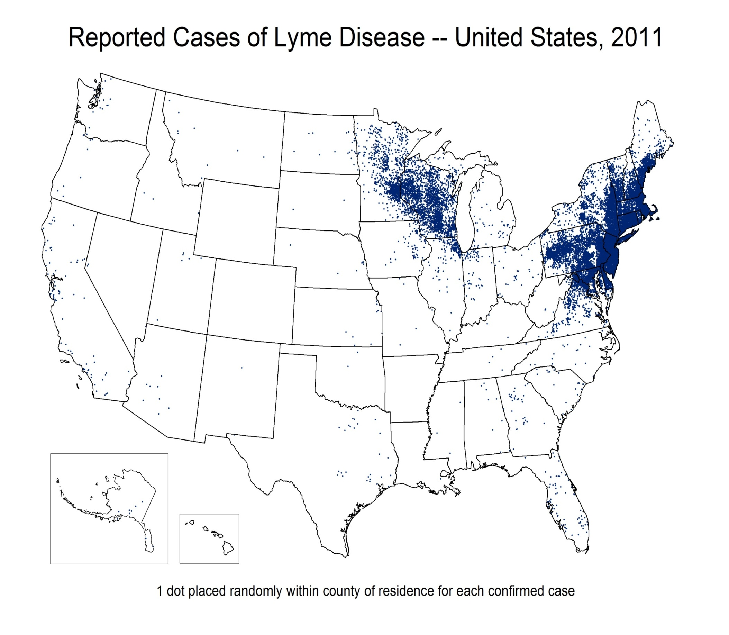
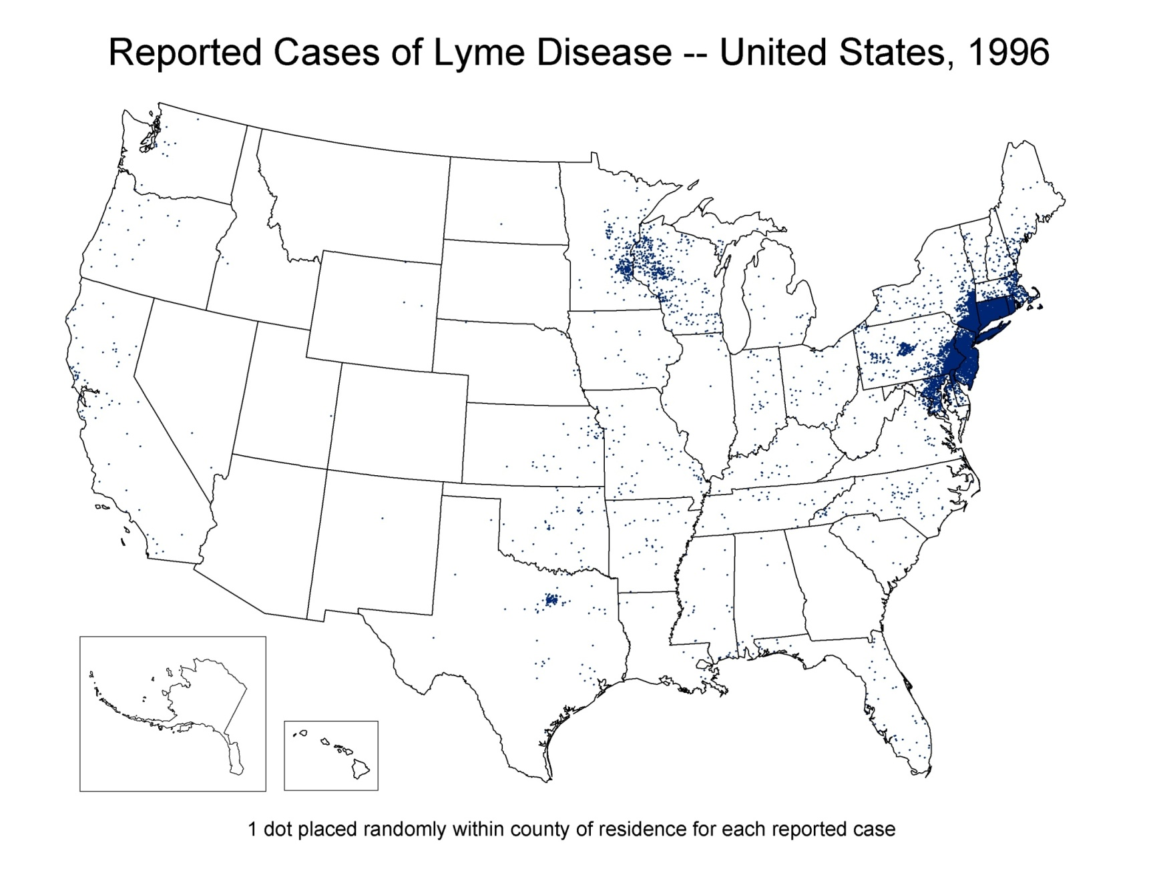
Lyme Disease Case Distribution Change
in the United States
2011
1996
http://www.cdc.gov/lyme/stats/maps/interactiveMaps.html
Notes:
This graphic indicates the geographic spread of Lyme disease cases from 1996 through 2011.
Total reported cases for each year. Each dot is a single reported confirmed case, dots are placed randomly in each county of residence.

Slide 22
Objectives
Summarize findings from 3rd US National Climate Assessment
Review evidence for climate change and its impact on human health
Describe CDC efforts to prepare for health effects of climate change
Notes:
Local ecosystems: the behavior and health of fish and game, subsidence of ground and surface water levels, and increasingly extreme local weather patterns.
This project may provide government officials with an important early warning of local events with public health significance, and represent a network for the dissemination of informed and culturally appropriate risk communications to guide adaption planning to mitigate the impact of climate change on Alaskan population health.

Slide 23
What is CDC doing to prepare for health effects of climate change?
CDC helps states and cities prepare for health challenges of climate change by
  Providing scientific guidance
  Developing decision support tools
  Ensuring public health concerns are considered in climate change adaptation and mitigation strategies
  Creating partnerships between public health and other sectors
CDC’s Climate and Health Program – nation’s only investment in climate change preparedness for public health sector
Notes:
CDC’s Climate and Health Program is the only Federal government investment designed to build climate change capabilities of health departments. The program aims to build the systems, skills and experience of state and local health departments to identify, plan for and respond to the near and long term health impacts of climate change. This $7 million program accomplishes this through funding provided to 16 states and two cities through the Climate Ready States and Cities Initiative (CSCRI). Funded states use the CDC developed Building Resilience Against Climate Effects (BRACE) framework. The BRACE framework enables a health department to identify likely climate impacts in their communities, potential health effects associated with these impacts, and their most at-risk populations and locations. The BRACE framework enables a health department to prepare and implement an adaptation plan that best reflects the greatest challenges within their jurisdiction and the best use of limited resources to achieve the most efficient and effective public health results.
CDC’s Climate and Health Program plays three critical roles.
Translating climate science for health departments and the public health community. For example:
Identifying regional climate trends that impact health
Identifying the health impacts of climate change and the populations most vulnerable to these impacts
Modeling future health impacts and how disease rates will change based on climate scenarios
Developing decision support tools for state and local health departments. For example:
Providing technical guidance and support for adaptation planning
Developing training and guidance for health departments to create vulnerability maps
Enhancing surveillance tools e.g. adding climate information and functionality on the CDC’s Environmental Public Health Tracking Portal.
Promoting public health engagement in the response to climate change
Ensuring public health concerns are addressed in climate change adaptation and mitigation strategies
Creating partnerships between public health and other sectors

Slide 24
Climate-Ready States and Cities Initiative
CDC effort to enhance capacity of state and local health agencies to deal with health challenges associated with climate change
CDC accomplishes this by
  Funding 18 state and local health departments
  Providing framework and tools for planning, implementing, and evaluating climate adaptation strategies
    Tools to identify populations and places vulnerable to climate impacts
    Materials to help communicate climate and health issues to public health partners (e.g., extreme heat toolkit)
Notes:
Objective: To enhance the capability of state and local health agencies to deal with the challenges associated with climate change
CDC accomplishes this through:
Cooperative Agreements with State and Local HDs:
“Developing Public Health Capacity and Adaptations to Reduce Human Health Effects of Climate Change”
Developing Decision Support Tools:
Communications and Educational Tools
Vulnerability Mapping Tools

Slide 25
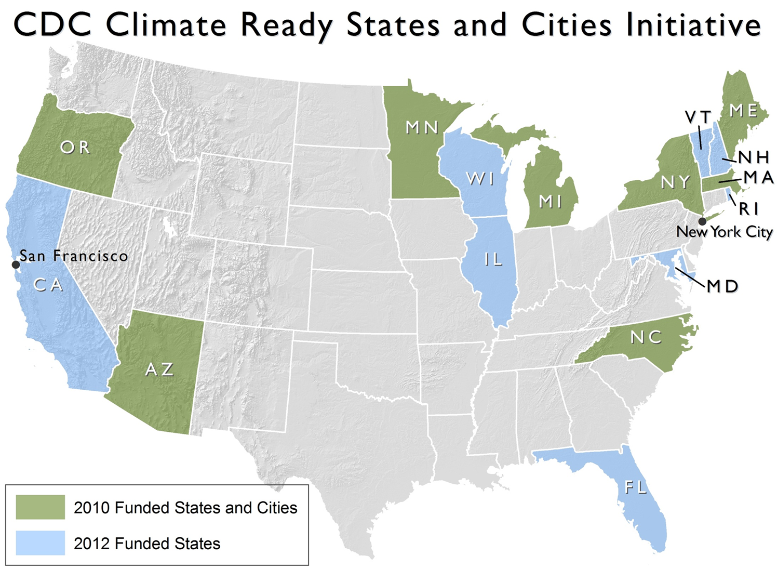
Notes:
CDC’s Climate Ready States and Cities Initiative supports the work of 16 states and 2 cities to do pioneering work to develop the methodologies for projecting and responding to climate change, that can be adopted by health departments around the country.
CDC roles in this is to provide a lot of the guidance, technical support, and tools while our state and city partners are adapting the theories and testing how it works in the real world environment that they face everyday.
The emphasis of the Climate Ready Initiative is to build and test methodologies, critique the methods employed and capture and widely disseminate the case studies and the findings.
Objective: To enhance the capacity of state and local health agencies to deal with the challenges associated with climate change
Cooperative Agreements with State and Local HDs:
“Developing Public Health Capacity and Adaptations to Reduce Human Health Effects of Climate Change”
Developing Decision Support Tools:
Communications and Educational Tools
Vulnerability Mapping Tools

Slide 26
1
Forecasting Climate Impacts and Assessing Vulnerabilities
2
Projecting the Disease Burden
3
Assessing Public Health Interventions
4
Developing and Implementing a Climate and Health Adaptation Plan
5
Evaluating Impact and Improving Quality of Activities
Building
Resilience
Against
Climate
Effects
Climate and Health Program, National Center for Environmental Health
Notes:
Here are the steps within the BRACE framework and I know many of you have seen these before:
Step 1: Big picture. Identify the range of climate impacts in an area, determining the potential health outcomes, & who and what are most vulnerable
Step 2: Work out the magnitude or size of each problem now and at key times in the future
Step 3: Look at options to do something about it
Step 4: Develop and implement a plan of action
Step 5: Evaluate, check and improve the methods (which in reality occurs throughout the process)

Slide 27
Success Stories: New York City
Problem
  Magnitude and intensity of heat waves likely to increase in New York City
Action
  With CDC funding and support, the New York City Department of Health and Mental Hygiene investigated sensitivity and effectiveness of its heat warning system
  Collaboration helped to better understand
    Historical death and hospitalization data
    Future temperature and humidity projections
    Urban heat island models
http://www.nasa.gov/centers/goddard/news/topstory/2005/nyc_heatisland.html
Notes:
New York City
With CDC funding New York City has been able to use climate models to develop a more sensitive & customized heat warning system to better protect New Yorkers during heat waves. To develop the customized warning system the Health Department in New York needed to study:
historical death and hospitalization data;
future projections for relevant climate conditions (such as temperature and humidity); and
localized models simulating the urban heat island effect in New York City.
Using this information NYC was able to determine that that the thresholds that set off the heat warning system needed to specifically calibrated for New Yorkers. This was because the climate of NY meant that less people were biologically accustomed to deal with heat waves, because the heavily urbanized area of the New York meant that more heat would be absorbed in the concrete and asphalt and trapped for longer, and because few New Yorkers have a/c which would allow them to escape the heat. The old thresholds to instigate action by the city were being tripped too late. The new system is tailored to New York, and allows a response customized to the conditions in New York and will better protect New Yorkers.

Slide 28
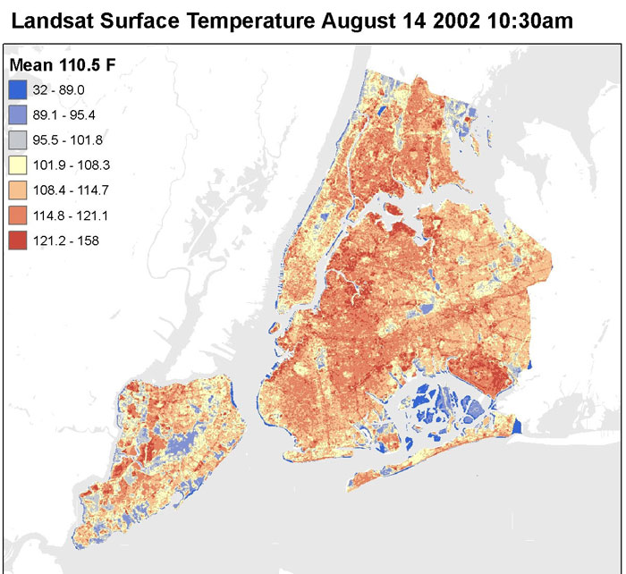
Success Stories: New York City
Outcome
  A more sensitive and tailored heat warning system developed for New York City, allowing more targeted emergency response to reduce heat illness
http://www.nasa.gov/centers/goddard/news/topstory/2005/nyc_heatisland.html
Notes:
New York City
With CDC funding New York City has been able to use climate models to develop a more sensitive & customized heat warning system to better protect New Yorkers during heat waves. To develop the customized warning system the Health Department in New York needed to study:
historical death and hospitalization data;
future projections for relevant climate conditions (such as temperature and humidity); and
localized models simulating the urban heat island effect in New York City.
Using this information NYC was able to determine that that the thresholds that set off the heat warning system needed to specifically calibrated for New Yorkers. This was because the climate of NY meant that less people were biologically accustomed to deal with heat waves, because the heavily urbanized area of the New York meant that more heat would be absorbed in the concrete and asphalt and trapped for longer, and because few New Yorkers have a/c which would allow them to escape the heat. The old thresholds to instigate action by the city were being tripped too late. The new system is tailored to New York, and allows a response customized to the conditions in New York and will better protect New Yorkers.

Slide 29
Success Stories: North Carolina
Problem
  Storm surge can cause failure of drinking and wastewater infrastructure in coastal communities, leading to waterborne disease outbreaks
Action
  Using CDC funding, North Carolina Department of Health and Human Services identified critical drinking and wastewater infrastructure in coastal communities
  Collaboration enabled health officials to use climate change models to estimate flooding in coastal areas
  Health officials used estimates of 0.5m, 1m, and 2m storm surge to map at-risk drinking water and wastewater infrastructure
Notes:
North Carolina
In North Carolina storm surge predictions have been mapped against the location of critical infrastructure of public health significance. Using inundation estimates at 0.5m, 1m, & 2m, the health department has been able to determine the location of vulnerable drinking water sources, & drinking water treatment & wastewater treatment facilities that would be adversely affected, and have begun planning to mitigate these risks. This information is informing preparedness plans and as well as future siting of these important facilities.

Slide 30
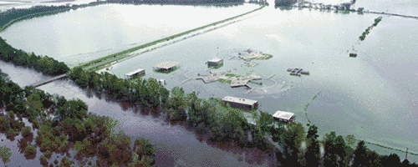
Success Stories: North Carolina
Outcome
  Findings informing preparedness planning and decisions on sites for future facilities
Wastewater treatment plant in Goldsboro , NC
Notes:
North Carolina
In North Carolina storm surge predictions have been mapped against the location of critical infrastructure of public health significance. Using inundation estimates at 0.5m, 1m, & 2m, the health department has been able to determine the location of vulnerable drinking water sources, & drinking water treatment & wastewater treatment facilities that would be adversely affected, and have begun planning to mitigate these risks. This information is informing preparedness plans and as well as future siting of these important facilities.

Slide 31
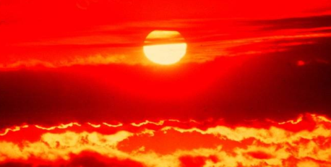


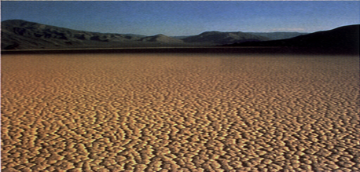
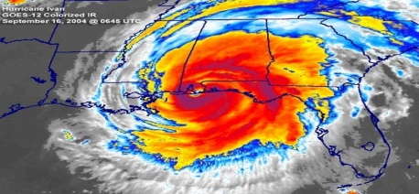
George Luber, PhD
770-488-3429
GLuber@cdc.gov
For more information please contact Centers for Disease Control and Prevention
1600 Clifton Road NE, Atlanta, GA 30333
Telephone: 1-800-CDC-INFO (232-4636)/TTY: 1-888-232-6348
E-mail: cdcinfo@cdc.gov Web: http://www.cdc.gov
The findings and conclusions in this report are those of the authors and do not necessarily represent the official position of the Centers for Disease Control and Prevention.
National Center for Environmental Health
Division of Environmental Hazards and Health Effects

