Slide 1
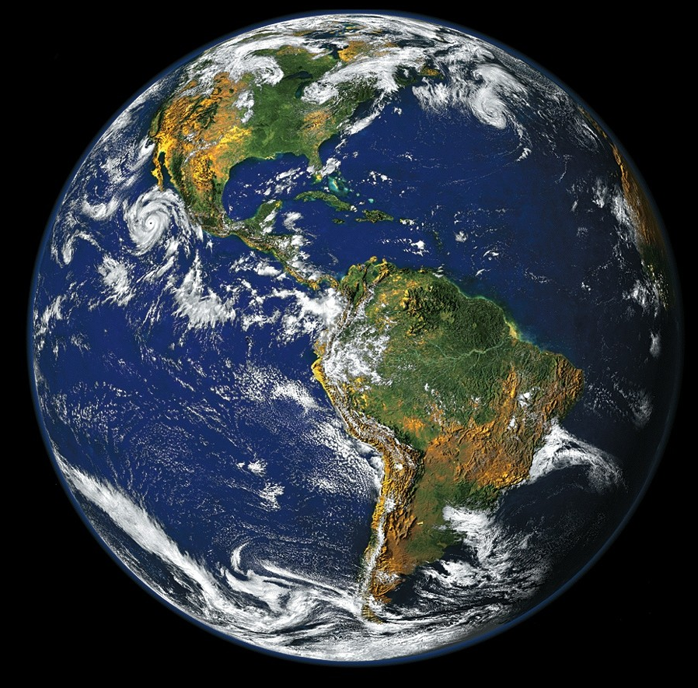
Climate change and vector-borne disease
How do we know what we know?
Richard S. Ostfeld
Cary Institute of Ecosystem Studies
Millbrook, New York

Slide 2
“As the atmosphere has warmed over the past century, droughts…and precipitation bursts…have promoted by various means the emergence, resurgence, and spread of infectious disease.”
--P. Epstein, Sci. Am. 2000
Notes:
Claims about climate exacerbating disease began to surface in the mid 1990s and by the end of the decade, claims such as this were rampant.

Slide 3
“As the atmosphere has warmed over the past century, droughts…and precipitation bursts…have promoted by various means the emergence, resurgence, and spread of infectious disease.”
--P. Epstein, Sci. Am. 2000
Notes:
Alarmists who were exaggerating the threat.

Slide 4
“Predictions that global warming will spark epidemics have little basis… [because] public health measures will inevitably outweigh effects of climate.”
--G. Taubes, Science, 1997

Slide 5
“Predictions that global warming will spark epidemics have little basis… [because] public health measures will inevitably outweigh effects of climate.”
--G. Taubes, Science, 1997
Notes:
Denialists who refused to face reality.

Slide 6

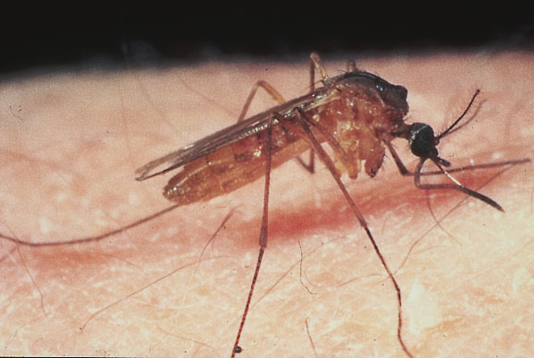
Notes:
The fact that climate impacts on infectious disease entered the public policy arena has only fueled the fire. Focus on malaria.

Slide 7
Hypothesis: Global climate change will increase the global burden of infectious disease
Notes:
The way this debate took form evolved from the way the scientific hypothesis was stated.

Slide 8
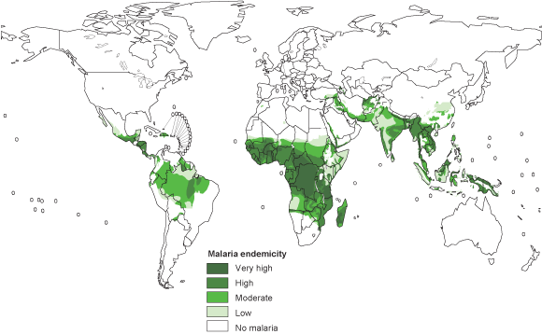

Hypothesis: Global climate change will increase the global burden of malaria
Notes:
And the poster child for the debate became malaria, one of the most important infectious diseases in the world. A grand hypothesis like this deserves a grand experiment, which in principle is very easy.

Slide 9


Slide 10
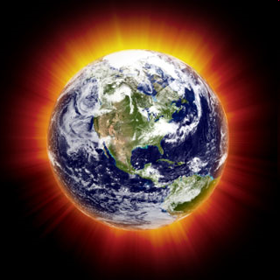
Notes:
Unfortunately, we can’t do the grand experiment that would settle this once and for all. Consequently, we have the do the best we can with less grand studies and assess the weight of evidence. So how do scientists tackle this?

Slide 11
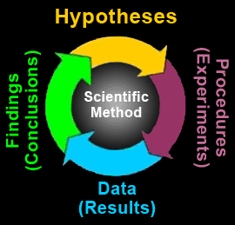
“The scientific method”
Notes:
Contrary to popular opinion, the Sci Method you learned in third grade isn’t very accurate or complete. It relies on the grand experiment to tackle the grand hypothesis, but it leaves out much richness.

Slide 12
The way science really works
Experiments
Correlations
Models
Notes:
If the grand experiment can’t be done to answer the grand question we can always use smaller experiments to answer smaller questions. And we also have other tools in our scientific toolkit, which together can address the grand question. Keep in mind that each of these approaches has limitations. The limitation of experiments is that they can be logistically difficult. Or in the case of our replicate Earths, *impossible*.

Slide 13
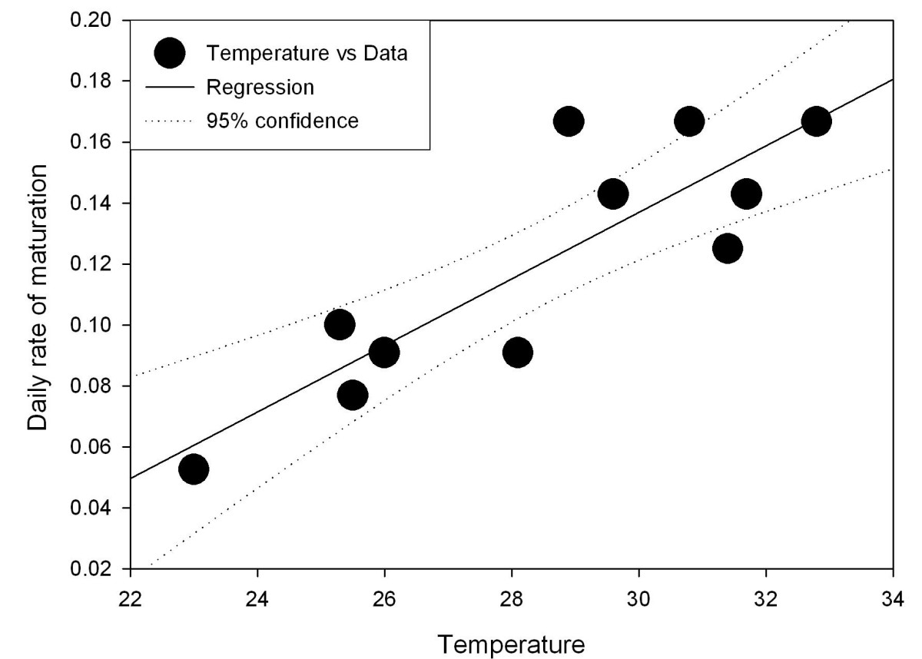
Resolution: standard / high Figure 2. Larvae maturation. Rate of development of larvae as a fraction of the complete development cycle as a function of the water temperature in Celsius. Data based on that of Jepson et al. Line best fit by least squares. X-axis average water temperature, Y-axis: rate of development (in 1/days) as the reciprocal of length of cycle. Hoshen and Morse Malaria Journal 2004 3:32 doi:10.1186/1475-2875-3-32 Download authors' original image
Anopheles gambiae larvae
Hoshen & Morse, Malar. J. 2004
Notes:
Hoshen and Morse, Malaria Journal, 2004

Slide 14
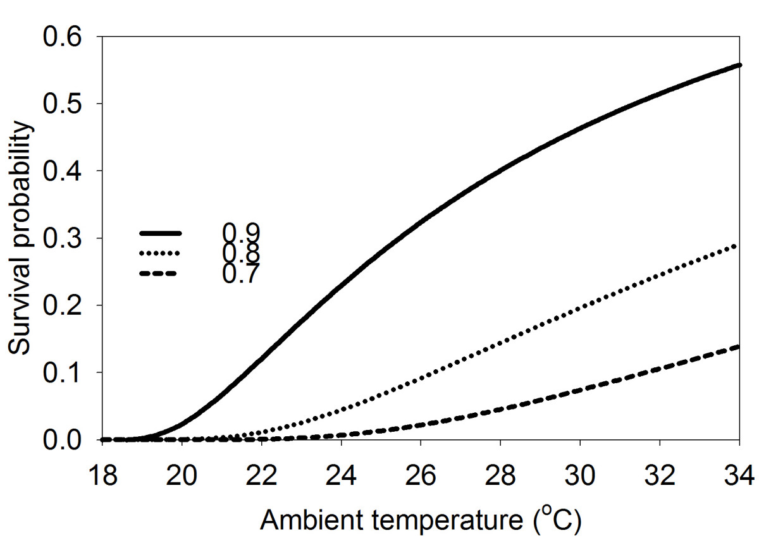
Anopheles gambiae larvae – probability of surviving to
maturity
Daily survival
Hoshen & Morse, Malar. J. 2004
Notes:
Hoshen and Morse, Malaria Journal, 2004. The probability of a new Anopheles
gambiae larva surviving to maturity as function of ambient
temperature for different values of per diem survivorship. Xaxis
temperature in °C. Y-axis the probability of completing
development until maturity. Lines from top to bottom daily
survivorships of 0.9, 0.8 and 0.7 respectively.

Slide 15
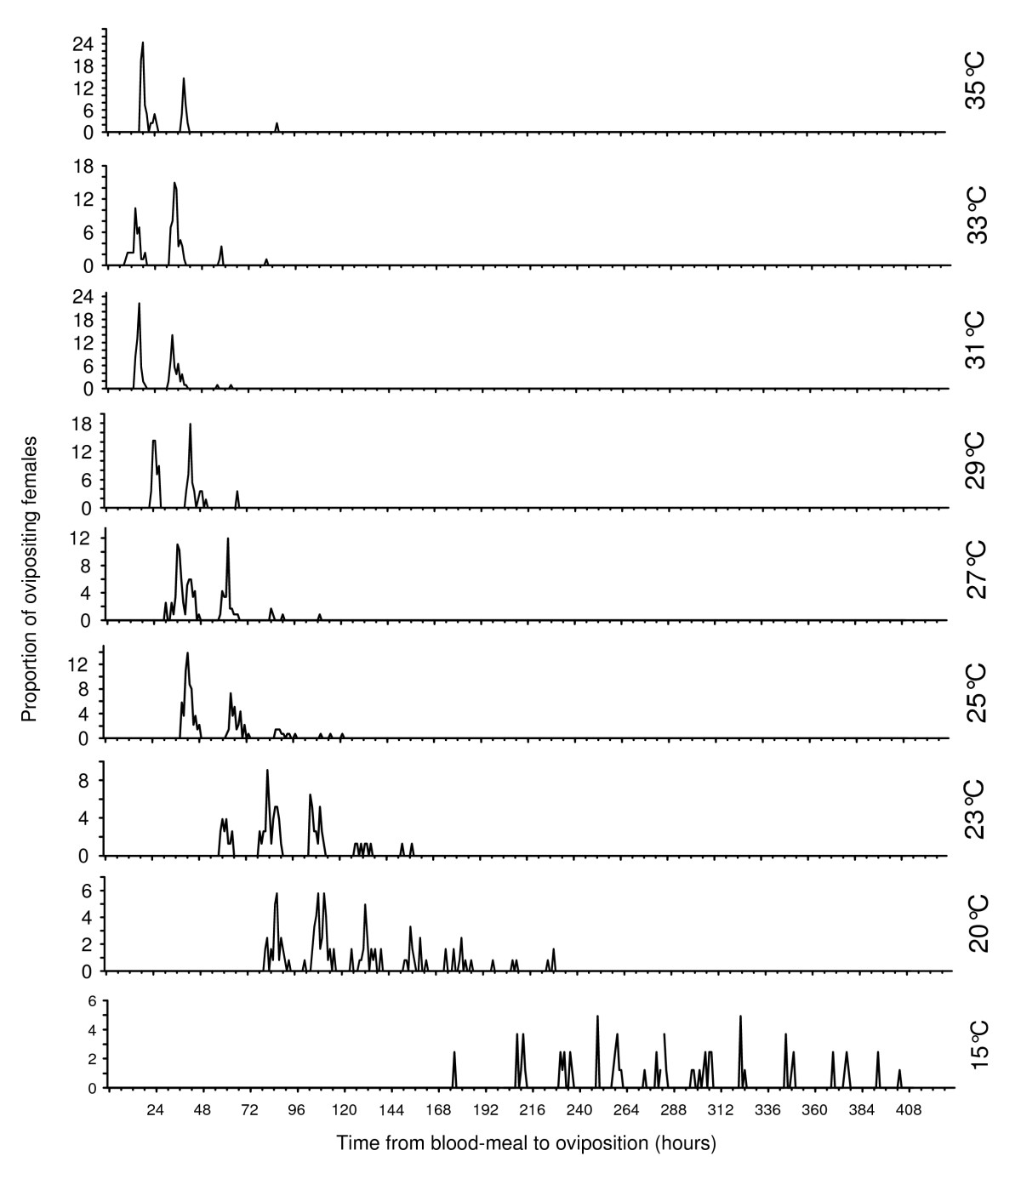
Anopheles
pseudo-
punctipennis
Time to
oviposition
Temperature
Lardeaux et al. 2008
Malar. J.
Notes:
Egg laying patterns for An. pseudopunctipennis at various constant temperatures. The number of ovipositing nights is pictured by the observed "pulses" which have a pseudo Gaussian mode.
Lardeux et al. Malaria Journal 2008 7:141 doi:10.1186/1475-2875-7-141

Slide 16
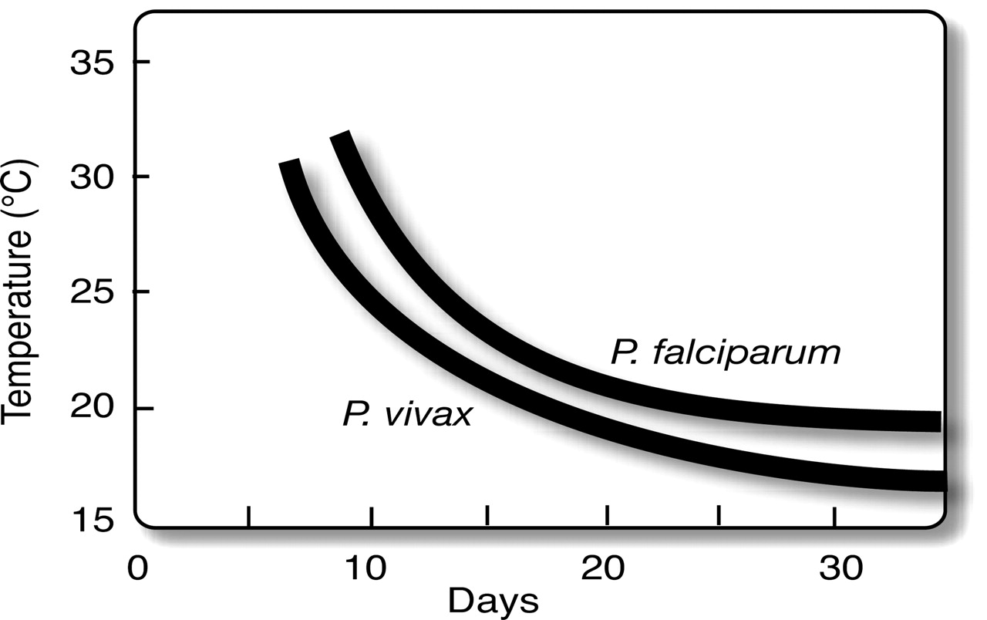
Relationship between temperature and
malaria parasite development time inside the mosquito
Patz J A, Olson S H PNAS 2006;103:5635-5636
©2006 by National Academy of Sciences
Notes:
Relationship between temperature and malaria parasite development time inside the mosquito (“extrinsic incubation period” or EIP). EIP shortens at higher temperatures, so mosquitoes become infectious sooner. Note the nonlinear response to temperature, as well as relative threshold limits for malaria parasite development (≈18°C and 15°C for P. falciparum, and P. vivax, respectively) (adapted from ref. 16).

Slide 17
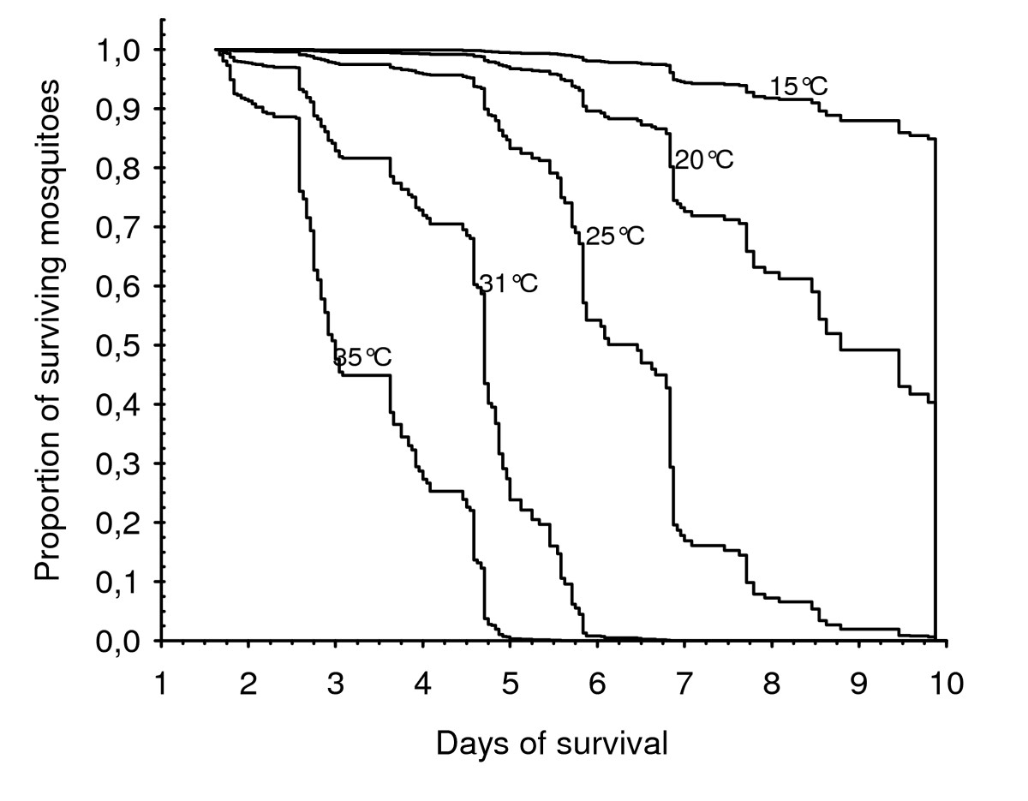
An. pseudopunctipennis
Temperature
Lardeaux et al. 2008
Malar. J.
Notes:
Cox model representation of An. pseudopunctipennis mortalities at various constant temperatures. The model expresses the instantaneous risk of mortality according to the temperature.
Lardeux et al. Malaria Journal 2008 7:141 doi:10.1186/1475-2875-7-141

Slide 18
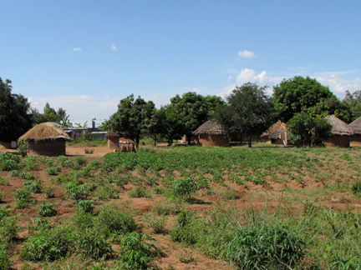
cool warm hot
Notes:
Deforestation made it warmer and drier, and strongly increased malaria risk in highlands. In deforested lowlands where it was even warmer and still humid, risk exploded.

Slide 19
Correlation: Malaria risk factors are higher in warmer areas.
cool warm hot
Notes:
Deforestation made it warmer and drier, and strongly increased malaria risk in highlands. In deforested lowlands where it was even warmer and still humid, risk exploded.

Slide 20
General conceptual model for vector-borne diseases
Vector vital
rates and
behavior
Human
incidence
rates
Abiotic
conditions
Risk of human
exposure
Climate
Parasite
development
rates
Notes:
So, we have experiments and correlations that suggest a conceptual model for how this system works.

Slide 21
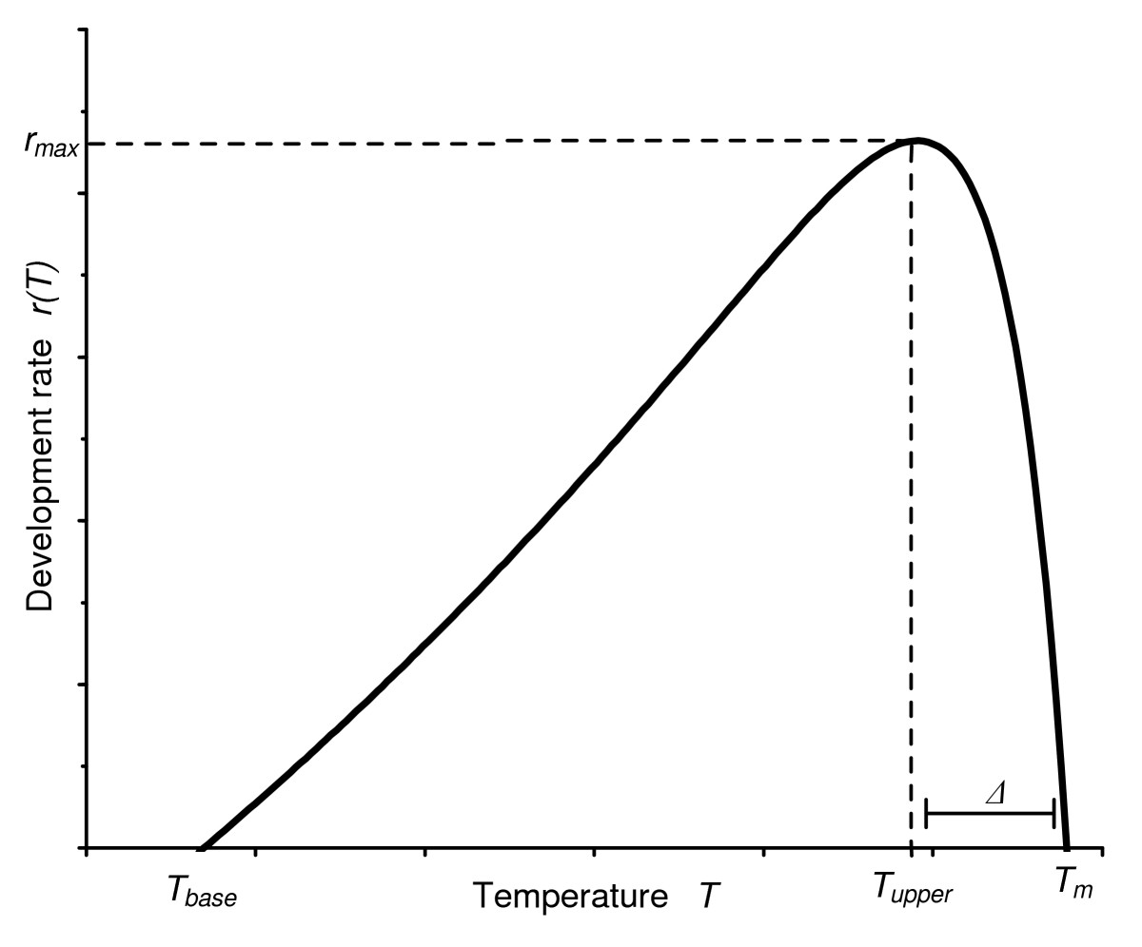
30 C
Faster development of
vector & parasite, faster
ovipositing & biting rate,
lower larval mortality,
higher adult mortality
rate
Model: Risk of infection increases with mean temperature up to about 30ºC (86ºF)
Force of infection
Notes:
Putting these data together, the best estimate of the relationship between temperature and force of infection probably looks like this. A generalized insect developmental rate curve as a function of temperature: the Lactin et al. function [20]. Descriptive parameters are T_{base}, the base temperature below which development does not proceed, the maximum development rate r_{max} and its corresponding temperature T_{upper}, the width Δ of decline phase in developmental rate above optimum temperature and the thermal maximum T_{m}.
Lardeux et al. Malaria Journal 2008 7:141 doi:10.1186/1475-2875-7-141

Slide 22
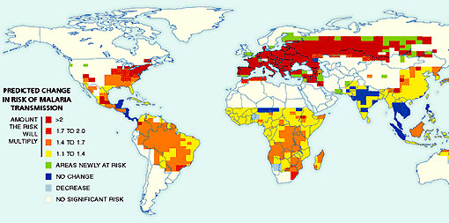
Yr 2100
Model: 450,000,000 more people at risk of malaria in 100 years
Martens et al. 1999
Notes:
Geographic model asked how this would translate into human cases around the planet. Risk would go up everywhere but particularly dramatically in temperate/boreal areas.

Slide 23
The way science really works
Experiments
Correlations
Models
Notes:
So I’ve just shown you how the results of small-scale laboratory experiments and correlations can be stitched together with a model to make predictions at a larger scale. But these methods all have limitations and conclusions are vulnerable to challenge.

Slide 24
Challenging a model’s predictions using correlations
Notes:
Argument formalized in recent paper by Gething et al

Slide 25
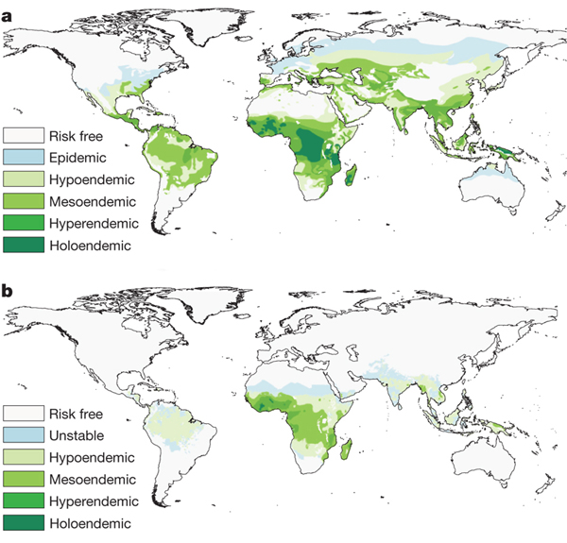
1900
2007
PW Gething et al. Nature (2010)
Notes:
Argument formalized in recent paper by Gething et al

Slide 26
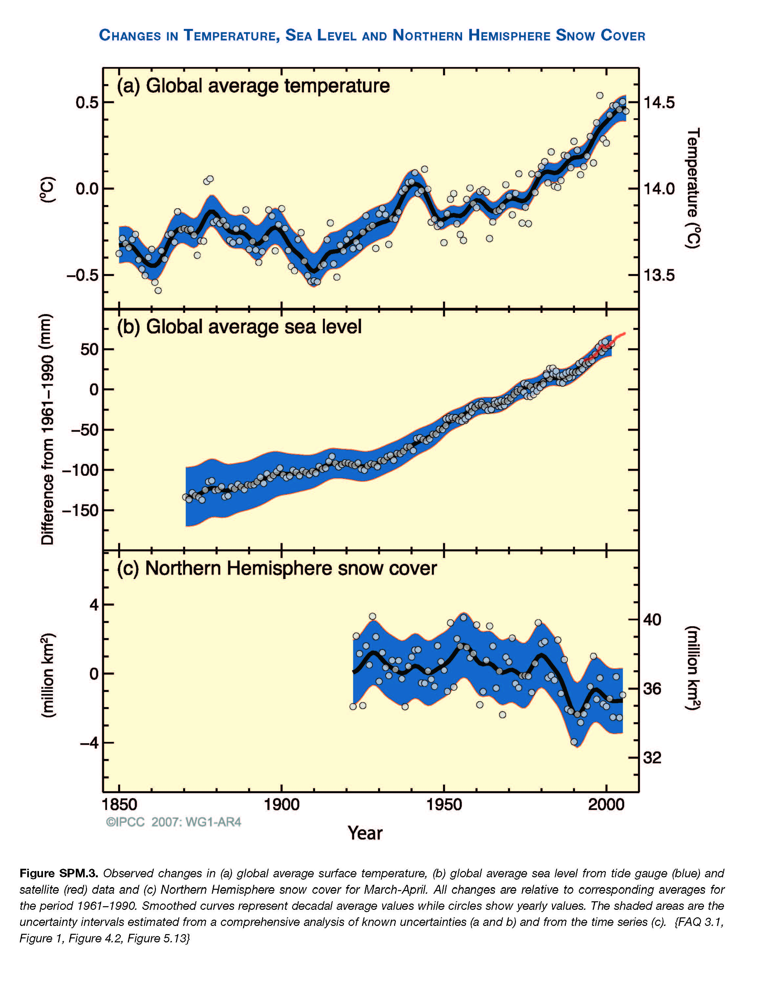
IPCC (2007)

Slide 27
“The quantification of a global recession in malaria… over the twentieth century…suggests that the success or failure of our efforts against the parasite in the coming century are likely to be determined by factors other than climate change.”
PW Gething et al. Nature (2010)
Notes:
What they’re saying is that warming and malaria burden were not positively correlated, therefore climate change is unlikely to determine future trends. But the well-known limitation of correlations is that they can be spurious – not representing causation. This appears to be the case here.

Slide 28
Questioning assumptions
Vector vital
rates and
behavior
Human immunity
Human
incidence
rates
Abiotic
conditions
Risk of human
exposure
Climate
Human behavior
Parasite
development
rates

Slide 29
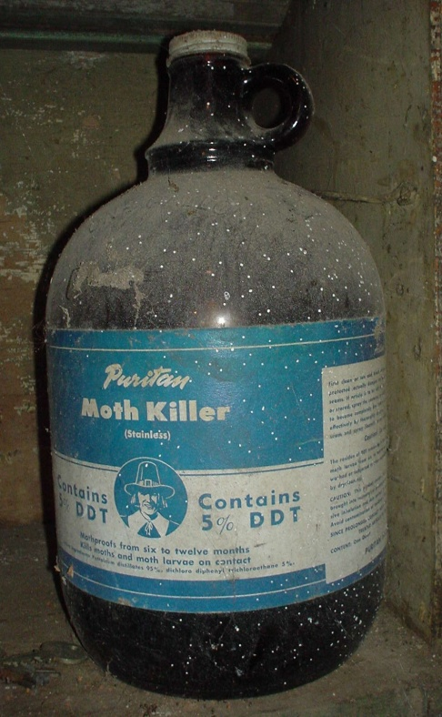
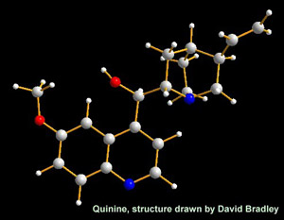
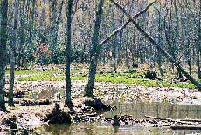
Causes of the 20th century malaria “recession”
Notes:
But of course these are yesterday’s interventions used yesterday. In the 21st Century these interventions are either unavailable or prohibitive in areas with current malaria, including much of the developing world. Even in the developed world, our infrastructure to reduce infectious disease risk can crumble.

Slide 30
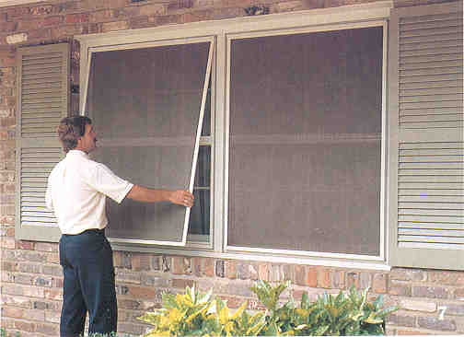
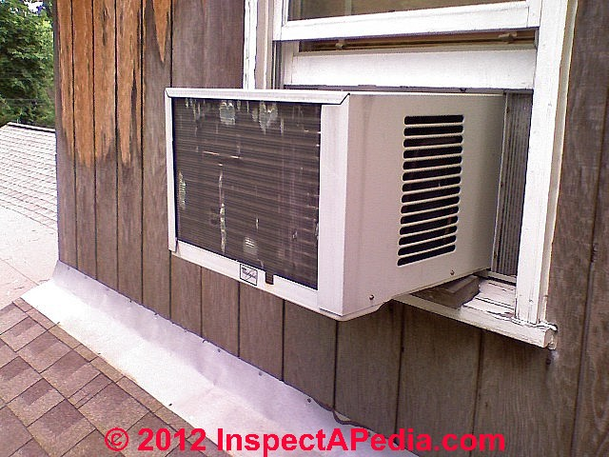
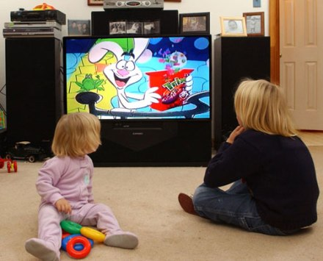
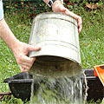
21st Century Protection in the developed world
Notes:
In the developed world, we use a variety of mitigations against mosquito-borne disease that could reduce climate impacts. But these mitigations are unavailable in many parts of the world.

Slide 31
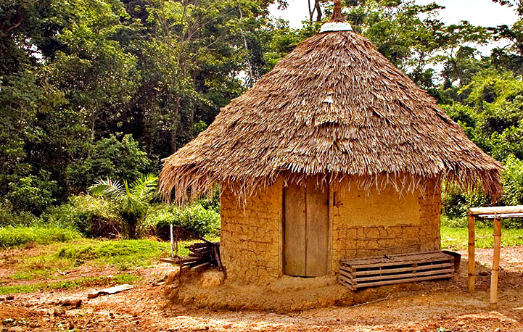
Hypothesis: Increase in standard of living will prevent increased risk from translating into increased actual cases.
Notes:
Critics: there will be increased standard of living globally, and that will prevent increased risk from becoming increased incidence.

Slide 32
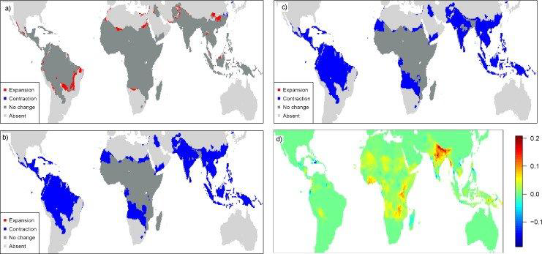
Modeled change in malaria between 2010 and 2050:
Climate and socioeconomic changes
Answer: 210 M more people at risk even with 4-fold increase in per capita gross domestic product.
Béguin et al. 2011. Global Env Change
Notes:
Increase in risk even accounting for 4-fold increase in GDPpc.

Slide 33
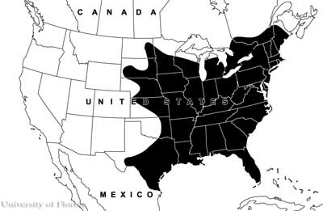
Data from CDC
Will malaria re-enter the US?
Anopheles quadrimaculatus

Slide 34
Relationship between temperature and
malaria parasite development time inside the mosquito
Patz J A, Olson S H PNAS 2006;103:5635-5636
©2006 by National Academy of Sciences
Notes:
At average temps in most of the US, it takes so long for the parasite to develop that transmission is unlikely even with some degree of warming. And preventive measures reduces that risk even further.

Slide 35
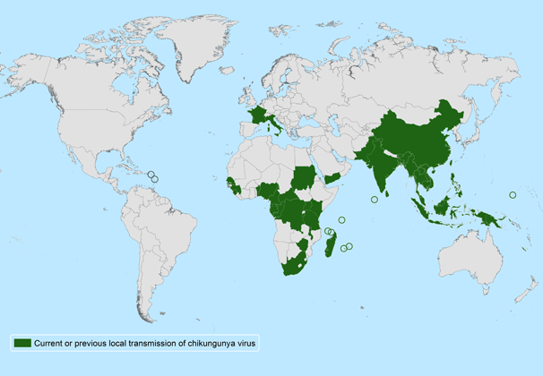
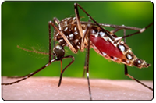
Chikungunya virus “that which bends up”
Aedes aegypti
and Ae. albopictus
6,675 locally-
transmitted cases as of
Feb. 21, 2014
Source: CDC

Slide 36
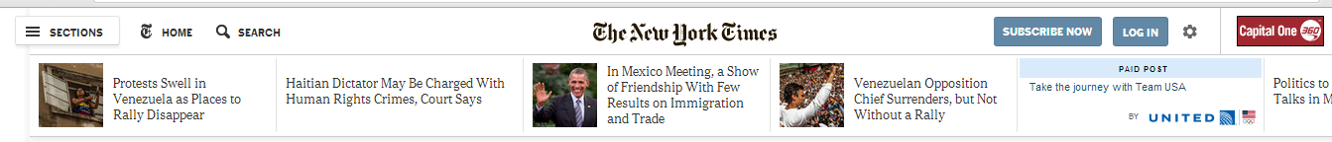
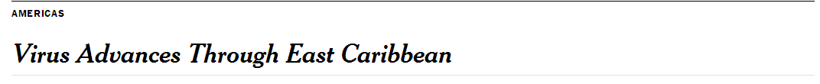
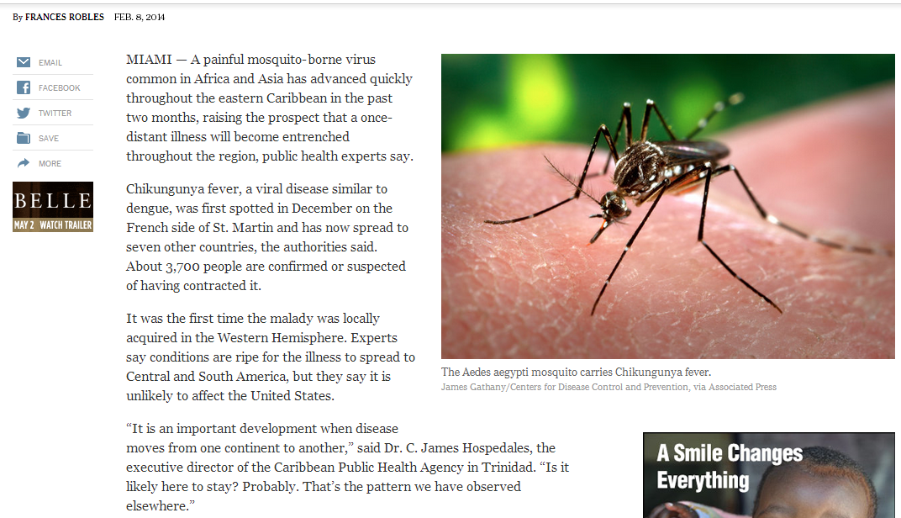
“The disease is not likely to spread to the United States, because it is carried by two species of mosquito – the yellow fever mosquito, Aedes aegypti, and the Asian tiger mosquito, Aedes albopictus – that prefer warm climates.”

Slide 37
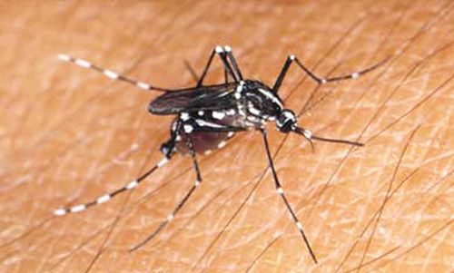
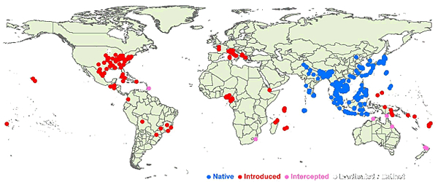
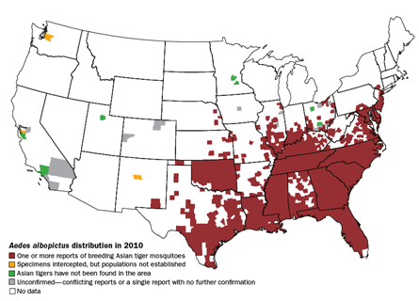
Aedes albopictus

Slide 38
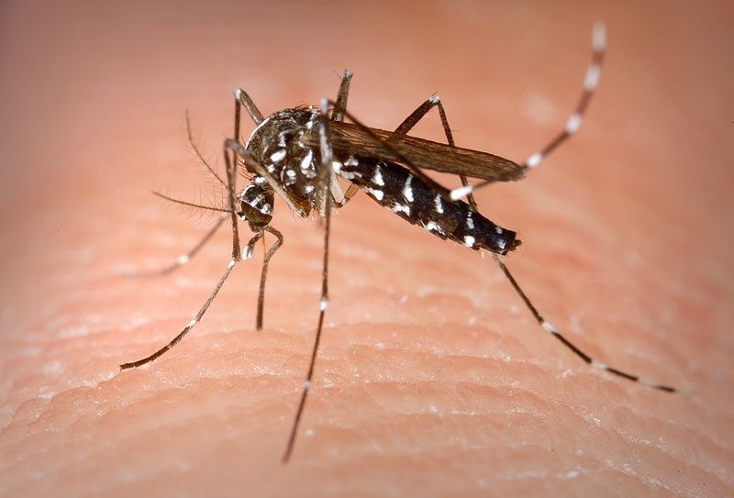
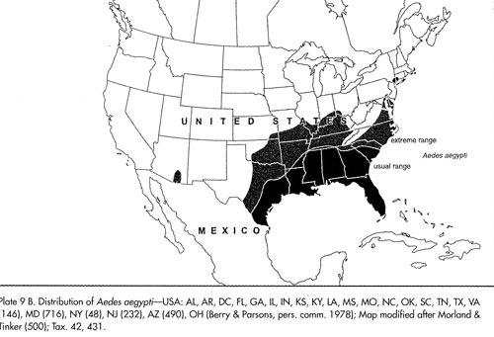
Aedes aegypti

Slide 39
Chikungunya virus: experiment
10
2-day incubation at 28º C!
8
6
o AAPT
Δ ALPROV
Log10 RNA copies/salivary glands
4
2
0
0
2
4
6
8
10
12
14
Day after infection
Dubrulle et al. PLoS ONE, 2009

Slide 40
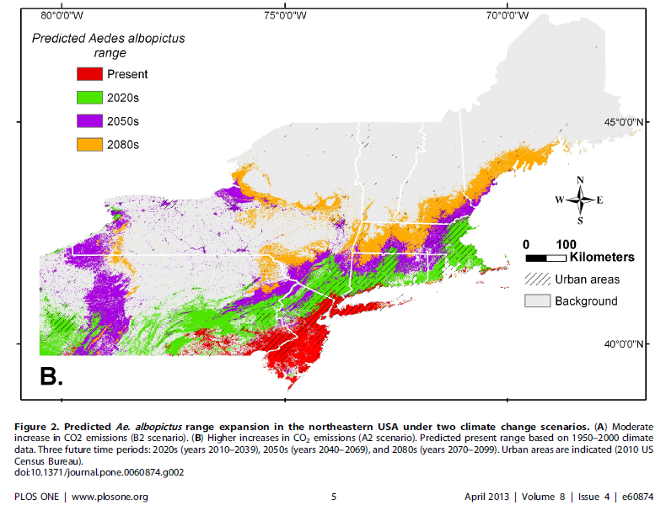
Aedes albopictus: model
Rochlin et al. PLoS ONE 2013

Slide 41
Conclusion: Chikungunya is highly likely to arrive in the United States, and climate change is likely to help it spread.

Slide 42
Wrap-up
Warming increases risk
Infrastructure protects in some cases
In others, warming will increase disease
Notes:
We are performing the grand experiment, but we have no replication and no controls, so our design is very poor.
Infrastructure – in developed world and with slowly developing diseases
Policy makers and regulators should take heed.

Slide 46
Mean temp = 18ºC

Slide 47
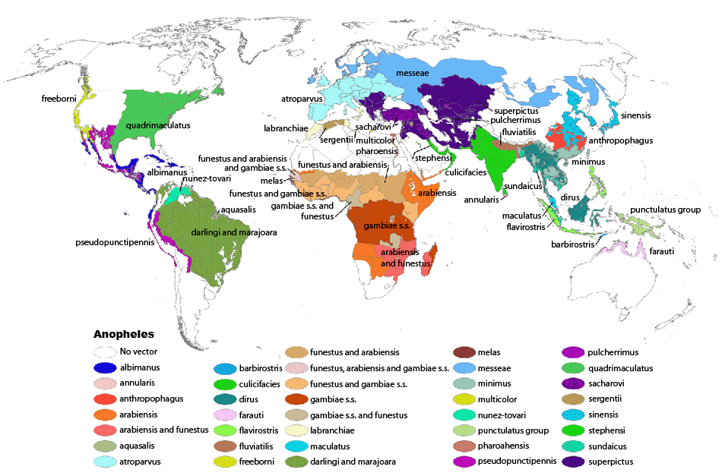

Slide 48
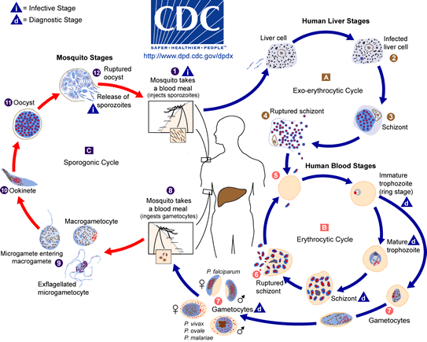

Slide 49
1.2
“The increase in global
temperatures by 1ºC was accompanied by a two- to
three-fold increase in the average prevalence of malaria in birds.”
1.0
0.8
Square-root arcsine (prevalence)
0.6
0.4
0.2
0.0
0
1
2
Temperature anomaly (°C)

