Slide 1
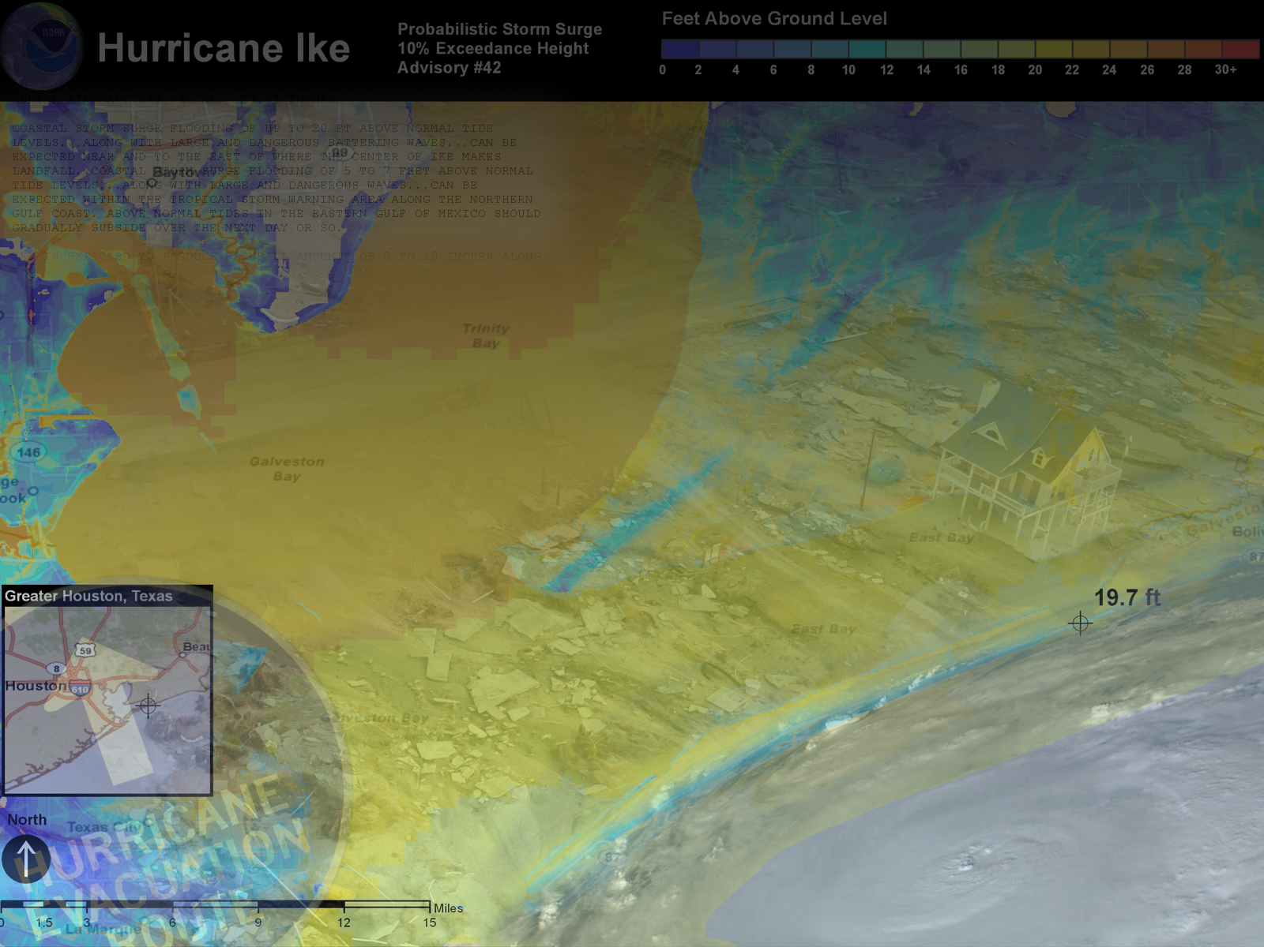




New National Weather Service Storm Surge Products and Messaging
Jamie Rhome
National Hurricane Center

Slide 2
Atlantic Tropical Cyclone Deaths
2,544 Fatalities From 1963–2012
Almost 50% the deaths are due to storm surge
Over 80% of deaths are due to water
Wind causes less than 10% of deaths

Slide 3
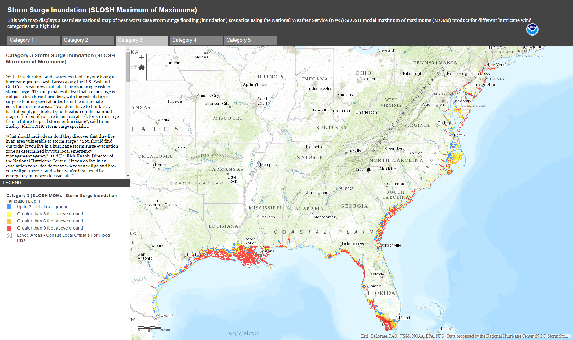
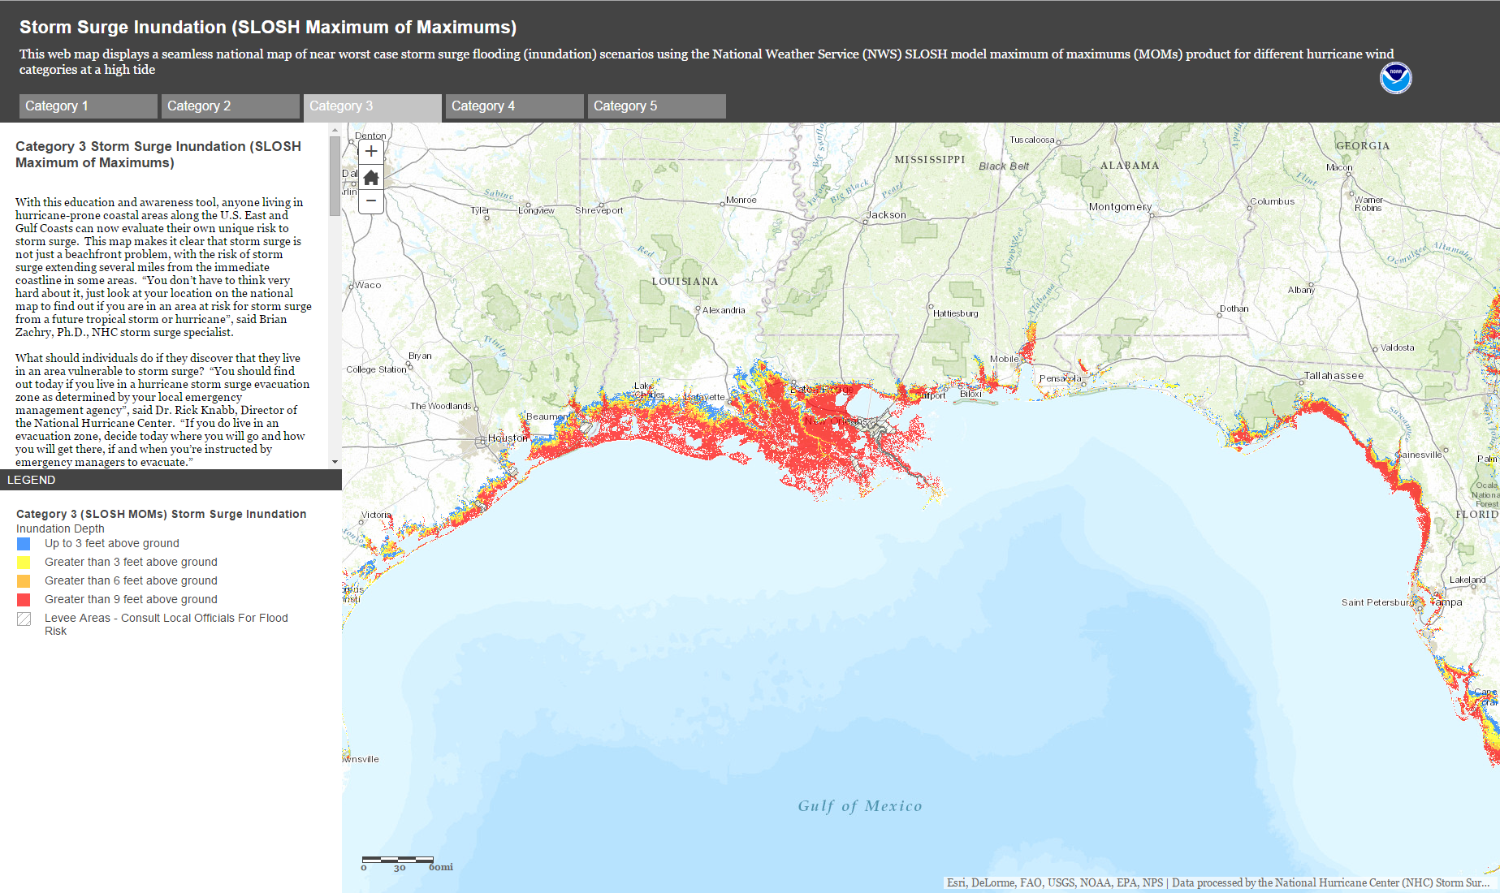
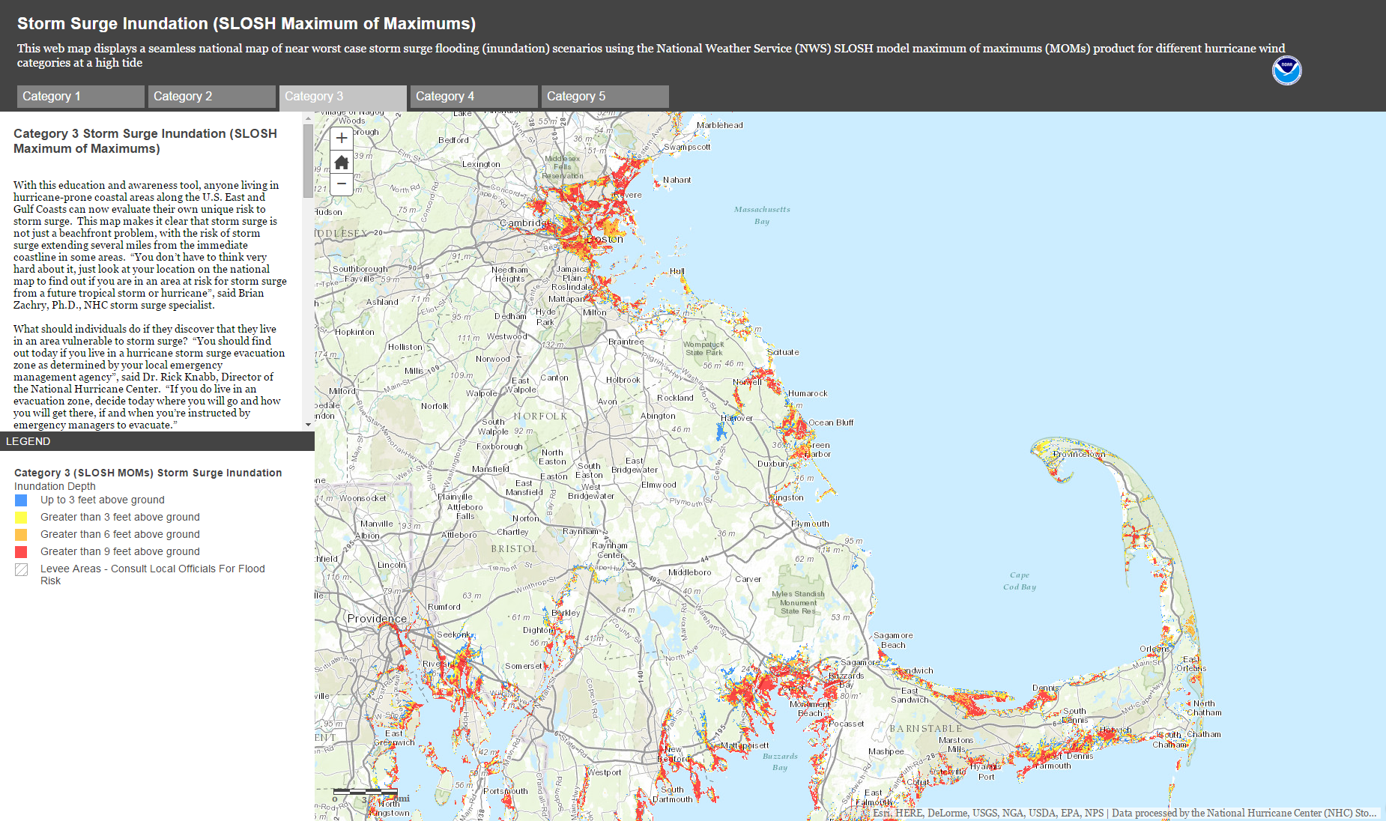
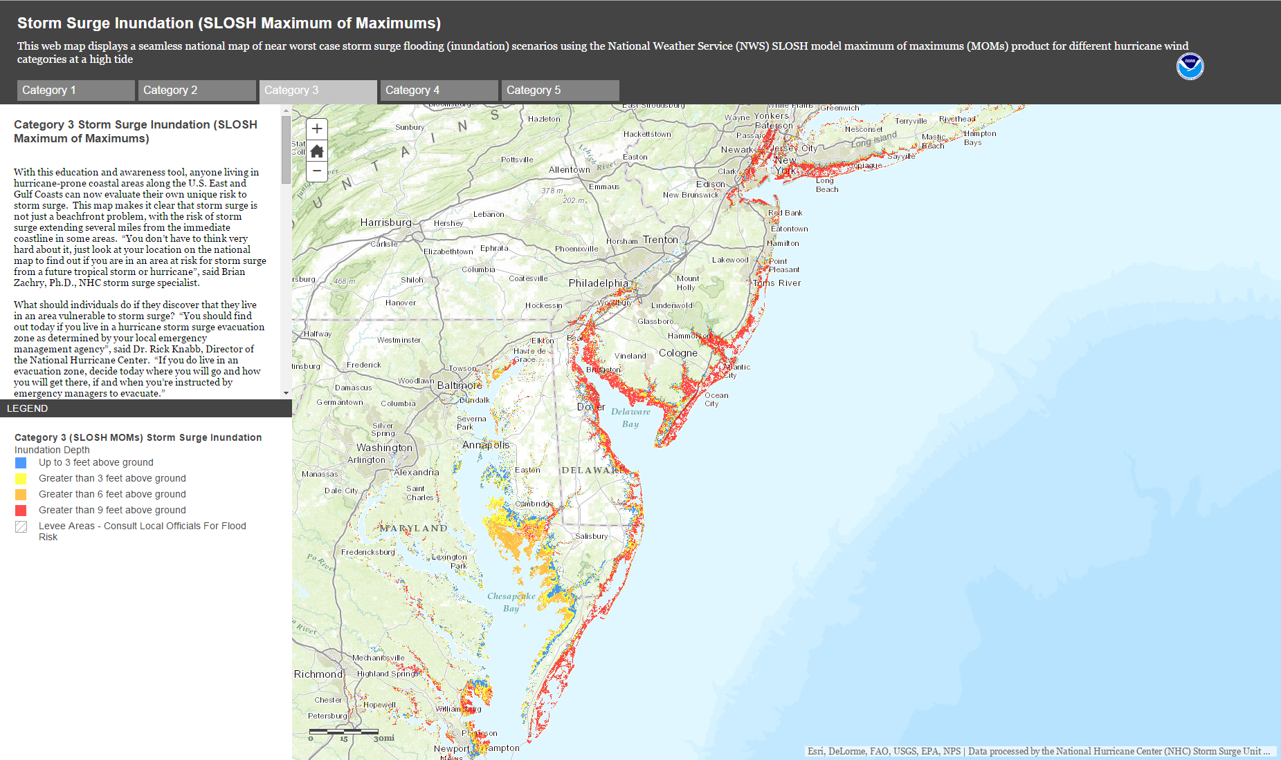
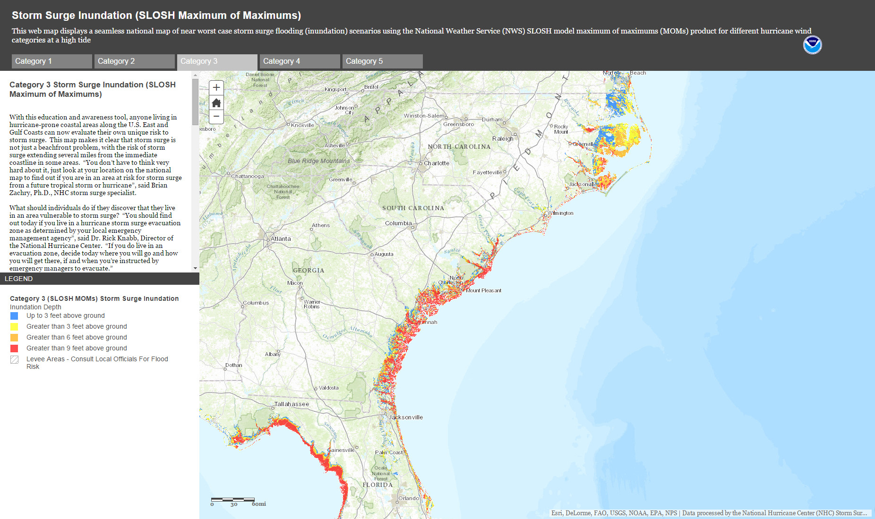
National Storm Surge Risk
Roughly 22 million people in U.S. are vulnerable to storm surge flooding
About 10,000 miles of evacuation route becomes inundated or cut off
Nearly 16 million housing parcels vulnerable to surge
http://noaa.maps.arcgis.com/home/item.html?id=b1a20ab5eec149058bafc059635a82ee

Slide 4
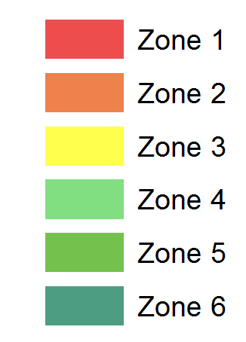
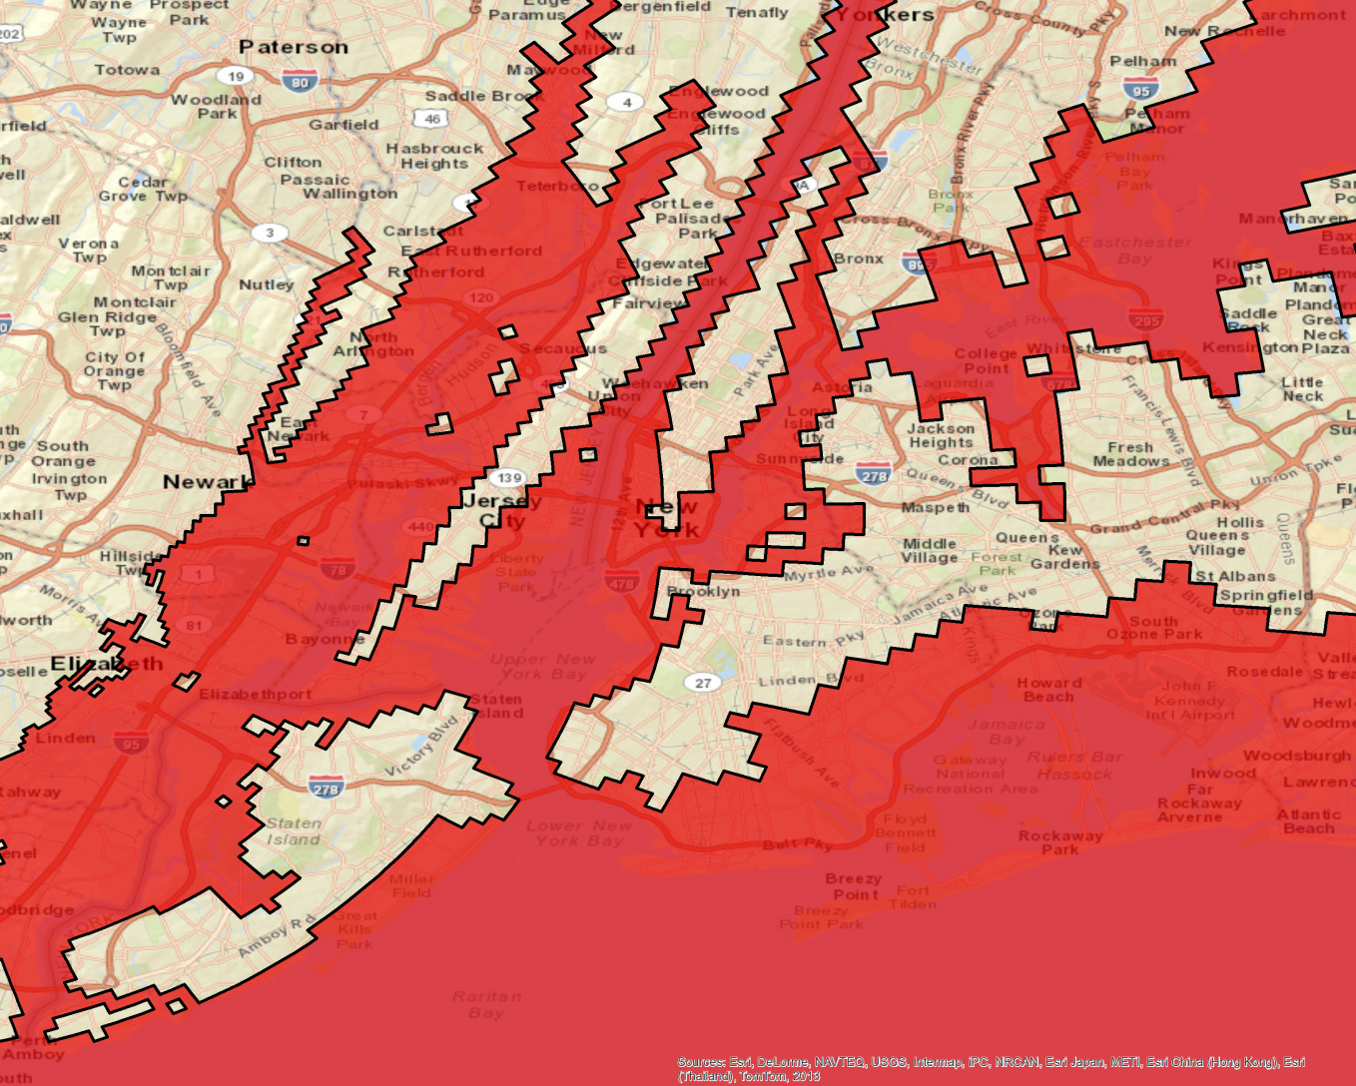
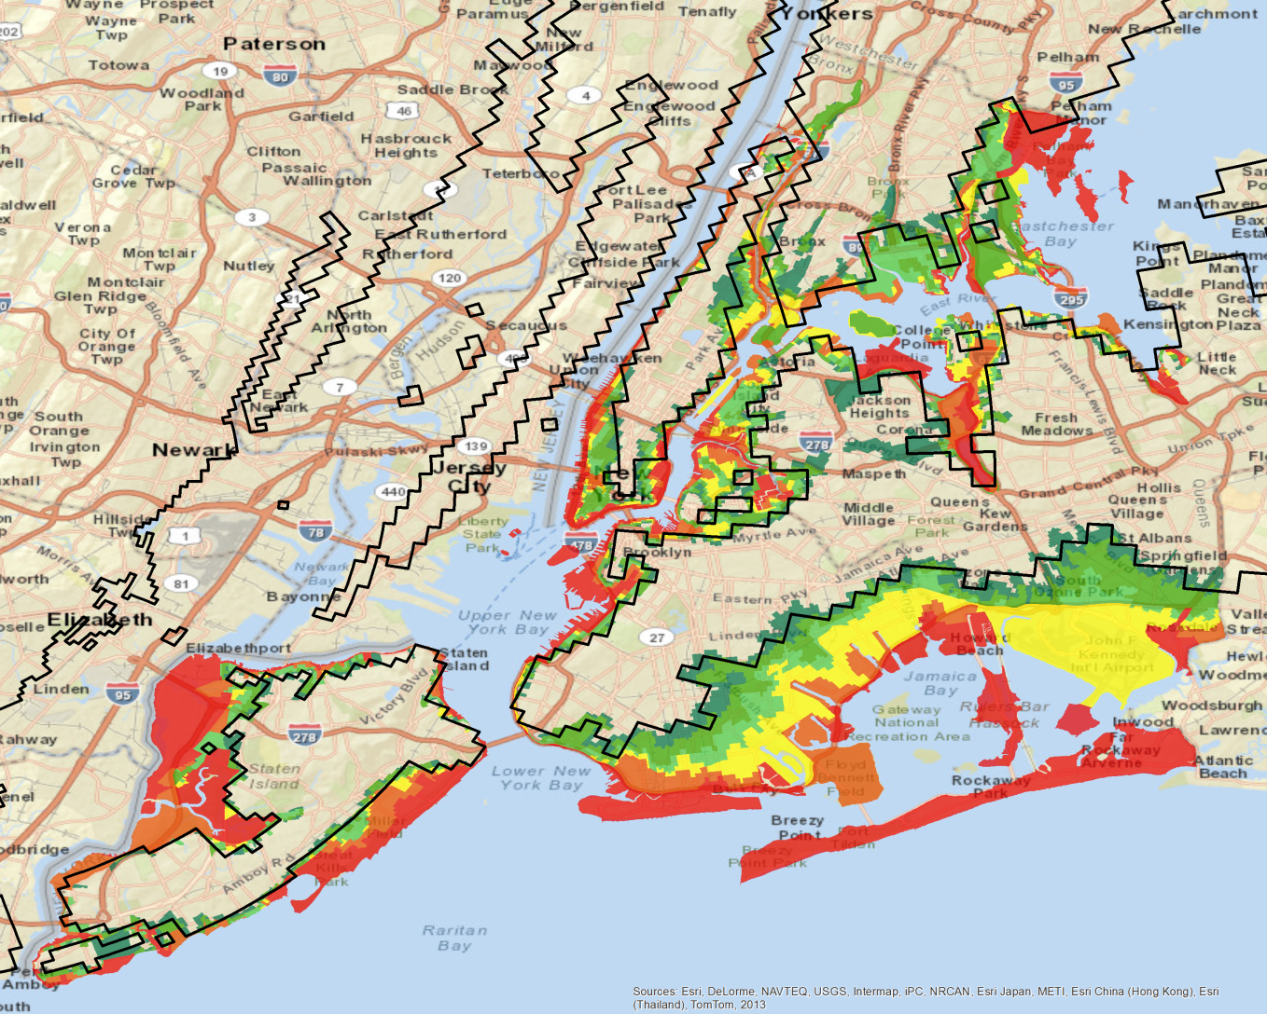
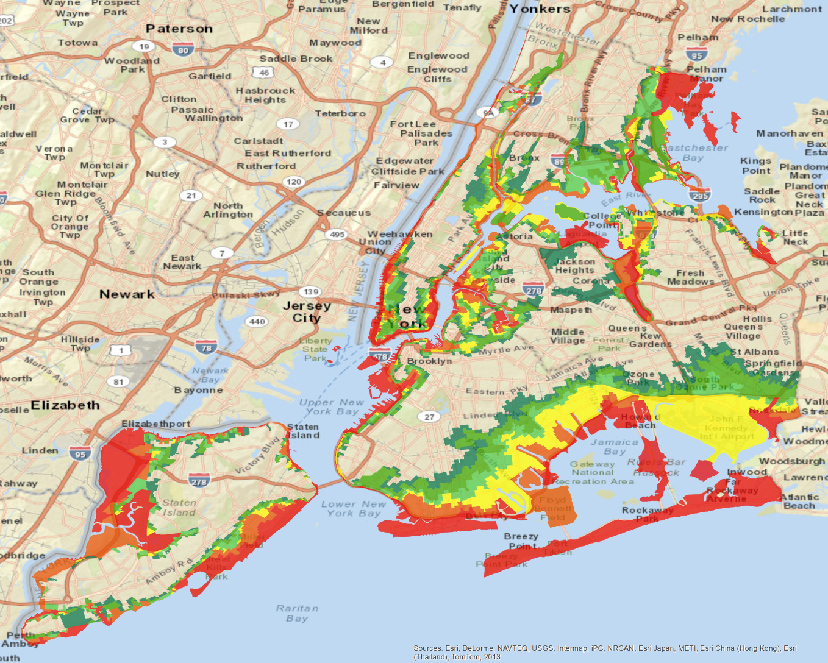
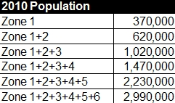
Why Does This Matter?
NYC Evacuation Zones / Cat 4, High Tide Anomaly
Cat 4, High Tide Anomaly
NYC Evacuation Zones

Slide 5
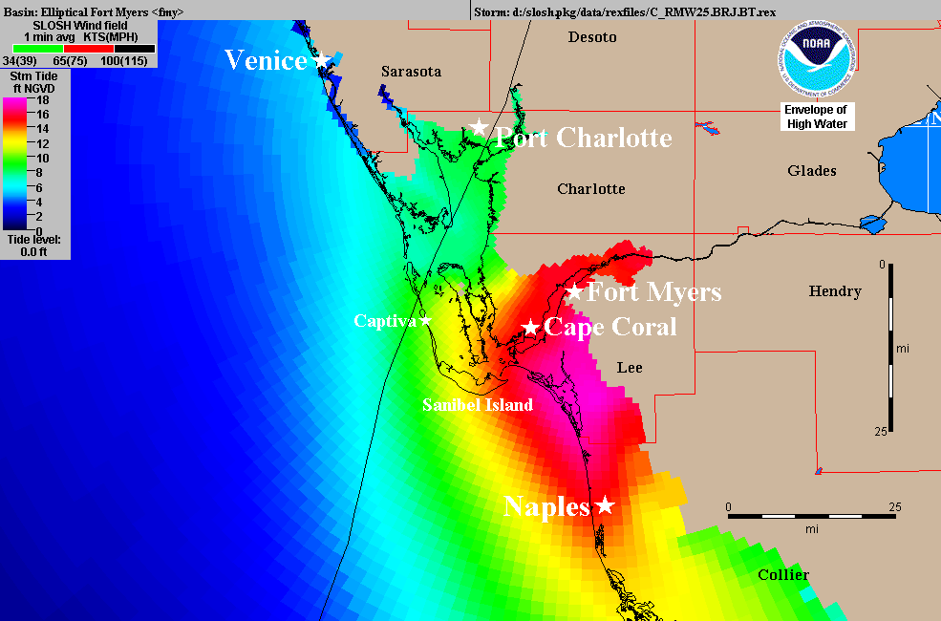
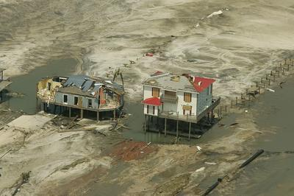
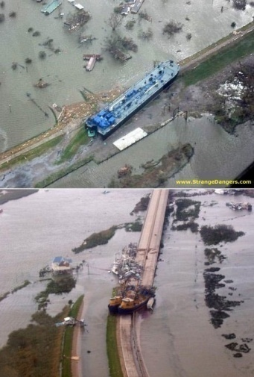
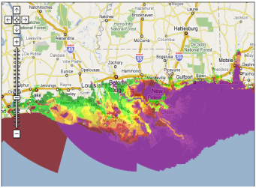
The NOAA/NWS Vision
Improve Storm Surge Guidance
  Produce water level analyses and forecasts that include all contributions to total water level rise
    Surge, tides, waves, fresh water, background anomaly
  Transition from deterministic to ensemble/probabilistic approaches
Inundation Products
  Provide information about the water depth over the land (inundation) above ground level (AGL)
Communicating Actionable Information
  Provide information that people can act on

Slide 6
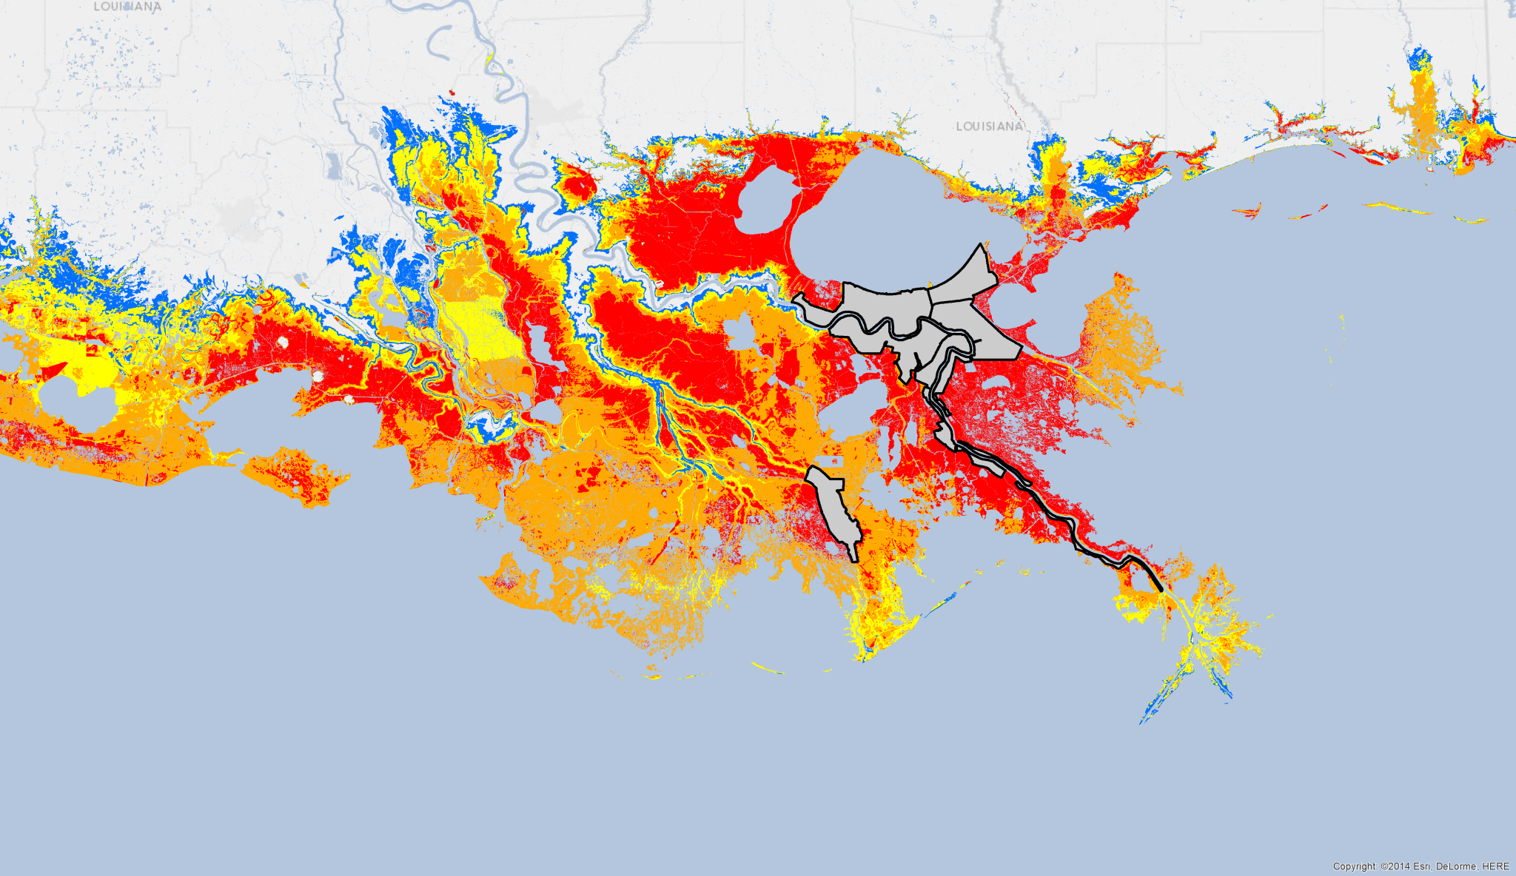
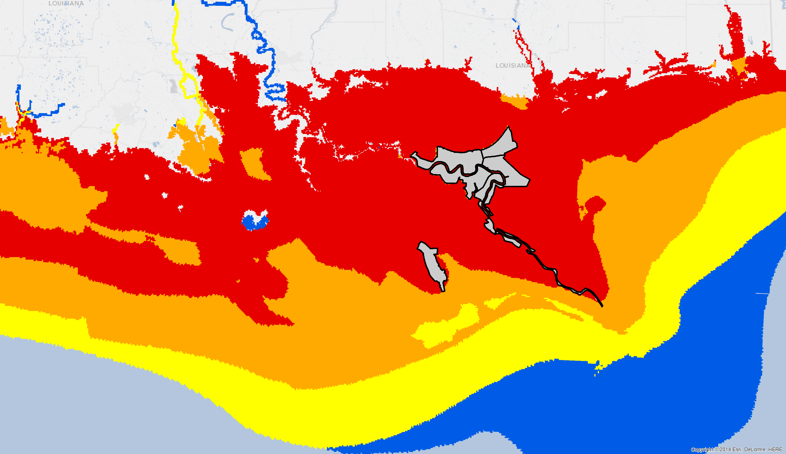
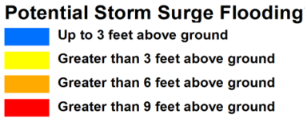
Inundation Mapping/Depth Analysis

Slide 7
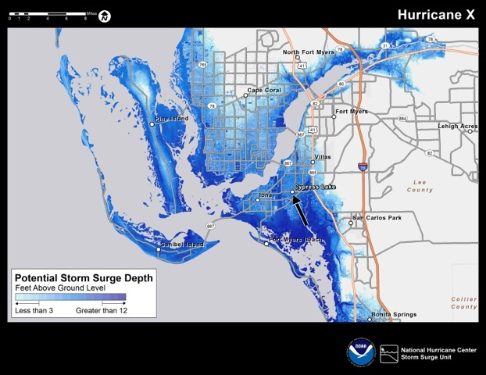
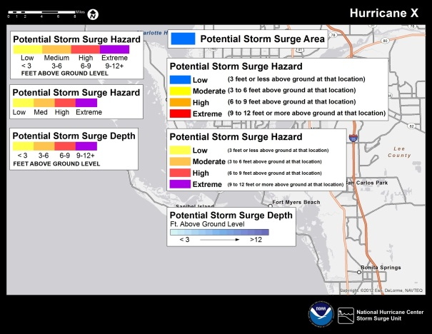
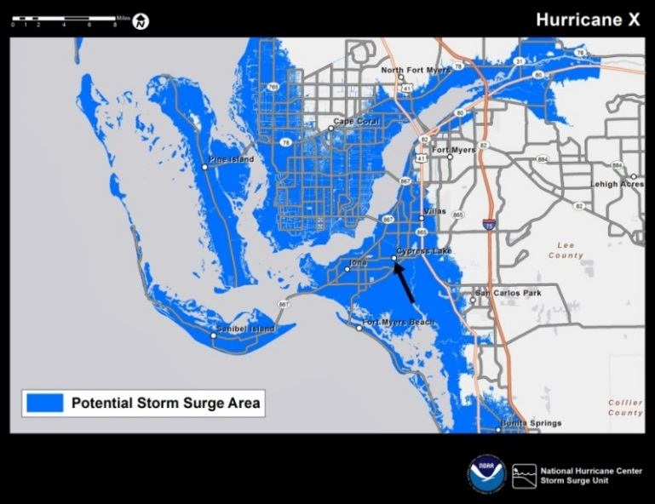
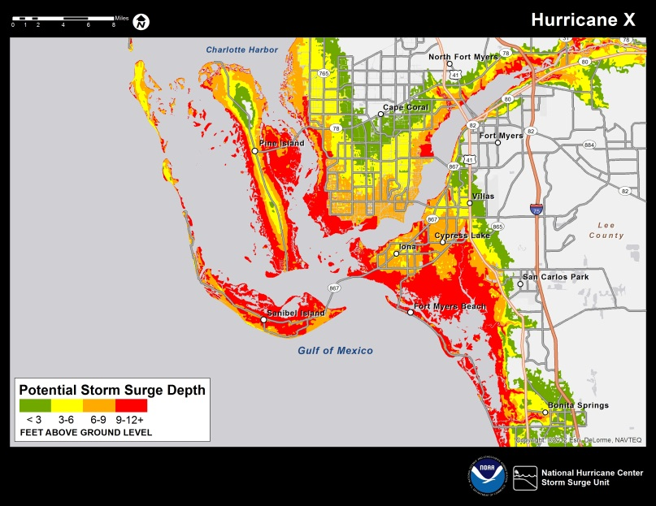
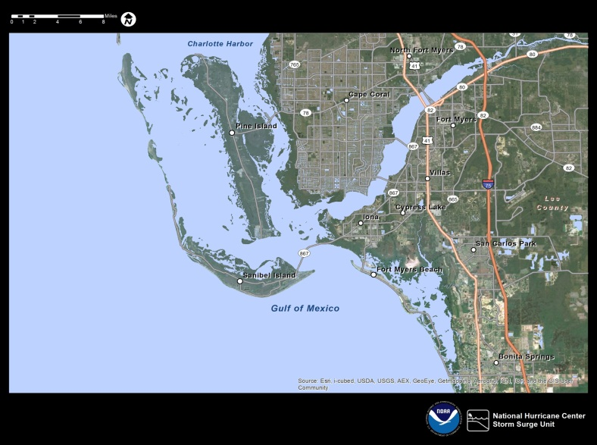
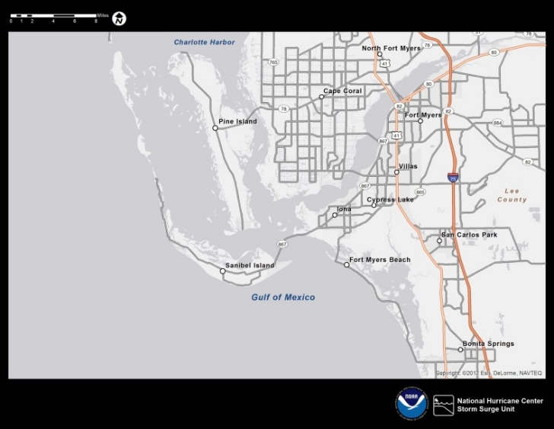
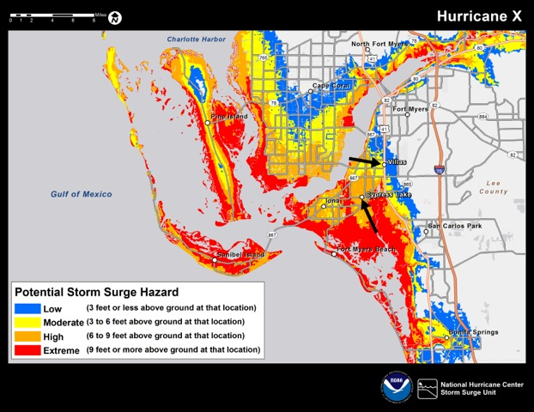
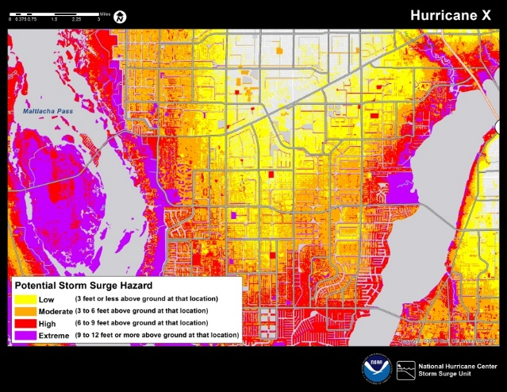
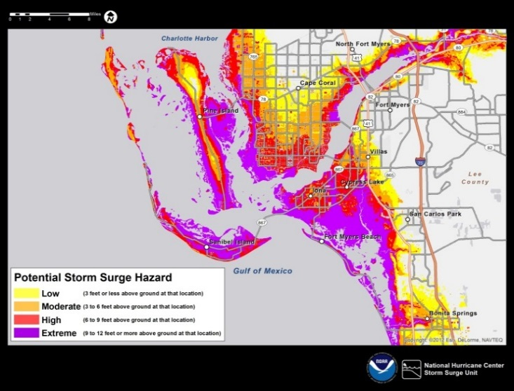

Slide 8
Customer Engagement
Interviews
Lee County,
FL
Citizens
Emergency Mangers
National Weather Service
FEMA
Discussions
Emergency Managers
National Weather Service
Interviews
Television
Booths,
Exhibits,
Polling
Emergency Mangers
Television
Citizens
6 Surveys
Emergency Managers
Television
National Weather Service
Public
18
Focus Groups
Emergency Mangers
Television
National Weather Service
Community Groups
Product Review
Emergency Managers
Television
2
Focus Groups
Community Members

Slide 9
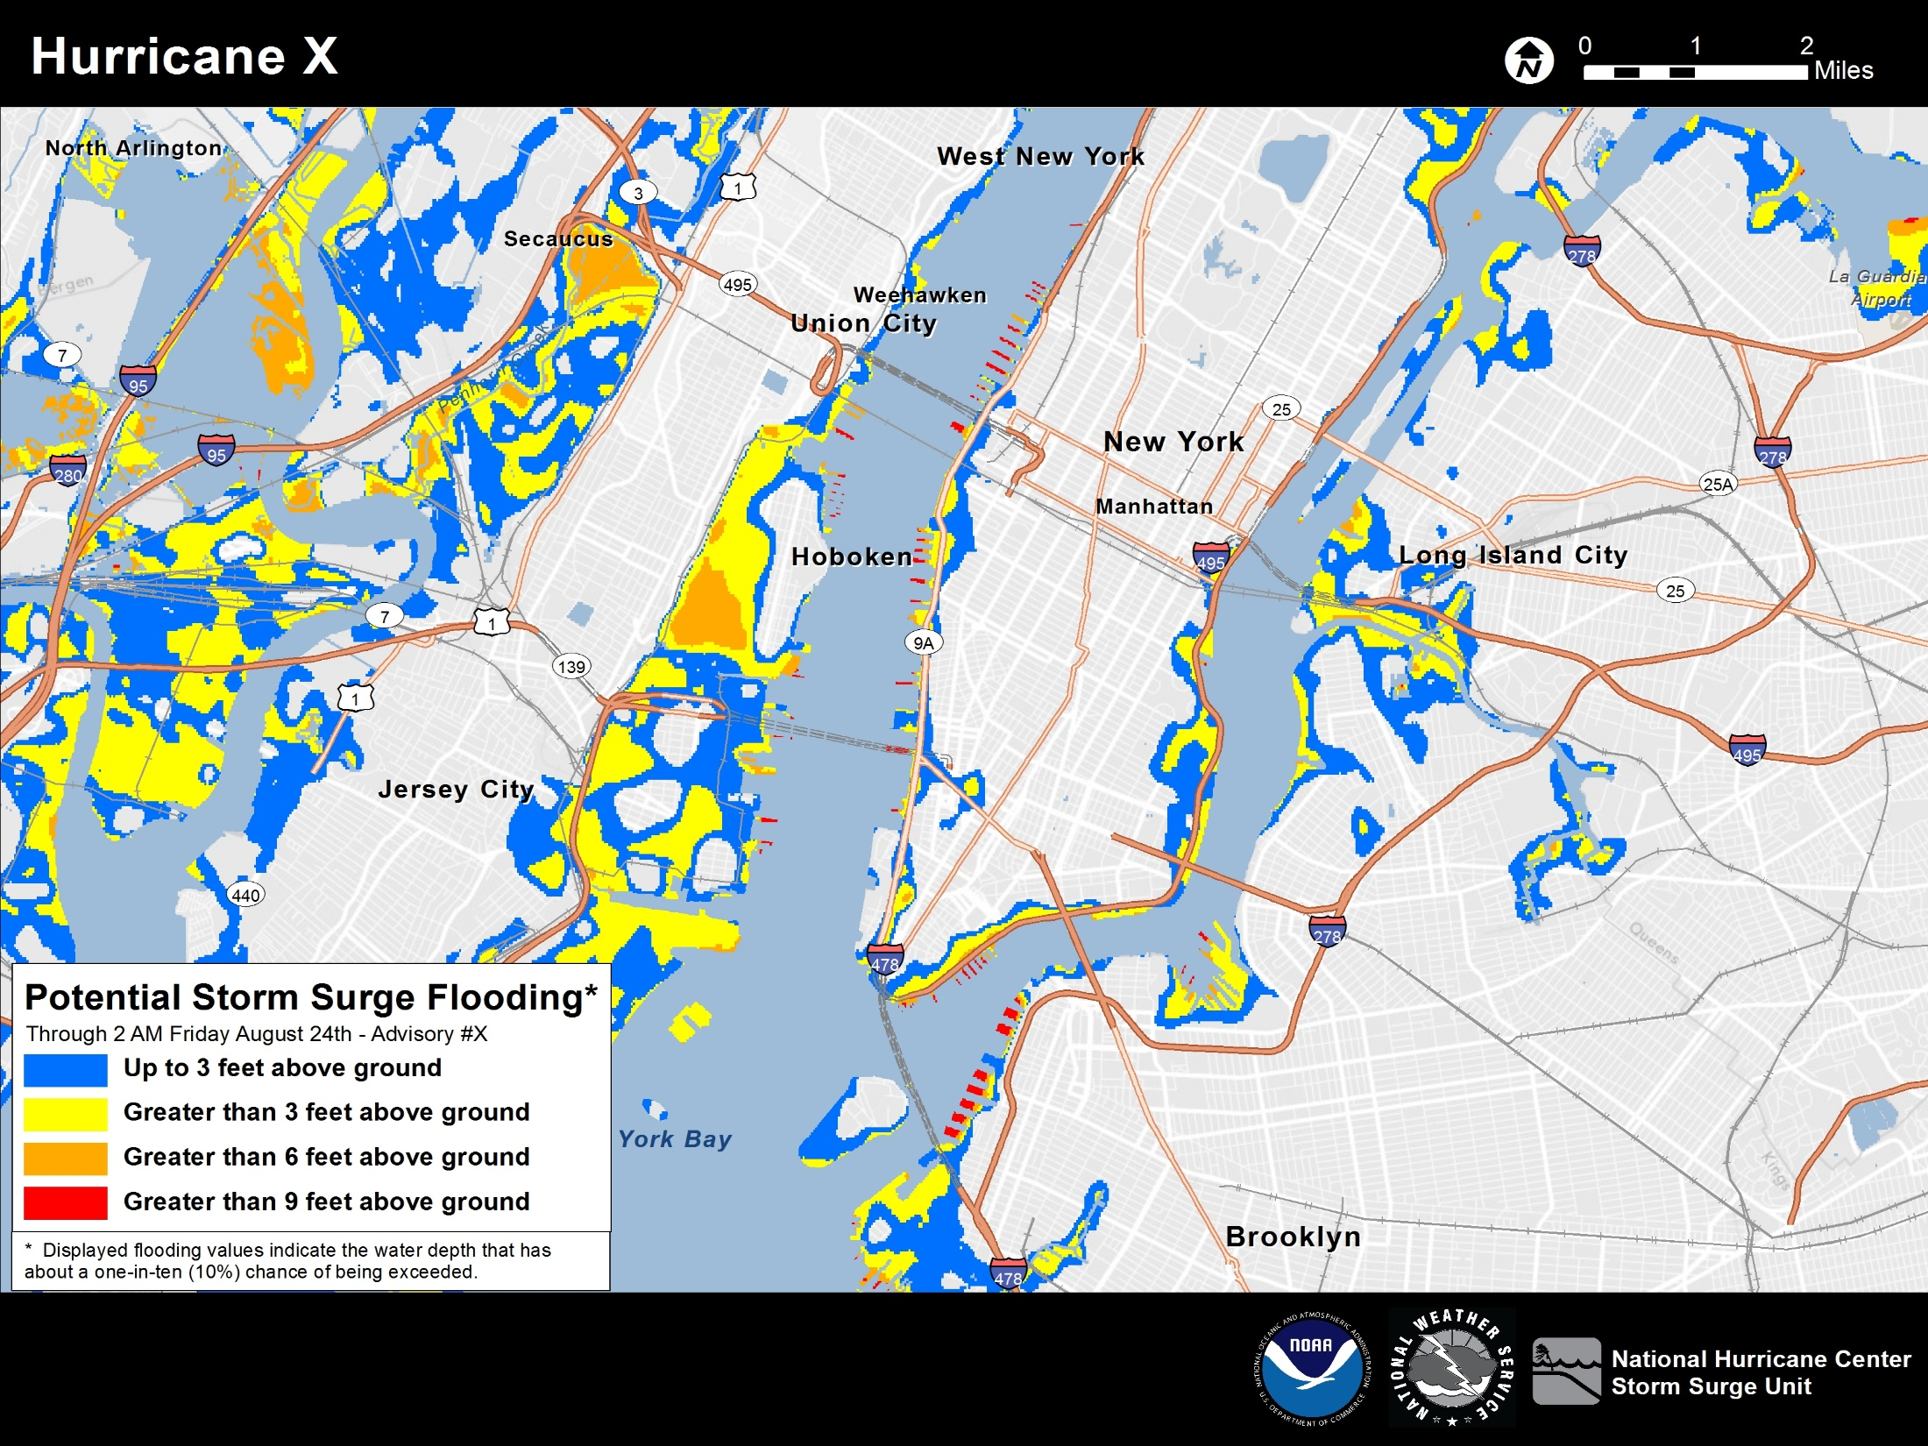

Slide 10
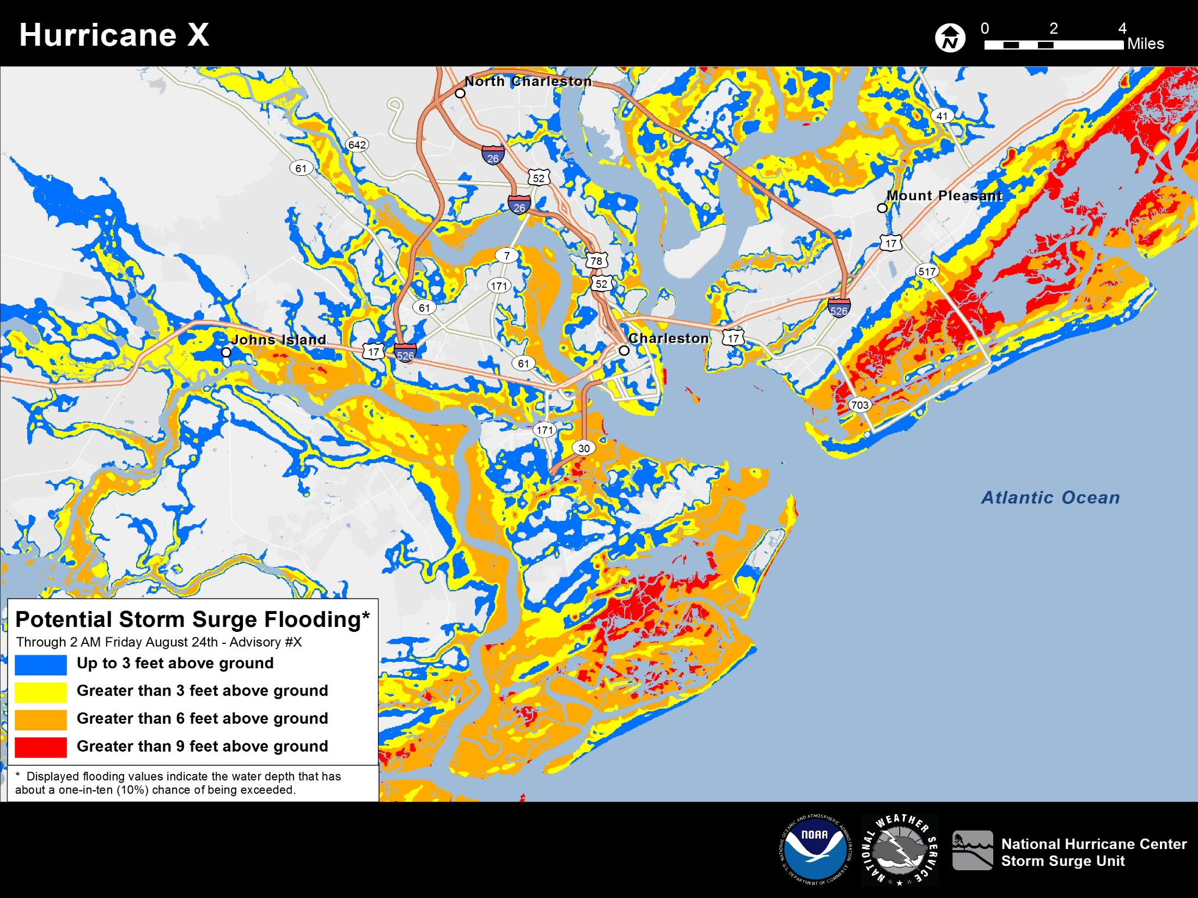

Slide 11
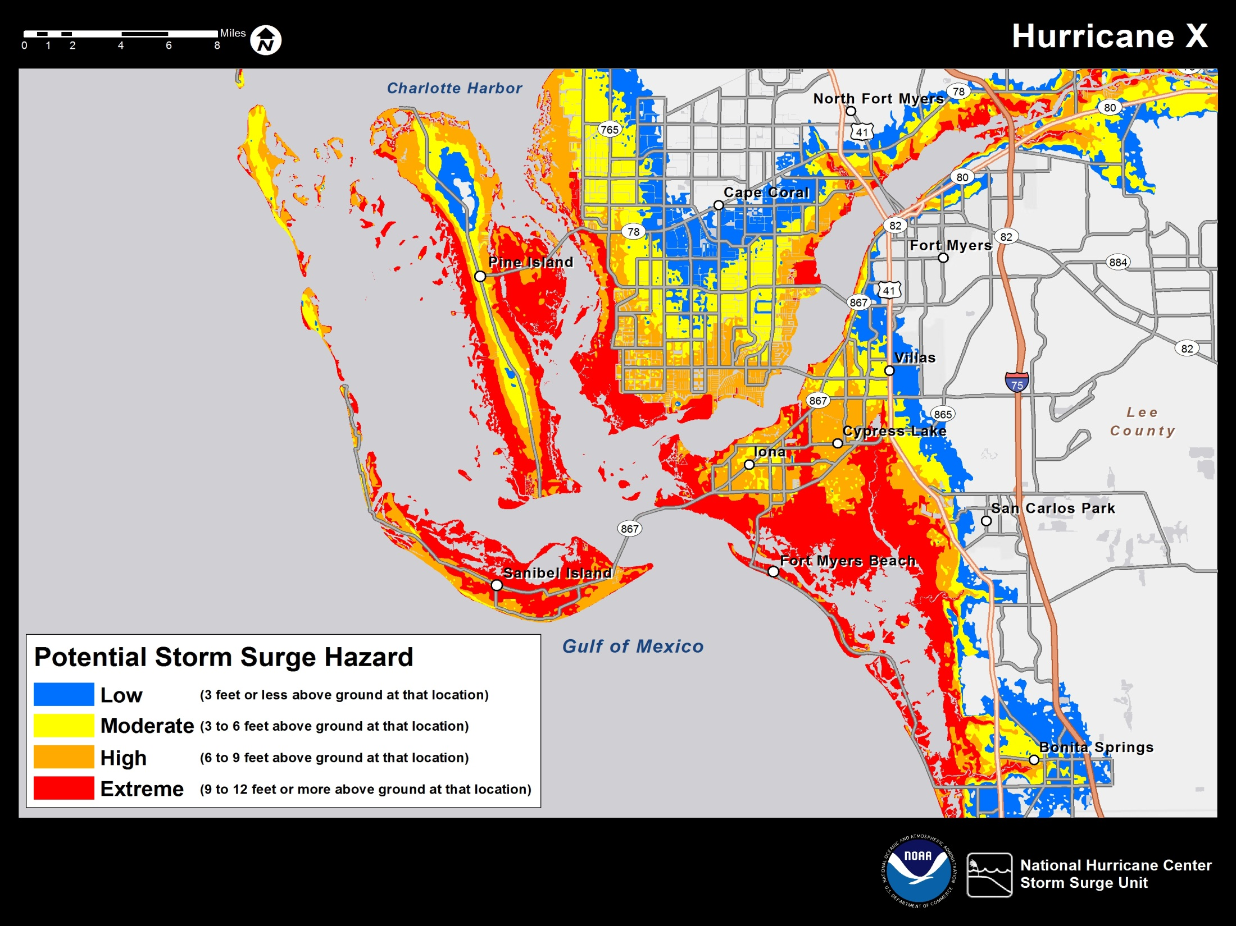

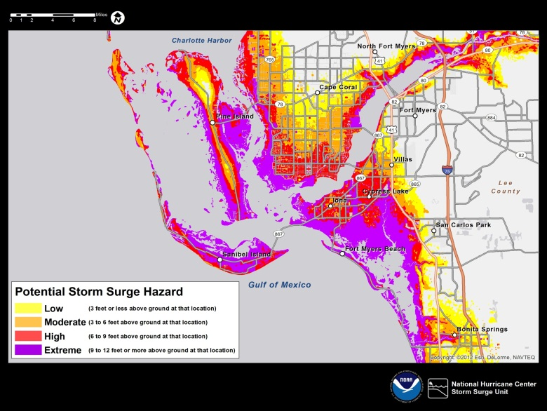

Slide 12
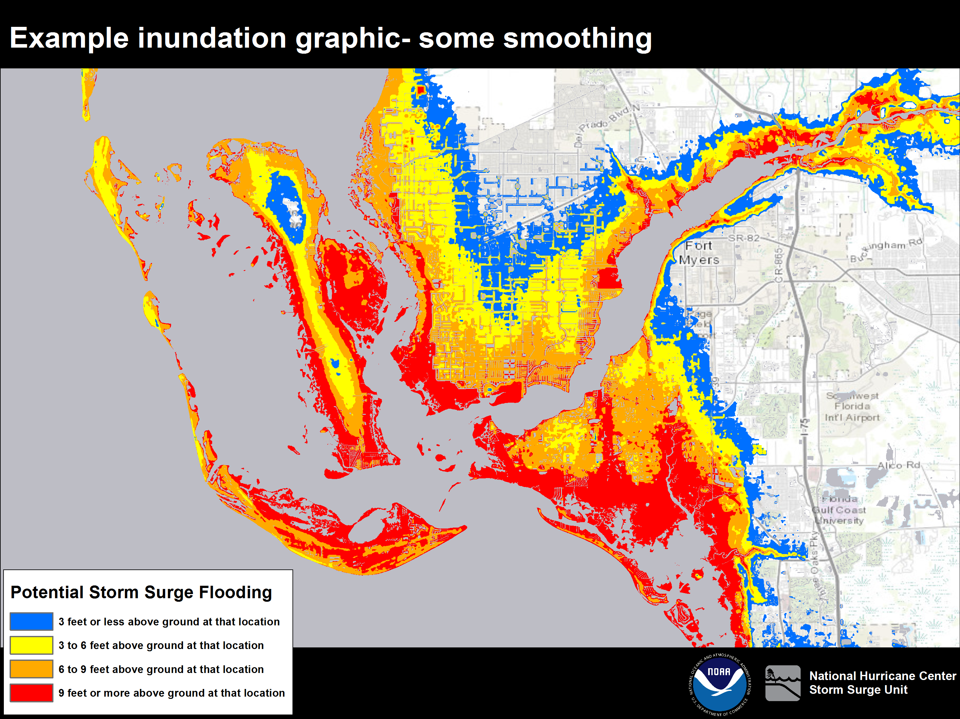
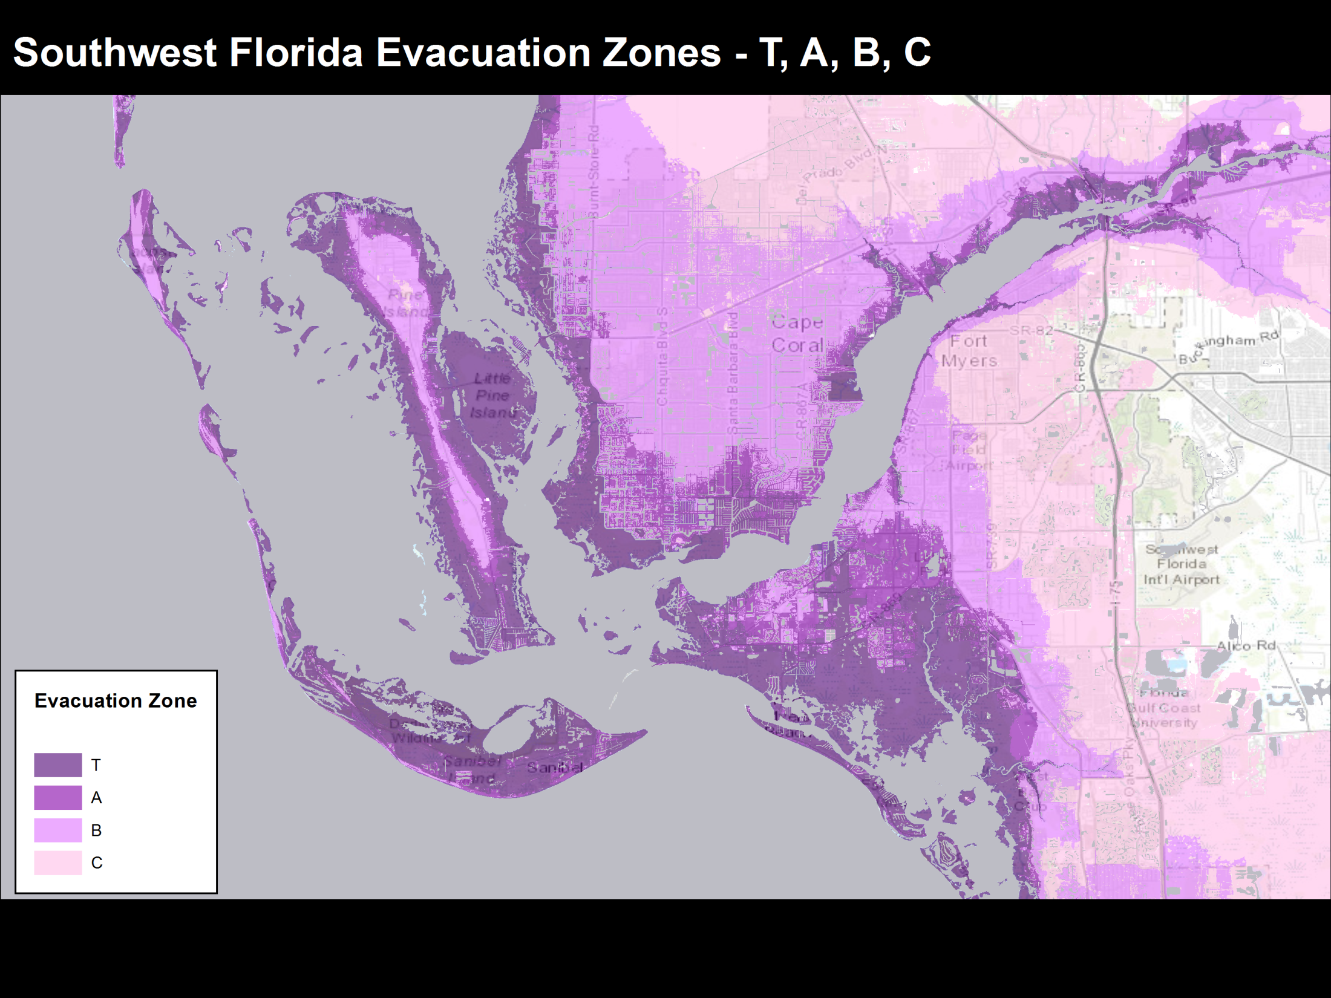

Slide 13
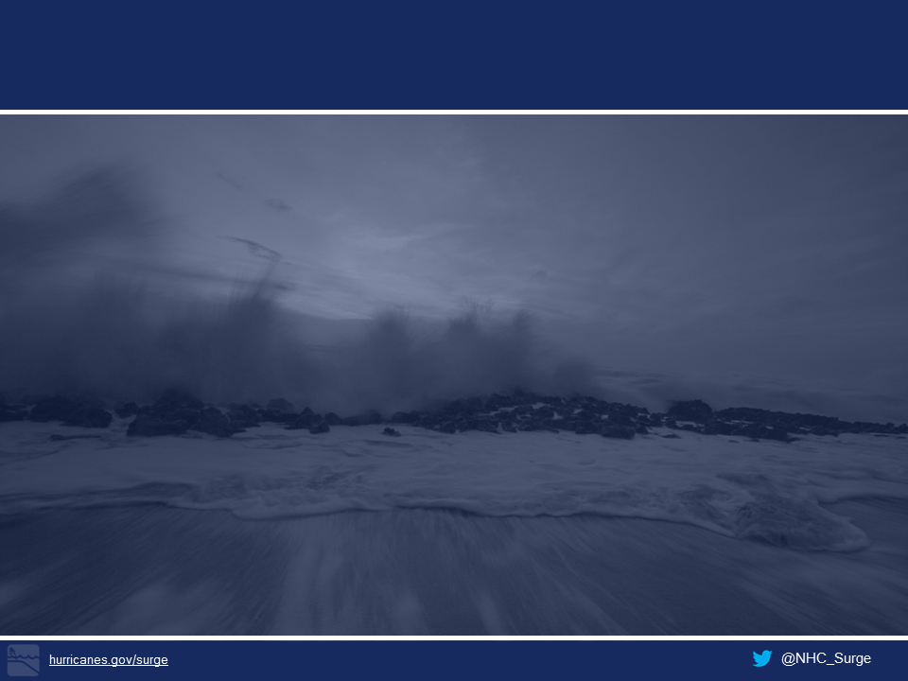
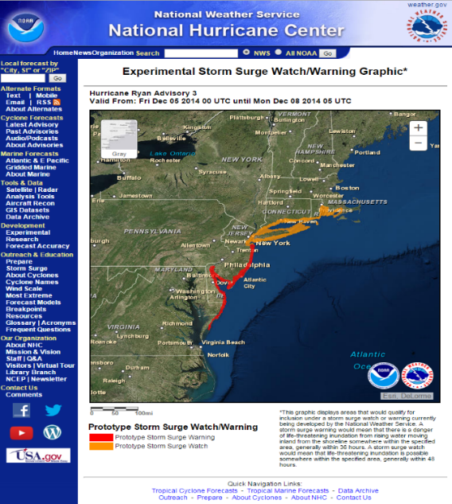
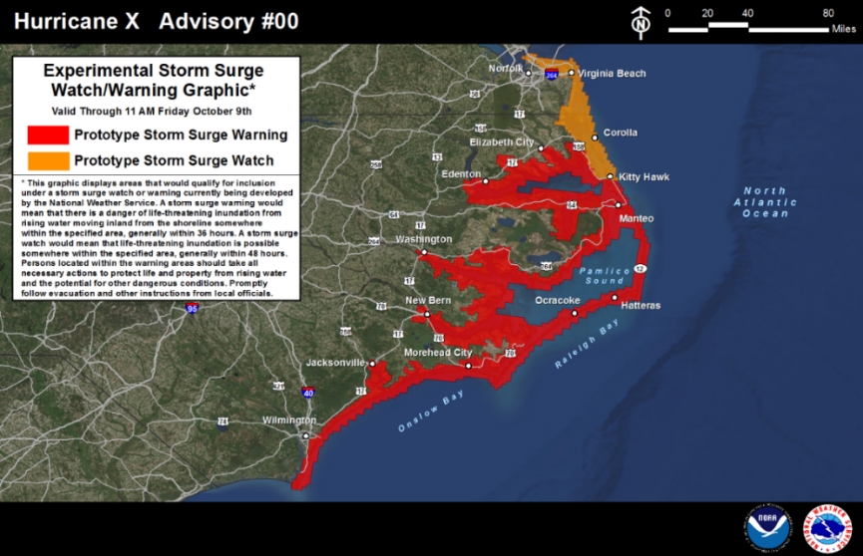
Storm Surge Watch / Warning
Phase 1: NWS storm surge watch/warning system debuts in 2015 via a prototype graphic.
Phase 2: Experimental Storm Surge Watch/Warning in NHC and WFO Tropical Cyclone Valid Time Event Code (TCV) introduced in 2016.
Phase 3: Storm surge watch/warning, including text products, TCV, graphics and gridded data, implemented operationally in 2017.

Slide 14
Storm Surge Watch / Warning
Meant to highlight areas of “life-threatening” coastal flooding thus enabling better evacuations
Based on probabilistic SLOSH guidance
  Current experimental criteria is 10% chance of 3 feet AGL
Same lead-times as existing hurricane warning
  Watch: 48 hours
  Warning: 36 hours
Complements the existing potential storm surge flooding map

Slide 15

NHC’s Storm Surge Unit
Jamie Rhome, Team Lead
Dr. Cristina Forbes
Dr. Brian Zachry
Tarah Sharon
William Booth
Nathan Hardin
Ethan Gibney
Cody Fritz
ncep.nhc.ssmia@noaa.gov
(305) 229-4448
hurricanes.gov/surge
@NHC_Surge

