Slide 1
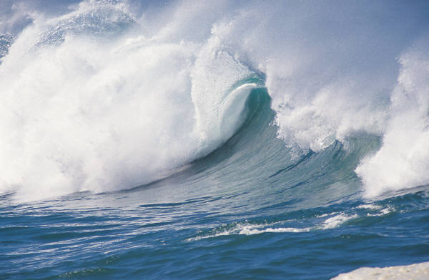

Coastal Flooding and Societal Impacts
Molly Mitchell
March 11, 2015
CAPITOL HILL BRIEFING: COASTAL FLOODING

Slide 2
Precipitation-driven flooding is influenced by…
Rainfall (amount and rate)
Topography
  water runs faster off steep ground and roofs)
Type of Soil
  how permeable
  how saturated
Developed and impervious land (roads and roofs)
Vegetation
  Marsh
  Forest
Size of watershed

Slide 3
Tidal and Storm surge flooding is influenced by…
Tidal cycles
Elevation
Storm Characteristics (pressure systems)
Natural shoreline
  Marsh
  Beach
Shoreline stability (erosion potential)
Local and global water levels

Slide 4
Flood Sources
Changing Conditions
Floodplain Occupancy
Rainfall &
Snowmelt
Extreme Tides
Storm Surge
Development
Storm Frequency/ Intensity
Sea Level Rise
Infrastructure
Residences
Businesses
Agriculture
People
Risk
Vulnerability
Flood damage

Slide 5
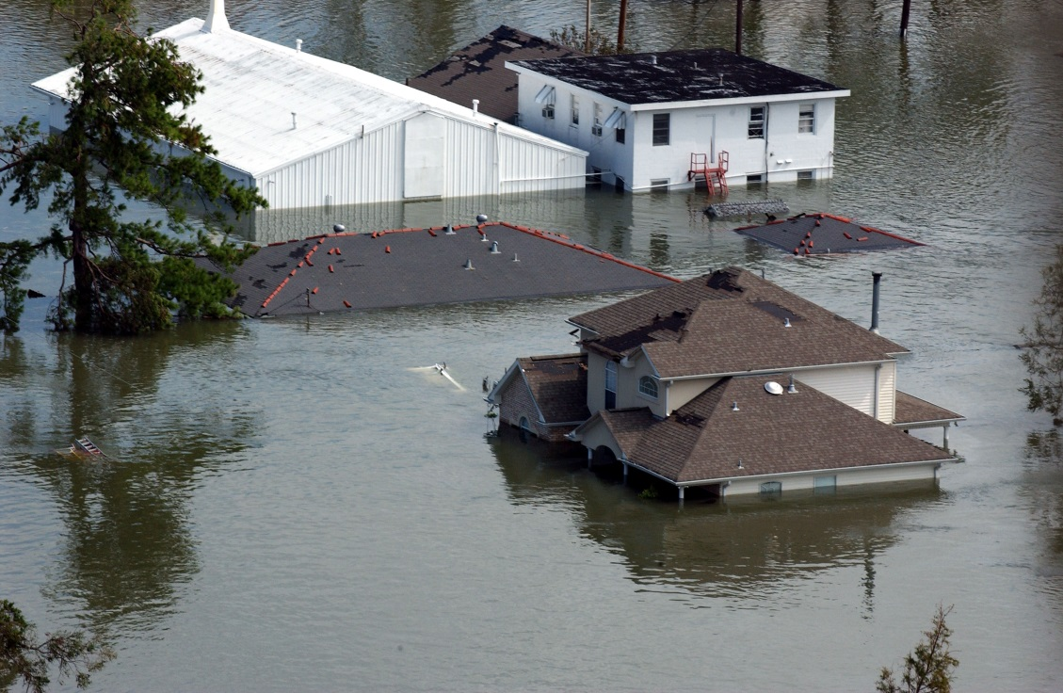
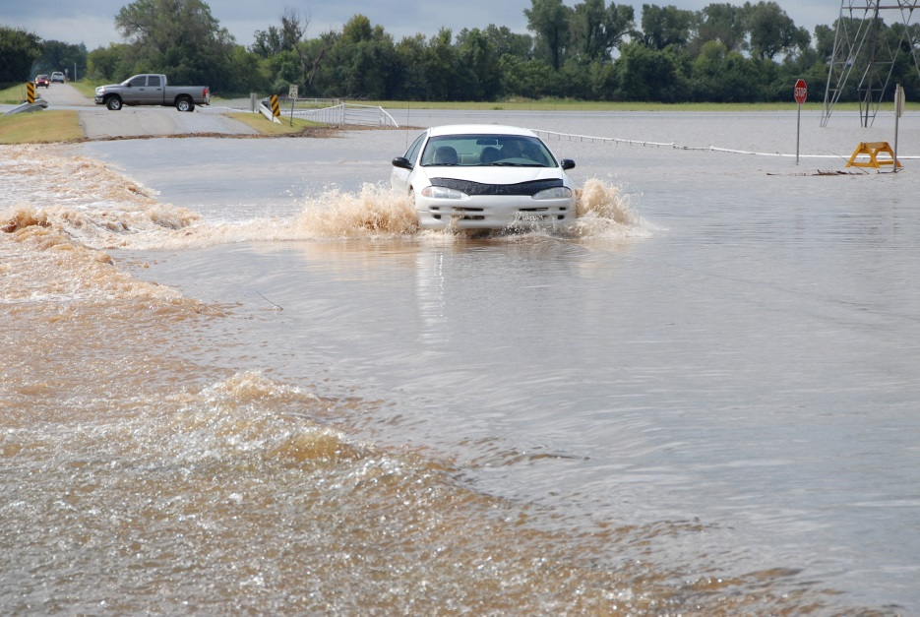
Two main types of flooding
Nuisance flooding
  Damage per event $
  Frequency ✔✔✔
Storm Surge
  Damage per event $$$
  Frequency ✔
Photo by Marvin Nauman/FEMA
Photo by Jocelyn Augustino/FEMA

Slide 6
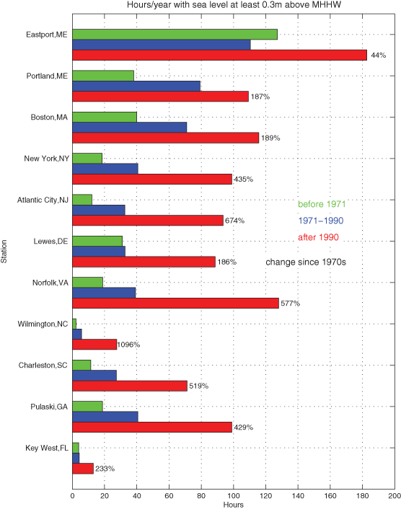
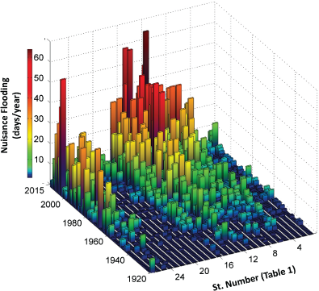
Changes in Nuisance flooding
Sweet, W. V. and Park, J. (2014) From the extreme to the mean: Acceleration and tipping points of coastal inundation from sea level rise
Ezer, T. and Atkinson, L. P. (2014), Accelerated flooding along the U.S. East Coast: On the impact of sea‐level rise, tides, storms, the Gulf Stream, and the North Atlantic Oscillations.
Earth's Future
Volume 2, Issue 12, pages 579-600, 18 DEC 2014 DOI: 10.1002/2014EF000272
http://onlinelibrary.wiley.com/doi/10.1002/2014EF000272/full#eft254-fig-0003
Earth's Future
Volume 2, Issue 8, pages 362-382, 11 AUG 2014 DOI: 10.1002/2014EF000252
http://onlinelibrary.wiley.com/doi/10.1002/2014EF000252/full#eft240-fig-0005

Slide 7
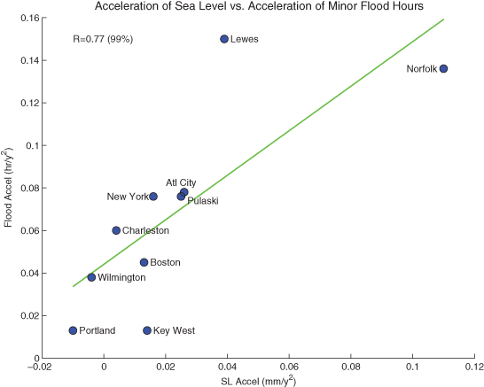
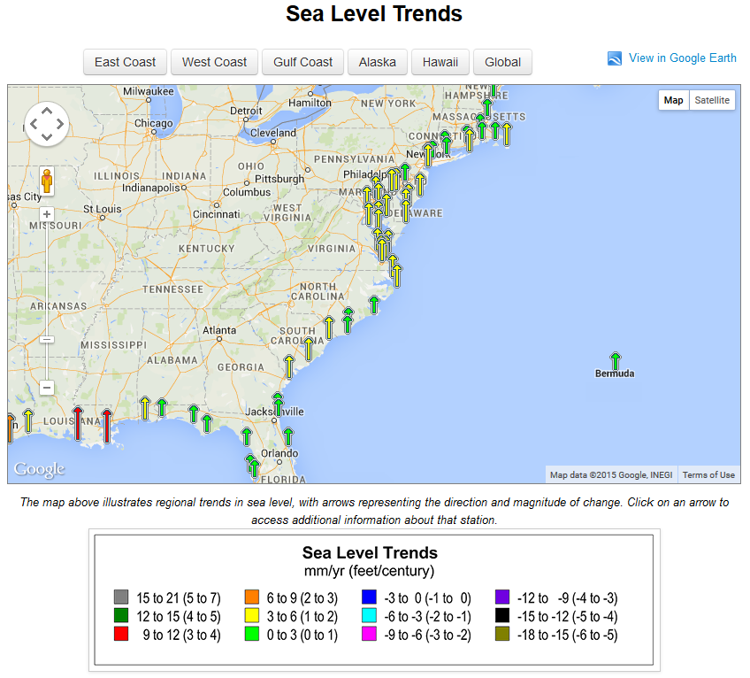
Sea level changes are one driver of increased nuisance flooding
Ezer, T. and Atkinson, L. P. (2014), Accelerated flooding along the U.S. East Coast: On the impact of sea‐level rise, tides, storms, the Gulf Stream, and the North Atlantic Oscillations.
Earth's Future
Volume 2, Issue 8, pages 362-382, 11 AUG 2014 DOI: 10.1002/2014EF000252
http://onlinelibrary.wiley.com/doi/10.1002/2014EF000252/full#eft240-fig-0006
http://tidesandcurrents.noaa.gov/sltrends/sltrends.html

Slide 8
In the mid-Atlantic, between ~900,000 and 3,400,000 people (~3-10 % of the total coastal population) live on low-lying land.
Rising Sea Level and More Severe Storms Threaten Eastern Seaboard. EPA Assessment of Climate Change Impacts on Mid-Atlantic Coast Released Friday, Jan. 1
https://www.fema.gov/statistics-calendar-year/loss-dollars-paid-calendar-year
Flooding and flood losses are increasing
Increases are expected to continue

Slide 9
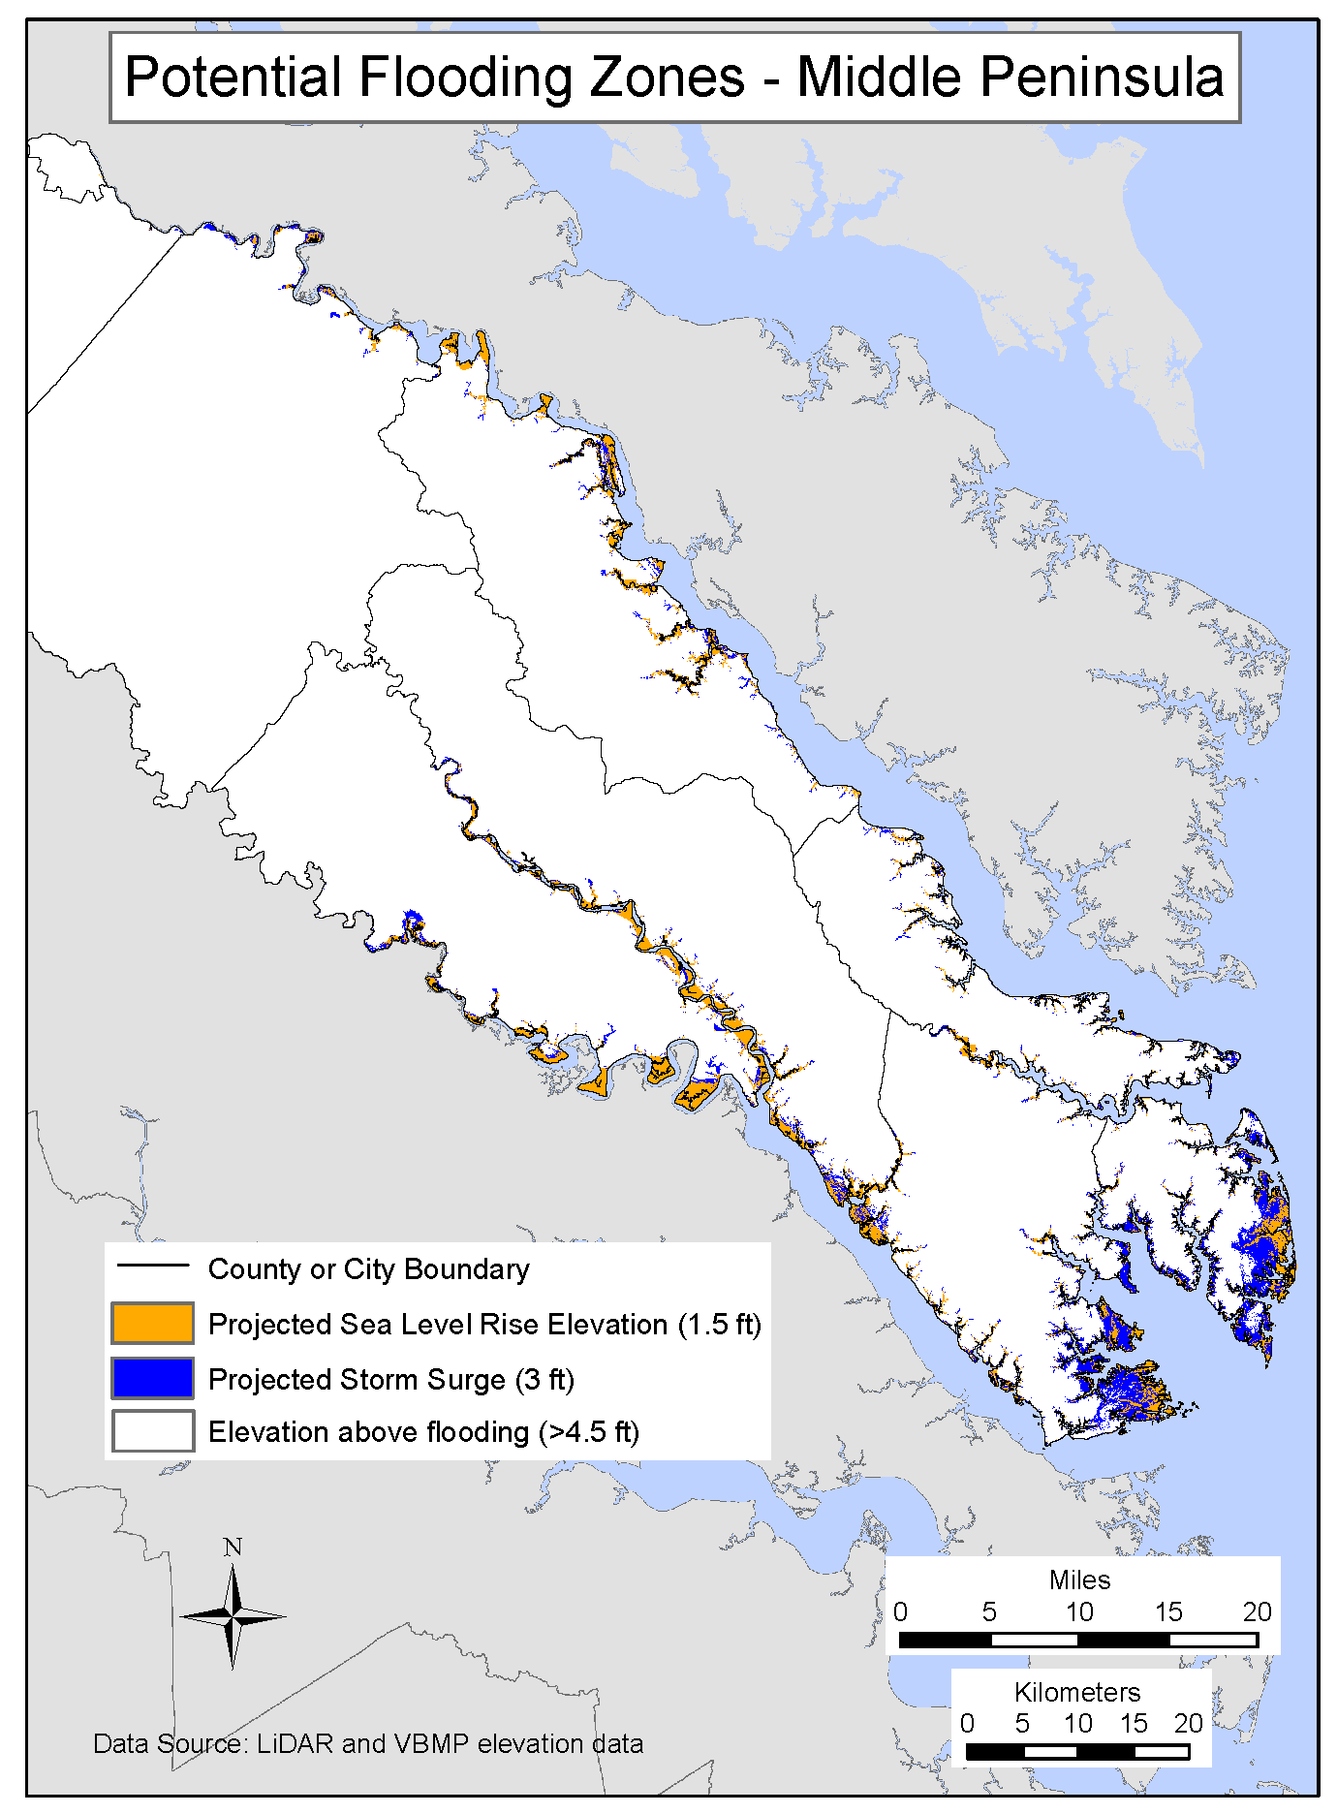
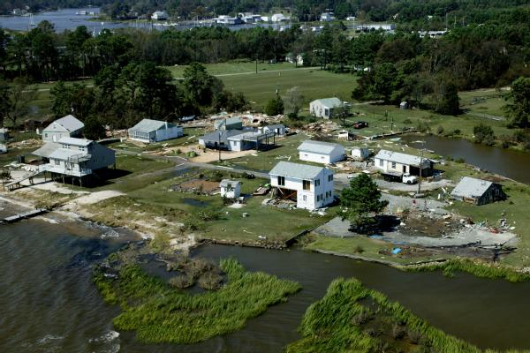
Impacts to infrastructure
(houses, roads, tunnels, rails, airports)
Locality | Vulnerable land (sq. mi)
Accomack | 208
Northampton | 186
Virginia Beach | 60
Chesapeake | 25
Gloucester | 24
Mathews | 17
James City | 14
King William | 14
Locality | Vulnerable land (sq. mi)
Poquoson | 11
York | 9
Newport News | 8
Hampton | 8
Portsmouth | 5
Norfolk | 4
Others (collective) | 53
Photo by Andrea Booher/FEMA News Photo

Slide 10
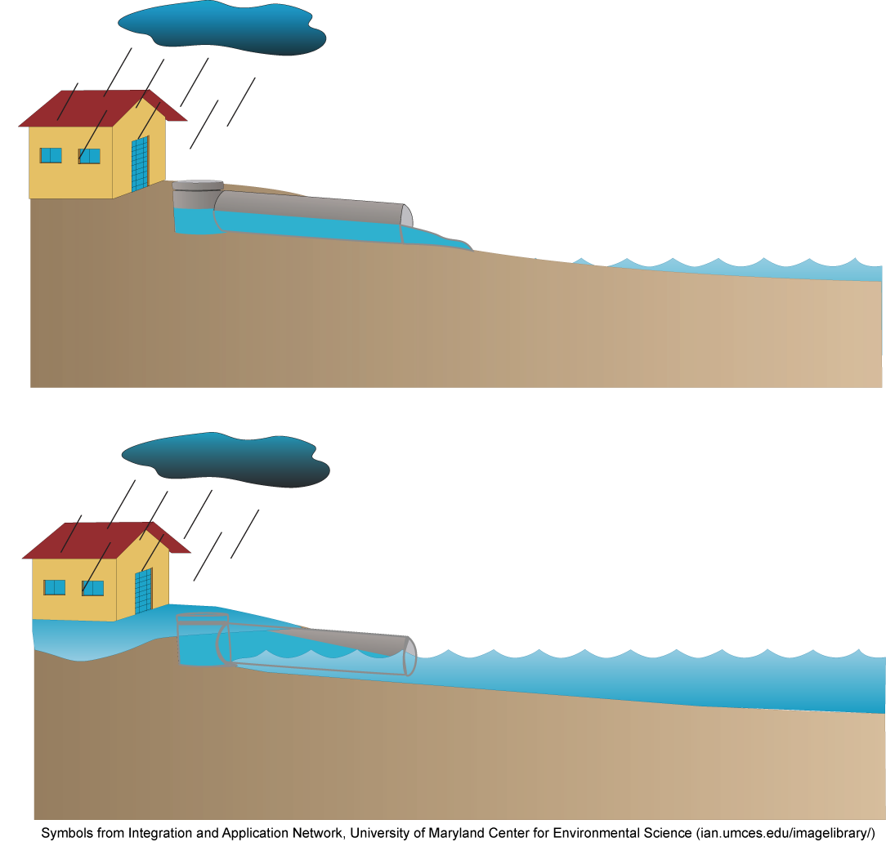
Reduced capacity of stormwater systems &
Increased wastewater overflows
Stormwater drainage outfalls at low elevation may be flooded during high tides or storm surges.
This prevents the pipes from draining, stormwater backs up and flooding occurs.

Slide 11
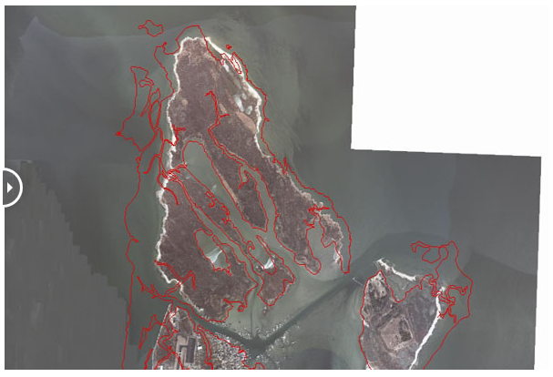
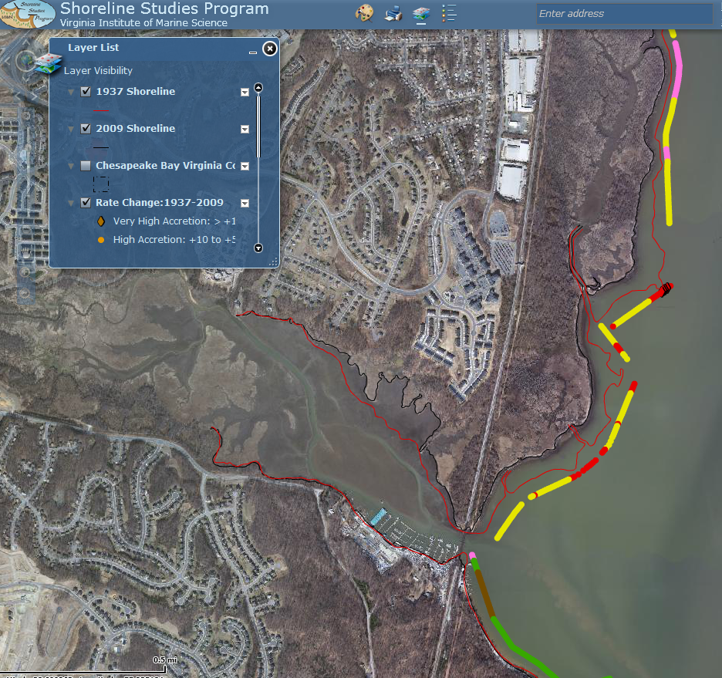
Increased shoreline erosion & Loss of ecosystems
tidal freshwater systems, barrier islands, bay islands, and shallow water habitat
Prince William County, Occoquan Bay
1938
Tangier Island - The Uppards in Accomack County
To learn more about shoreline erosion:
VIMS Shoreline Studies Program
http://web.vims.edu/physical/research/shoreline/GISData/Flexviewer/SSP_for_web/

Slide 12
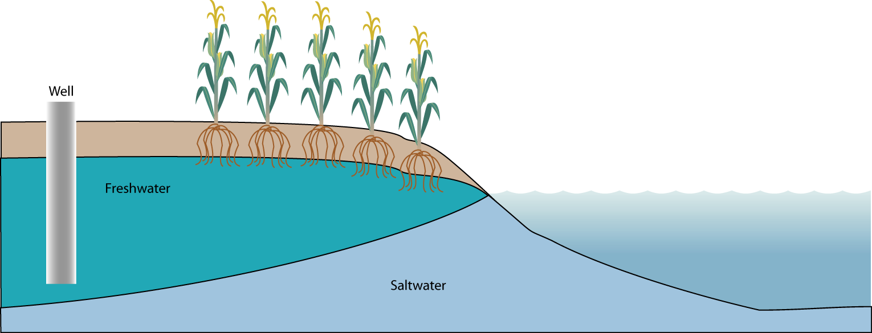
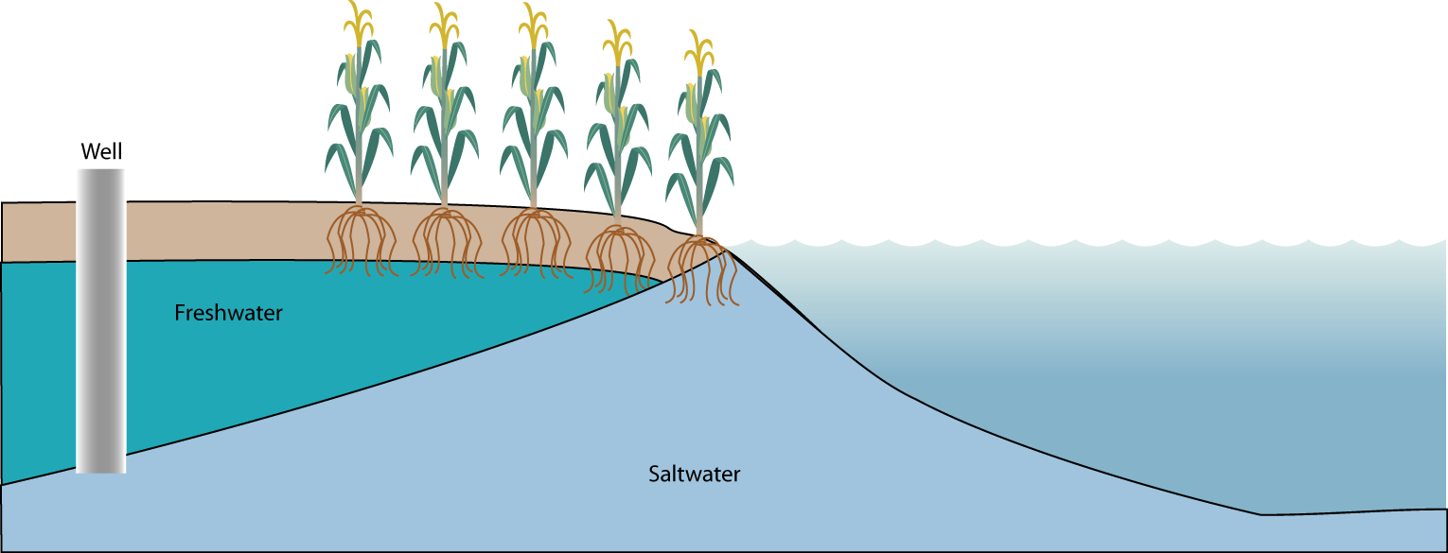
Saltwater intrusion into drinking water and agricultural fields

Slide 13
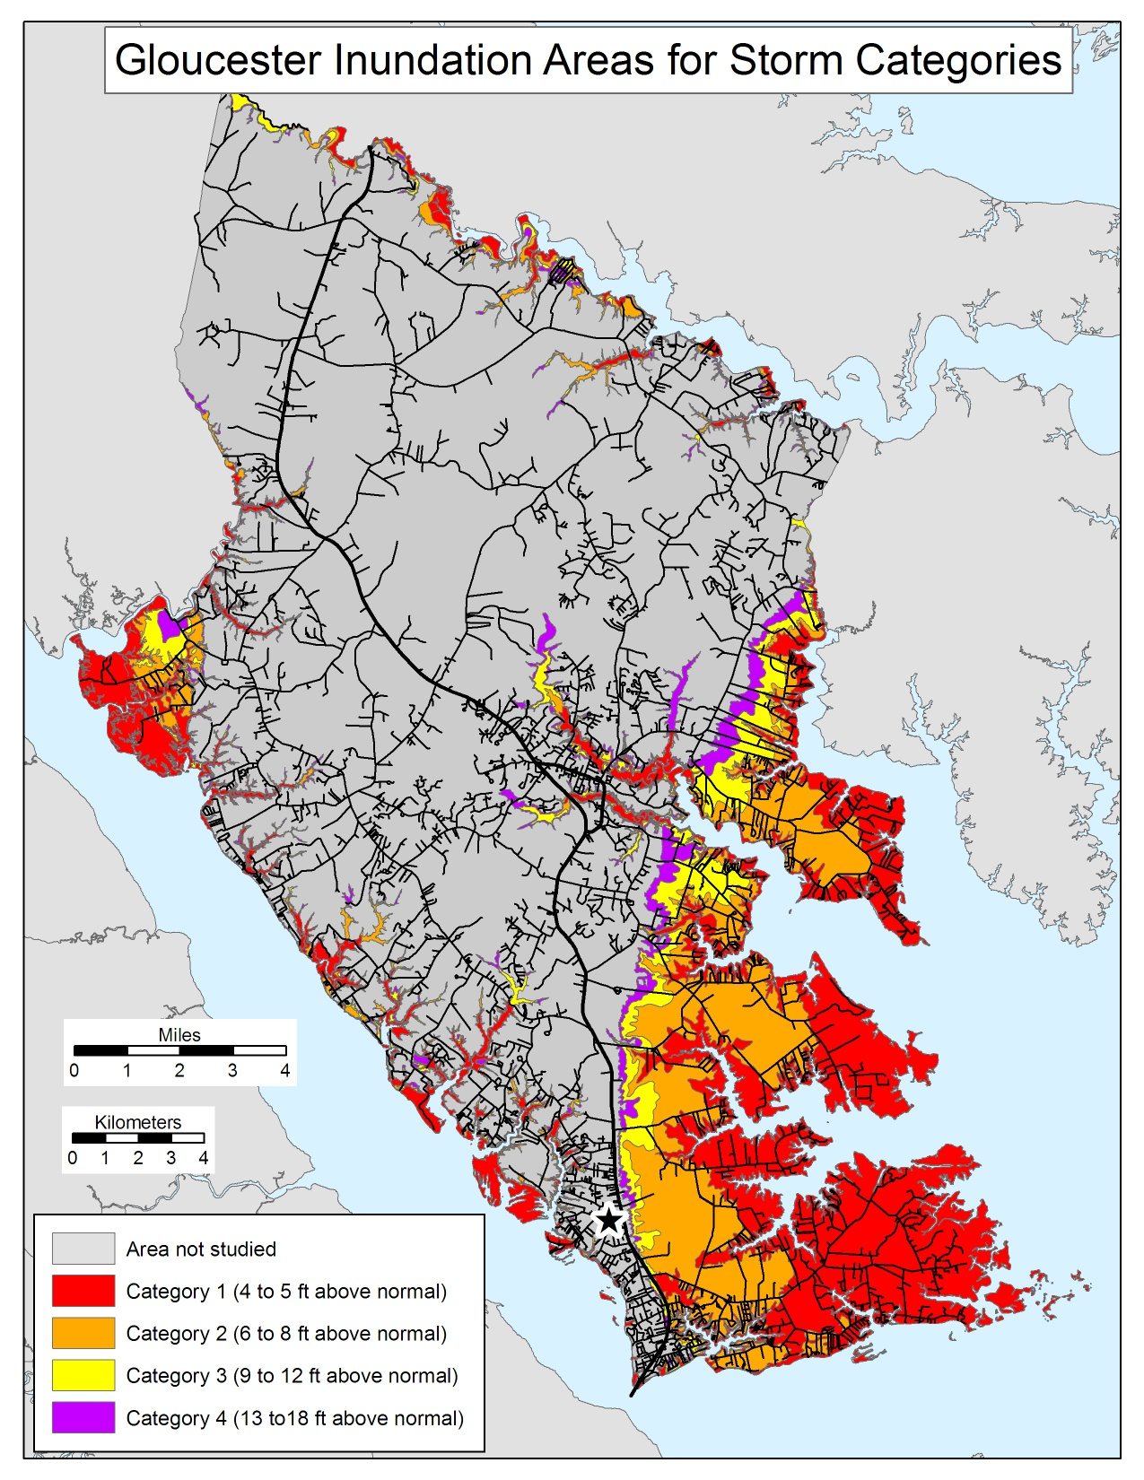
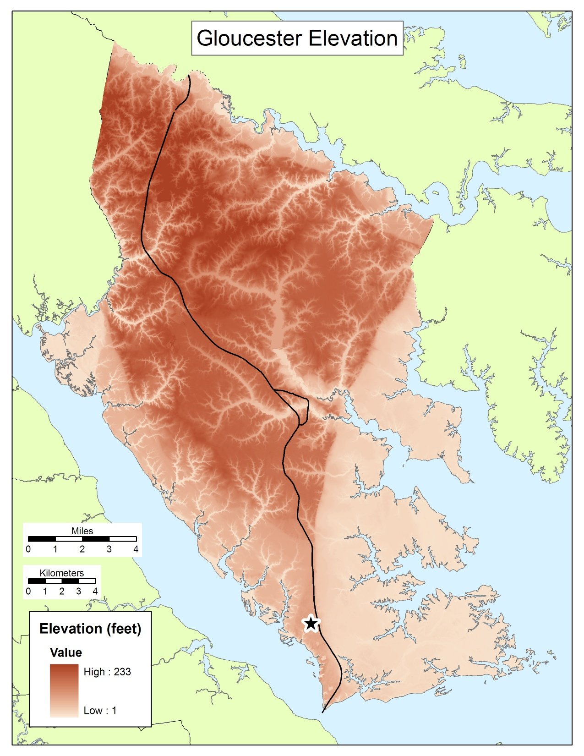
Impacts to evacuation routes and other emergency measures
Notice the number of flooded roads

Slide 14
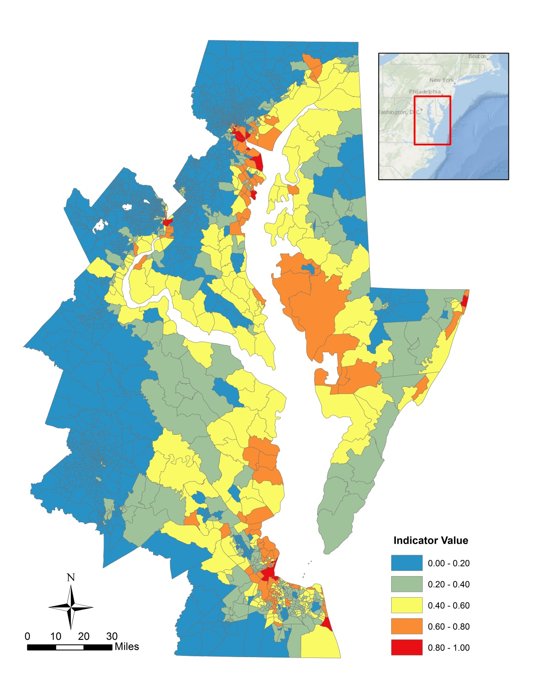
Physical vulnerability by census tract
elevations below 10 ft
+
volume to surface area ratios
+
Land cover below 10 ft
+
Fetch
+
Low
Tide Range
High

Slide 15
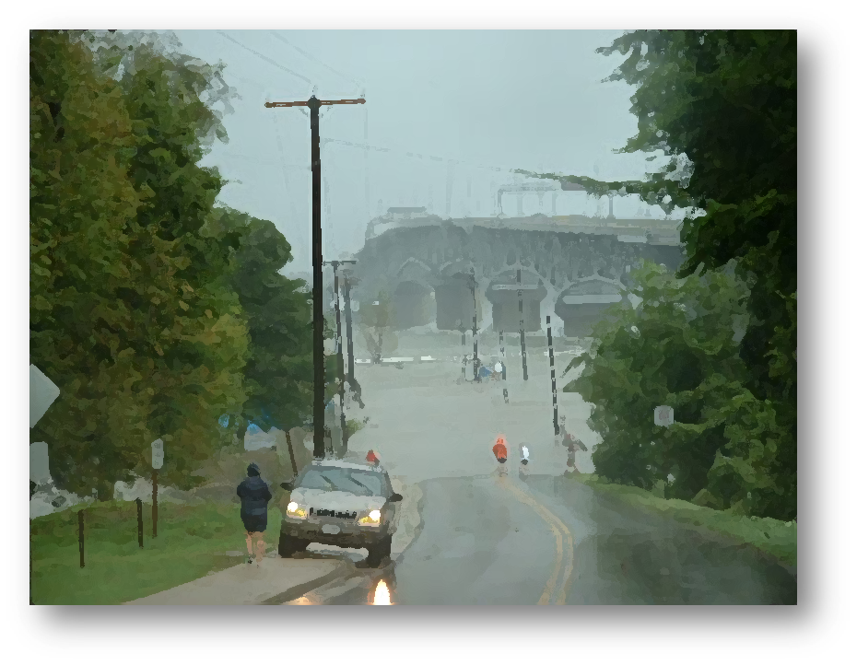
Thank you

