Slide 1
New York State Flooding and Mitigation
American Meteorological Society Policy Program
Inland Flooding Briefing
May 6, 2015

Slide 2
State Hit Hard by Larger than 100-Yr Floods
June 2006 Tropical System (Not a Tropical Storm)
  Near or Over 500 Year Floods: Delaware, Susquehanna and Mohawk Basins
Spring 2011, Snow Melt and Rain
  Over 100 Year Floods, Upper Hudson and Lake Champlain Basins; Lake Champlain hit Record Levels
August 2011: Irene
  Near or Over 500 Year Floods: Upper Hudson, Schoharie, Catskill Streams, Lake Champlain Tributaries
September 2011: Lee
  Over 100 Year Floods, Susquehanna Basin; 500 Year Mohawk Basin

Slide 3
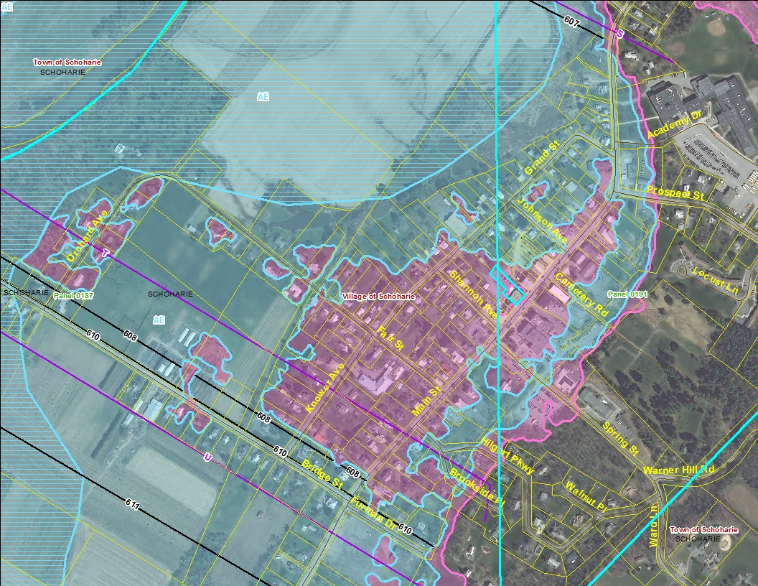
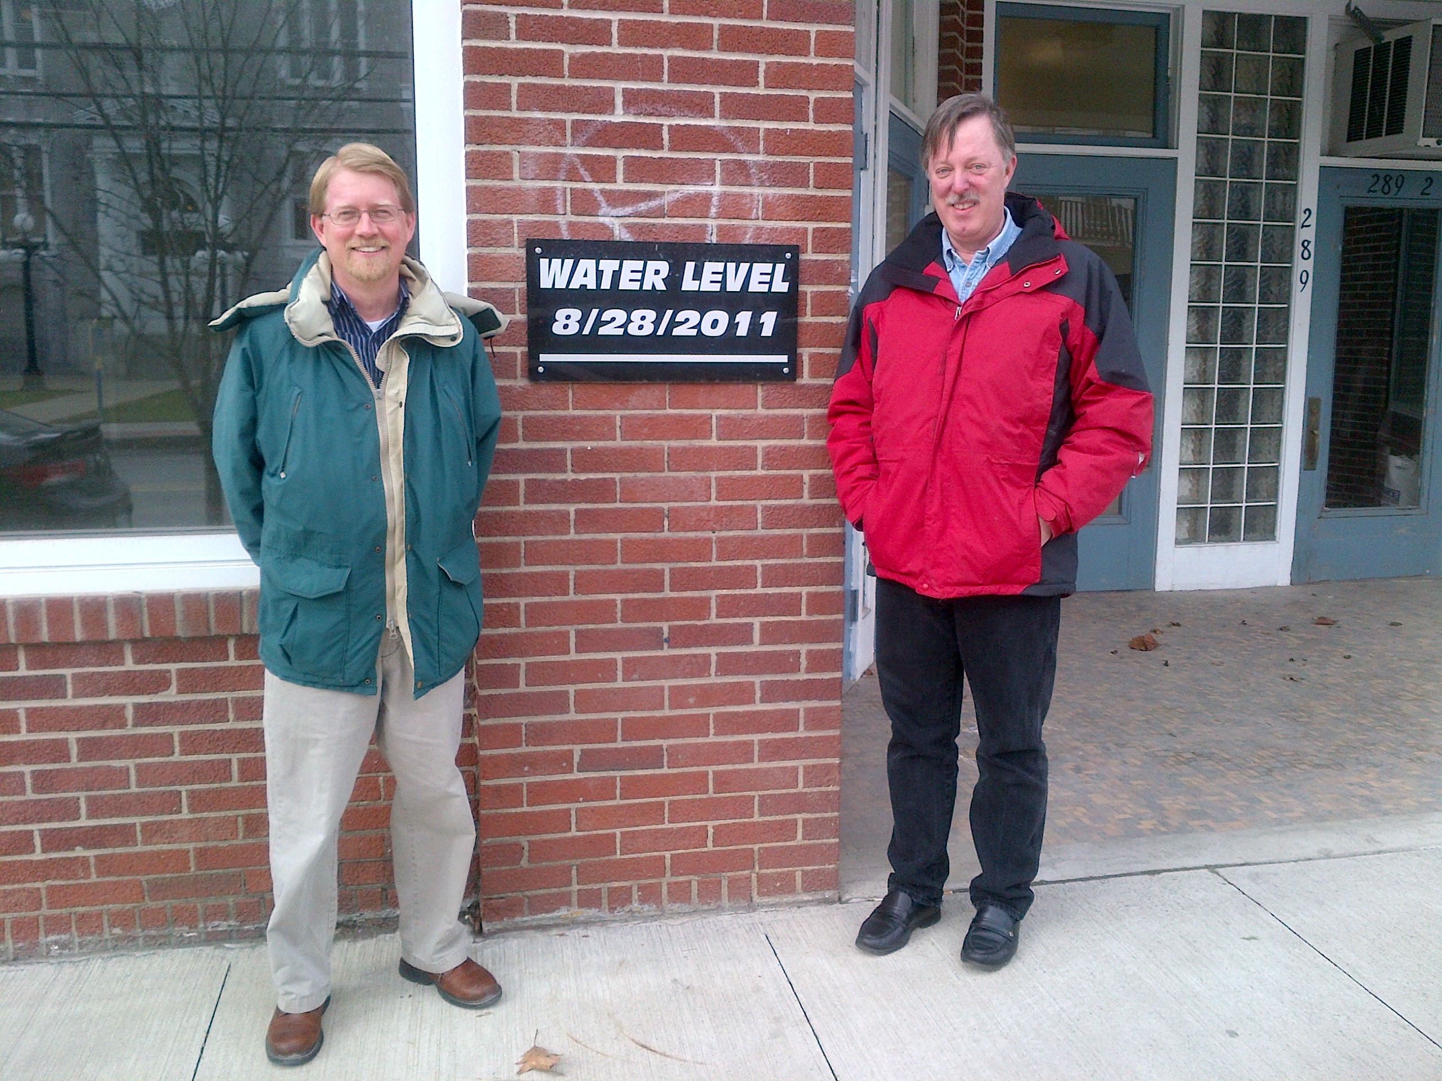
High Water Mark, Main Street, Schoharie

Slide 4
Irene’s Path of Destruction

Slide 5
Irene’s Destruction was Widespread

Slide 6
Lee: Insult on top of Injury

Slide 7
25yr-50yr
50yr-100yr
100yr-200yr
200yr-500yr

Slide 8
Post Floods: Multitude of Responses
Local Municipalities
NYS Department of Environmental Conservation
  Coordinates Floodplain Management Response
NYS Department of State
  Lead on Community Planning
NYS Office of Emergency Management
  Emergency Response and FEMA Mitigation Programs
NYS Department of Housing and Economic Development
  HUD CDBG Funded Programs
FEMA
COE
HUD
NOAA

Slide 9
NYS Office of Storm Recovery
Overall Coordination
Funding for Communities hit by Irene, Lee or Sandy
Four Programs
Housing Recovery
  Includes Home Elevations and Buy-Outs
  Elevations to Base Flood Elevation + 2’
  Use Best Available Mapping Data
Small Business
Community Reconstruction
Infrastructure

Slide 10
Innovative Mitigation
NY Rising Community Reconstruction Program
Gov. Office of Storm Recovery
NY RISING
Housing Recovery
Small Business
Community Reconstruction
Infrastructure
Planning Grants: $25 million; 124 Communities
  Public Engagement
  Asset Inventory
  Risk Assessment
  Needs and Opportunities Assessment
  Investment and Action Strategies
  Implementation Schedule
$3 million to $25 to million to each Community for project implementation

Slide 11
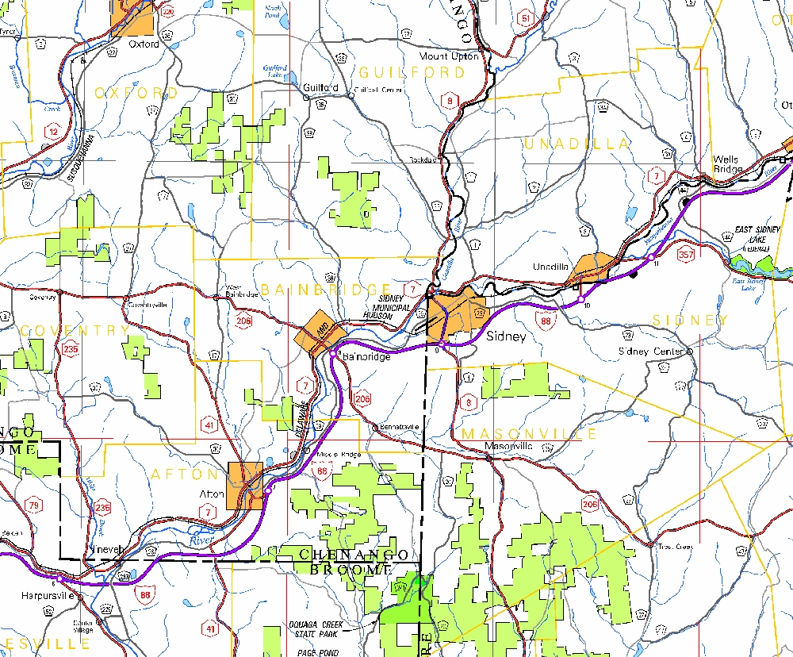
One Innovative Plan: Sydney, NY

Slide 12
Sidney Risk Areas

Slide 13
Sidney Plans
Create a Vital New Neighborhood Away from Flood Risk
165 Acre Parcel for $1.3 million
Extend Municipal Infrastructure for $2 million
Buyouts and Relocation Assistance for $3 million
Develop Community Housing for $41 million
Develop Community Facilities for $5.8 million
  Use Green Building, Green Energy Solar Microgrid
Develop Recreation and Flood Storage on 30 acre lower terrace: $4.1 million

Slide 14
Sidney Flood Mitigation Plans
Design 140 Acre GreenPlain
Passive Recreation, Trails, Edible Forest, Wetland Walks, Picnic Areas, Riverwalk and Active Recreation
Develop Sidney Waterfront Entertainment, History and Environmental Education Center

Slide 15
NYS Community Risk and Resiliency Act
Signed into Law 9/22/14
Requires sea-level rise projections by January 1, 2016 Adds consideration of sea-level rise, storm surge and flooding to NYS Smart Growth Public Infrastructure Policy Act criteria
Requires model local laws to enhance resiliency
Requires consideration of sea-level rise, storm surge and flooding in specified facility-siting regulations, permits and funding programs
Requires guidance on implementation and use of natural resiliency measures to reduce risk by January 1, 2017 (DEC, DOS)
Notes:
DEC, no later than January 1, 2016 to adopt regulations establishing science-based state sea level rise projections.
DOS, in consultation with DEC, to prepare model local laws concerning climate risk including sea level rise, storm surges and flooding, and to make such model laws available to municipalities
DEC, in consultation with DOS to develop guidance on implementation of the law and additional guidance on the use of resiliency measures
that utilize natural resources and natural processes to reduce risk
And requires consideration of future risk due to sea-level rise, storm surge and flooding in several specific permitting and funding programs:

Slide 16
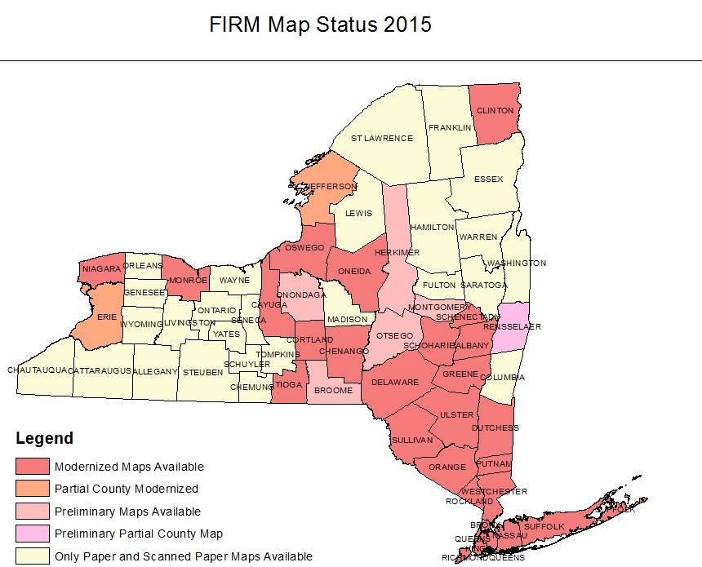
Good Flood Maps needed for Good Plans
NYS Flood Mapping Status
Half of State Has Old Paper Maps
  Up to 40 Years Old
  “Modernized Maps”
  90% of Population
  50% of Land Area
  2 Million People in Communities that Rely on Old Paper Maps
  Even Modernized Maps have Hundreds of Miles of Old Flood Studies
  Mapping Not Keeping up with Risk!
Notes:
Unfortunately, most of the southern tier, and many other areas outside of the state’s main population centers have not been modernized.

Slide 17
Thank You
  William Nechamen, CFM
  Chief, Floodplain Management
  625 Broadway, 4th Floor,
  Albany, NY 12233-3504
  William.Nechamen@dec.ny.gov
  518-402-8146
Connect with us:
Facebook: www.facebook.com/NYSDEC
Twitter: twitter.com/NYSDEC
Flickr: www.flickr.com/photos/nysdec

