Slide 1
Inland Flooding Briefing:
State of Minnesota Mitigation Work
Ceil Strauss, CFM – MN State Floodplain Manager
For American Meteorological Society
May 6, 2015

Slide 2
Approaches to Mitigation
Forward-thinking Planning
Higher Standards
State Level Flood Reduction Grants
MnDOT Example
Continued Need for Better Mapping

Slide 3
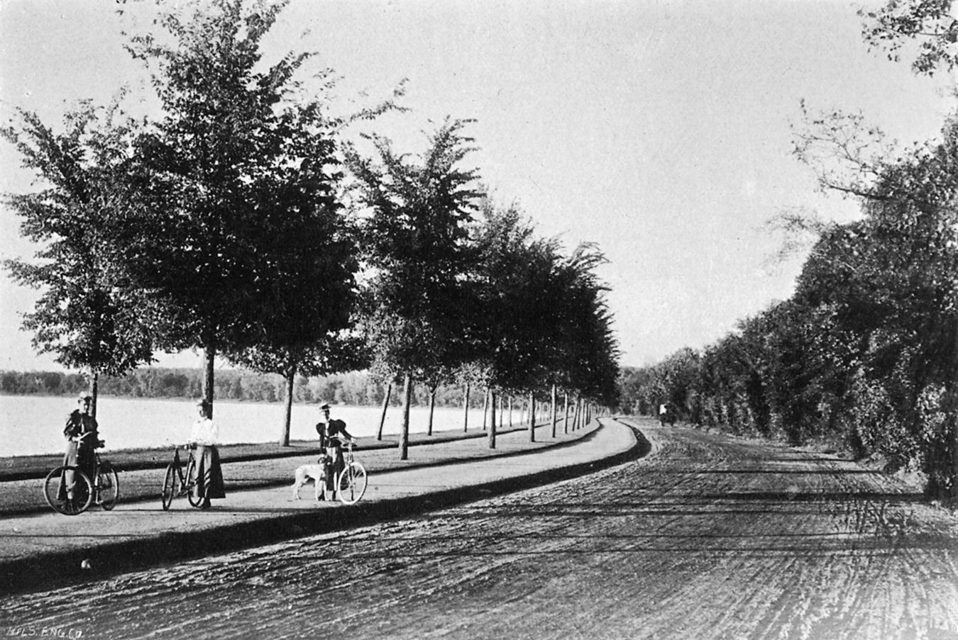
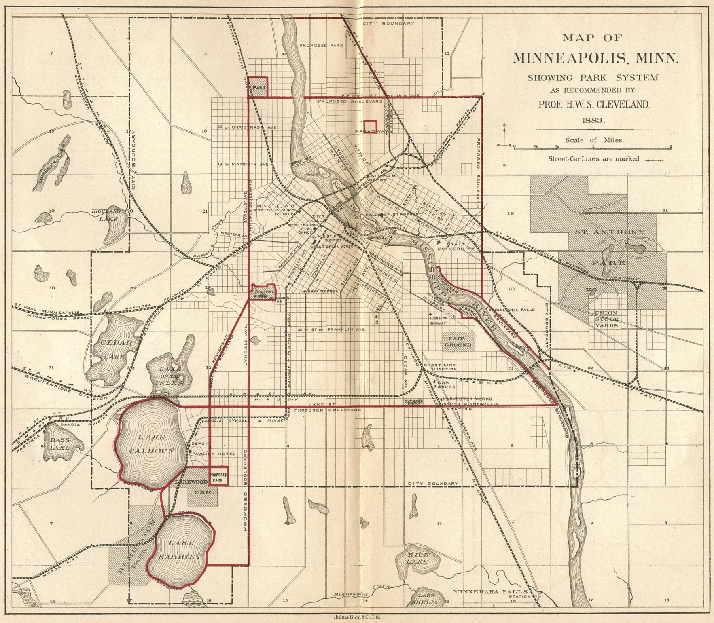
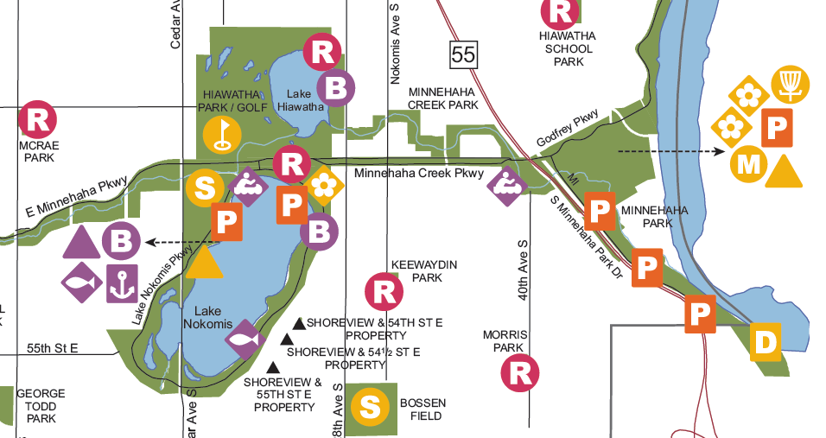
Lake Harriet - 1896
Notes:
Example of forward thinking. Minneapolis had vision of keeping land next to lakes and rivers public starting in 1880s, and it can be seen in current city park map.

Slide 4
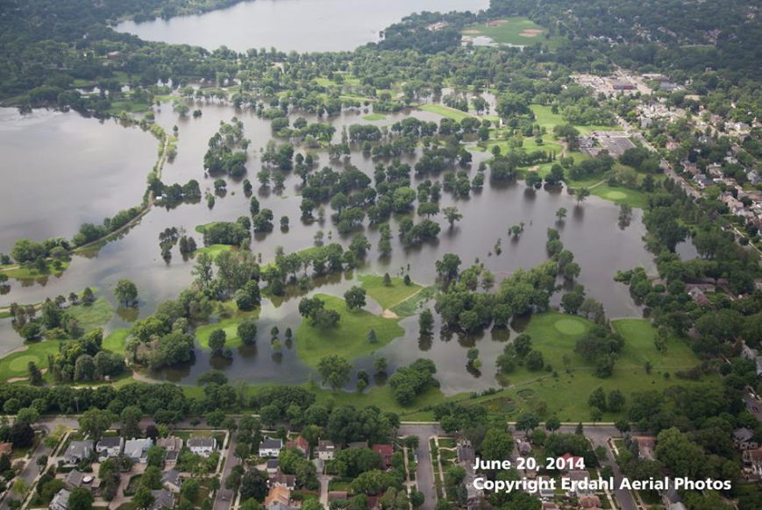
Lake Hiawatha & Lake Hiawatha Golf Course
Highest Lake Levels in 130 years of Records
Notes:
June 2014 – highest recorded water levels (130 years of records) – No impacted structures. (Though loss of golf course revenue, and costs for repairs)

Slide 5
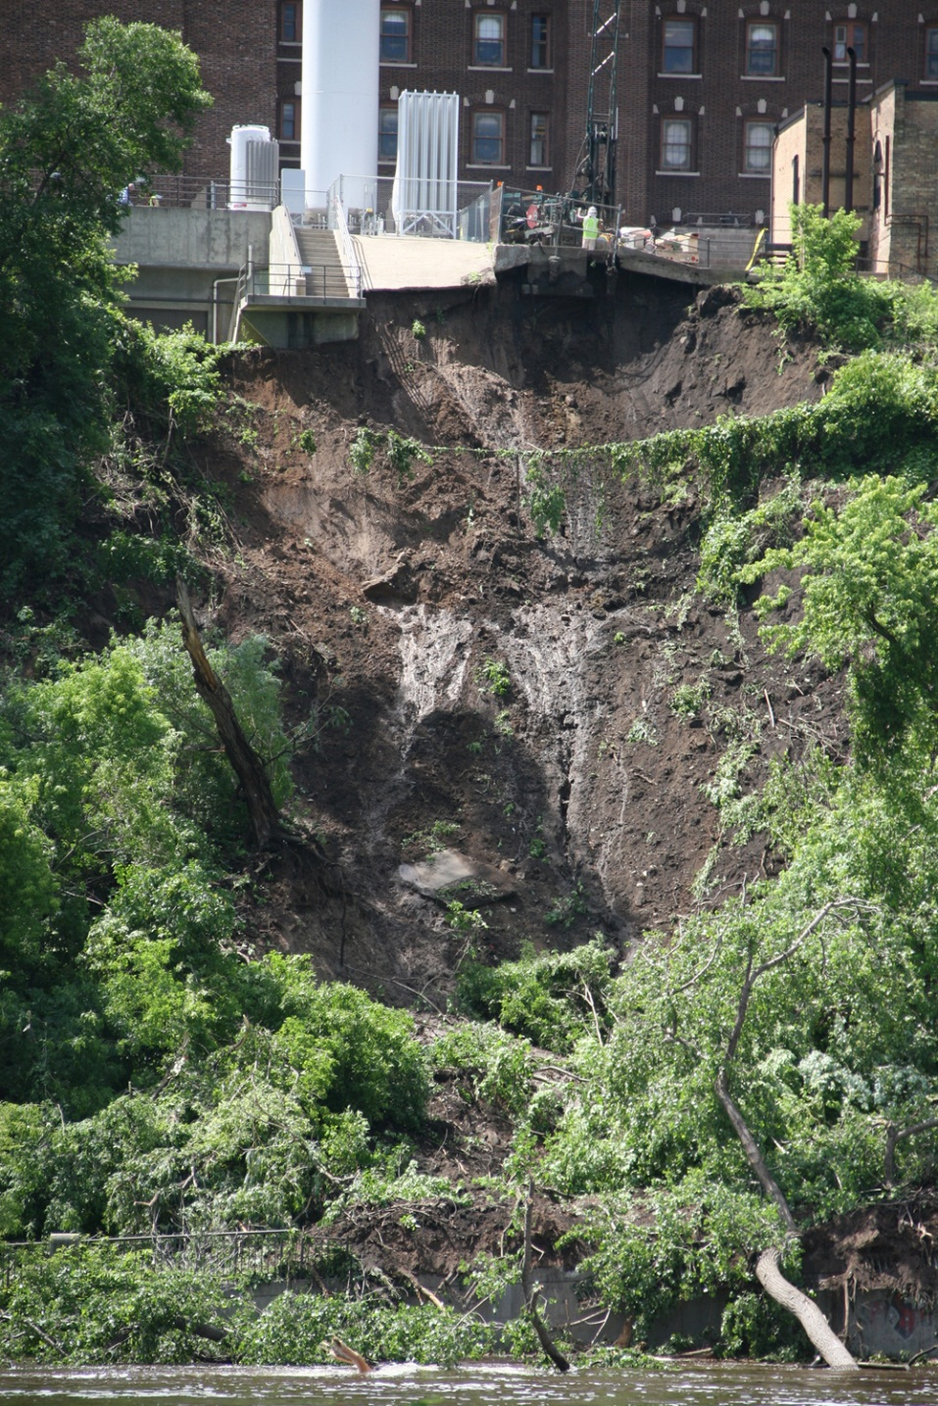

Mainly Public Infrastructure Damage
Landslide next to U of MN Hospital (closes road)
Walkers & bikers must share!
Photo source: MNDNR EWR
Photo source: MNDNR EWR
Notes:
Landslides a problem statewide.

Slide 6
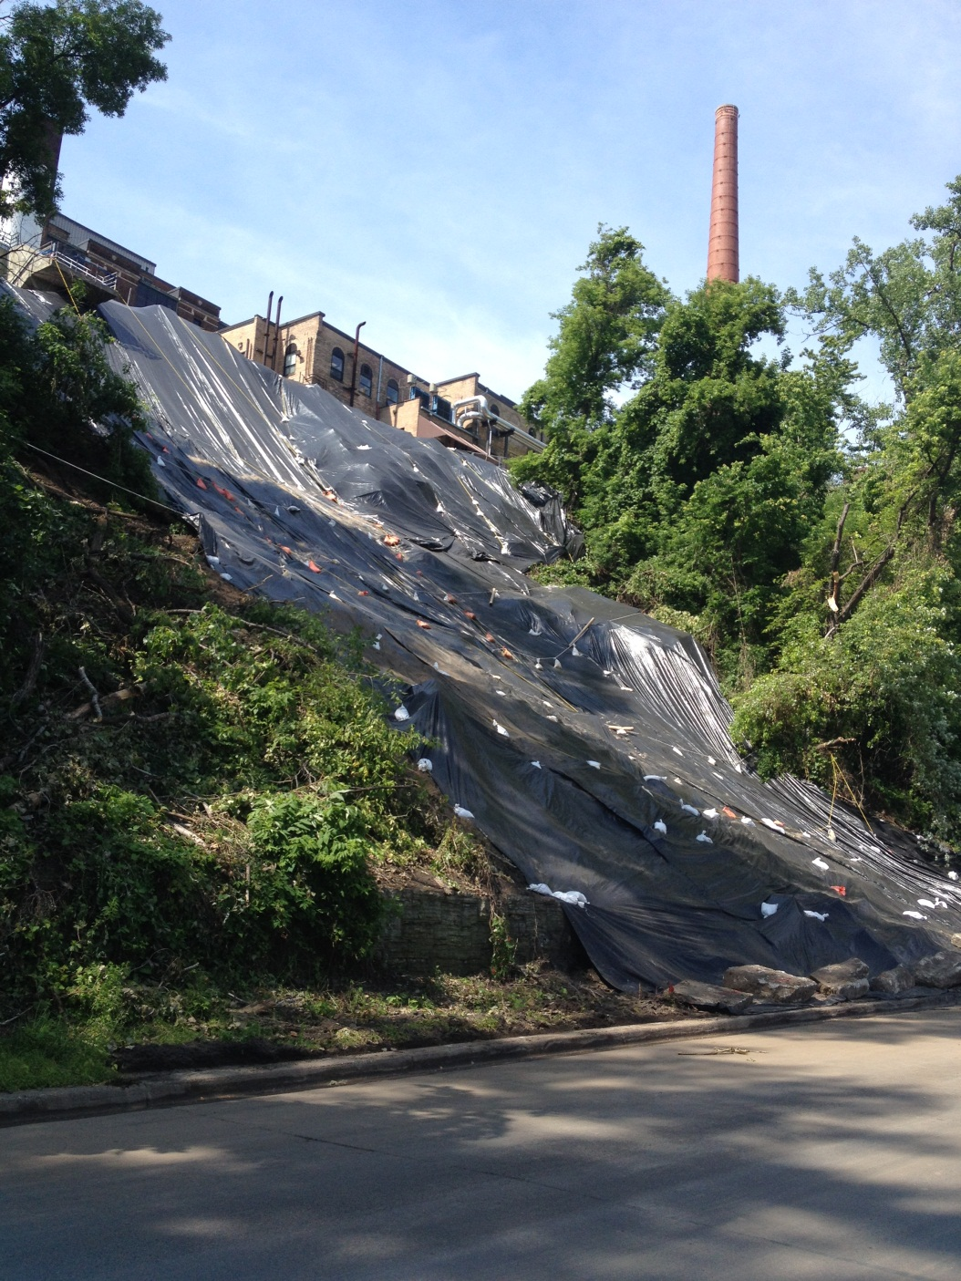
Mainly Public Infrastructure Damage
Landslide next to U of MN Hospital (closes road)
Walkers & bikers must share!
Photo source: MNDNR EWR
Photo source: MNDNR EWR
Notes:
Landslides a problem statewide.

Slide 7

July 15, 2014 All Star Game
Photo: Star Tribune
Notes:
Hosted All Star Game less than a month later. Bet no one realized Minneapolis just had record flooding!

Slide 8
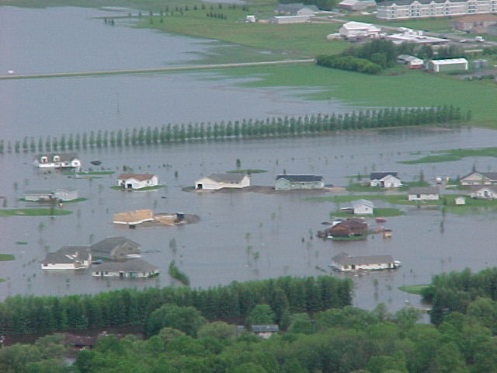
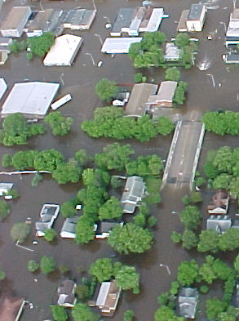
Higher State Freeboard Requirement
Roseau, MN June 12, 2002 (close to 500-yr)
Photos source: MNDNR Forestry
Notes:
MN has had several higher standards since first enabling legislation in 1970s – i.e., freeboard, most structures prohibited in FW, etc.

Slide 9
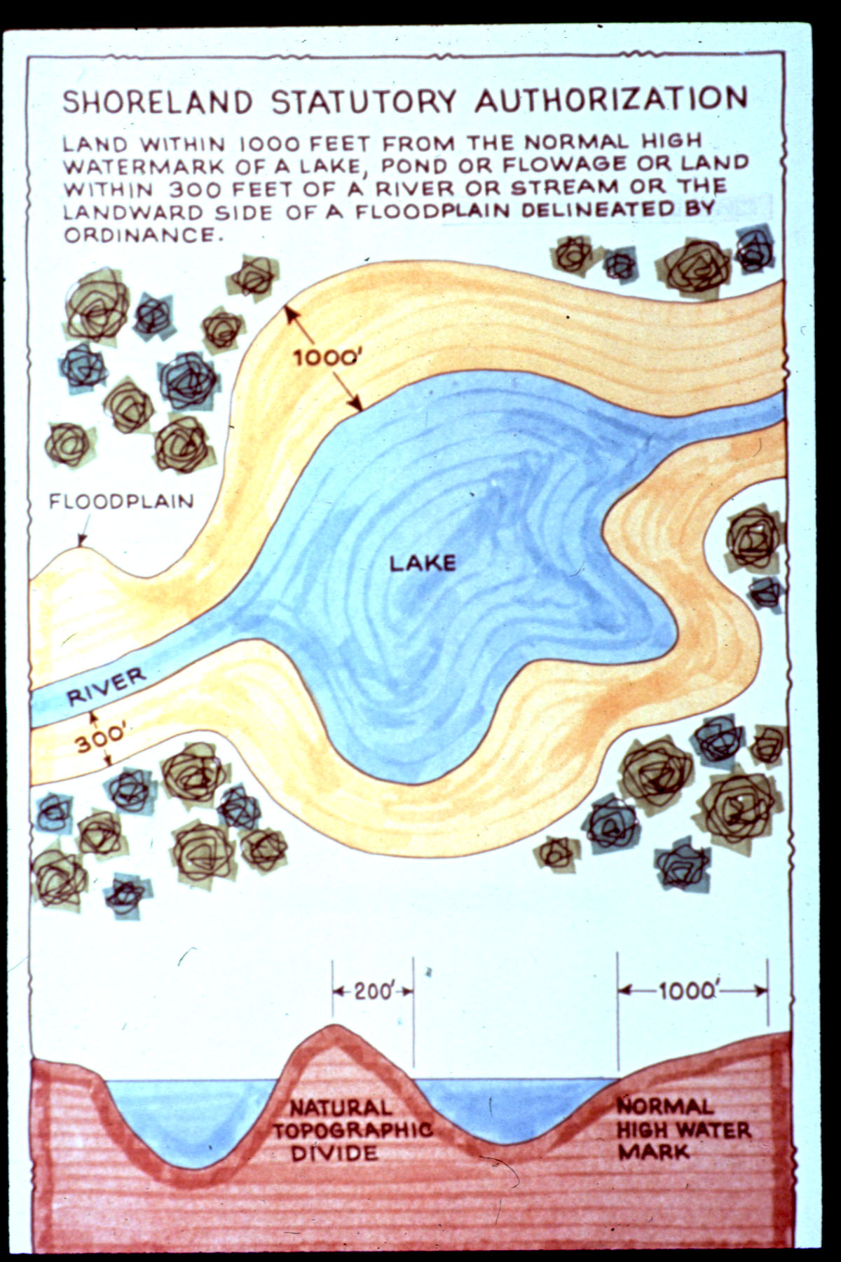
Higher Standards
Shoreland management regulations have required minimum lowest floor elevations in “shoreland districts” in counties (unincorporated areas) since 1970, and in priority cities since 1973.
Notes:
And minimum elevations required in “Shoreland Districts” going back 1000 feet from lakes and 300 feet from watercourses. So usually extends well beyond the FEMA mapped floodplain.

Slide 10
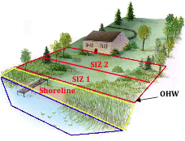
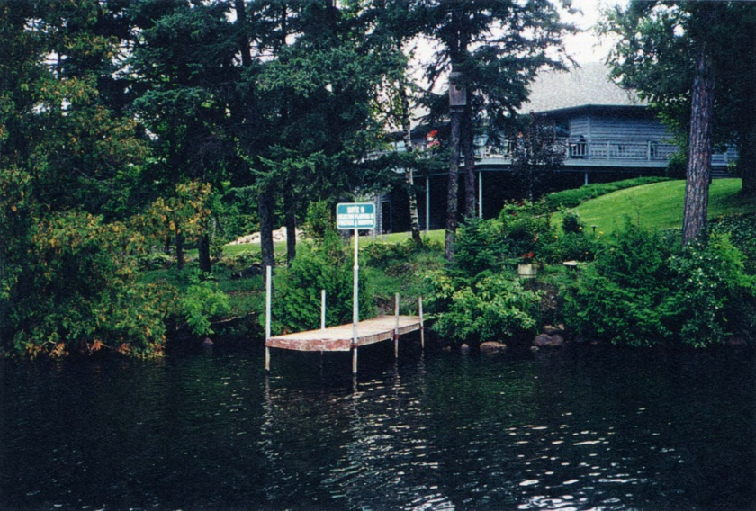
Other Shoreland Requirements
Structure setbacks (50 – 150’ from OHWL* and 30’ from bluff line)
*Ordinary High Water Level is official boundary
Vegetation management: Reduce runoff, Aesthetics / screening
Notes:
Structure setbacks from the OHWL and bluffs (if they exist) also helps to protect natural systems including habitat and decrease the potential for erosion.
Vegetation management serves to both maintain the aesthetic quality of our lakes and rivers as well as to protect natural systems and reduce potential for erosion.

Slide 11
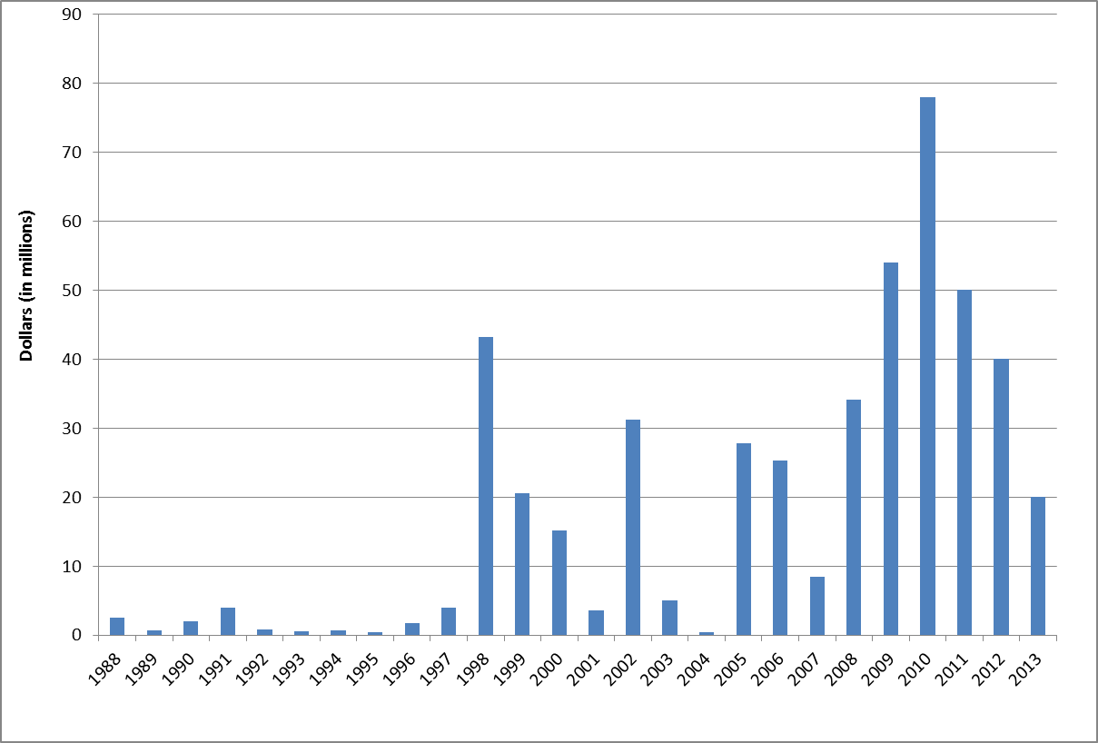

Funding History for Minnesota’s Flood Damage Reduction (FDR) Grant Program
$473.7 million - predominantly bond funds
Historic 1997 Red River flood
Notes:
Own flood mitigation grant program – State Legislature has strongly supported being proactive for mitigation, especially since big 1997 flood.

Slide 12
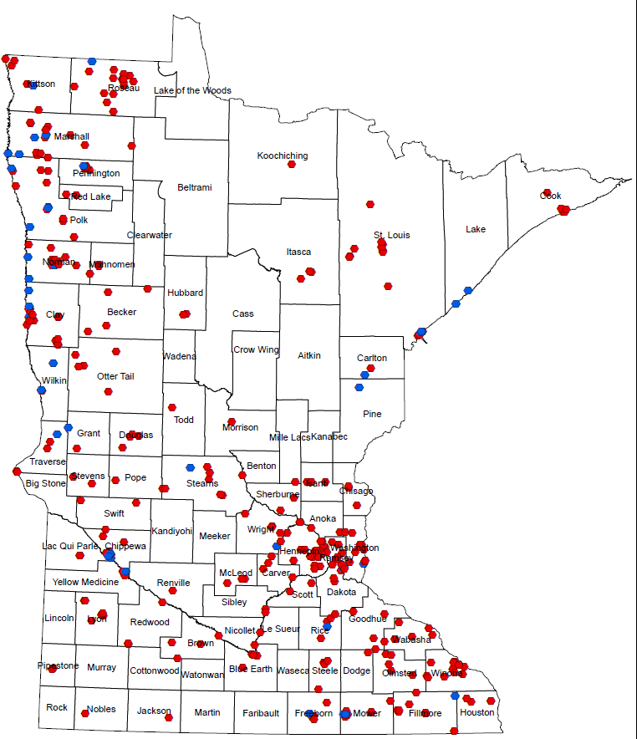
Minnesota Flood Risk Reduction Projects
Red River Area
1987 – Present: 323 Completed & 44 In-Progress (as of 2/9/15)
~85% of funding in Red River Valley
Montevideo
Austin
Complete
In-Progress

Slide 13
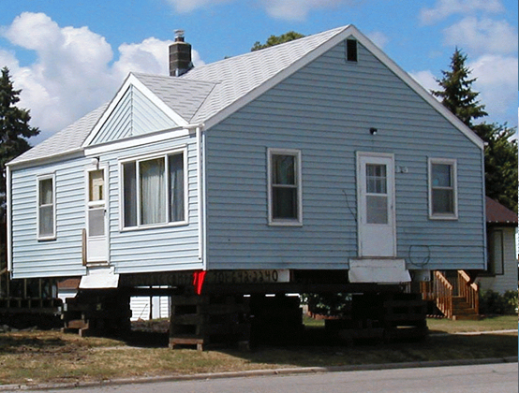
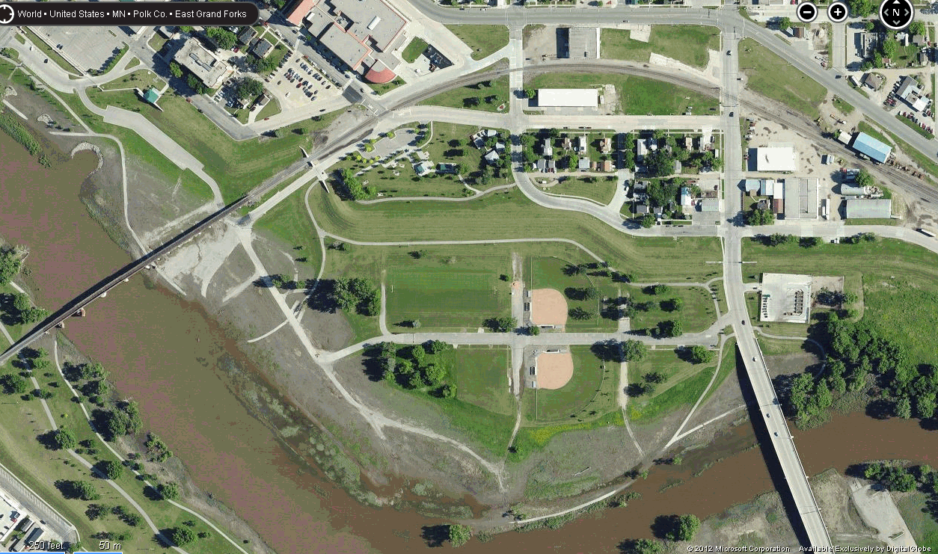
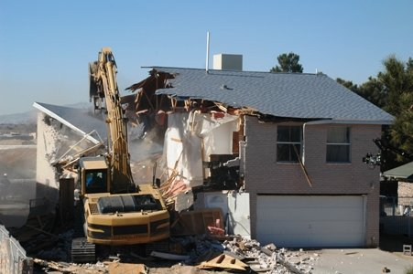
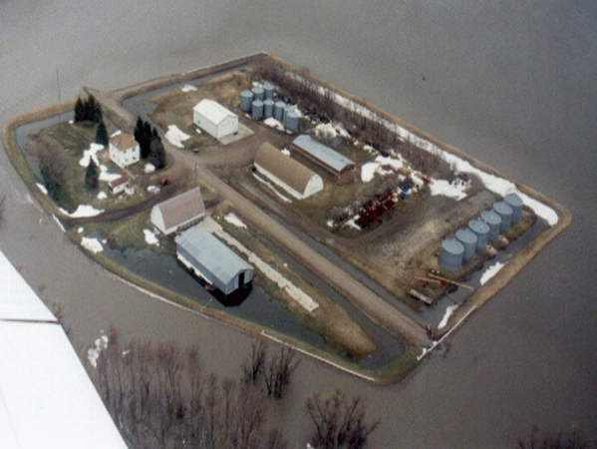
Flood Damage Reduction (FDR)
Over 3,500 structures removed from floodplain (with FDR assistance)
Large Flood Control Structures
Acquisitions
Ring Dikes
East Grand Forks: Set back levee; many buyouts
Red River Valley: Over 215 ring dikes 1998 to present; ~ $4.5 Million FDR

Slide 14
MN Department of Transportation
Example
Worked with MnDNR early 2001-2002 on streamlining & better coordination
Championed getting updated precipitation data for planning
Flash flood Vulnerability and Climate Adaptation Pilot Project

Slide 15
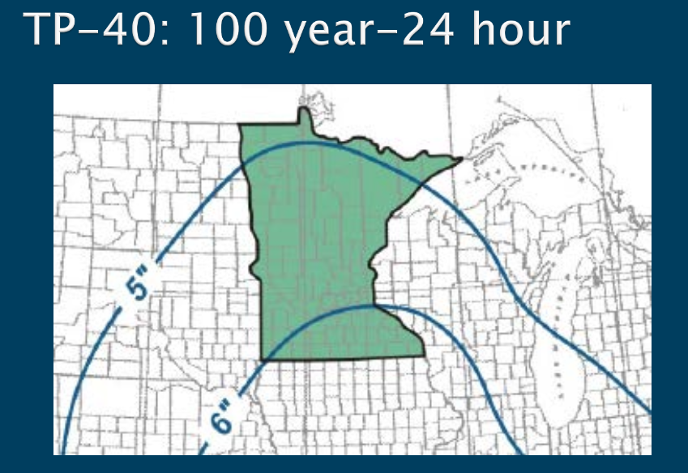
TP-40: based on 1960 data; less stations; shorter record

Slide 16
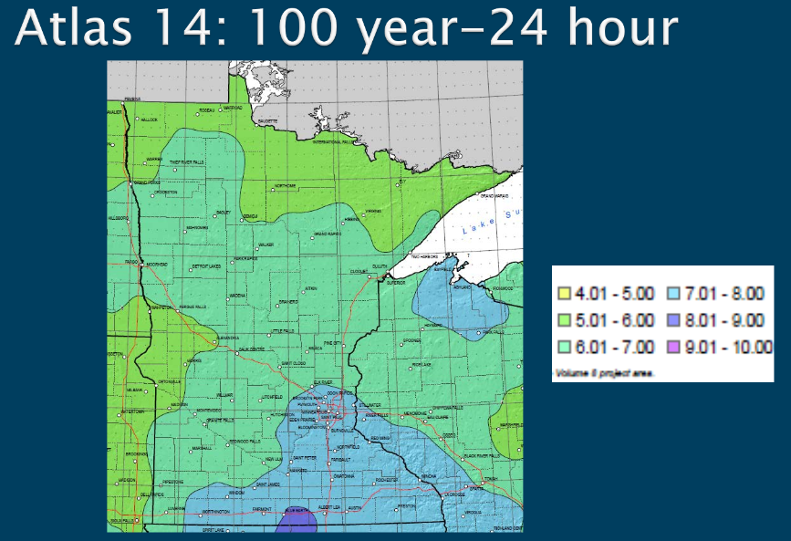

5”
TP-40
5-6”
Fargo/Moorhead 5.3 – 6.3” (+19%)
6-7”
5-6”
Minneapolis 6.0 – 7.9” (+32%)
6”
7-8”
Notes:
MnDOT was lead in pushing to get the funding needed to get the Atlas 14 data out – published in 2013. Additional 50 years of data, and based on more stations.

Slide 17
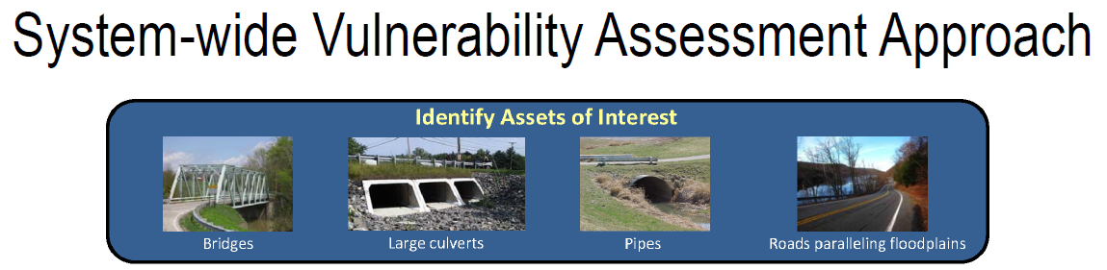
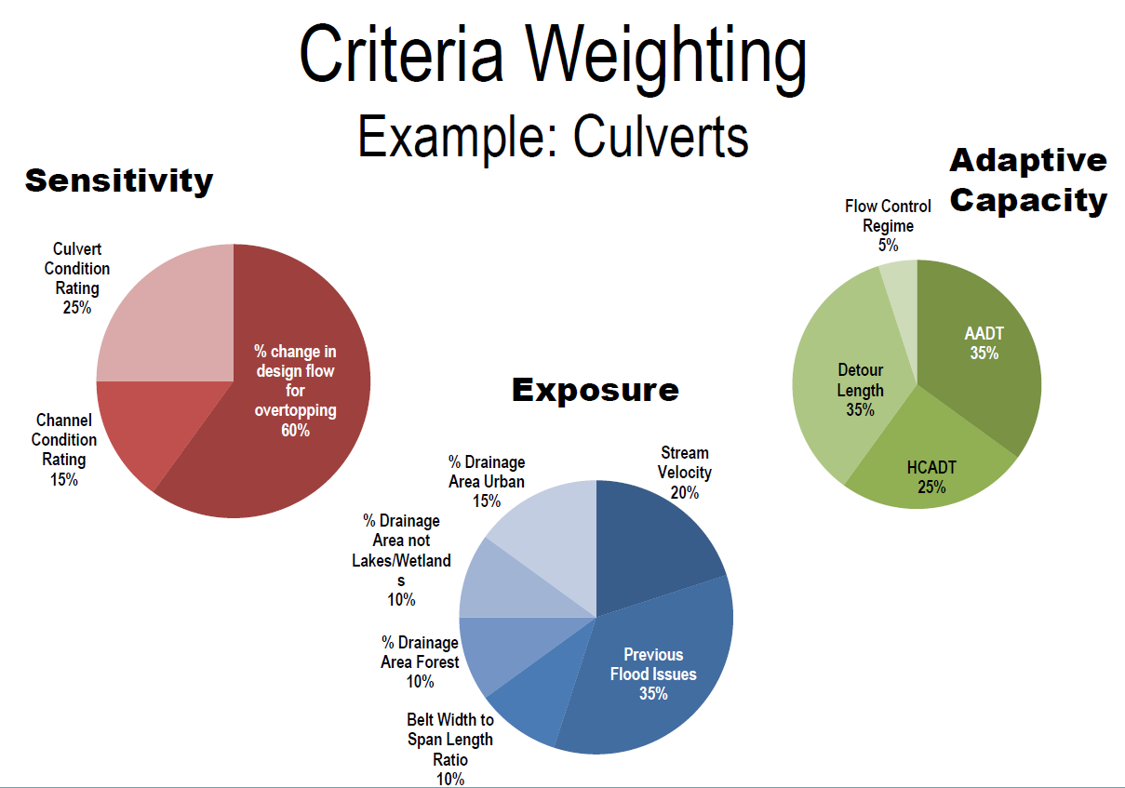
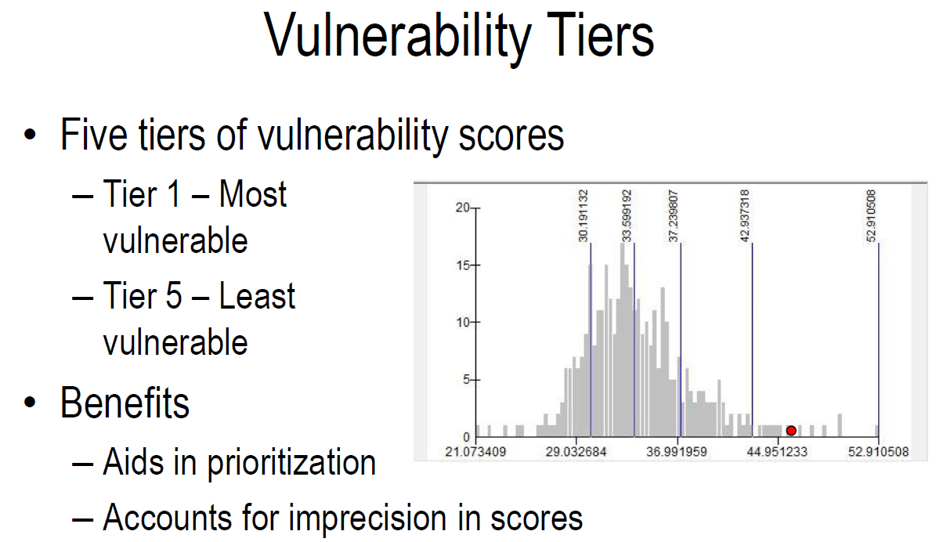
MnDOT Flash Flood Vulnerability and Climate Adaptation Pilot Project
Notes:
Clips from presentation MnDOT gave at Mn Association of Floodplain Managers conference in November 2014. Targeted bridges, culverts & roads parallel to floodplains. Evaluated several criteria and came up with vulnerability tiers.

Slide 18
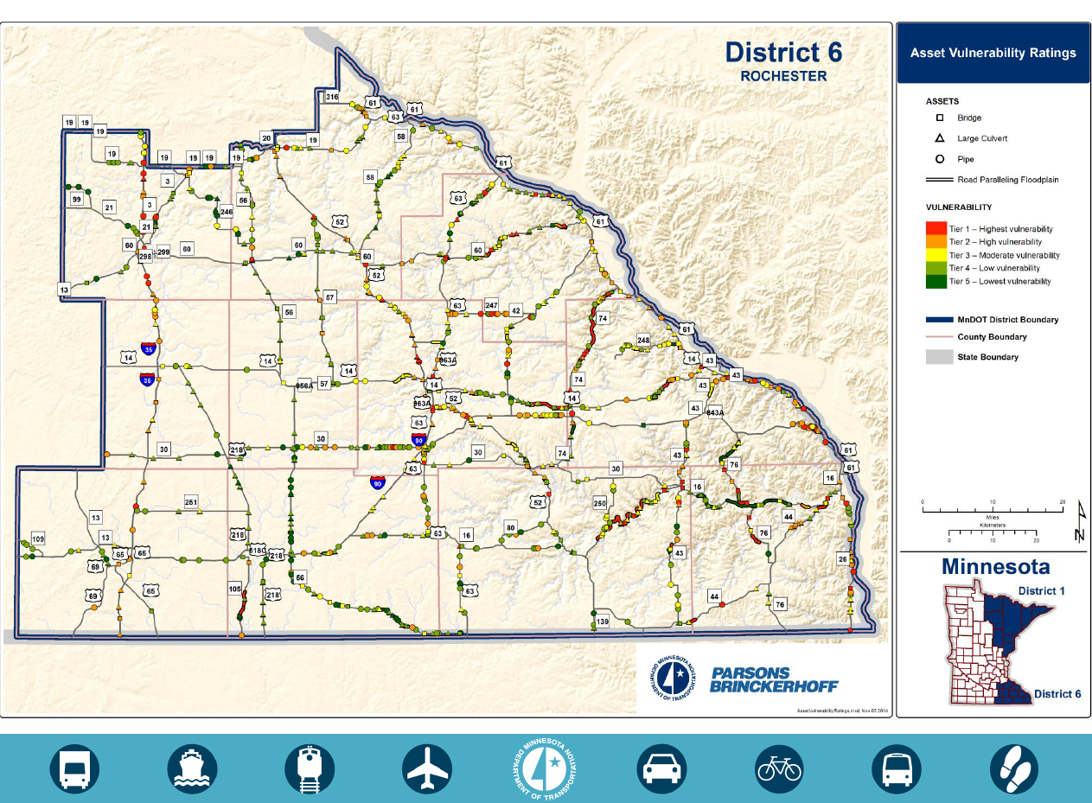
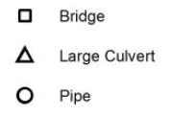
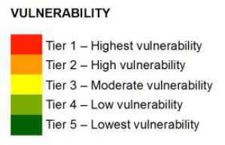
Notes:
Example of map showing the vulnerability tiers. Used this map at the FEMA Risk Map Action meetings for a HUC8 watershed in SE MN – shared with communities and regional agencies.

Slide 19
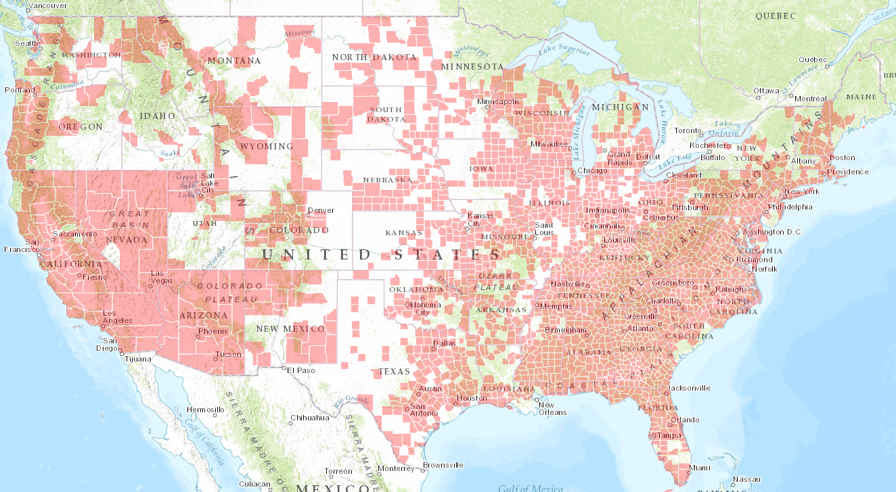
Continued Need for Better Mapping
FEMA’s National Flood Hazard Layer
Shaded counties have Digital Flood Insurance Rate Map (DFIRM)
Notes:
We have a long ways to go with getting accurate maps for the country. Mapping – understandably – prioritized the densely populated areas. Many areas did not get DFIRMs, and are not funded to get DFIRMs. Half of MN does not have, and is not funded to get, DFIRMs. And – in general - those funded before 2007 are mainly digitization of those old 1970/1980 era maps.

Slide 20
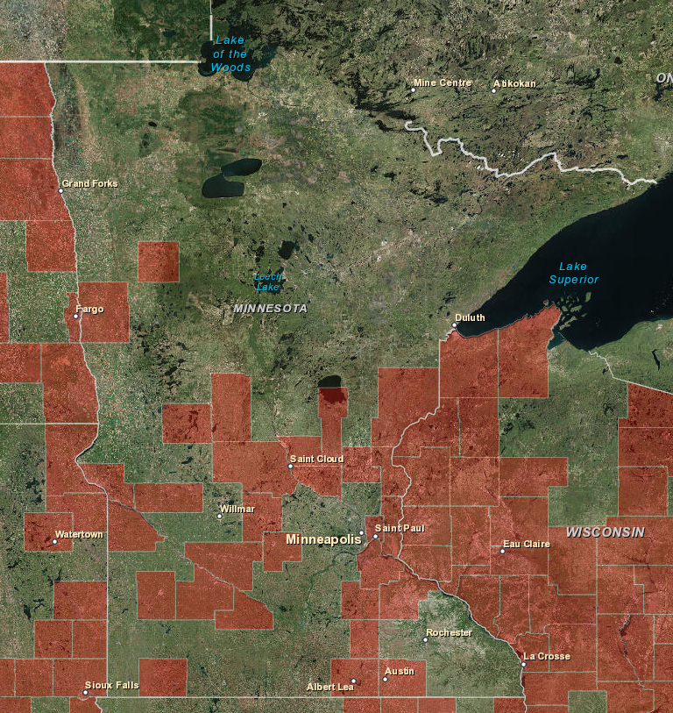
Continued Need for Better Mapping
FEMA’s National Flood Hazard Layer
Shaded counties have Digital Flood Insurance Rate Map (DFIRM)
Notes:
We have a long ways to go with getting accurate maps for the country. Mapping – understandably – prioritized the densely populated areas. Many areas did not get DFIRMs, and are not funded to get DFIRMs. Half of MN does not have, and is not funded to get, DFIRMs. And – in general - those funded before 2007 are mainly digitization of those old 1970/1980 era maps.

Slide 21
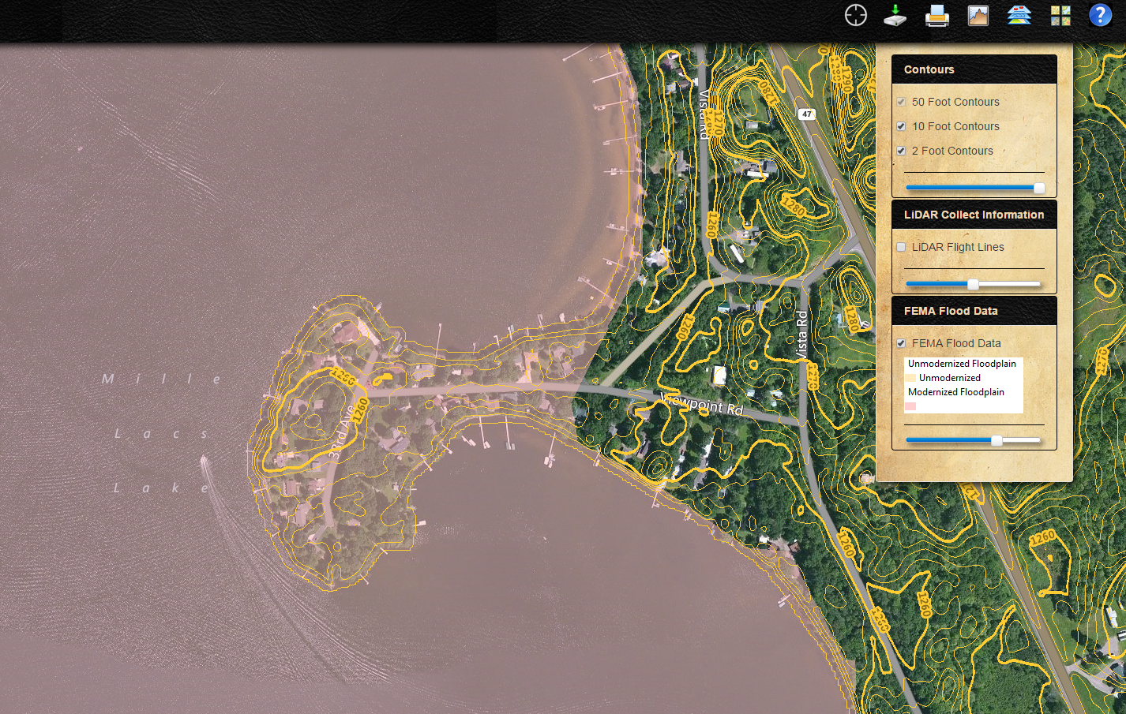

MN Has Statewide LiDAR & Public 2’ Contour Viewer
Notes:
For MN – about 20% of population has DFIRMs with accurate boundaries and supporting data, about 65% will have DFIRMs – but won’t have accurate boundaries based on LiDAR or won’t have accurate supporting data (or both), and about 15% of population won’t have DFIRMs. Example in Mille Lacs County. Hennepin County (with Mpls and western suburbs - ~25% of state population) to get DFIRM in about 9 months and has MANY similar situtations.

Slide 22
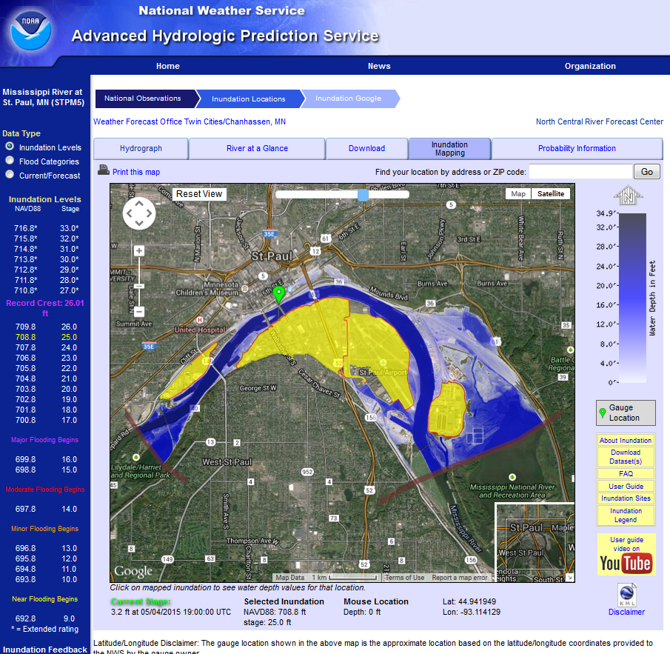

MN Silver Jackets Example
Notes:
You just heard from Stacey & Steve about the Silver Jackets. This shows one MN Silver Jacket example – St Paul inundation mapping!

Slide 23
Thanks!
Questions?
Contact Information:
Ceil Strauss
651-259-5713
ceil.strauss@state.mn.us

