Slide 1

Silver Jackets Program – Interagency Teams Working to Reduce Flood Risk
Presenters: Stacey Underwood, U.S. Army Corps of Engineers, Baltimore District, Silver Jackets Coordinator
Stephen Bekanich, Director,
PA Bureau of Recovery and Mitigation
AMS Capitol Hill Briefing on Inland Riverine Flooding
6 May 2015

Slide 2
Silver Jackets (SJ)
Interagency Flood Risk Management Teams
State-Led
  States set priorities for coordinated interagency support
  Interagency
  Collaboration across agencies / levels of government
  Leverage resources: talent, data, funding
Continuous, not project-specific
Life-Cycle Risk Management
44
Active Interagency FRM Team (SJ)
7
Ongoing Effort to Develop Team
As of April 2015
Notes:
SJ is a relatively new USACE program that establishes state-led interagency teams that work together to reduce flood risk
Currently 44 active teams, and 7 have ongoing effort to develop a team
Why the name Silver Jackets?
Traditionally, different agencies wear different colored jackets when responding to emergencies. For example, FEMA personnel wear blue and Corps personnel wear red. The name Silver Jackets is used to underscore the common flood risk mgmt mission of the diverse agencies involved. Term “silver jackets” used to emphasize this unity of purpose.
Team is truly interagency – bring together many federal, regional, state and local officials to coordinate and collaborate
In the past, agencies would just meet to discuss a project – this is a continuously meeting team to talk about more than just individual projects
And we discuss all parts of FRM life cycle – mitigation, preparedness, response and recovery

Slide 3
Silver Jackets Goals
  Facilitate collaborative solutions to
  state-prioritized flood risks
  Leverage & optimize resources, improve processes, share information
  Improve & increase flood risk communication, unify interagency message
  Strengthen relationships to facilitate integrated post-disaster recovery
Notes:
Agencies work together to collaborate on solutions
Leverage our programs and resources
The Silver Jacket teams allows USACE and others to share and have input to their on-going and completed projects. For example, we coordinated extensively with the SJ teams during the North Atlantic Coast Comprehensive Study and will continue to use the SJ teams to demonstrate the results of the Study to make communities more resilient from both coastal and riverine flooding.
A lot of focus on flood risk communication and making sure we have a unified message when speaking with public
Working together strengthens our relationships which helps during emergency

Slide 4
Shared Risk Management
“ Driving Down the Risks with an Informed and Engaged Public “
Initial Risk
Outreach
Federal / State / Local
Natural Storage
Federal / State / Local
Structural (levees/floodwalls)
Federal / State / Local
Non – Structural (acquisitions, elevations)
Federal / State / Local
Risk
Contingency Plans
Federal / State / Local / Individual
Building Codes
State / Local
Zoning
Local
Insurance
Individual / NFIP
Residual Risk
All Stakeholders Contribute to Reducing Risk !
Notes:
Flood risk management is a shared responsibility between various Federal agencies, state and local governments, and many other partners including NGOs, academia, the private section, and private citizens.
Each of these partners can contribute different actions and strategies shown on this slide for managing and reducing flood risk. Bringing together multiple strategies and approaches in a collaborative and coordinated manner will result in development of more comprehensive solutions and increased resilience of affected communities.
Combining these strategies, especially pairing structural solutions with a variety of nonstructural approaches, will drive down risk to the Nation. It must be understood, though, that there is no way to completely eliminate flood risk, there will always be some level of residual risk that must be communicated and understood.
Silver Jackets Teams were established to help coordinate this shared risk mgmt approach

Slide 5
State Team Participation
USACE & FEMA offer to develop team with State Hazard Mitigation Officer (SHMO) and State National Flood Insurance Program (NFIP) Coordinator
State invites additional participants in accordance with state priorities
  Federal participation may include: FEMA, USGS, NRCS, NOAA-NWS, NWS Coastal Services, FWS, Forest Service, EPA, BoRec, FHWA, EDA, NPS
  State participation may include: Depts of Nat’l Resources, Homeland Security, Emergency Management, Transportation, Economic Dev, Water Conservation Board, Environmental Protection
  Occasional Local, Tribal, NGO and/or private participation
Notes:
Typically USACE and FEMA offer team to state, then others are invited

Slide 6
SJ Interagency Projects
134 projects initiated in 42 states:
  Funded in part by USACE Floodplain Mgmt Services Program:
    18 Silver Jackets “Pilots” (FY11-12)
    21 Flood Risk Management Projects
    83 Interagency Nonstructural Projects
  Funded in part by USACE Flood Control Coastal Emergencies Program
    12 Levee Safety Projects
USACE funded projects that:
  Support state priority in flood risk management
  Leverage partner resources, and
  Will demonstrate tangible benefits
  Not a grant: USACE funds most typically support USACE labor that, in combination with partner contributions, allows achievement of a greater whole
Notes:
Although pulling together state teams often to coordinate and collaborate is key, another significant part of the program are the interagency projects we execute together
Since 2011 – 134 interagency FRM projects…
Explain FRM, nonstructural (flood proofing, flood inundation mapping, flood warning plans, etc.), levee safety

Slide 7
USACE Baltimore District
SJ Program
Lead USACE district supporting 3 SJ Teams:
  Pennsylvania
  Maryland
  Washington DC
Our district supports a different lead USACE district for 3 SJ Teams:
  Virginia (Norfolk District)
  New York (Buffalo and New York Districts)
  West Virginia (Huntington District)
Being involved in numerous teams helps members to share information across states
Notes:
In Baltimore District, we are the lead USACE rep for 3 teams…
We also support another lead District for 3 teams

Slide 8
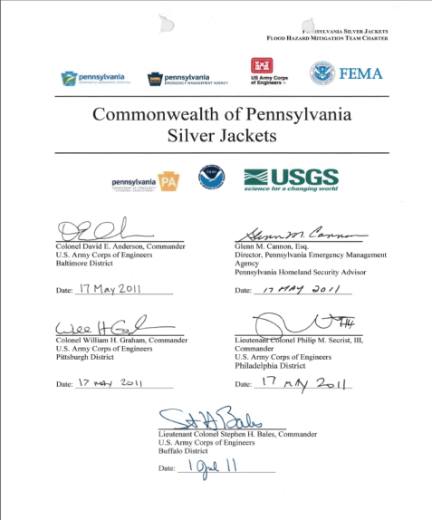
PA Silver Jackets Team
Initiated in 2010; charter signed by 10 agencies in 2011
Approximately 15 active agencies currently participate
Meet quarterly and have monthly webinars
Outreach is one of priorities – to inform
others so they can take actions necessary
to reduce flood risk
Completed various interagency flood risk
management projects
Team received the Paul R. Beatty Partnership
award from Keystone Emergency Mgmt
Association in 2013
Notes:
I will focus the next few slides on PA SJ team since that is the team I have been involved with the longest and has been a very active and successful team
The team received an award from the Keystone Emergency Management Association in February 2013 for its outstanding work in furthering flood risk management principles and improving the safety of PA residents through interagency projects and outreach.

Slide 9
Harrisburg Flood Inundation Mapping Tool
On-line map library for 20 mile reach near Harrisburg, PA
Provides local officials, emergency managers, and general public access to maps prior to and during a flood
Maps are tied to USGS stream gage and NWS forecast point – “real time” data
Maps show predicted extent and depth of flooding
Maps available on NWS, USGS and Susquehanna Inundation Map Viewers
Notes:
We are very proud of the Harrisburg FIM Tool we developed as our interagency project

Slide 10
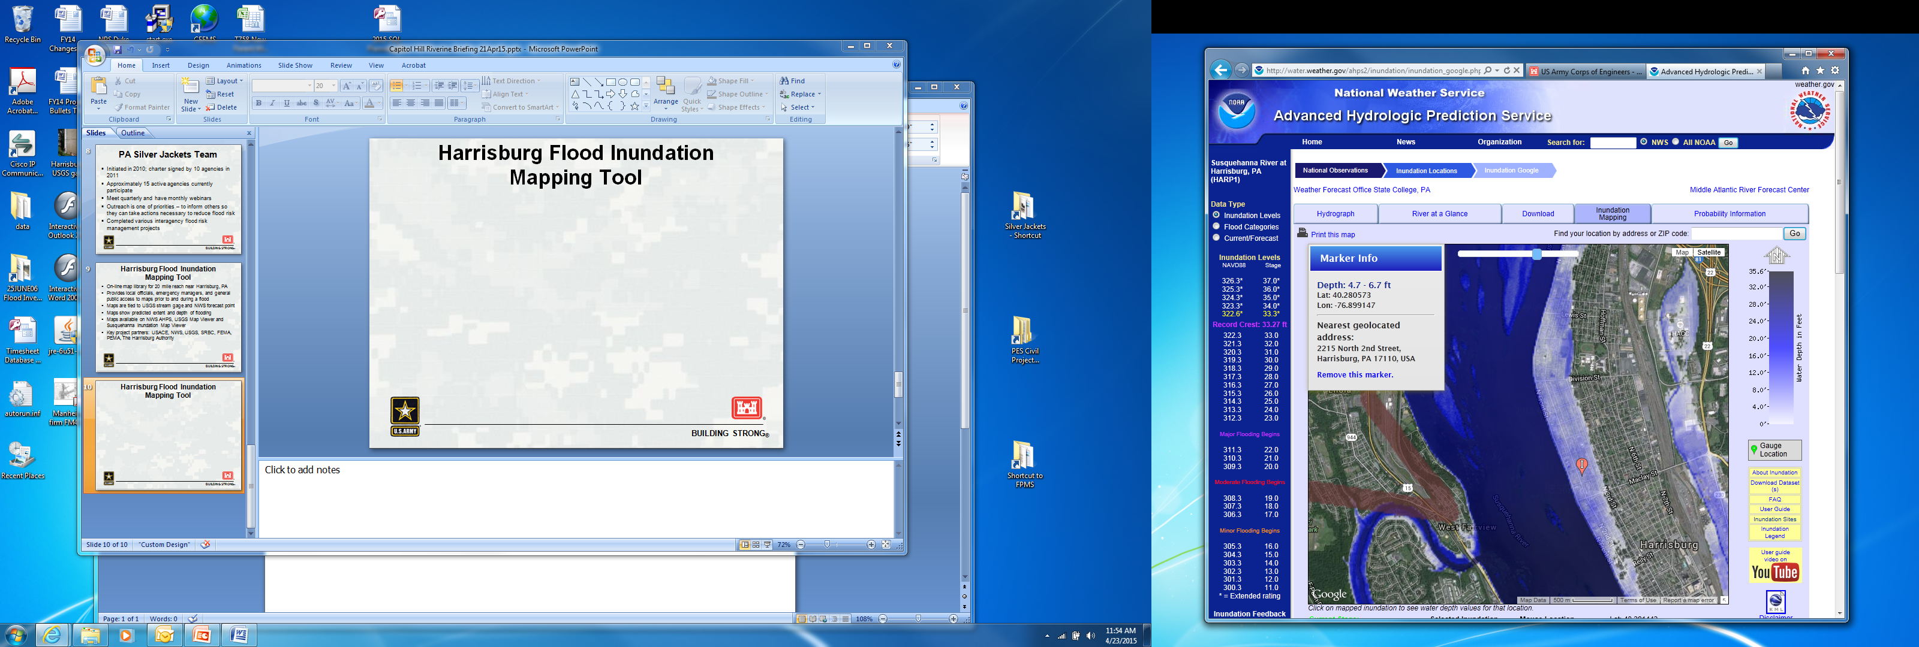
Harrisburg Flood Inundation Mapping Tool

Slide 11
Harrisburg Flood Inundation Mapping Tool
Great Interagency Effort
Expertise/experience from multiple agencies
Data Collection: USGS
Hydraulic Modeling/Mapping: USACE
On-line Map Viewers: NWS, USGS, SRBC
Outreach: NWS, SRBC
Project Team: The Harrisburg Authority, PEMA, FEMA, NWS, USGS, SRBC, USACE
Notes:
Outreach – NWS, SRBC met with county and other municipal leaders to demonstrate tool

Slide 12
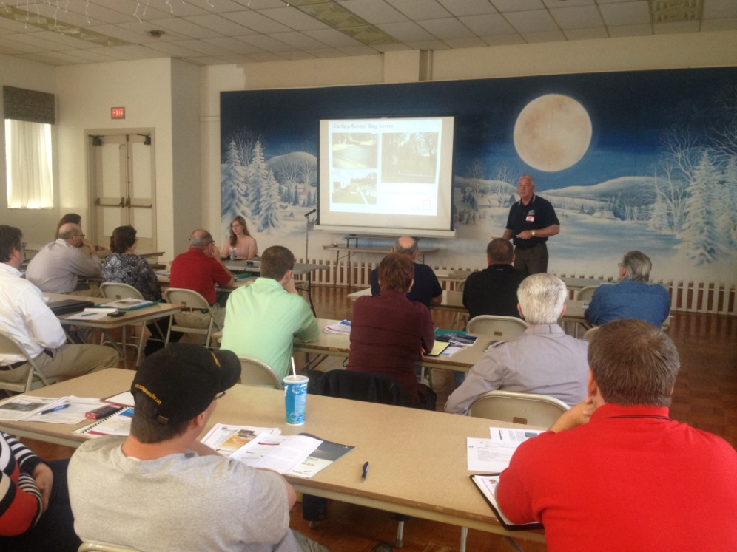
Non-Structural Flood Proofing Workshops
May 2013, PA SJ members hosted 3 days of workshops in 3 different counties
Met with local officials during the day, held public meetings in the evening
Purpose was to provide information
on flood proofing methodologies
and programs available to assist
them
Key partners: USACE, FEMA,
PEMA, PADEP, PA DCED,
PA DCNR, PAFPM, SRBC

Slide 13
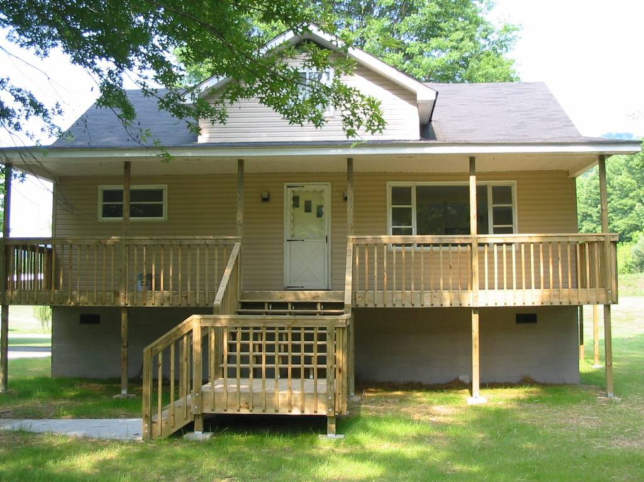
Lycoming County, PA, Flood Proofing Economic Assessment
Study recently initiated
Flood proofing measures for 20 prototypical residential and commercial structures will be evaluated
Benefit-cost analysis will be conducted to compare cost of measures against reduction in future flood insurance costs and future potential damages
Study will assist County in
prioritizing structures for
mitigation
Analysis may be pilot for others
Key Partners: USACE, FEMA,
Lycoming County, PEMA, SRBC

Slide 14
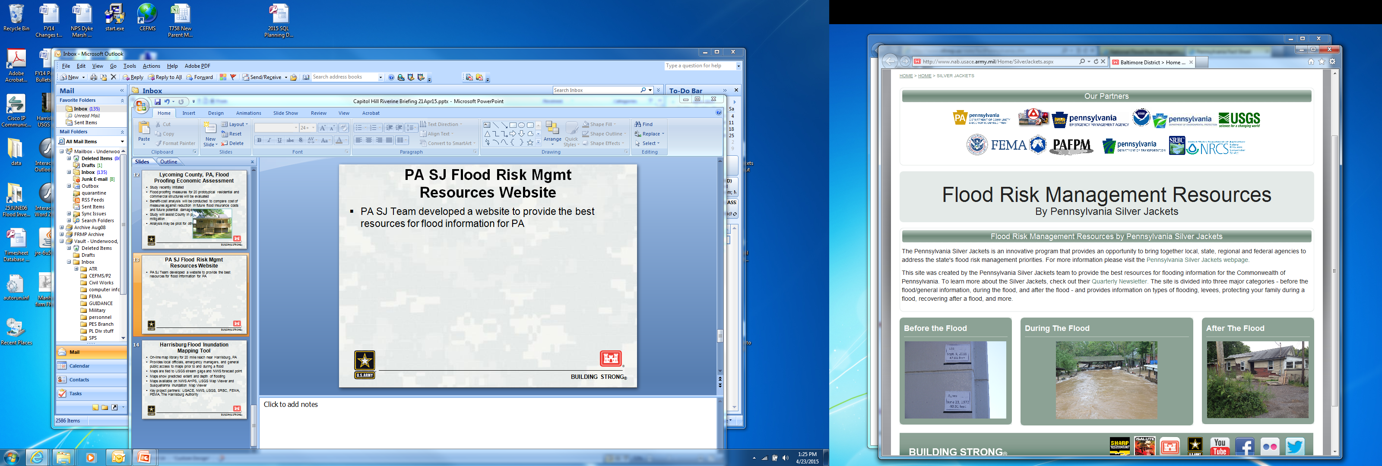
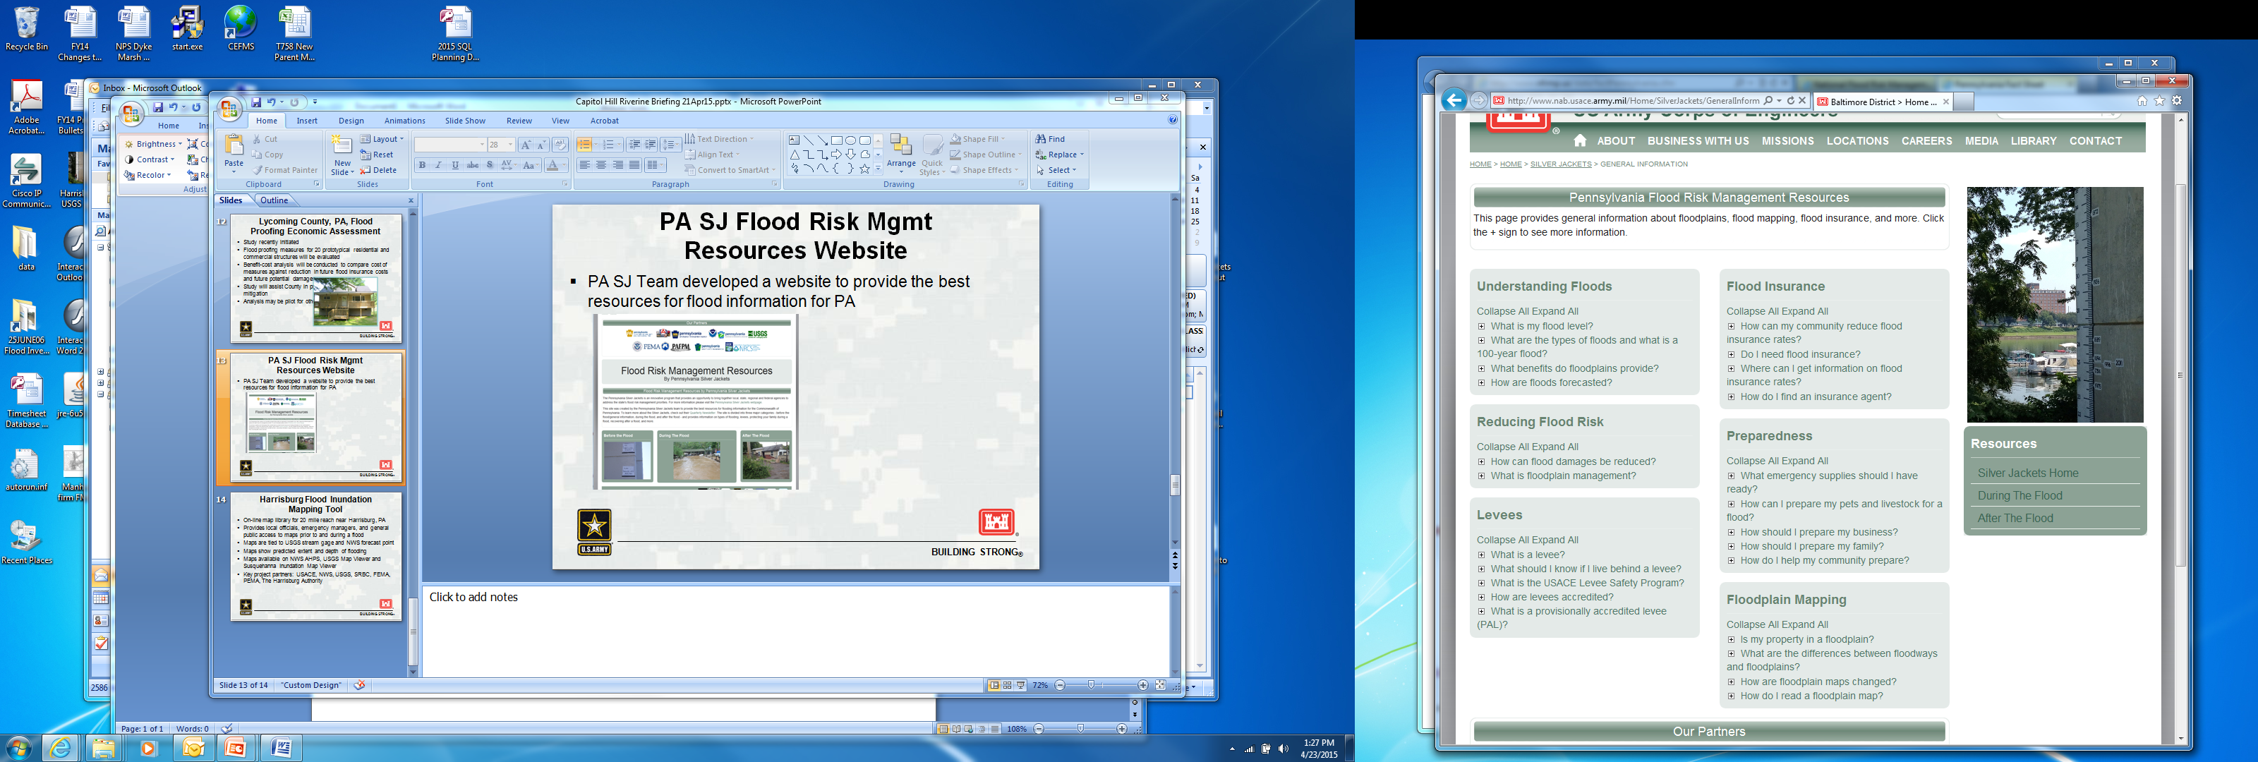
PA SJ Flood Risk Management
Resources Website
PA SJ Team developed a website to provide the best resources for flood information for PA
http://www.nab.usace.army.mil/Home/SilverJackets.aspx
Notes:
Developed website with links to best FRM resources for PA
Before, during and after event

Slide 15
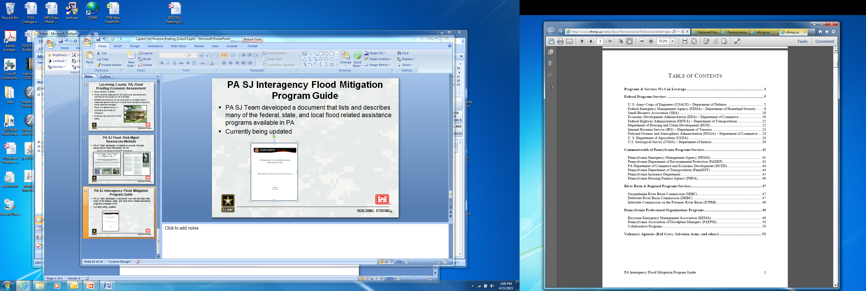
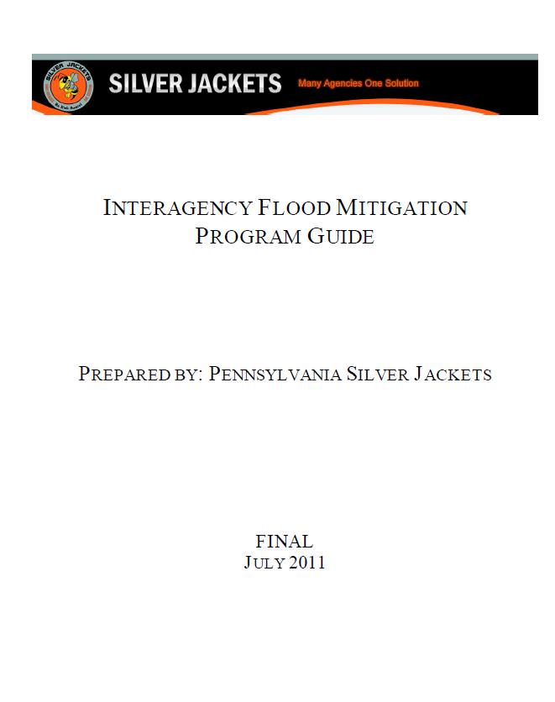
PA SJ Interagency
Flood Mitigation Program Guide
PA SJ Team developed a document that lists and describes many of the federal, state, and local flood related assistance programs available in PA
Currently being updated
Notes:
This has been shared extensively with PA counties and municipalities and many other State teams for use. Recently Philly representatives briefed the SJ team and said how useful the product was.

Slide 16
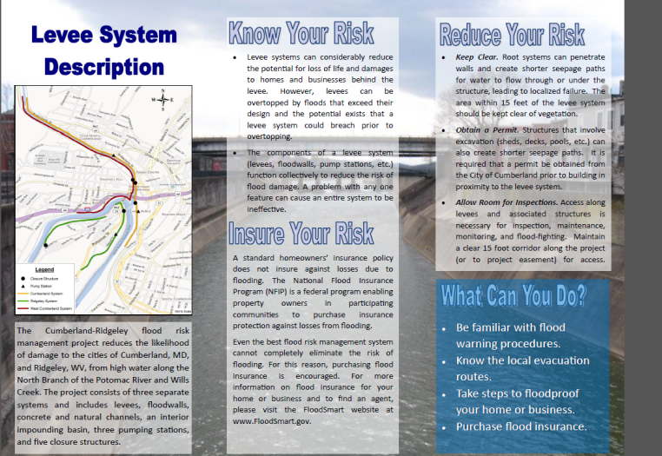
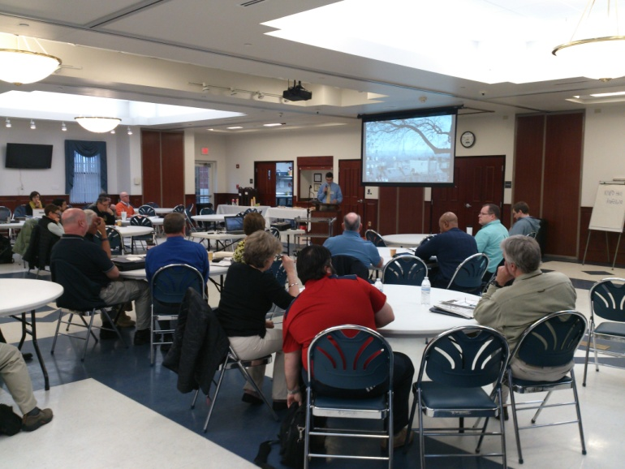
Other SJ Team
Interagency Projects
MD SJ Team
  Cumberland/Ridgely Levee
  Outreach Brochure
  MD Coastal Flood Workshop
Notes:
I also help lead MD SJ team – two interagency projects
Levee brochure – know your risk, insure your risk, reduce your risk. City, MD, FEMA, USACE, others all worked together to develop unified flood risk message
Successful MD Coast Flood workshop held in May

Slide 17
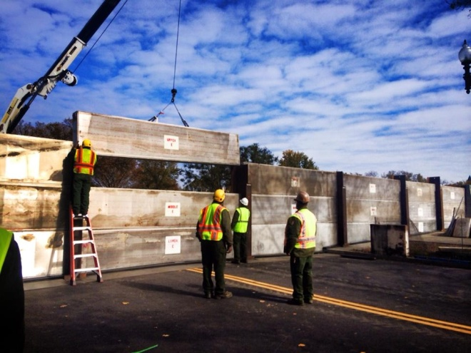
Other SJ Team
Interagency Projects
DC SJ Team
  DC Flood Inundation Mapping Tool
    Riverine and tidal flood inundation mapping for Potomac River
  DC Flood Exercise
    Planned for Fall, 2015
    Will “test” the effectiveness of the DC Flood Emergency Manual
  Communication Plan for 17th Street Closure
    Closure was constructed in Fall 2014
    Multiple agencies developed a communication
    plan so public receives same message from
    various agencies
    Continue to develop communication materials
    through FEMA’s flood mapping process
Notes:
DC Team - 3 efforts
FIM underway
Flood Exercise planned for fall
Communication Plan – USACE has FRM project in DC and new closure across 17th street just constructed fall, 2014
USACE constructed it, NPS operates it, FEMA maps it – so needed good unified communication plan

Slide 18
Commonwealth of Pennsylvania’s
Perspective of Silver Jackets Program
Stephen Bekanich
Director,
PA Bureau of Recovery and Mitigation

Slide 19
Points of Contact
Stacey Underwood, USACE Baltimore District, Silver Jackets Coordinator
stacey.m.underwood@usace.army.mil
Stephen Bekanich, Director, PA Bureau of Recovery and Mitigation
sbekanich@pa.gov
Silver Jackets Website:
http://www.nfrmp.us/state/

