Slide 1
Lightning: Economic Impact and Data Sources
AMS Capitol Hill Briefing
Washington, D. C., November 20, 2014
Amitabh Nag, Ph.D.
Scientist, Vaisala Inc., Boulder, Colorado

Slide 2
Lightning: Economic Impact and Data Sources
Lightning and its Types
Impact of Lightning on Society
Applications of Lightning Data
Brief History of the U.S. National Lightning Detection Network
Modern Lightning Locating Systems
Examples
Summary
2

Slide 3
What is Lightning?
Lightning is an electrical discharge that is
transient
high-current
transfers charge between the atmosphere and the Earth or between different parts of the atmosphere.
The primary sources of lightning are the separated charge centers located in clouds termed cumulonimbus, commonly referred to as thunderclouds [Uman, 1987].
3

Slide 4
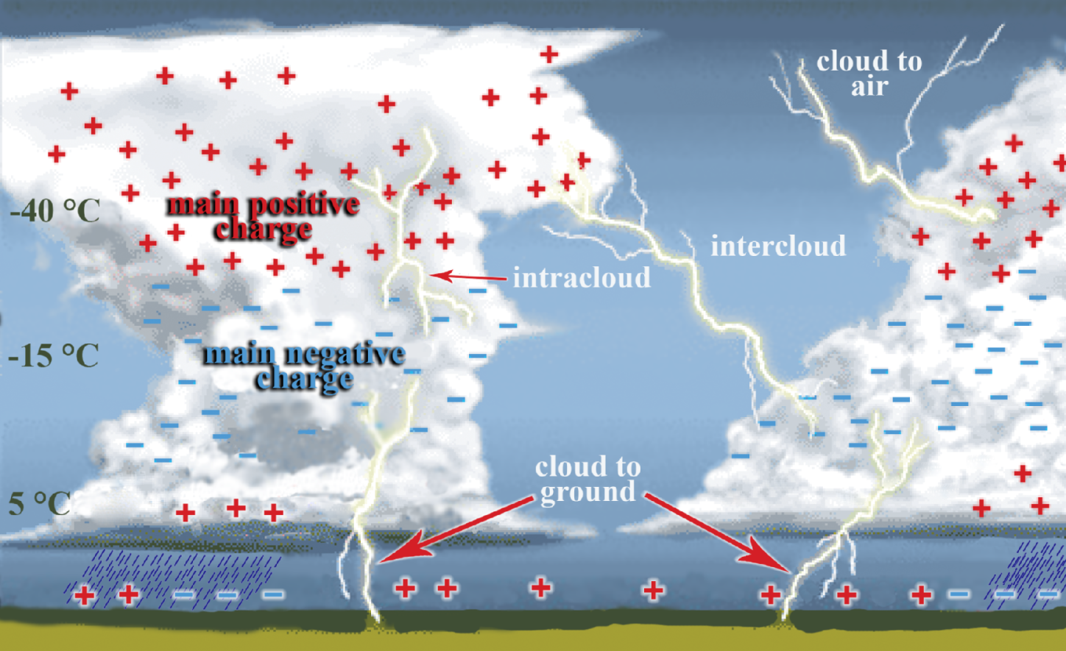
Lightning and its Types
Intracloud, intercloud, and cloud-to-air discharges (ICs) comprise around 75% of lightning discharges.
25% of all lightning discharges is made up of cloud-to-ground discharges (CGs).
4

Slide 5
Impact of Lightning on Society
Fatalities and Injuries from lightning
  32 deaths and about 300 injuries per year (on average) due to lightning in the U.S. over the past 10 years
  Impact on outdoor events, recreational activities, and venue management
Economic impact
  Damage to ground-based objects
  Forest fires
  Impact on the transmission-distribution grid and wind farms
  Impact on air travel and spacecraft launches
  Impact on mining, on shore and off shore drilling
  Impact on (sea and air) port activities
5

Slide 6
Impact of Lightning on Society
A recent study by the Insurance Information Institute states that over 100,000 homeowner insurance claims were paid in 2013 for lightning damage incidents in the U.S. at a total cost of $673.5 million.
In the prior three years (2010 – 2012), home insurers paid approximately $1 billion per year, on average, to policy holders.
There are 22,600 building fires per year, on average, due to lightning resulting in $451 million in property damage per year [NFPA, 2013].
There are 9,000 wild-land fires per year started by lightning from 2008-2012 that each burned an average of 420 acres; four firefighters per year were killed [NIFC, NFPA, 2013].
Billions of dollars in additional costs.
6

Slide 7
Applications of Lightning Data
Meteorological (includes warnings, nowcasting, and forecasting)
Energy
Airports
Defense, insurance, mining, and others
7

Slide 8
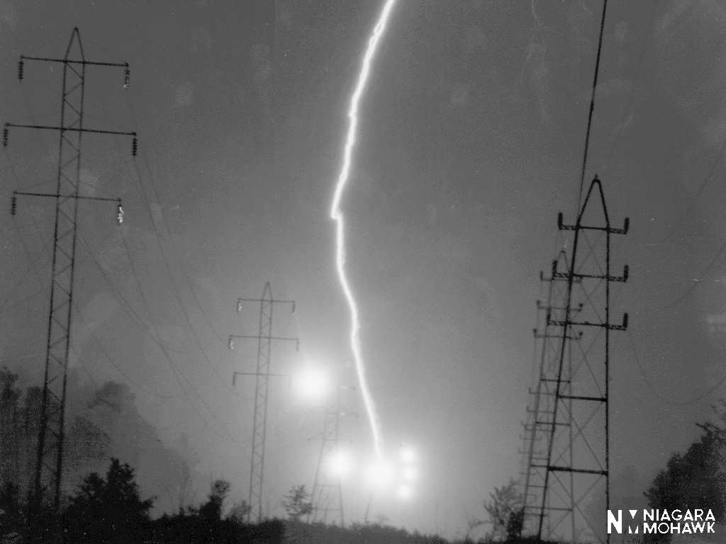
Impact on the Energy Industry
Based on a survey of U.S. power utilities performed by EPRI in 1996, lightning was found to be the largest single cause of outages on distribution and transmission systems in lightning prone areas.
Utilities in the path of intense lightning storms can prepare for storms, alert repair crews, and arrange for help from neighboring utilities.
Real-time lightning data has been shown to reduce maintenance costs by shortening the thunderstorm-watch period and to improve reliability by allowing prepositioning of repair crews.
Also, using line failure history, designers can analyze the lightning and line historical data and prioritize line upgrades to protect them from future storms by employing additional protection.
8

Slide 9
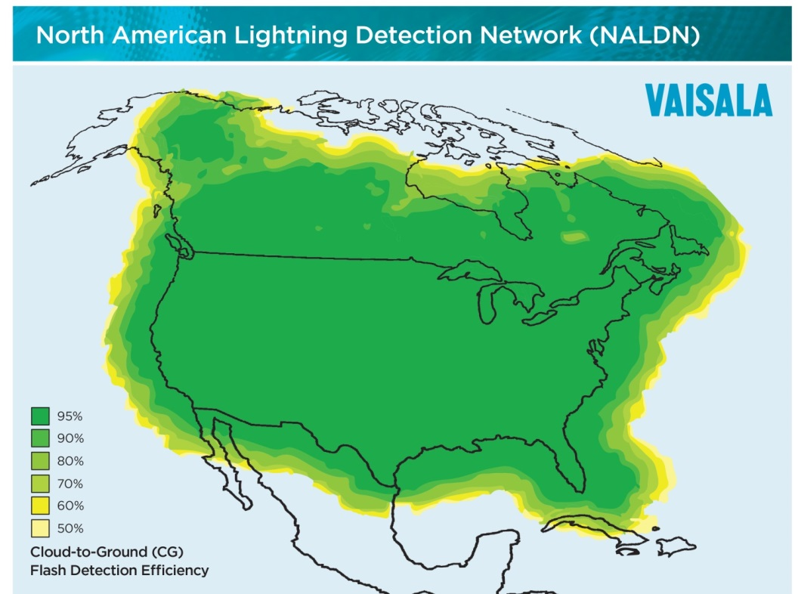
U.S. National Lightning Detection Network: History
Government, Academia, and Industry Partnership
  Funded by EPRI, NSF, and expanded in partnership with BLM, NASA, and SUNY Albany.
  Commercially owned and operated by Global Atmospherics and now Vaisala.
Continuous CONUS Data Since 1989
  The U.S. National Lightning Detection Network (NLDN) has been providing real-time, continental-scale lightning data since 1989.
Continuous and Quantified Improvement
  Upgrades in 1995, 2003-4, 2010-12, and 2013 were coupled with detailed performance analyses.
Modern day NLDN provides total lightning (cloud and cloud-to-ground) data
9

Slide 10
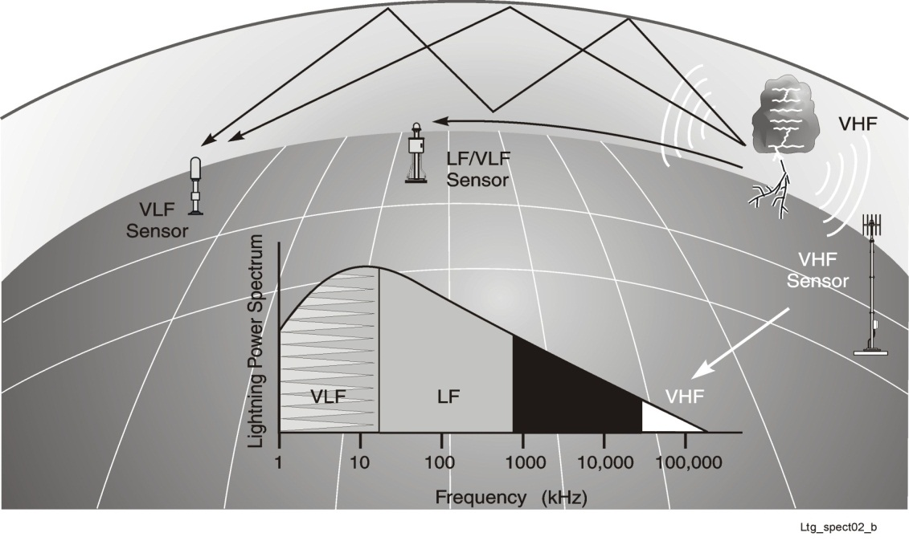

Modern Lightning Locating Systems
Lightning discharges may have durations of a second or more and individual processes within a particular discharge may last from a few hundred milliseconds to a few microseconds or less.
These processes produce electromagnetic signatures in the range from a few hertz (long continuing currents) to 10²⁰ Hz (hard x-rays) [Rakov, 2008].
Optical Sensor
Optical
10

Slide 11
Modern Lightning Locating Systems
  Ground Based LLSs
    Typically a network of a minimum of 4 to 5 sensors and a central processor.
    Each sensor, operating in a part of the ELF to VHF range, measures the EM signal produced by a lightning process (or event) and sends back key information to the central processor.
    In the central processor, information from multiple sensors about the same lightning event along with one or more techniques can be used to geolocate the lightning event.
  Satellite Based LLSs
    Modern satellite-based LLSs use CCD-array-based optical imagers on board low earth orbiting satellites [e.g. Boccippio et al., 2002].
    VHF direction-finding systems [e.g. Jacobson et al., 2011] in combination with optical imaging [Morimoto et al., 2011] on board low-earth orbiting satellites have also been used.
    The first geostationary satellite-based LLS is expected to be launched in the near future (early 2016 [Goodman, personal communication]).
11

Slide 12
Characteristics of Lightning Data from Different LLSs
LLS Type |  | Sensor Baseline Distance/ Optical Imager Field of View | Detection Efficiency |  |  | Median Location Accuracy/ Spatial Resolution | Temporal Resolution | CG Stroke Peak Current, Polarity Estimation Error | CG Stroke Location and Multiplicity | Lightning Type Classification Accuracy
 |  |  | CG Stroke | CG Flash | IC Flash
Ground Based | Long-range (VLF) | Several thousand kilometers | 3-40% | 10-70% | Few to less than 10% | 2 km to more than 10 km | Ten to several tens of microseconds | 25-30%, 1-4% | Yes | NA
 | Medium-range (ELF-HF) | 150-400 km | 70-90% | 85% to more than 95% | 40-50% | About 100 meters to less than 1 kilometer | Several tens of nanoseconds | 15-20%, negligible | Yes | 48-96%
 | Short-range (ELF-HF) | 50-75 km | Greater than 90% | Greater than 95% | About 75% | About 100 meters to few hundred meters | Several tens of nanoseconds | 15-20%, negligible | Yes | 48-96%
 | VHF mapping | 10-40 km for TOA, 150 km or less for interferometry | Total flash DE of greater than 95% |  |  | Several tens to few hundred meters | Ten microseconds or more for TOA), 100 µs for interferometry | NA | NA | NA
Satellite Based | Low earth orbit optical imaging/ mapping | 600 x 600 km to 1300 x 1300 km areas for 90 s to a few minutes | Total flash DE of 38 to 88%, depending upon instrument and time of day |  |  | Ten to a few tens of kilometers | 2 ms | NA | NA | NAª
 | Geo-stationary optical imaging/ mapping | Two optical imagers on board two satellites (east and west) staring continuously at the Americas and nearby oceans | Total flash DE of 85-90%^{b} |  |  | 8-14 km^{b} | 2 ms | NA | NA | NAª
ªEstimation of the fraction of cloud-to-ground flashes in thunderstorms may be available [Koshak, 2010; Koshak and Solakiewicz, 2011].
^{b}Estimated performance characteristics for the GLM which will be operational in the near future.

Slide 13
Characteristics of Lightning Data from Different LLSs
LLS Type |  | Sensor Baseline Distance/ Optical Imager Field of View | Detection Efficiency |  |  | Median Location Accuracy/ Spatial Resolution | Temporal Resolution | CG Stroke Peak Current, Polarity Estimation Error | CG Stroke Location and Multiplicity | Lightning Type Classification Accuracy
 |  |  | CG Stroke | CG Flash | IC Flash
Ground Based | Long-range (VLF) | Several thousand kilometers | 3-40% | 10-70% | Few to less than 10% | 2 km to more than 10 km | Ten to several tens of microseconds | 25-30%, 1-4% | Yes | NA
 | Medium-range (ELF-HF) | 150-400 km | 70-90% | 85% to more than 95% | 40-50% | About 100 meters to less than 1 kilometer | Several tens of nanoseconds | 15-20%, negligible | Yes | 48-96%
 | Short-range (ELF-HF) | 50-75 km | Greater than 90% | Greater than 95% | About 75% | About 100 meters to few hundred meters | Several tens of nanoseconds | 15-20%, negligible | Yes | 48-96%
 | VHF mapping | 10-40 km for TOA, 150 km or less for interferometry | Total flash DE of greater than 95% |  |  | Several tens to few hundred meters | Ten microseconds or more for TOA), 100 µs for interferometry | NA | NA | NA
Satellite Based | Low earth orbit optical imaging/ mapping | 600 x 600 km to 1300 x 1300 km areas for 90 s to a few minutes | Total flash DE of 38 to 88%, depending upon instrument and time of day |  |  | Ten to a few tens of kilometers | 2 ms | NA | NA | NAª
 | Geo-stationary optical imaging/ mapping | Two optical imagers on board two satellites (east and west) staring continuously at the Americas and nearby oceans | Total flash DE of 85-90%^{b} |  |  | 8-14 km^{b} | 2 ms | NA | NA | NAª
ªEstimation of the fraction of cloud-to-ground flashes in thunderstorms may be available [Koshak, 2010; Koshak and Solakiewicz, 2011].
^{b}Estimated performance characteristics for the GLM which will be operational in the near future.

Slide 14
Characteristics of Lightning Data from Different LLSs
LLS Type |  | Sensor Baseline Distance/ Optical Imager Field of View | Detection Efficiency |  |  | Median Location Accuracy/ Spatial Resolution | Temporal Resolution | CG Stroke Peak Current, Polarity Estimation Error | CG Stroke Location and Multiplicity | Lightning Type Classification Accuracy
 |  |  | CG Stroke | CG Flash | IC Flash
Ground Based | Long-range (VLF) | Several thousand kilometers | 3-40% | 10-70% | Few to less than 10% | 2 km to more than 10 km | Ten to several tens of microseconds | 25-30%, 1-4% | Yes | NA
 | Medium-range (ELF-HF) | 150-400 km | 70-90% | 85% to more than 95% | 40-50% | About 100 meters to less than 1 kilometer | Several tens of nanoseconds | 15-20%, negligible | Yes | 48-96%
 | Short-range (ELF-HF) | 50-75 km | Greater than 90% | Greater than 95% | About 75% | About 100 meters to few hundred meters | Several tens of nanoseconds | 15-20%, negligible | Yes | 48-96%
 | VHF mapping | 10-40 km for TOA, 150 km or less for interferometry | Total flash DE of greater than 95% |  |  | Several tens to few hundred meters | Ten microseconds or more for TOA), 100 µs for interferometry | NA | NA | NA
Satellite Based | Low earth orbit optical imaging/ mapping | 600 x 600 km to 1300 x 1300 km areas for 90 s to a few minutes | Total flash DE of 38 to 88%, depending upon instrument and time of day |  |  | Ten to a few tens of kilometers | 2 ms | NA | NA | NAª
 | Geo-stationary optical imaging/ mapping | Two optical imagers on board two satellites (east and west) staring continuously at the Americas and nearby oceans | Total flash DE of 85-90%^{b} |  |  | 8-14 km^{b} | 2 ms | NA | NA | NAª
ªEstimation of the fraction of cloud-to-ground flashes in thunderstorms may be available [Koshak, 2010; Koshak and Solakiewicz, 2011].
^{b}Estimated performance characteristics for the GLM which will be operational in the near future.

Slide 15
Characteristics of Lightning Data from Different LLSs
LLS Type |  | Sensor Baseline Distance/ Optical Imager Field of View | Detection Efficiency |  |  | Median Location Accuracy/ Spatial Resolution | Temporal Resolution | CG Stroke Peak Current, Polarity Estimation Error | CG Stroke Location and Multiplicity | Lightning Type Classification Accuracy
 |  |  | CG Stroke | CG Flash | IC Flash
Ground Based | Long-range (VLF) | Several thousand kilometers | 3-40% | 10-70% | Few to less than 10% | 2 km to more than 10 km | Ten to several tens of microseconds | 25-30%, 1-4% | Yes | NA
 | Medium-range (ELF-HF) | 150-400 km | 70-90% | 85% to more than 95% | 40-50% | About 100 meters to less than 1 kilometer | Several tens of nanoseconds | 15-20%, negligible | Yes | 48-96%
 | Short-range (ELF-HF) | 50-75 km | Greater than 90% | Greater than 95% | About 75% | About 100 meters to few hundred meters | Several tens of nanoseconds | 15-20%, negligible | Yes | 48-96%
 | VHF mapping | 10-40 km for TOA, 150 km or less for interferometry | Total flash DE of greater than 95% |  |  | Several tens to few hundred meters | Ten microseconds or more for TOA), 100 µs for interferometry | NA | NA | NA
Satellite Based | Low earth orbit optical imaging/ mapping | 600 x 600 km to 1300 x 1300 km areas for 90 s to a few minutes | Total flash DE of 38 to 88%, depending upon instrument and time of day |  |  | Ten to a few tens of kilometers | 2 ms | NA | NA | NAª
 | Geo-stationary optical imaging/ mapping | Two optical imagers on board two satellites (east and west) staring continuously at the Americas and nearby oceans | Total flash DE of 85-90%^{b} |  |  | 8-14 km^{b} | 2 ms | NA | NA | NAª
ªEstimation of the fraction of cloud-to-ground flashes in thunderstorms may be available [Koshak, 2010; Koshak and Solakiewicz, 2011].
^{b}Estimated performance characteristics for the GLM which will be operational in the near future.

Slide 16
Characteristics of Lightning Data from Different LLSs
LLS Type |  | Sensor Baseline Distance/ Optical Imager Field of View | Detection Efficiency |  |  | Median Location Accuracy/ Spatial Resolution | Temporal Resolution | CG Stroke Peak Current, Polarity Estimation Error | CG Stroke Location and Multiplicity | Lightning Type Classification Accuracy
 |  |  | CG Stroke | CG Flash | IC Flash
Ground Based | Long-range (VLF) | Several thousand kilometers | 3-40% | 10-70% | Few to less than 10% | 2 km to more than 10 km | Ten to several tens of microseconds | 25-30%, 1-4% | Yes | NA
 | Medium-range (ELF-HF) | 150-400 km | 70-90% | 85% to more than 95% | 40-50% | About 100 meters to less than 1 kilometer | Several tens of nanoseconds | 15-20%, negligible | Yes | 48-96%
 | Short-range (ELF-HF) | 50-75 km | Greater than 90% | Greater than 95% | About 75% | About 100 meters to few hundred meters | Several tens of nanoseconds | 15-20%, negligible | Yes | 48-96%
 | VHF mapping | 10-40 km for TOA, 150 km or less for interferometry | Total flash DE of greater than 95% |  |  | Several tens to few hundred meters | Ten microseconds or more for TOA), 100 µs for interferometry | NA | NA | NA
Satellite Based | Low earth orbit optical imaging/ mapping | 600 x 600 km to 1300 x 1300 km areas for 90 s to a few minutes | Total flash DE of 38 to 88%, depending upon instrument and time of day |  |  | Ten to a few tens of kilometers | 2 ms | NA | NA | NAª
 | Geo-stationary optical imaging/ mapping | Two optical imagers on board two satellites (east and west) staring continuously at the Americas and nearby oceans | Total flash DE of 85-90%^{b} |  |  | 8-14 km^{b} | 2 ms | NA | NA | NAª
ªEstimation of the fraction of cloud-to-ground flashes in thunderstorms may be available [Koshak, 2010; Koshak and Solakiewicz, 2011].
^{b}Estimated performance characteristics for the GLM which will be operational in the near future.

Slide 17
Characteristics of Lightning Data from Different LLSs
  Ground Based VLF (~3 – 30 kHz) LLSs
    Provide global coverage with a spatial resolution of 2-10 km.
    Primarily detect and geolocate cloud-to-ground lightning and tell us when and where lightning struck ground.
  Ground Based LF (~30 – 300 kHz) LLSs
    Provide continental/countrywide coverage with a spatial resolution of few 100 m.
    Detect and geolocate nearly all cloud-to-ground lightning and a large fraction of cloud lightning, and tell us when and where lightning struck ground.
  Ground Based VHF (~30 – 300 MHz) LLSs
    Provide regional coverage with a spatial resolution of 100 m or better.
    Detect and geolocate nearly all cloud-to-ground and cloud lightning (lightning mapping) but cannot tell us when and where lightning struck ground.
  Satellite Based (~30 – 300 THz) LLSs
    Provide continental/countrywide coverage (depending upon field-of-view and number of satellites used) with a spatial resolution of about 10 km.
    Detect and geolocate nearly all cloud-to-ground and cloud lightning (lightning mapping) but cannot tell us when and where lightning struck ground.
    Low earth orbiting satellites monitor each point for a few minutes, while geostationary satellites can monitor all regions within field-of-view continuously.
    Since different LLSs are sensitive to different aspects of lightning they provide unique and complementary information, in addition to “matching” information.

Slide 18
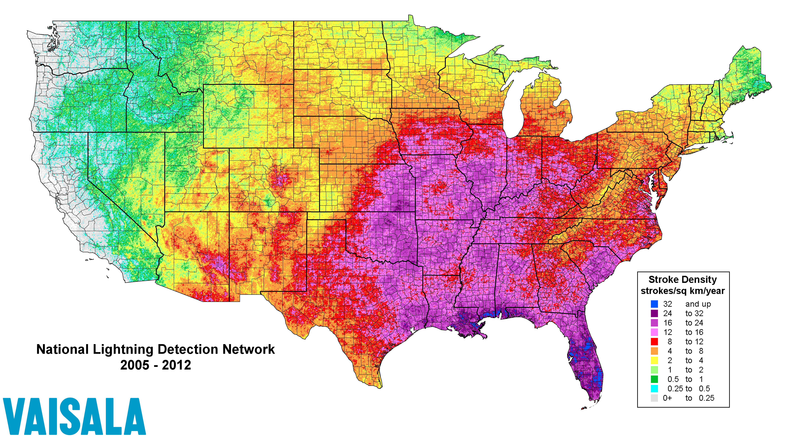
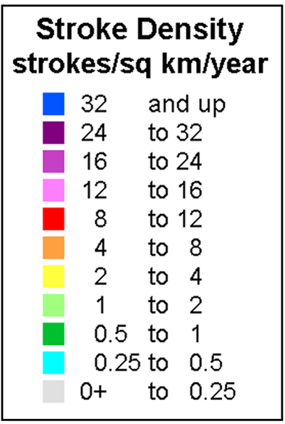
Long Term Climatological Dataset
18

Slide 19
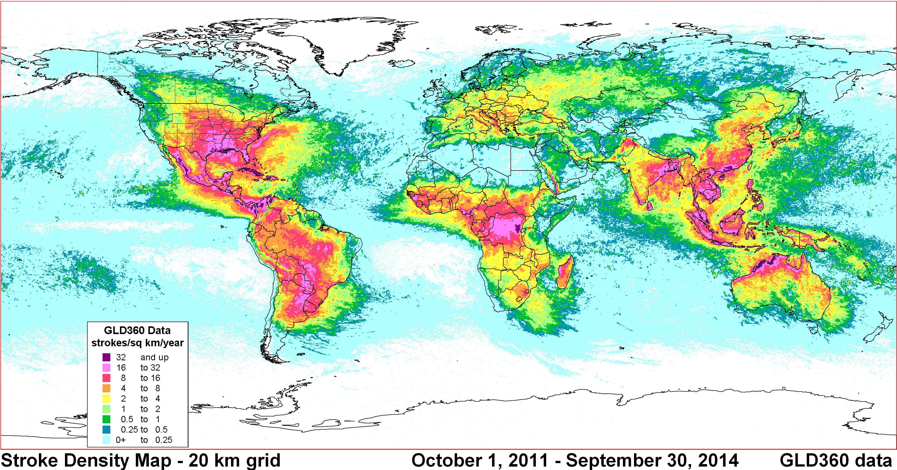
Global Lightning Dataset
19

Slide 20
Summary
Lightning has significant public safety and economic impact.
Typical users of lightning information include national and regional meteorological agencies, aviation or air traffic authorities including space launch facilities, land management entities, forest services, electric power transmission and distribution operators, wind farm operators, and other public utilities.
Ground-based or satellite-based lightning locating systems operating at different frequency ranges detect emissions associated with a variety of different lightning processes.
As a result, lightning data provided by such systems often contain complementary information about flashes and thunderstorms.
Understanding the characteristics of different lightning data sets allows us to use such data properly in applications.
20

Slide 21
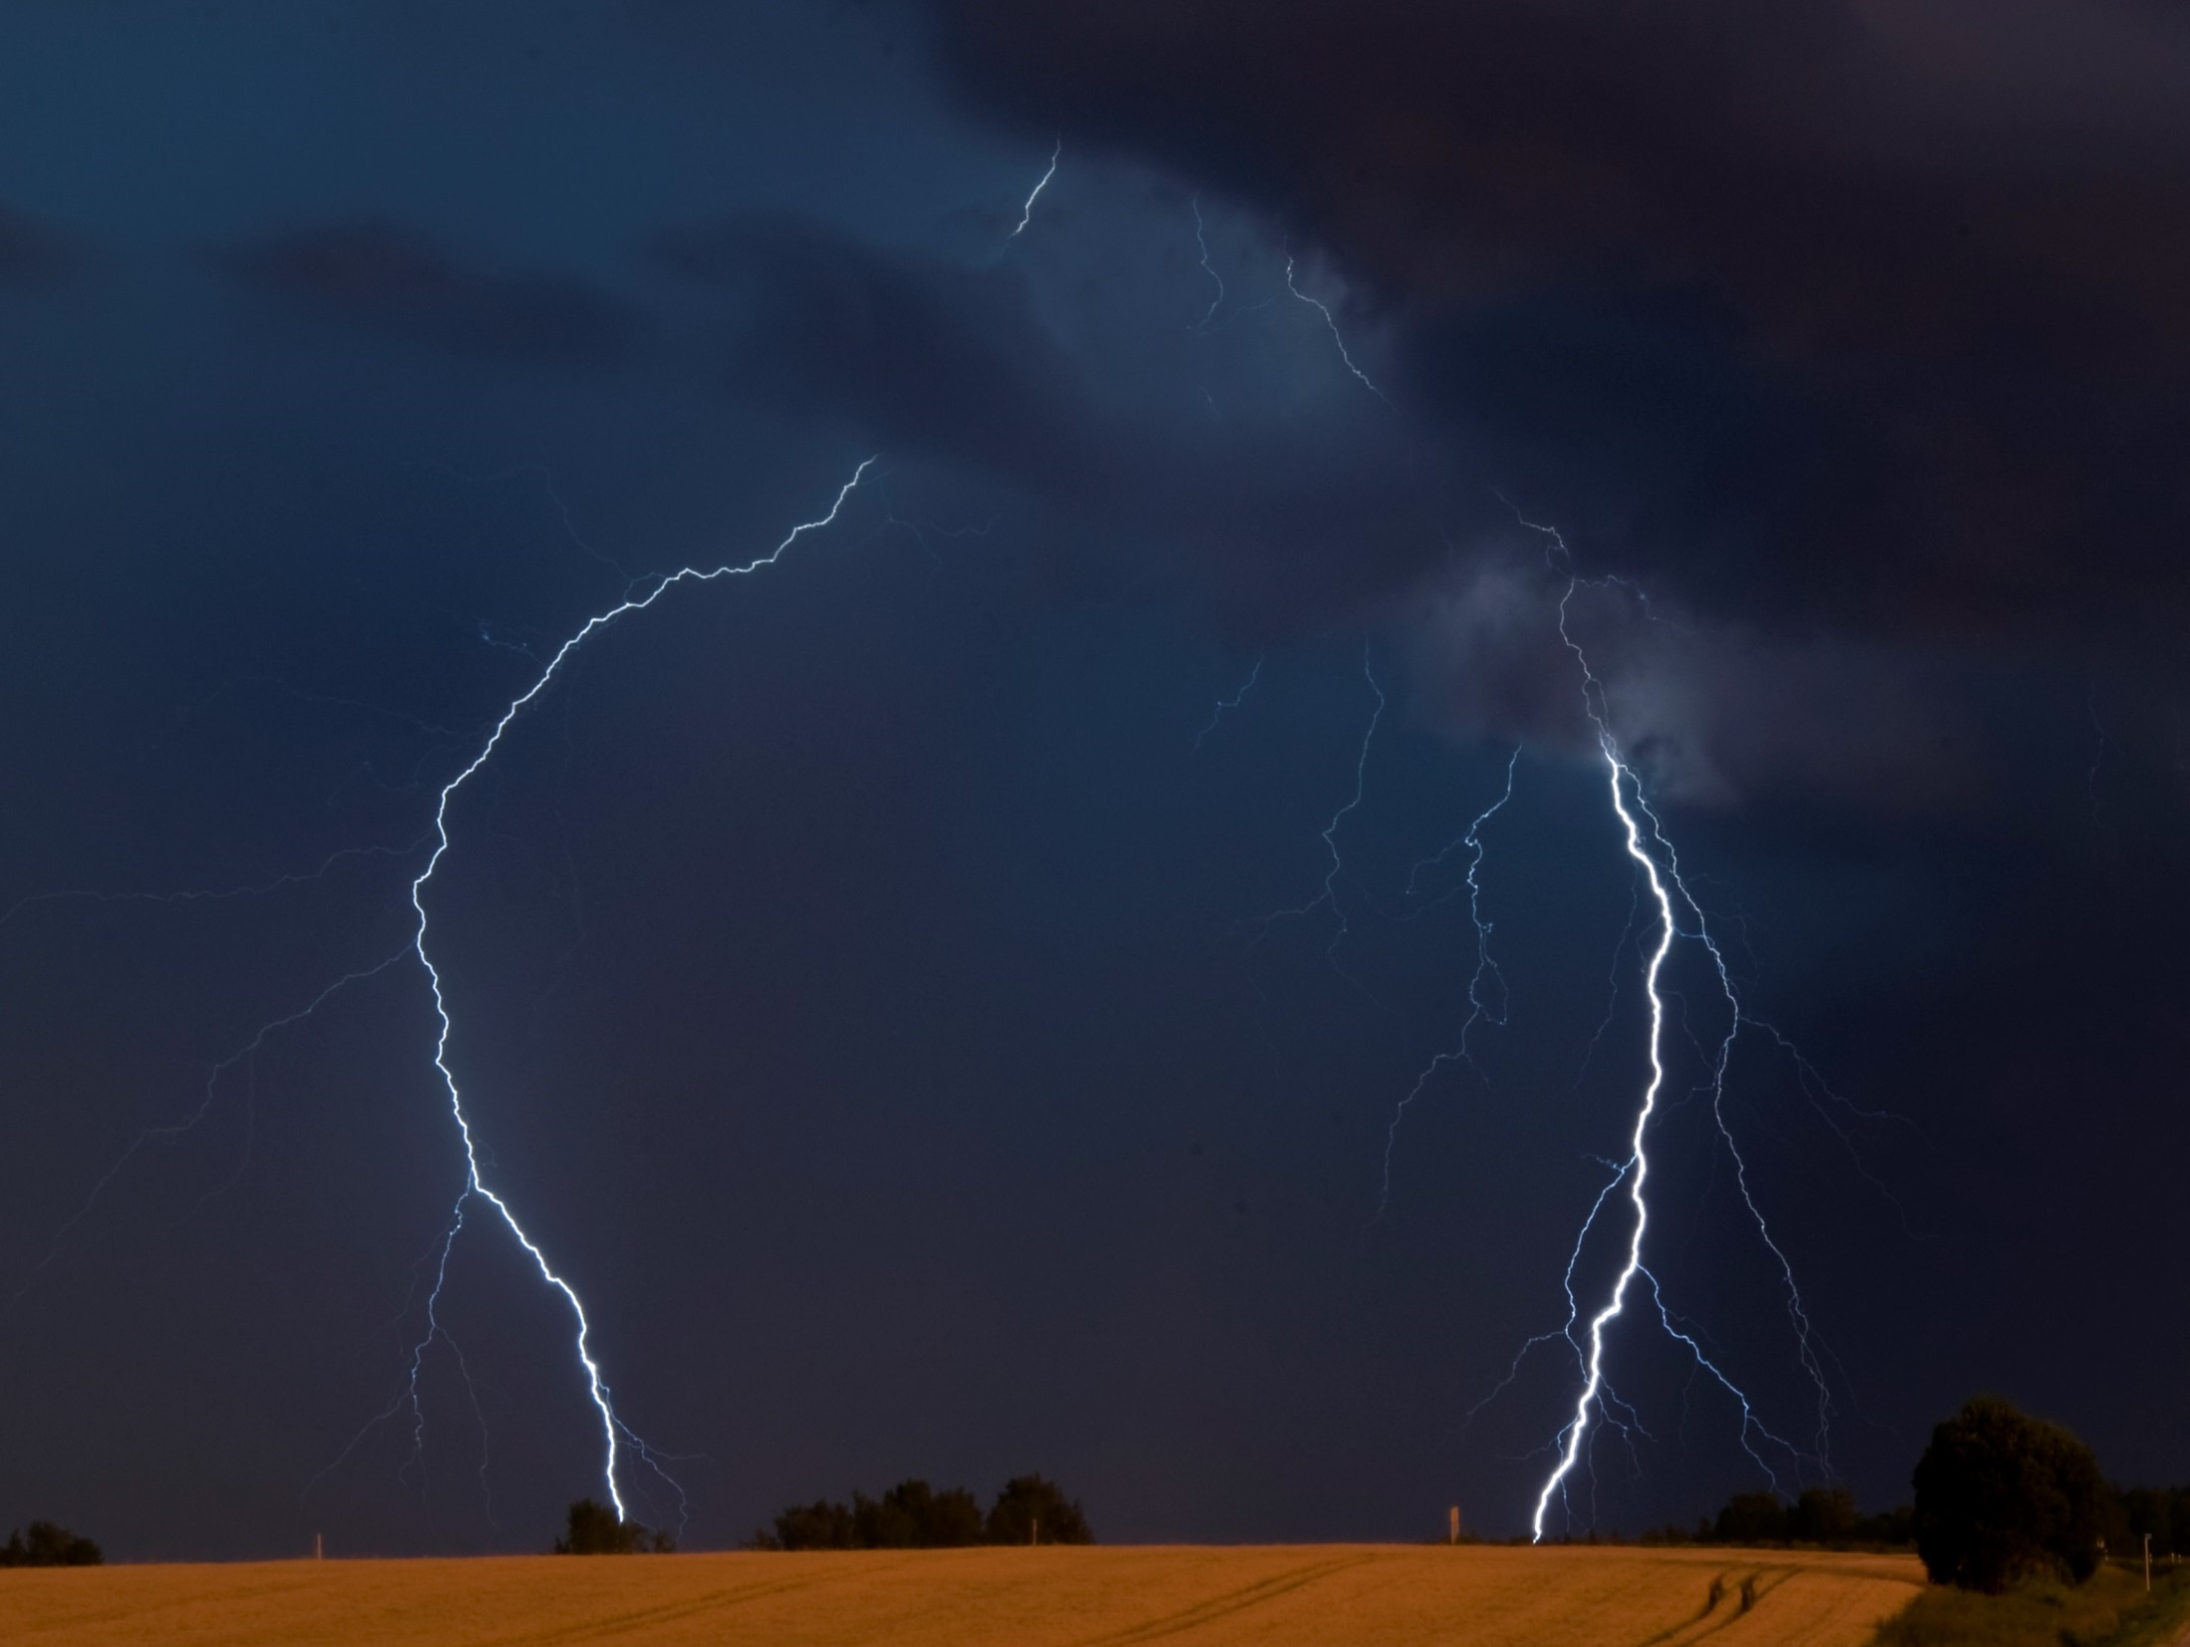
Thank You

