Slide 1
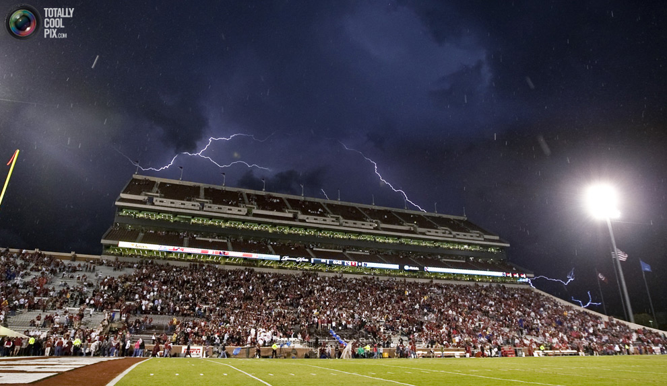

Dr. Kevin Kloesel, University Meteorologist
University of Oklahoma
American Meteorological Society
Policy Program’s Capitol Hill Briefing Series
20 November 2014
Lightning and Public Safety on a University Campus

Slide 2
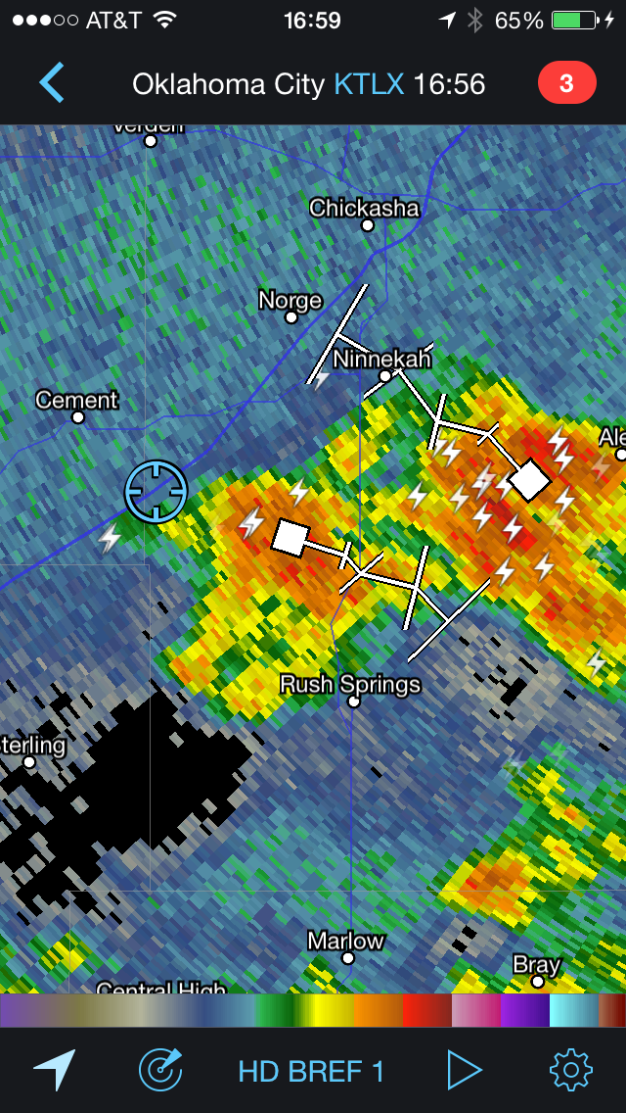
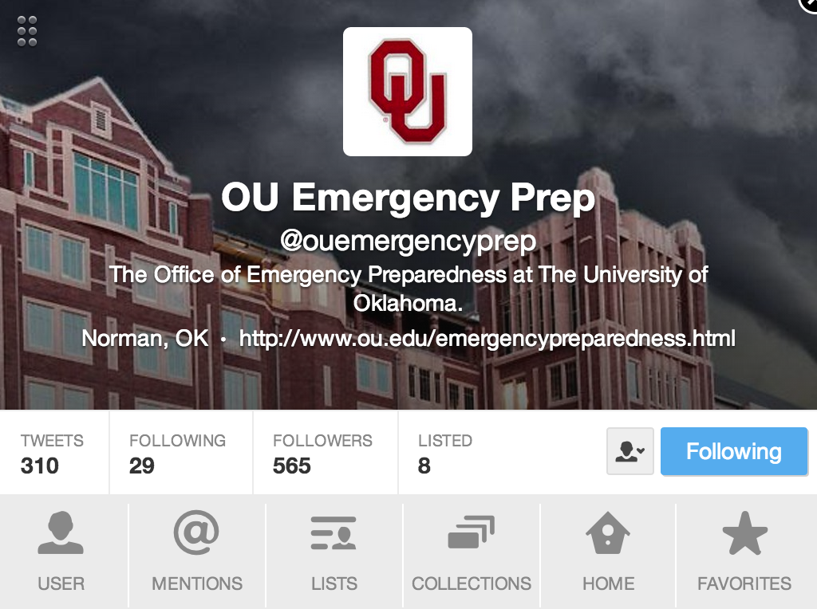
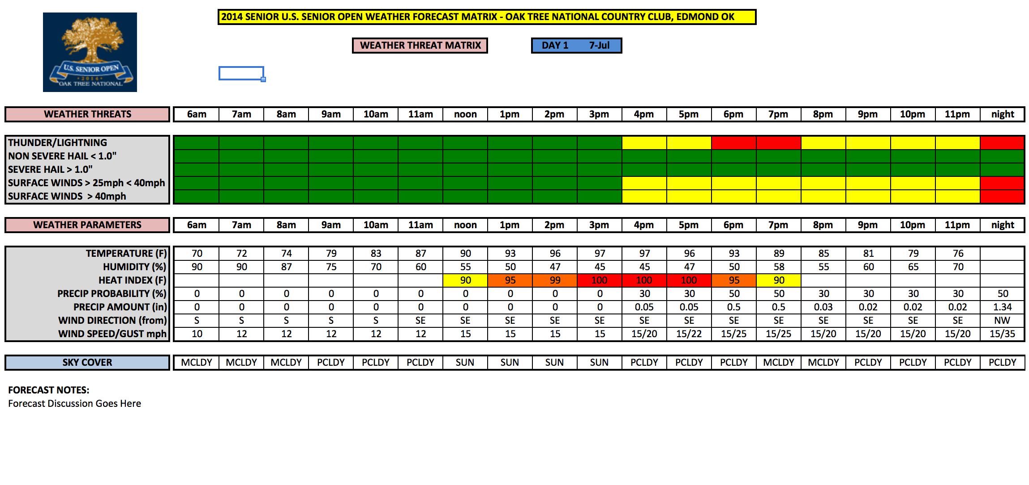
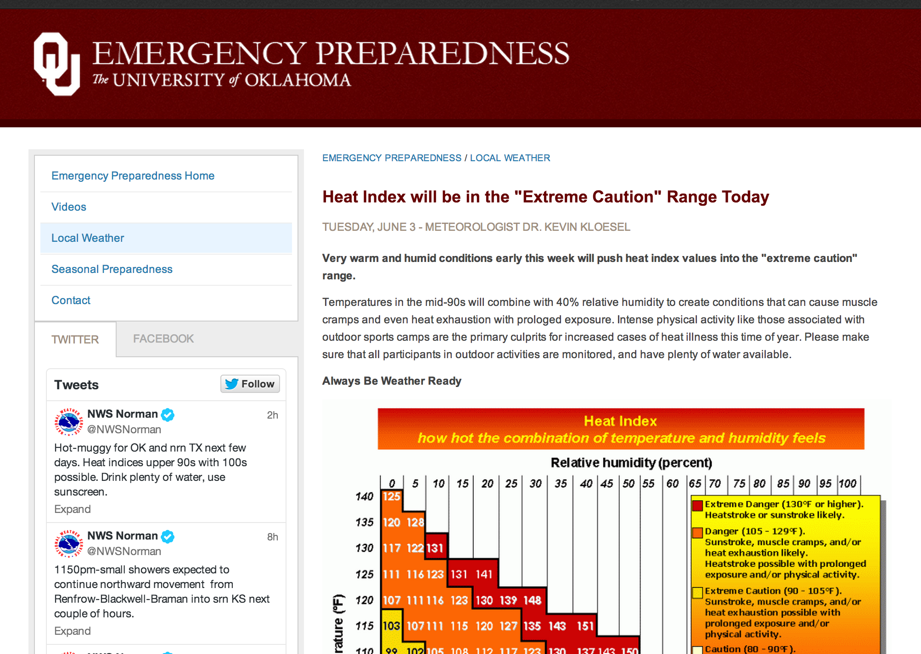
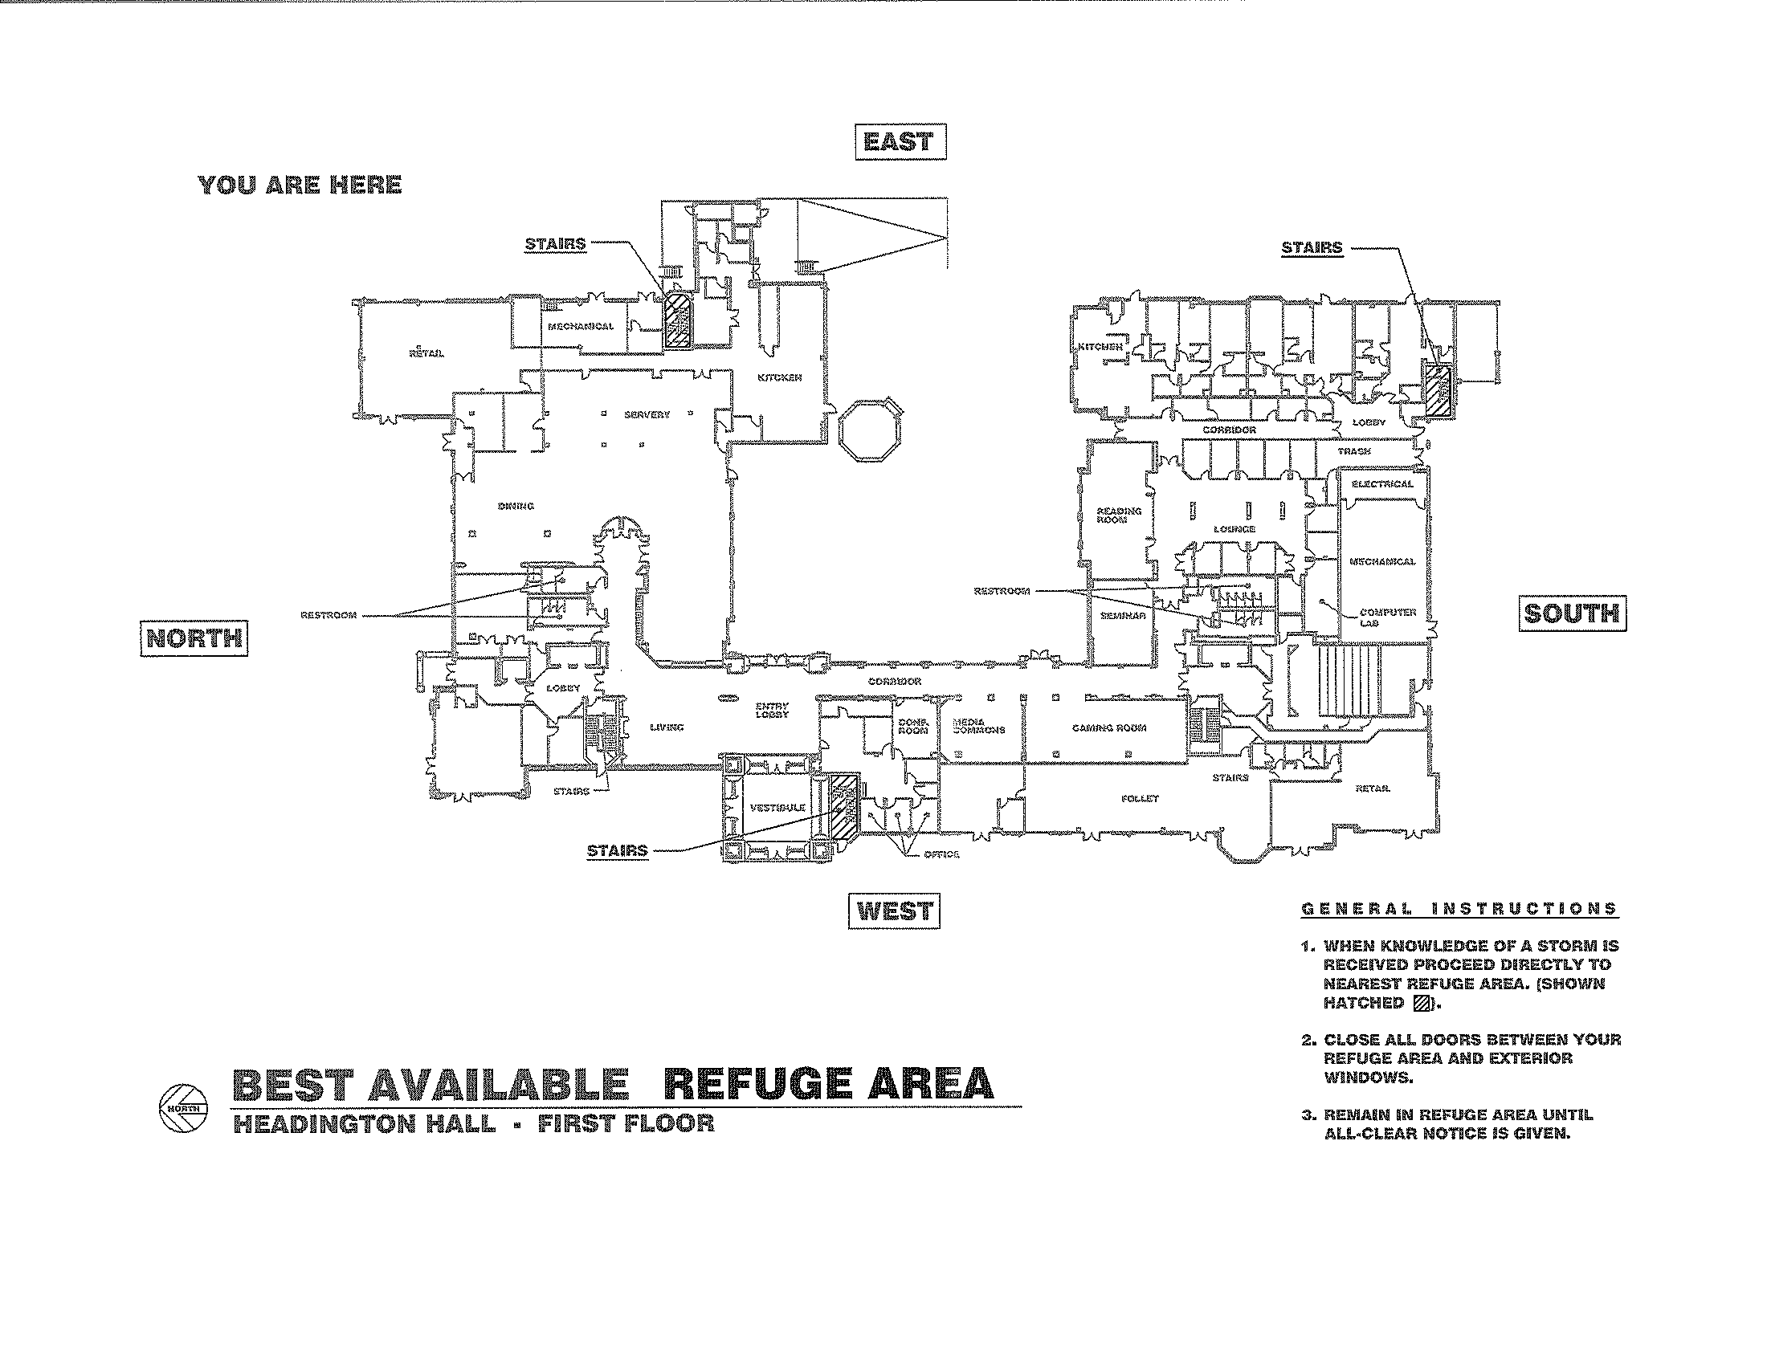
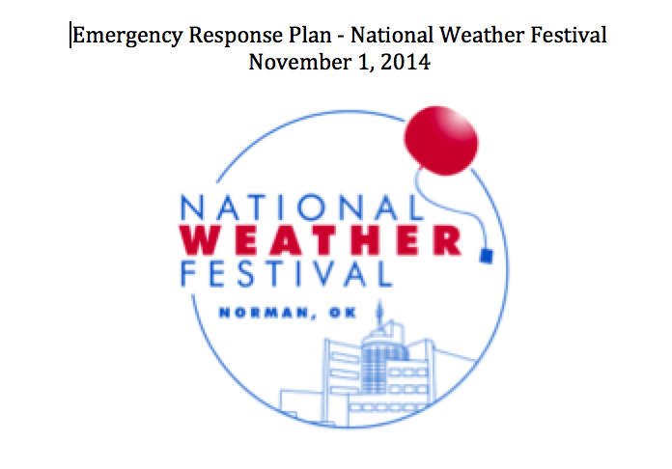
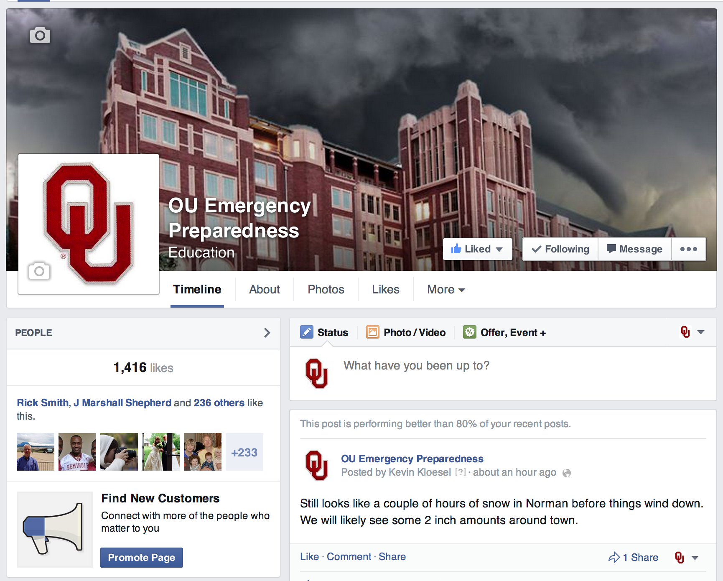
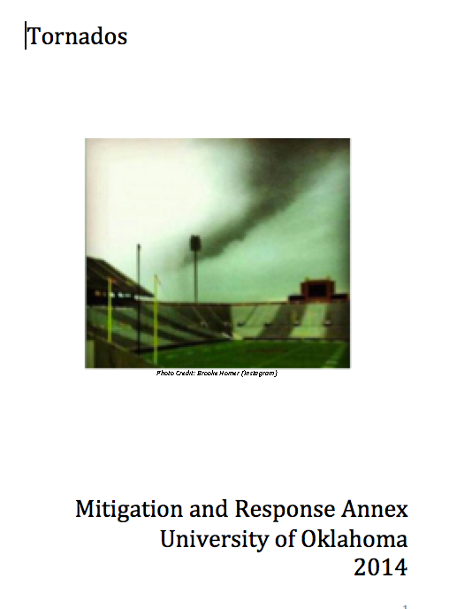
What is a University Meteorologist?
Hazard and safety forecasting for events, education and training of students/faculty/staff, production of weather annexes, building evacuation and sheltering plans, sheltering, and direct event safety support, etc.
Notes:
These are the things that I am tasked with in my position as University Meteorologist. I update the web page daily, or as needed more frequently. Take care of social media, provide ICS213-Wx forms for ICS/NIMS activities, write annexes for the OU EOP. Forecasts, safety training, education, syllabus text, etc.

Slide 3
Today, we will highlight the following four topics:
1. The intersection of lightning (and other weather hazards) and people is not new, and is the subject of research papers and articles.
2. Lightning Kills
3. The current state of “venue” protection from weather (with and without lightning data) as observed via an audience participation case study.
4. Advice for successful practices where lightning is a threat.
Notes:
4 main points. Not a new problem, it’s a killer, too many pretty colors and reliance on traditional warnings, what can we do better?

Slide 4
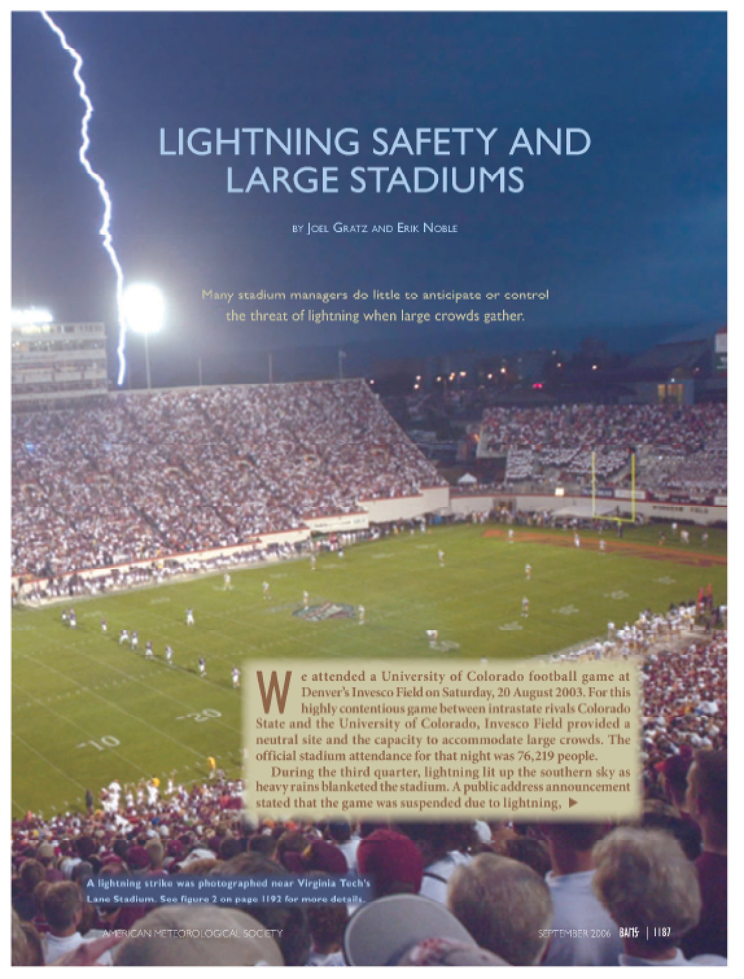
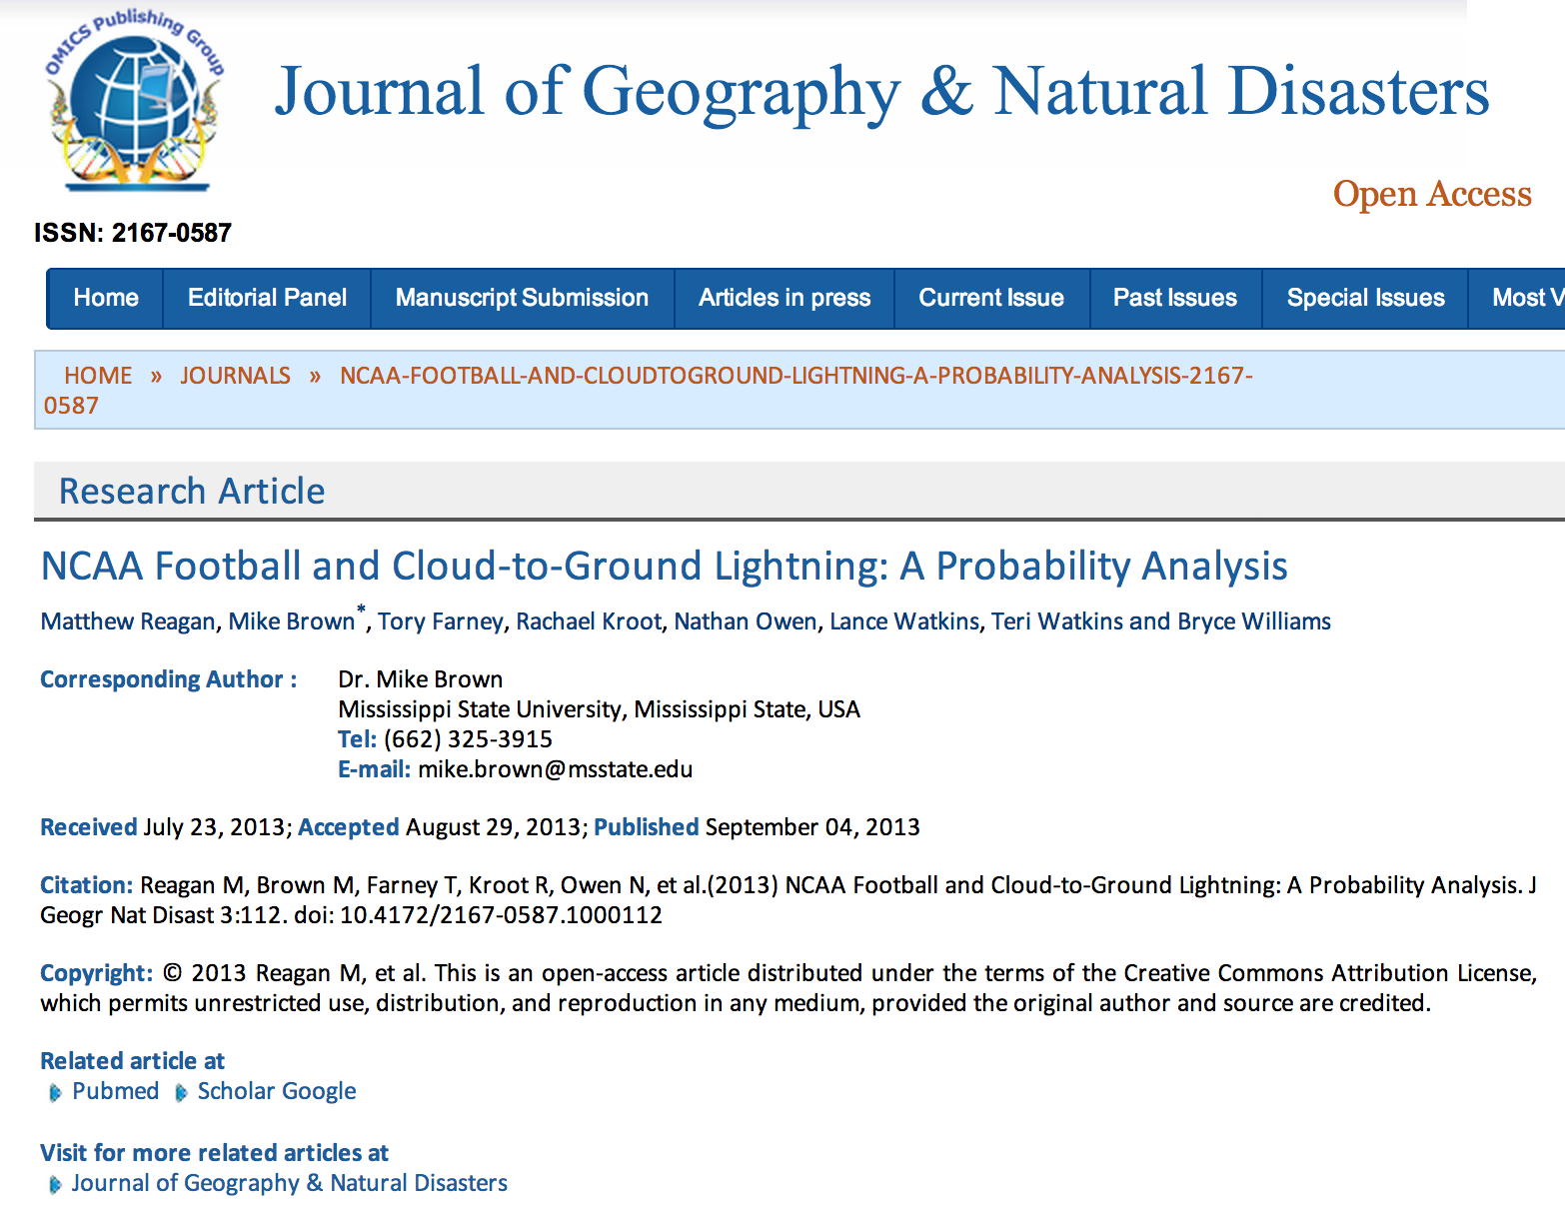
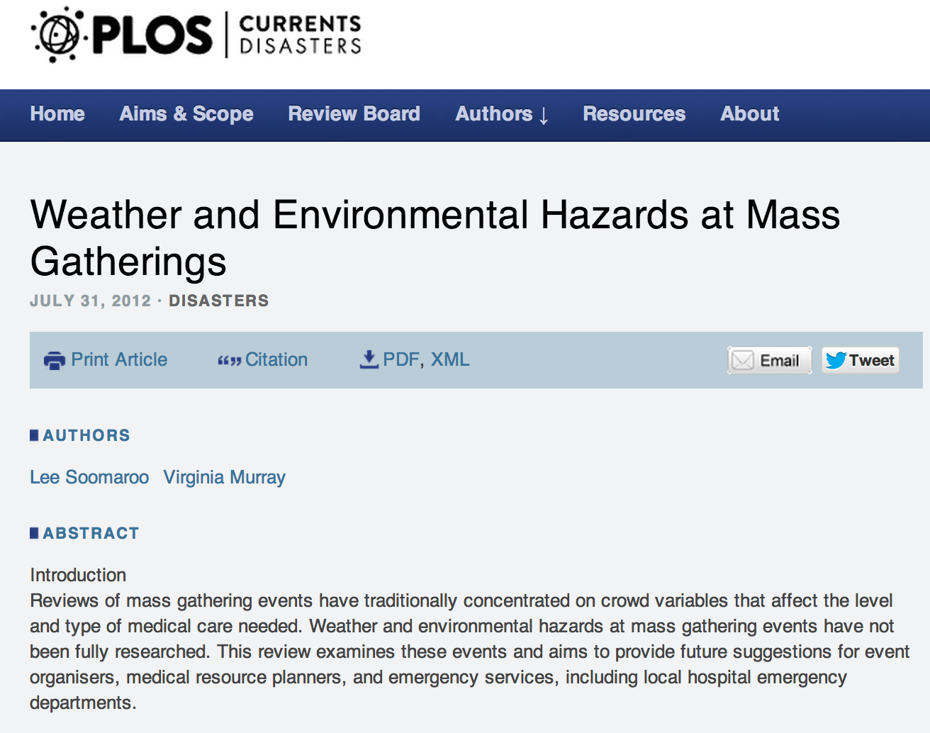
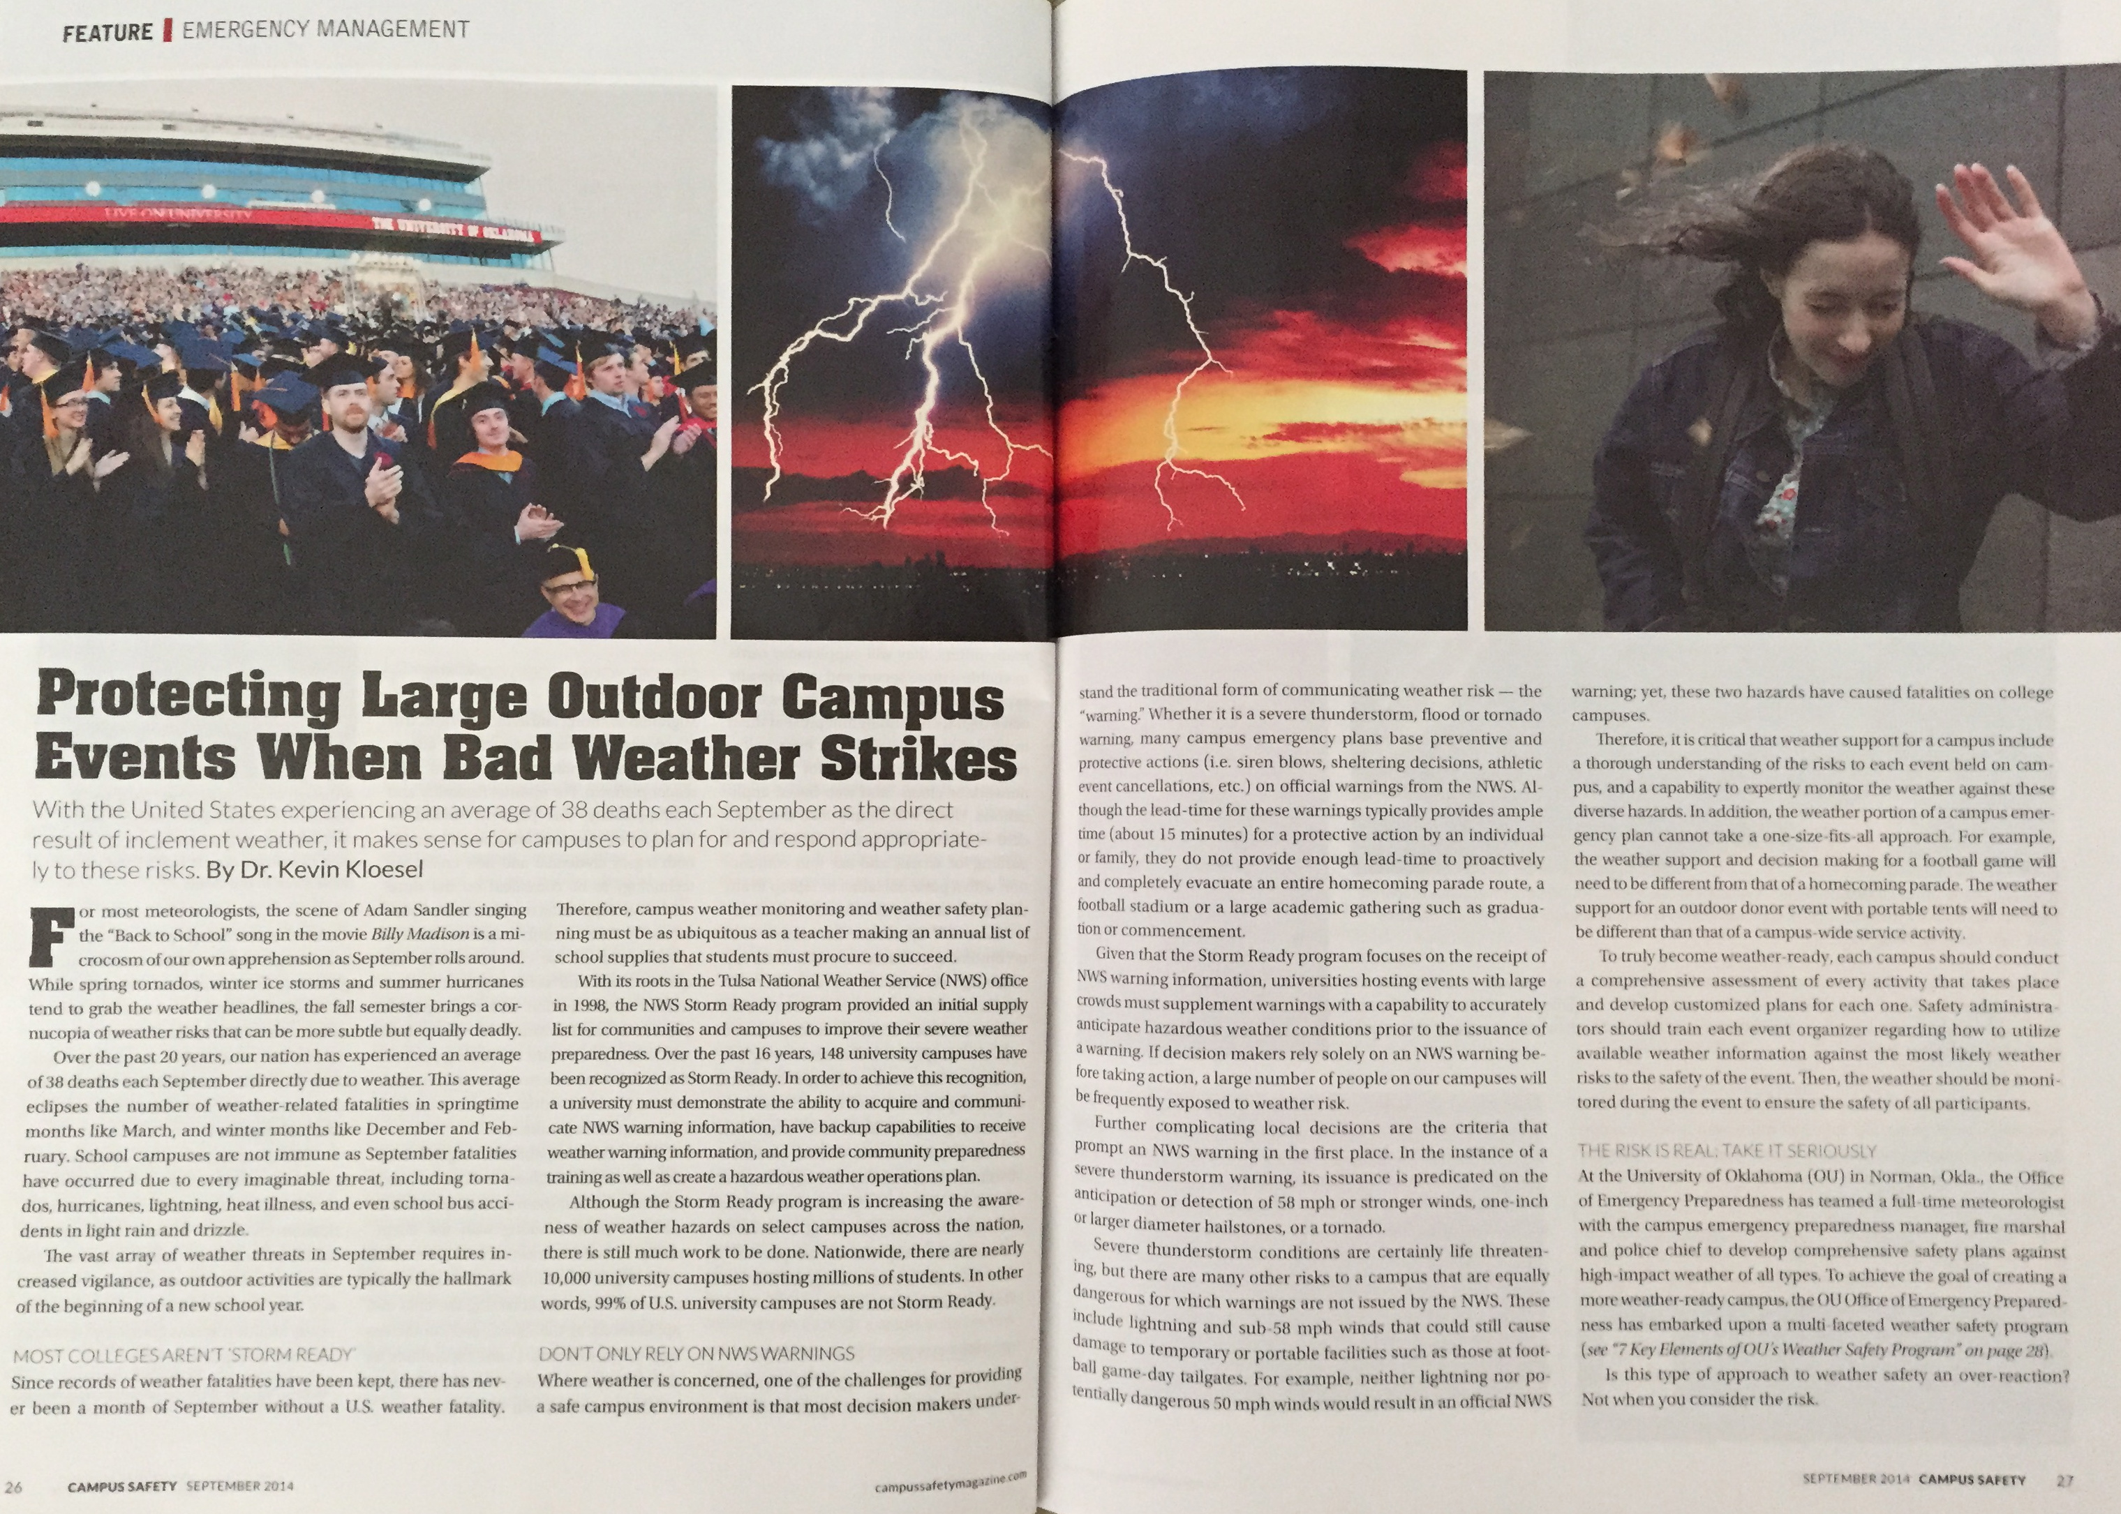
The topic we are discussing today is not new!
Notes:
Lots of previous research on this topic!

Slide 5

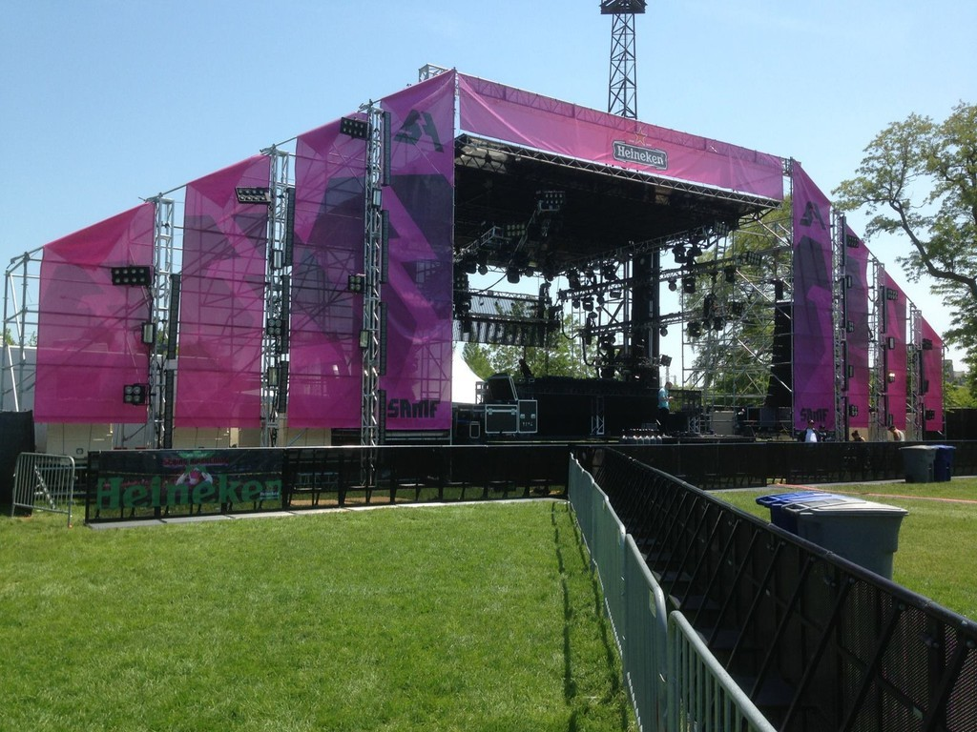
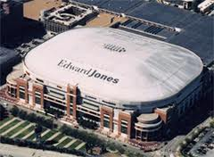
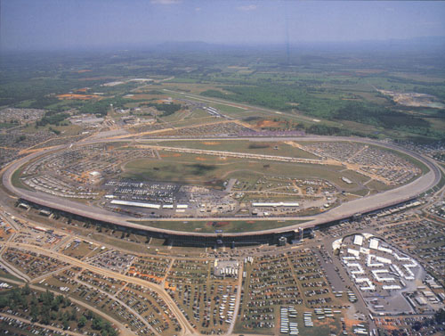

2012 Attendees at the National Weather Center
AEG WorldWide Los Angeles CA
Alpha & Omega Services, Inc. Southlake TX
Comcast Arena Everett WA
Contemporary Services Corporation Jacksonville FL
Dubuque Five Flags Center Dubuque IA
Edward Jones Dome Saint Louis MO
Elkhart County 4-H Fair Goshen IN
Emergency Management Torrington WY
Georgia World Congress Center Atlanta GA
GNW Evergreen Insurance Brentwood TN
Goshen County Division of Emergency Management Torrington WY
Indiana University Bloomington IN
K2 Structures Winton-Salem NC
Kansas Speedway Kansas City KS
Kansas State Athletics Manhattan KS
Klance Unlimited Pacific MO
Kleege Industries, Inc. San Diego CA
Lambda Productions Brecksville OH
Linkin Park Downingtown PA
Little Rock Convention and Visitor's Bureau Little Rock AR
North Kansas City Missouri Fire Department Kansas City MO
Phish Inc. Willow Grove PA
Romeo Entertainment Group Omaha NE
Sandy Amphitheater Sandy UT
SMG Wichita KS
Superfly Presents Rocklin CA
Talladega Super Speedway Talladega AL
TOMCAT USA, Inc. Midland TX
Tuba Productions Lawrence KS
Tulsa Drillers Tulsa OK
University of Georgia Athens GA
Veteran Fire Department Lingle WY
Walton Arts Center Fayetteville AR
Wakarusa & Pipeline Productions Leawood KS
Yoder Fire Department Yoder WY
Notes:
We have hosted a severe weather safety workshop for venue managers in 2012, 2013, 2014 This is the 2012 list

Slide 6
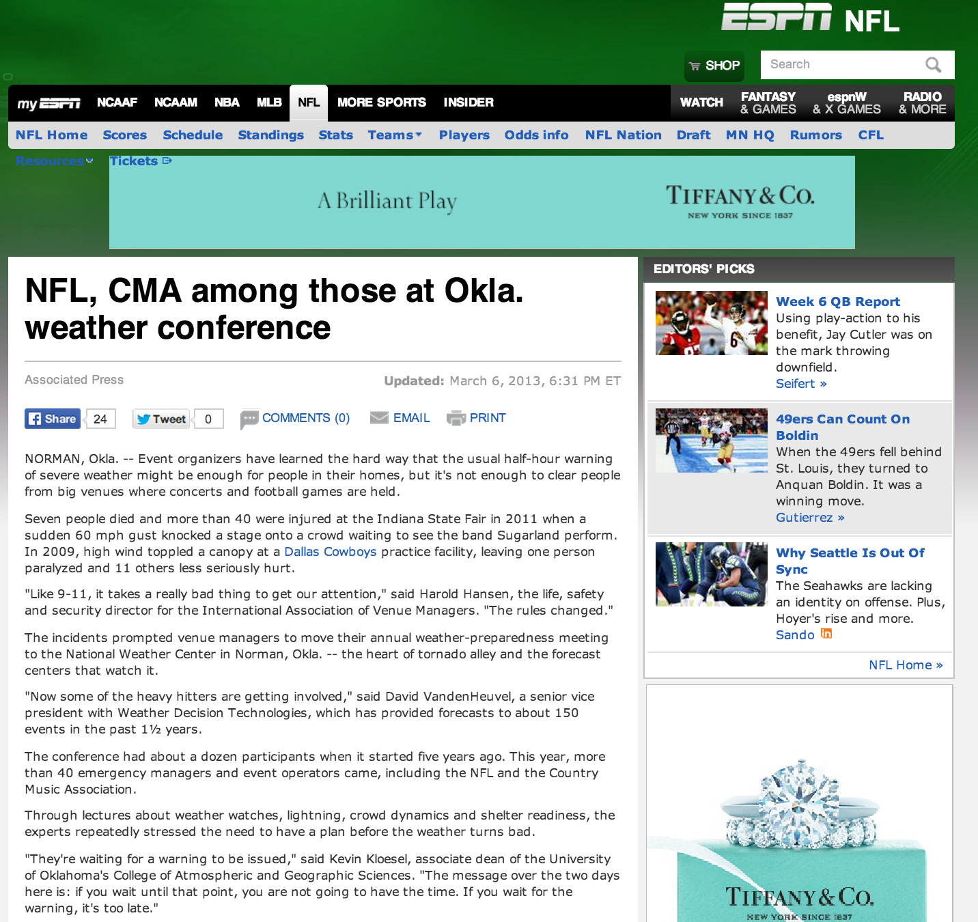
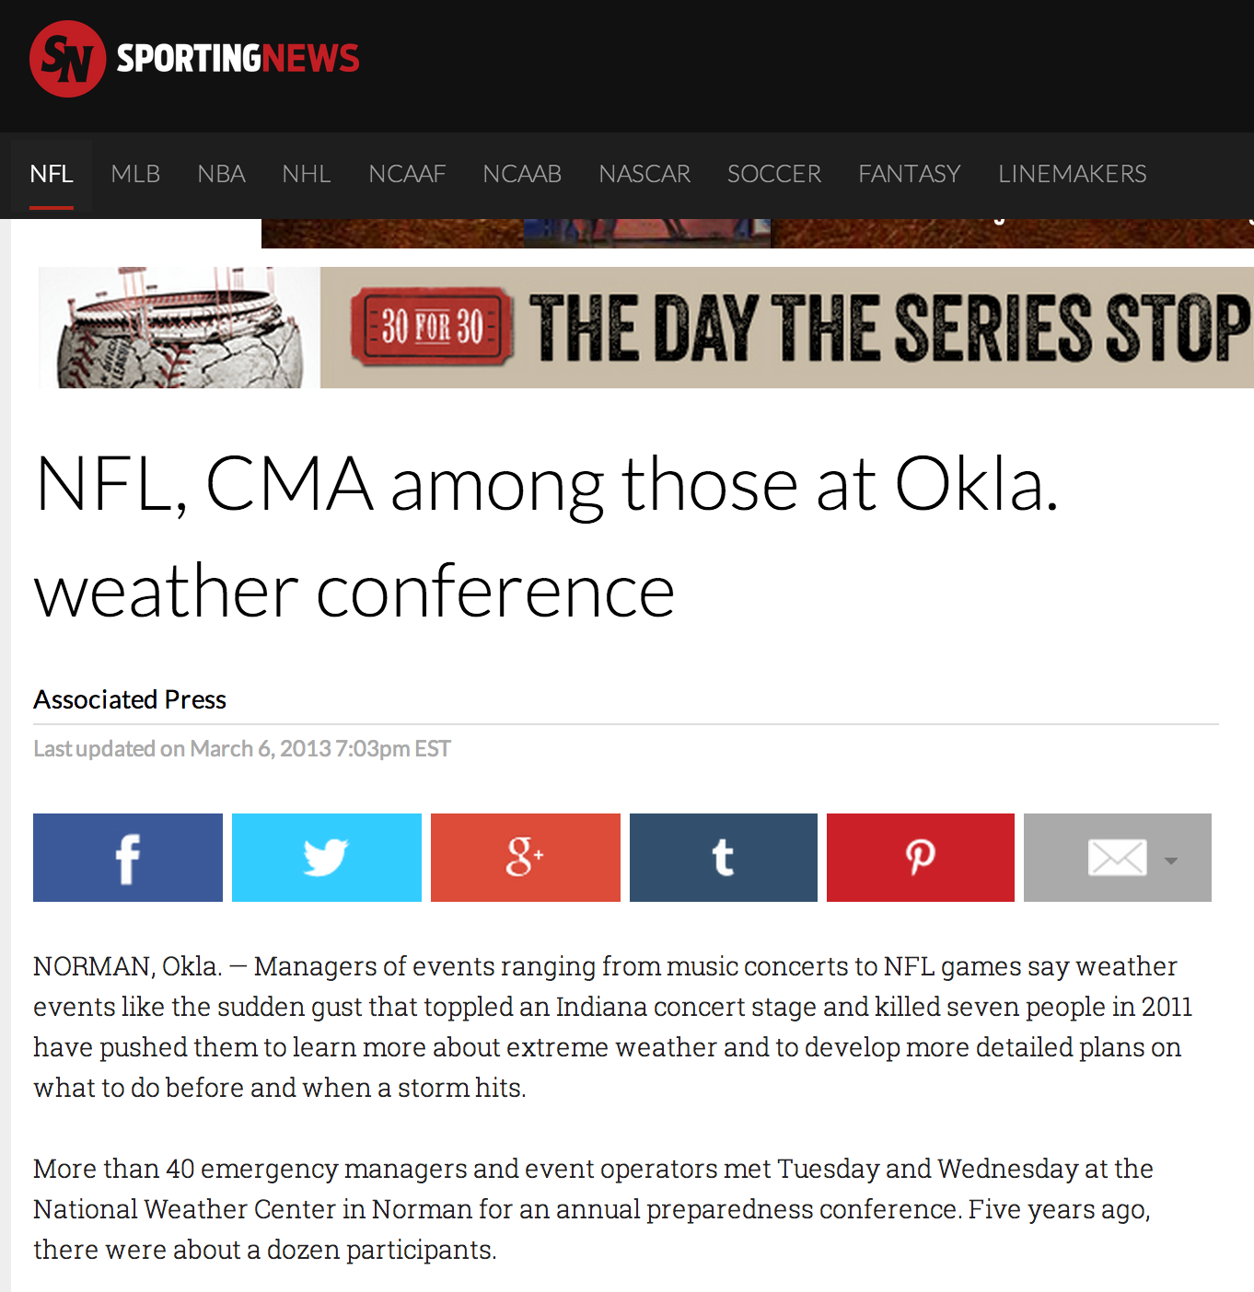
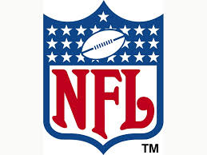
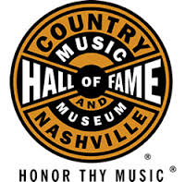
2013 Attendees at the National Weather Center
Amarillo Civic Center Complex Amarillo TX
Arkansas State Univ Convocation Center State University AR
Baylor University Waco TX
Chicagoland Speedway/Route 66 Raceway Joliet IL
Country Music Association Nashville TN
Downtown Bentonville, Inc. Bentonville AR
East Carolina University Greenville NC
Environment Canada Edmonton AB Canada
Event Staffing Incorporated Virginia Beach VA
Event Tech Baltimore MD
Georgia Dome Atlanta GA
Hershey Entertainment & Resorts Company Hershey PA
Integrated Management Group Portsmouth VA
Kansas Speedway Kansas City KS (2)
Klance Unlimited Pacific MO (2)
Magouirk Conference Center Dodge City KS
Monterrey Security Consultants Chicago IL
National Football League New York NY
Pocono Raceway Long Pond PA
Pro Event Staging Lowell MA
Rhino Staging & Event Solutions Tempe AZ
Select Management & Security Belfast Ireland
United Wireless Arena Dodge City KS
Utah State Fair Park Salt Lake City UT
Winnebago County Emergency Management Oshkosh WI
Notes:
2013

Slide 7
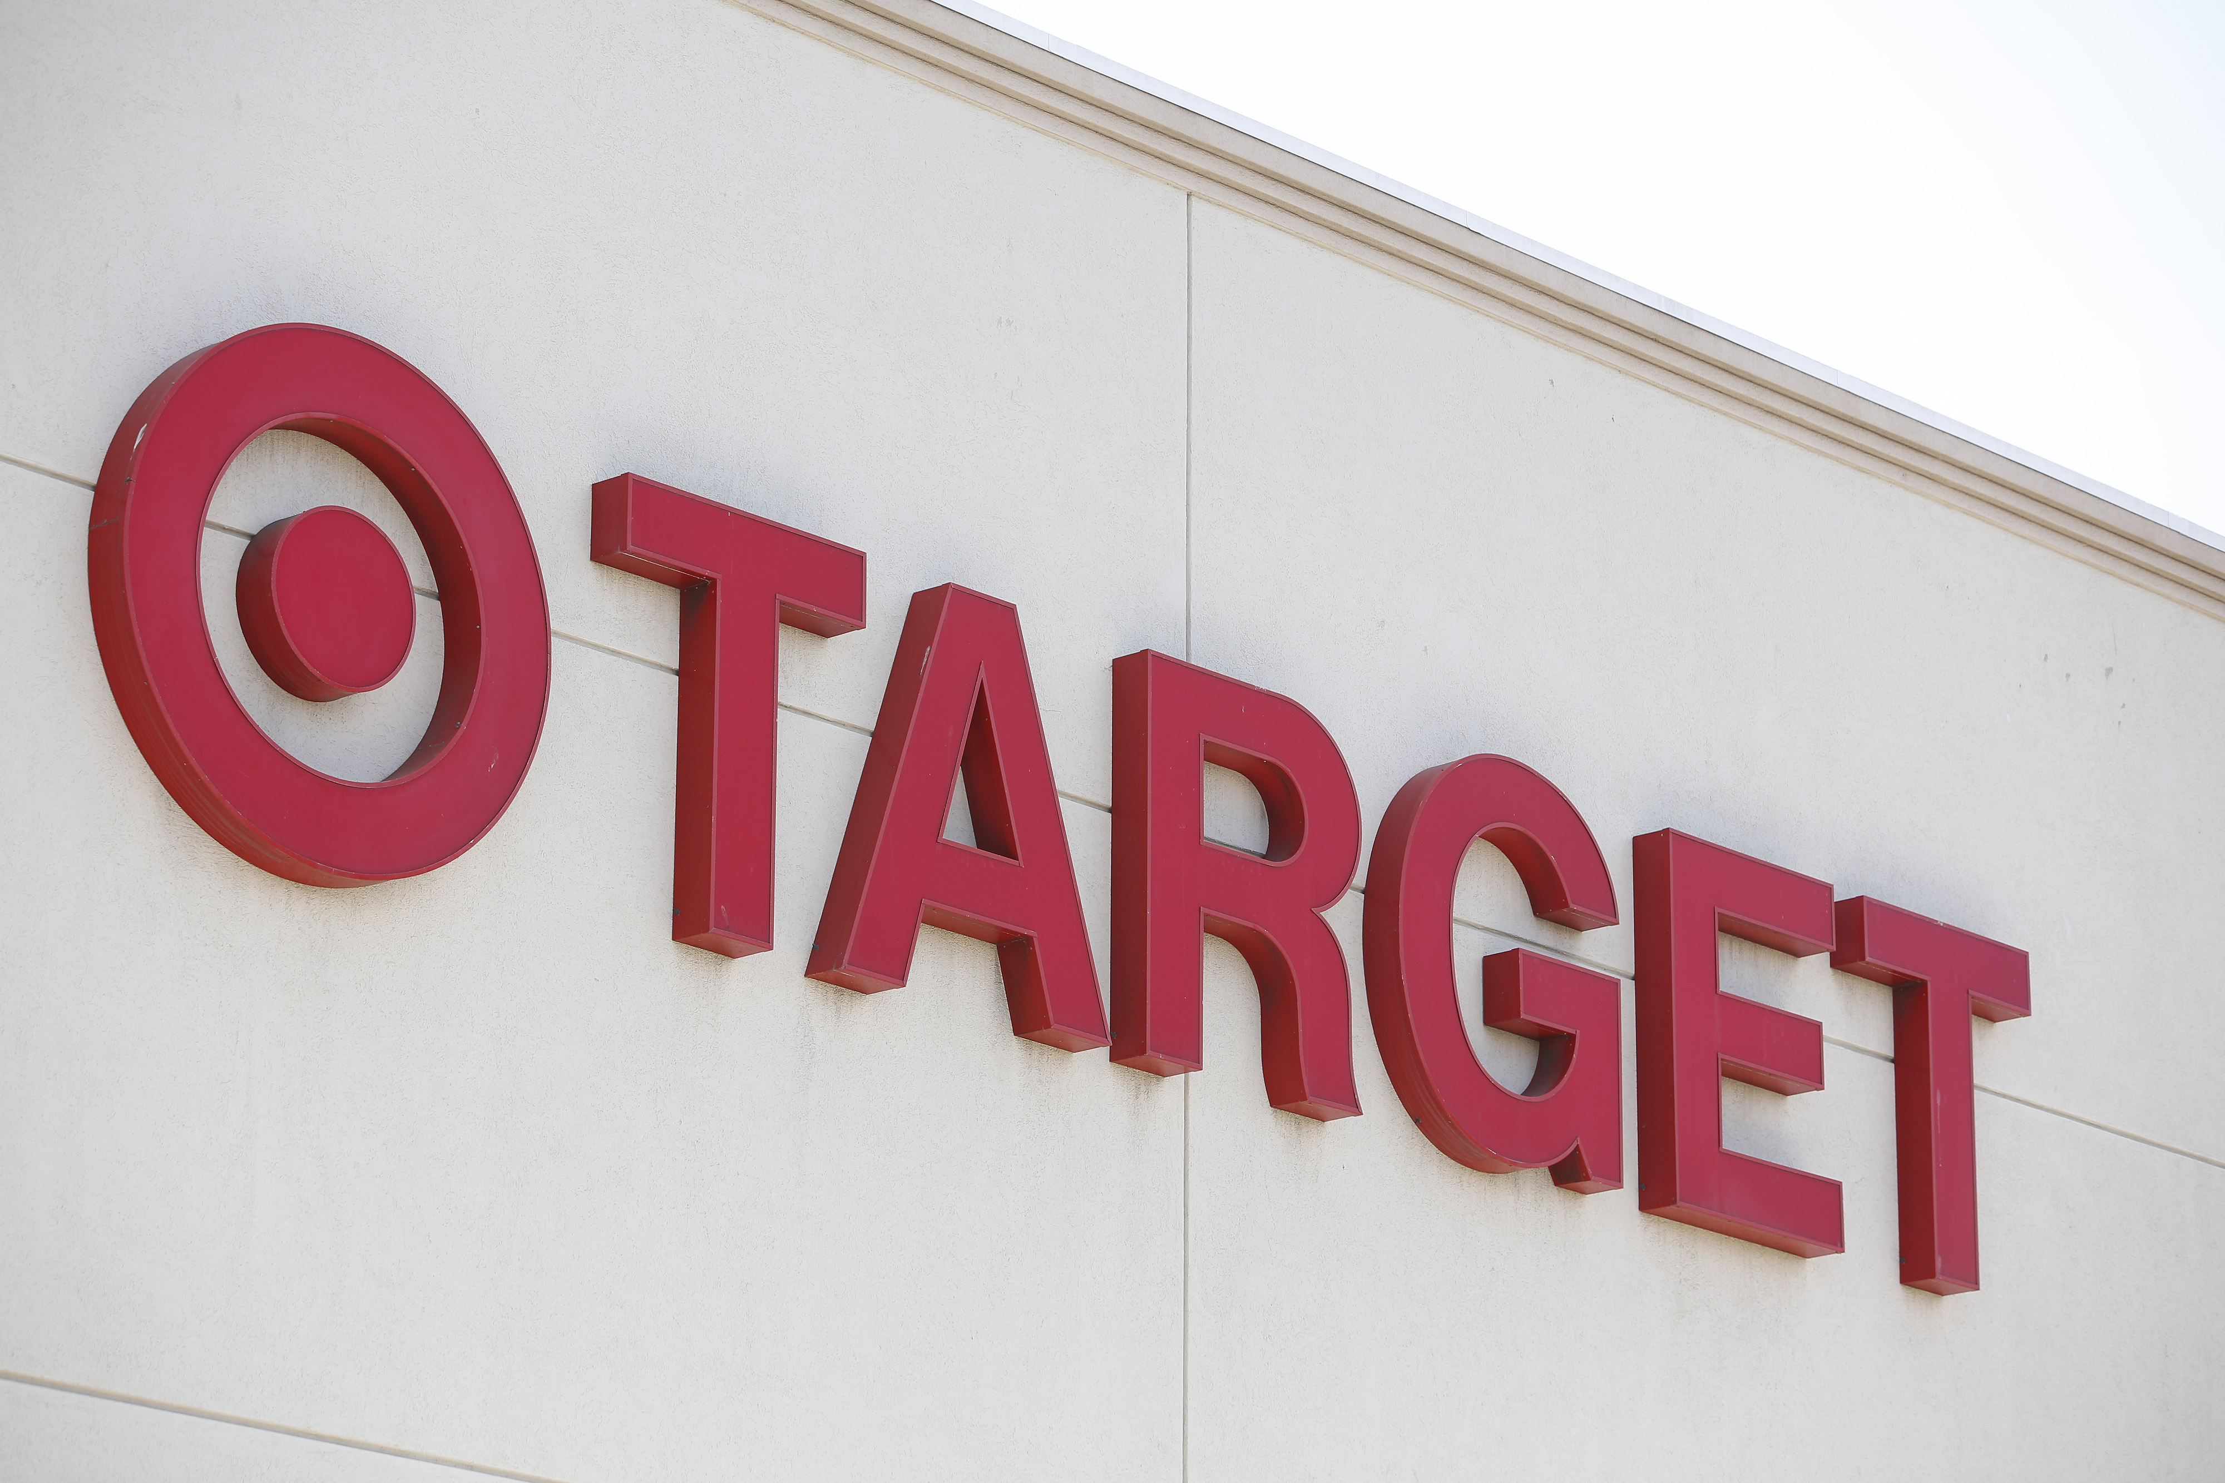

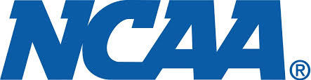

2014 National Weather Center
AEG Worldwide Los Angeles CA (2)
AT&T Performing Arts Center Dallas TX
Braden Auditorium Normal IL
CIty of Fort Worth Fort Worth TX
Cruzan Amphitheatre West Palm Beach FL
El Paso Live El Paso TX
Fort Worth Convention Center Fort Worth TX
Hershey Entertainment and Resorts Hershey PA (2)
Illinois State University Normal IL
INTRUST Bank Arena Wichita KS
Klance Unlimited Pacific MO (3)
Klipsch Music Center/Live Nation Noblesville IN
Live Nation Maryland Heights MO
NCAA Indianapolis IN
Show Me Center Cape Girardeau MO
SMG Wichita KS (2)
Target Corporation Minneapolis MN
University of Notre Dame Notre Dame IN
Verizon Theatre Grand Prairie TX
Walmart Stores, Inc Bentonville AR
Will Rogers Memorial Center Fort Worth TX
Zoo Amphitheater Grand Prairie TX
(76 Venues/Entities over 3 years; Next: Mar 10-12, 2015)
Notes:
2014 included the ‘Box stores” for the first time.

Slide 8
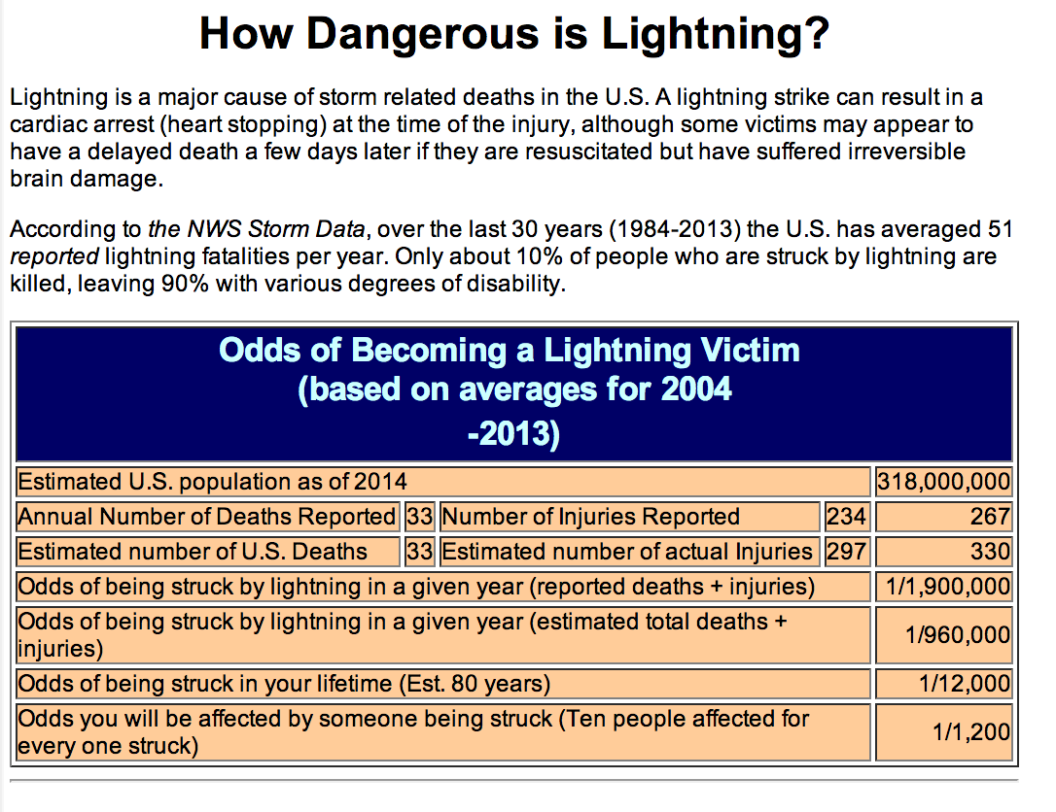
Data courtesy of John Jensenius – NOAA/NWS <john.jensenius@noaa.gov>
Notes:
NWS items

Slide 9
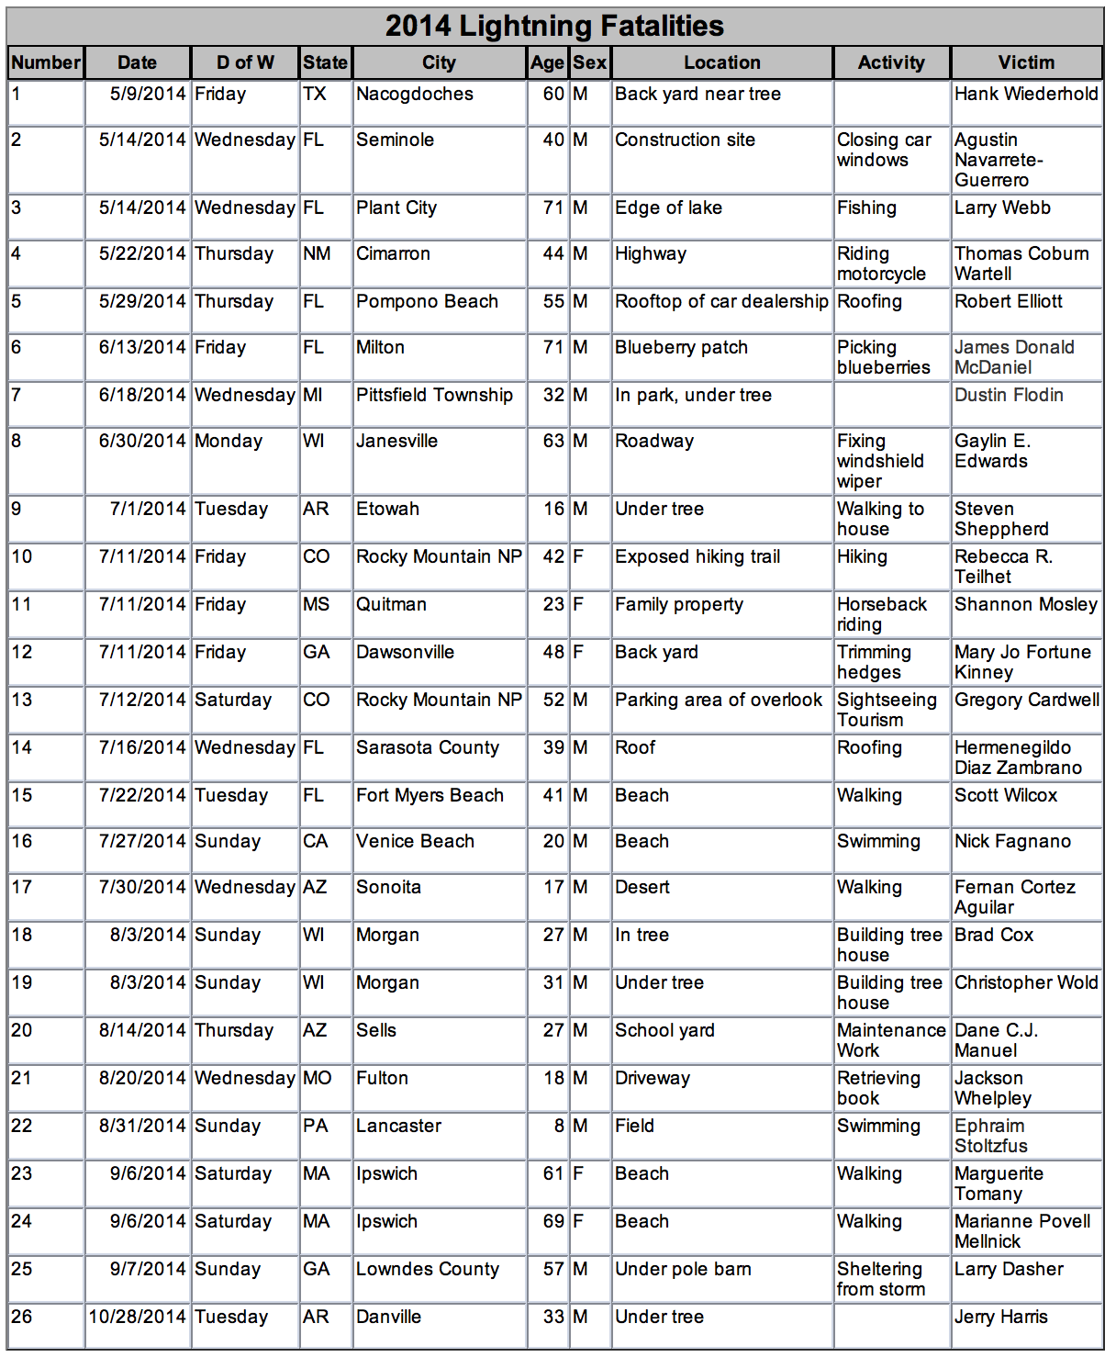
Lightning Kills!
Data courtesy of John Jensenius – NOAA/NWS <john.jensenius@noaa.gov>
Notes:
NWS items

Slide 10
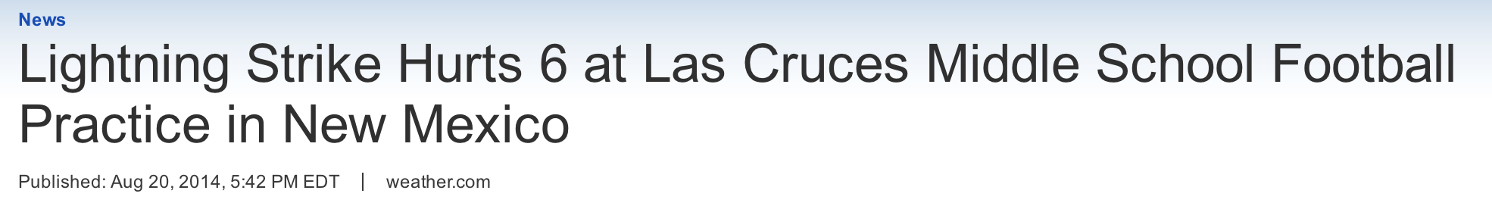
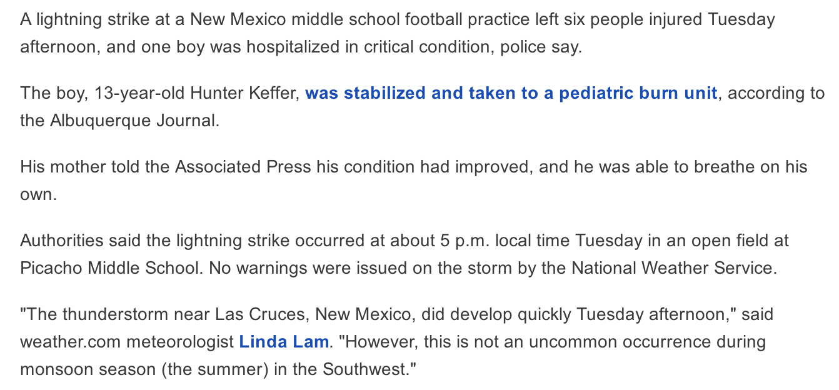
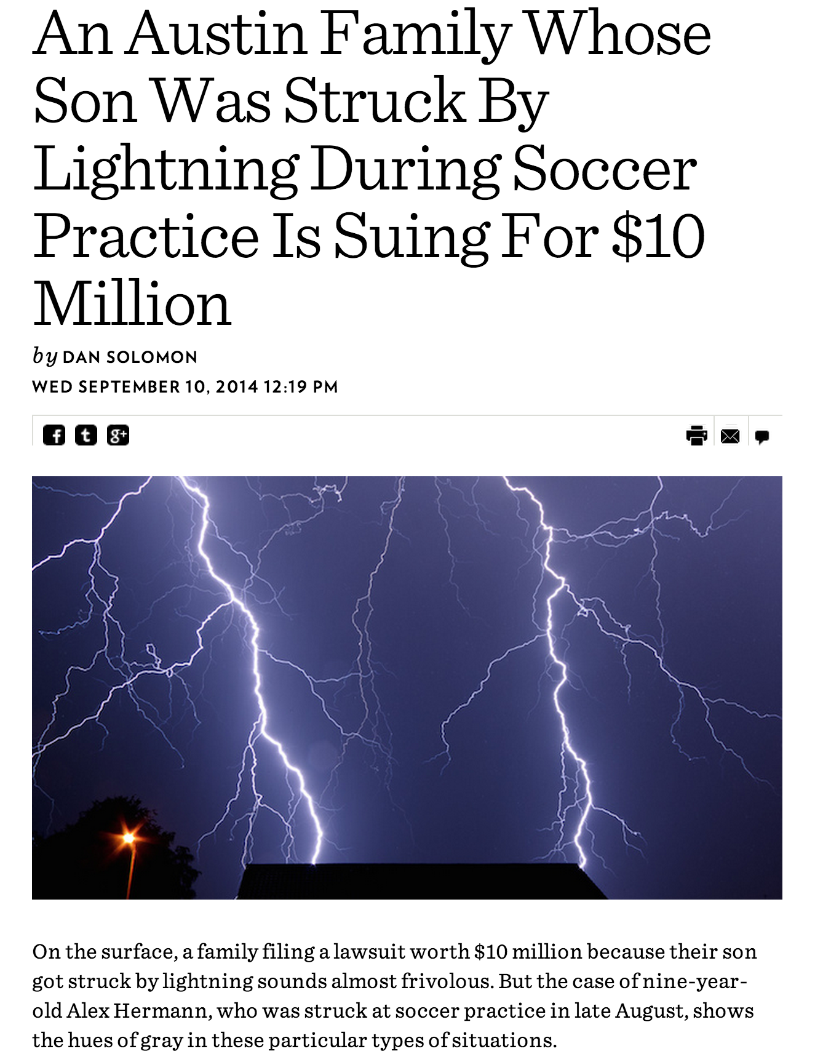
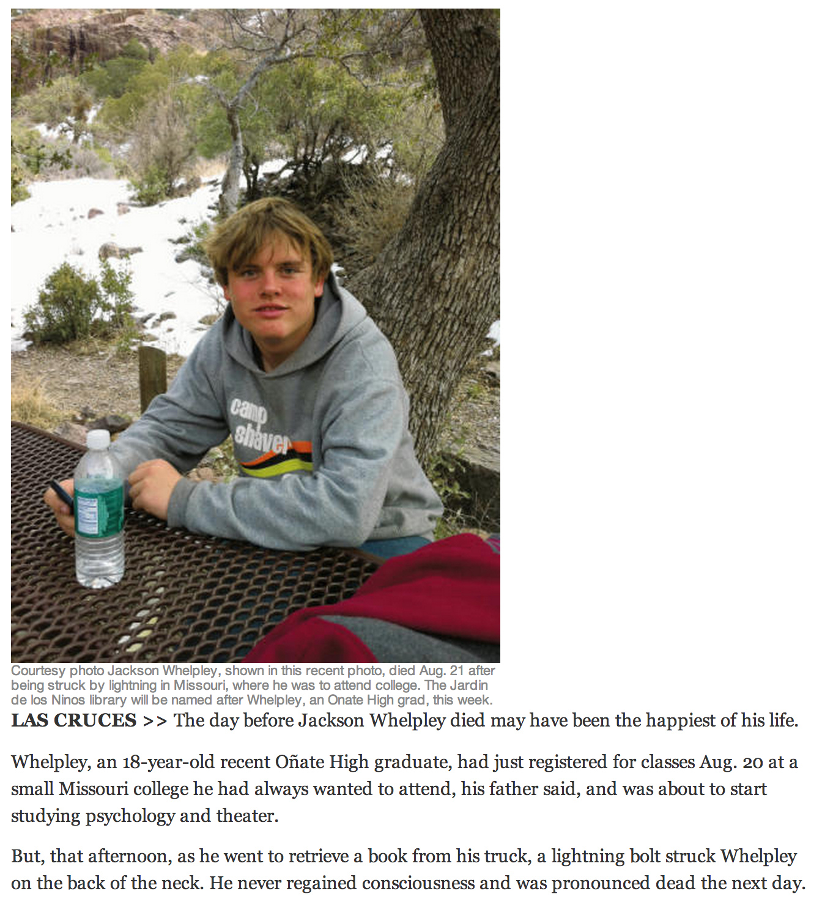
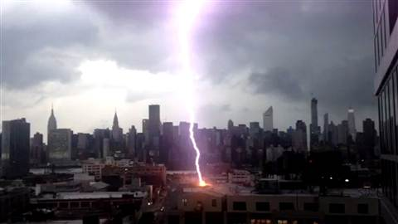
Notes:
Its now almost daily news

Slide 11
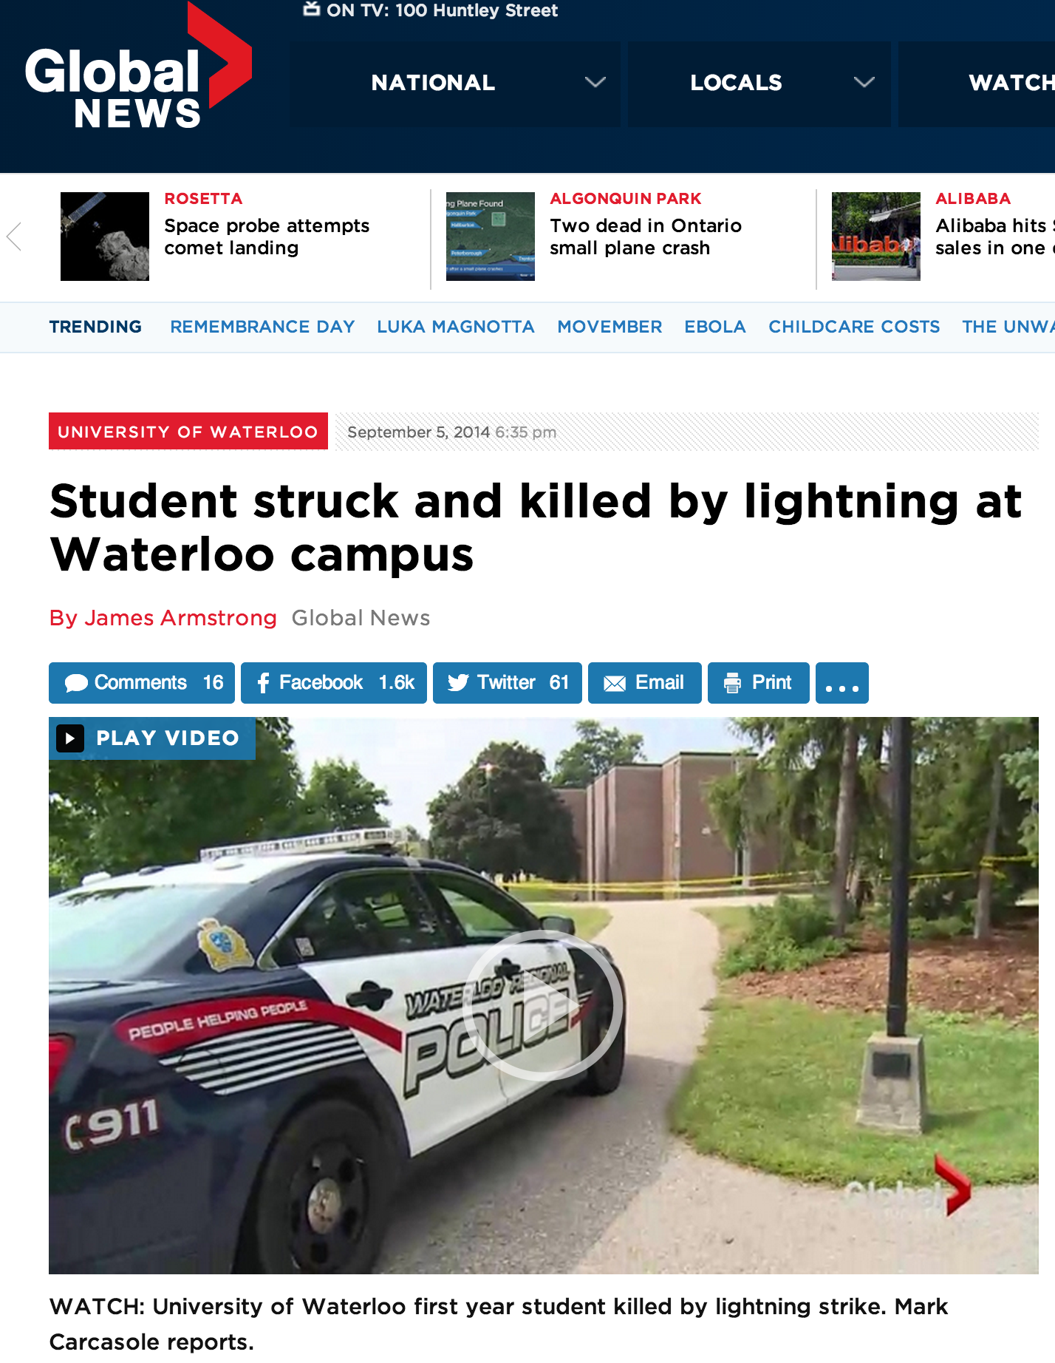
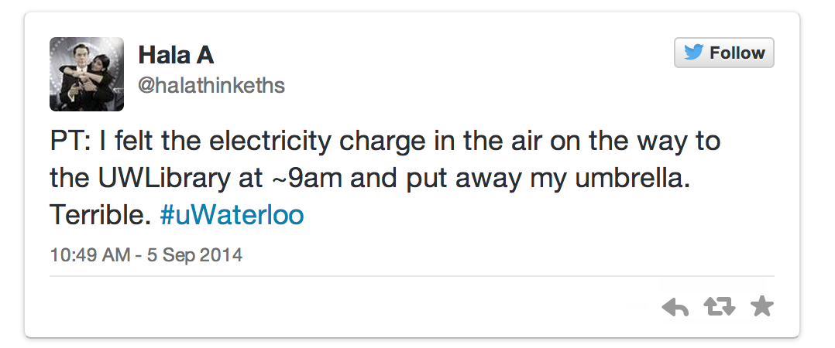
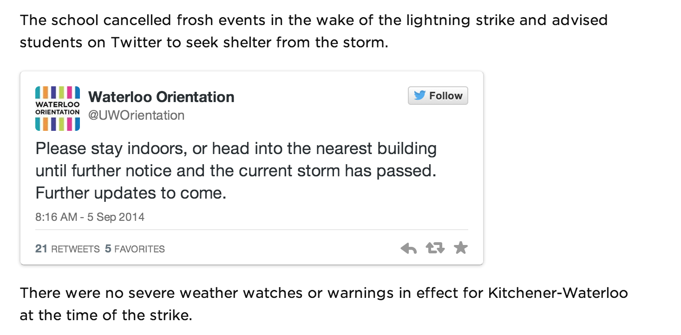
Notes:
I am extremely sensitive to campus lightning issues because so many of our students are outside every day, many times a day.. Not to mention events!

Slide 12
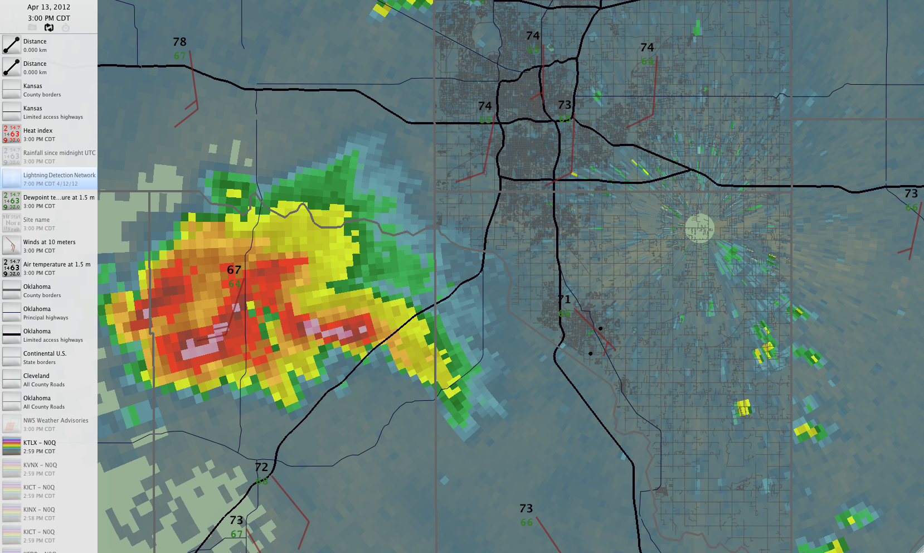
AN EXAMPLE: Central Oklahoma 3:00 pm Central Time Friday 13 April 2012
OKC
MOORE
NORMAN
RADAR HAS BECOME A PRIMARY WEATHER MONITORING TOOL (EMs, Broadcasters, etc.)
Notes:
13 April 2012. The day that set the stage for a newfound awareness of needing to be prepared in Norman. What would you be doing if you were a decision maker in OKC? Moore? Norman?

Slide 13
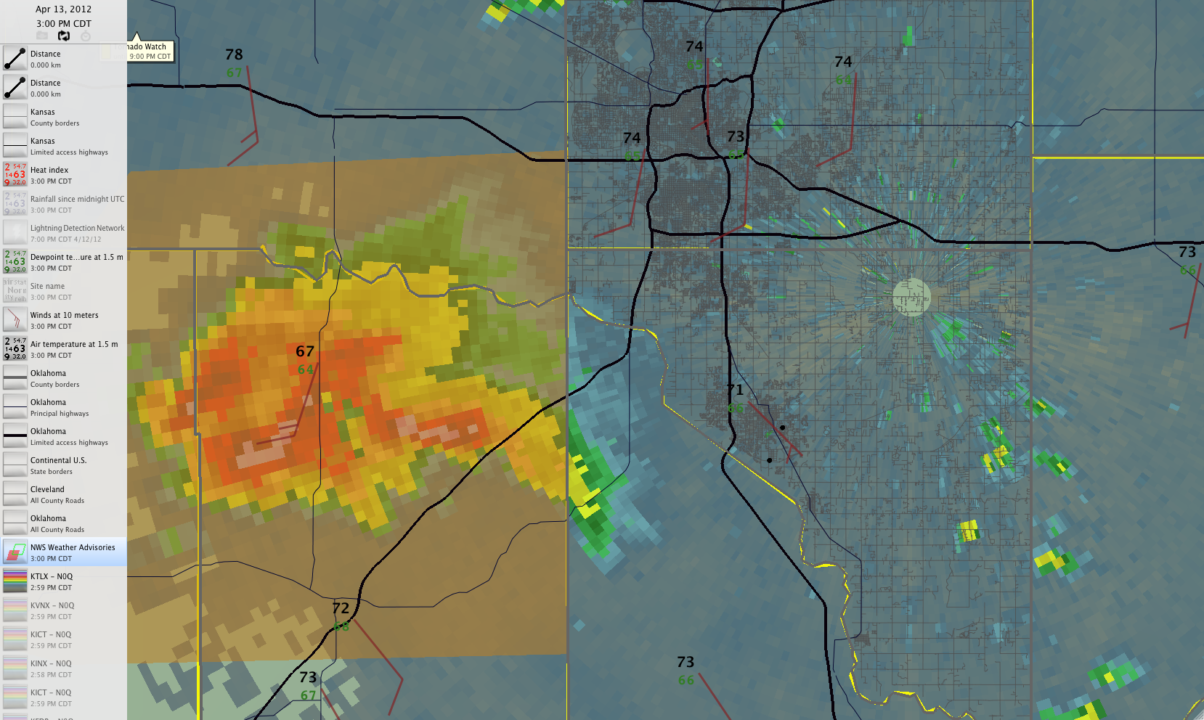
Central Oklahoma 3:00 pm Central Time Friday 13 April 2012
Shaded area is
NWS Severe Thunderstorm Warning
OKC
MOORE
NORMAN
NWS WARNINGS ARE A PRIMARY WEATHER DECISION TOOL (EMs, Broadcasters, etc.)
Notes:
There is a current warning

Slide 14
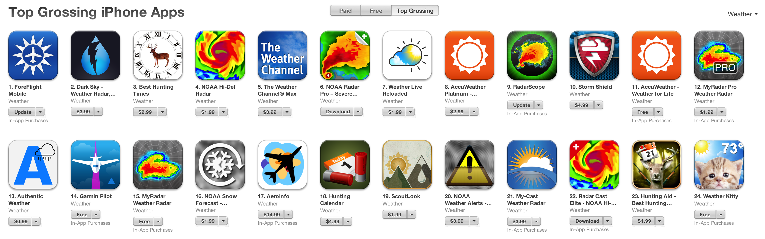
The Top 24 “Grossing” iPhone Weather Apps
We know that NOAA National Weather Service (NWS) weather radar data and NOAA NWS warning “Alerting” apps are a critical part of daily decision making in safety-related fields. (blue are radar, red are alerting, some apps do both)
iPhone app data pulled from the Apple App Store on 12 November 2014
Notes:
And EVERYONE has an app for that (primary function of apps is to provide radar, or NWS warnings.

Slide 15
Central Oklahoma 3:00 pm Central Time Friday 13 April 2012
OKC
MOORE
#2
NORMAN
#1
Based on RADAR … WHAT ARE THE RISKS ASSOCIATED WITH CIRCLES #1 and #2?
Notes:
Storm is moving NE… likely that #2 is a high risk region than area #1

Slide 16
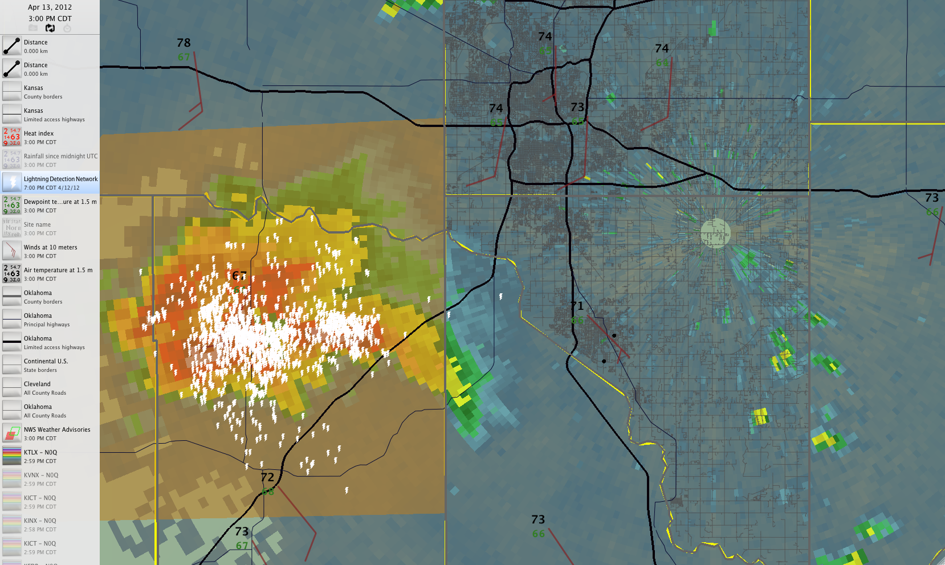
Central Oklahoma 3:00 pm Central Time Friday 13 April 2012
OKC
MOORE
NORMAN
THE ABILITY TO ADD LIGHTNING DATA CHANGES THE SITUATIONAL AWARENESS
Notes:
But if you add lightning data…

Slide 17
Central Oklahoma 3:00 pm Central Time Friday 13 April 2012
OKC
MOORE
NORMAN
Circles #1 and #2 from the earlier slide are shown again on the lightning image.
Notes:
Area #1 (rain free) is the high risk, and if you are in Moore, lightning appears to be arriving long before the pretty colors do. (also occurring outside of the NWS warning, which much of the public simply doesn’t understand)

Slide 18
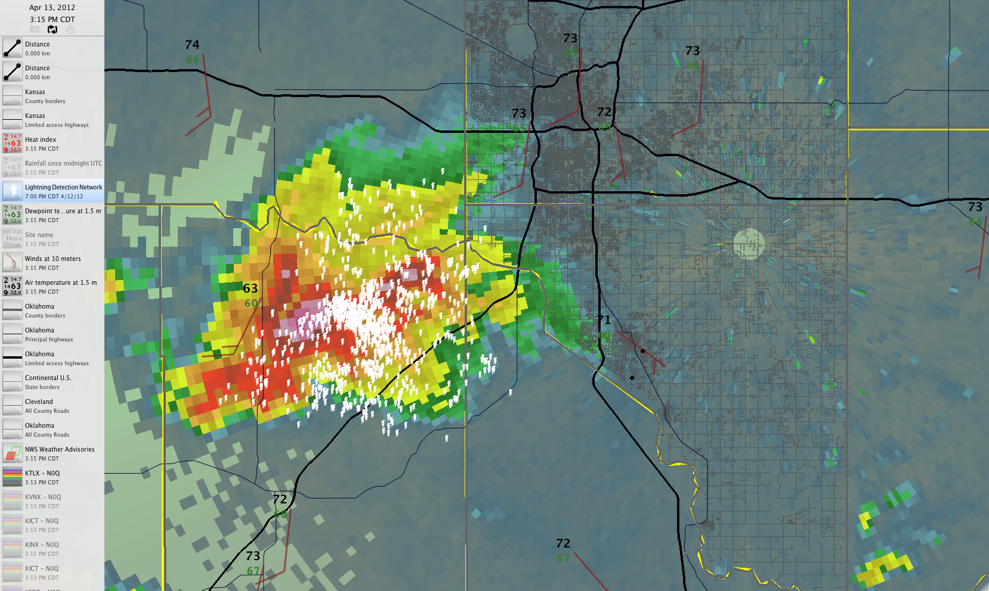
Central Oklahoma 3:15 pm Central Time Friday 13 April 2012
OU
The NWS severe thunderstorm warning in the earlier slides expires, a new warning is imminent.
Question for the audience… Will Norman be in this next warning?
Notes:
Storm continues to move NE toward OKC and Moore

Slide 19
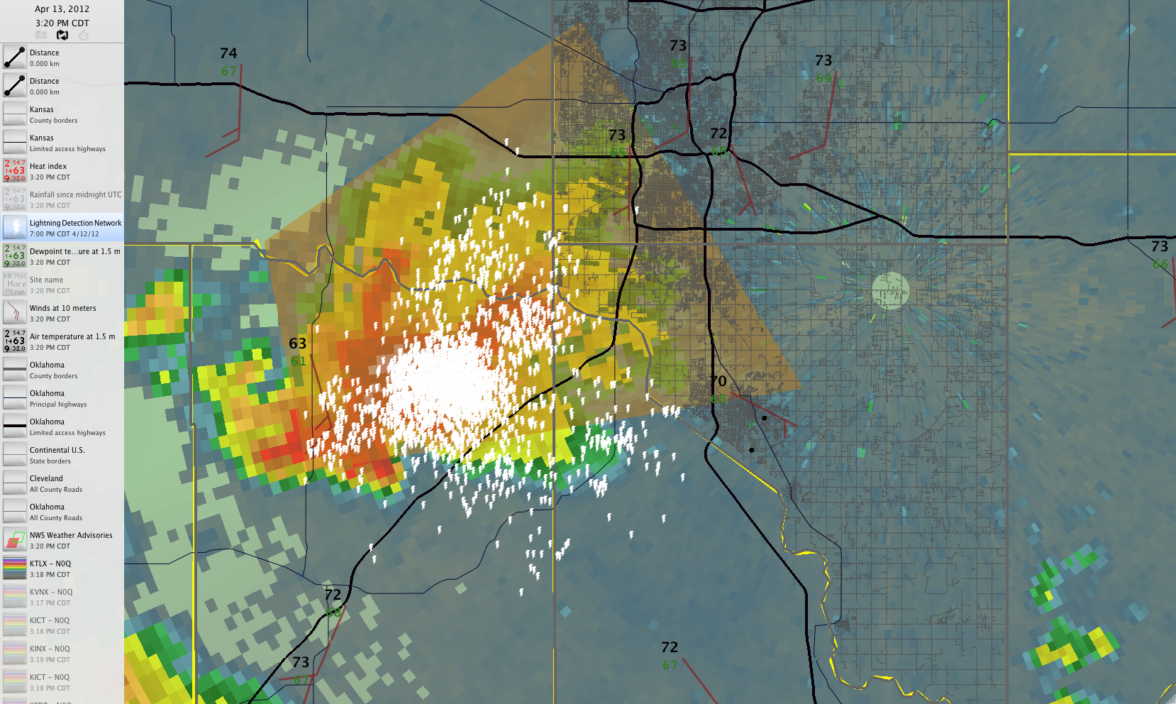
Central Oklahoma 3:20 pm Central Time Friday 13 April 2012
OU
(NOTE: New NWS warning does not include OU Campus, either of Norman’s high schools, none of the 4 middle schools, nor 17 of 18 elementary schools.)
Notes:
Warning does not include Norman proper, but check out the lightning information. Norman is going to be at risk very soon

Slide 20
Central Oklahoma 3:20 pm Central Time Friday 13 April 2012
OU
Availability of lightning information paints a different picture of risk to Norman, OK

Slide 21
Central Oklahoma 3:00pm Central Time Friday 13 April 2012
OU
The black ring is the 6-mile radius defined historically by the “30-30 Lightning rule”
Notes:
If you use the traditional 6 mile radius, no actions are likely at this point. EMs and venue managers are “policied” to wait until 6 miles (especially if this is a football game that makes millions of dollars

Slide 22
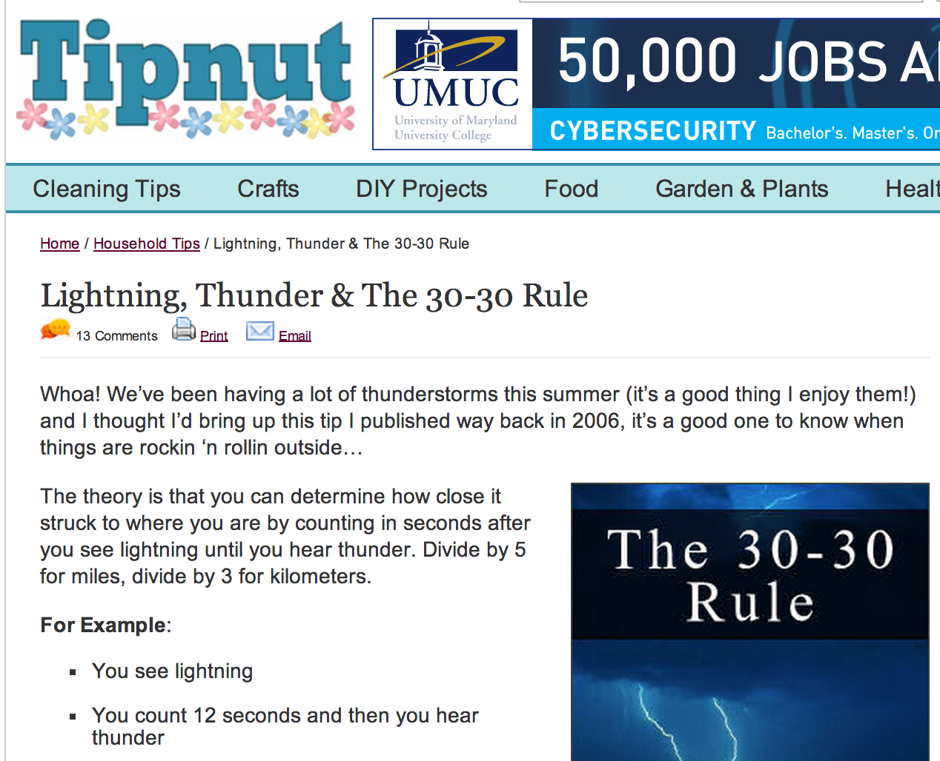
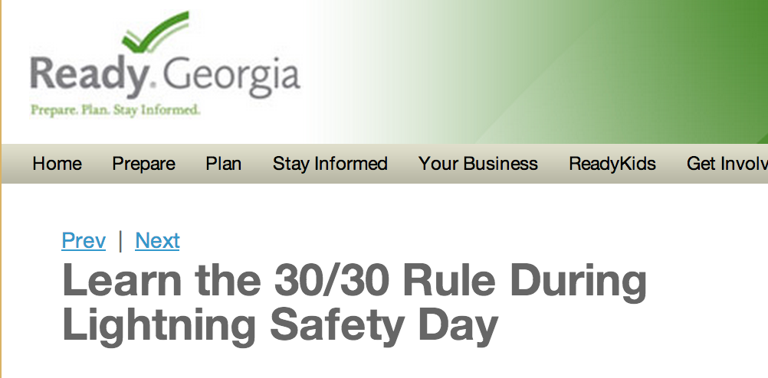
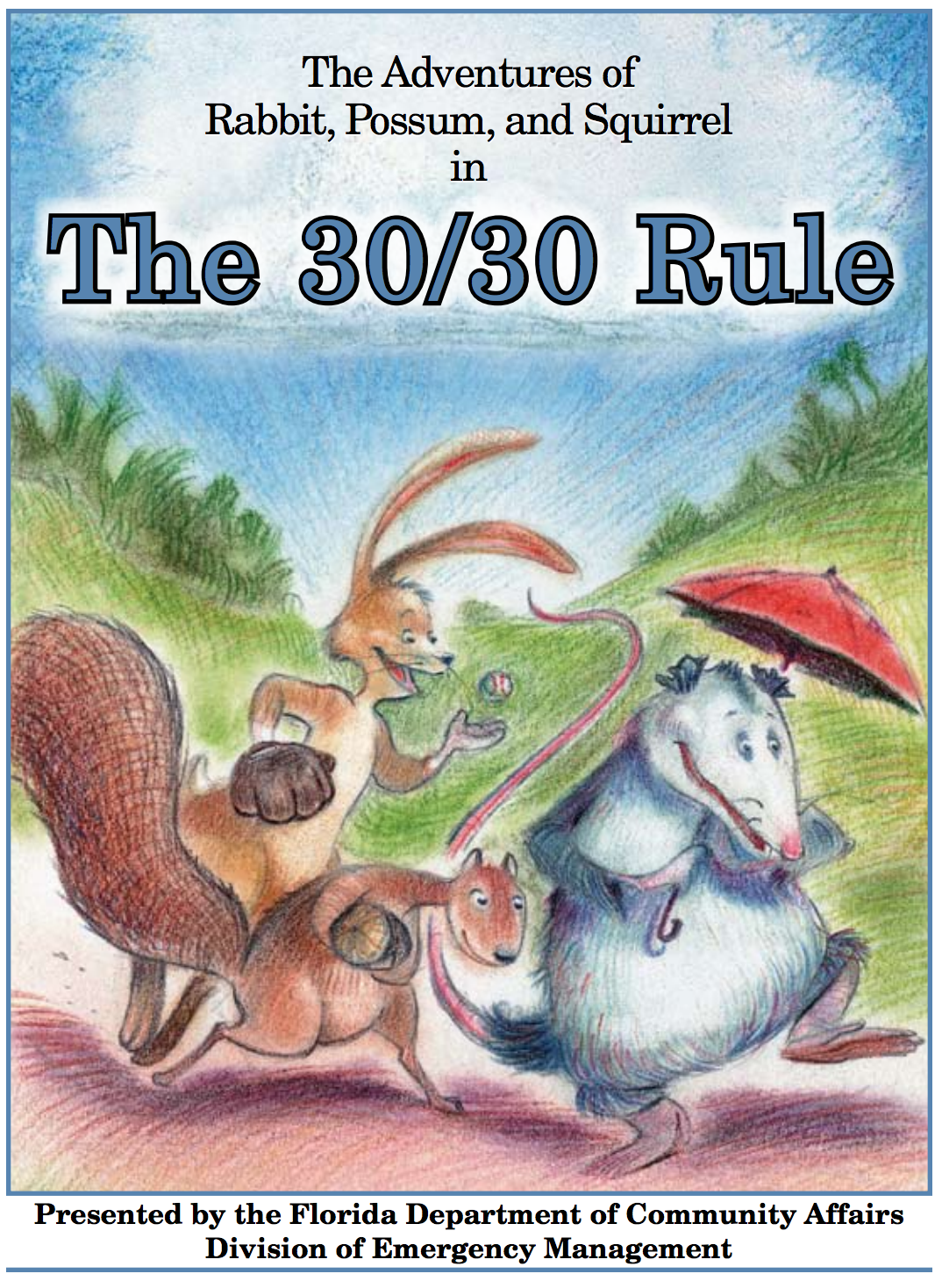
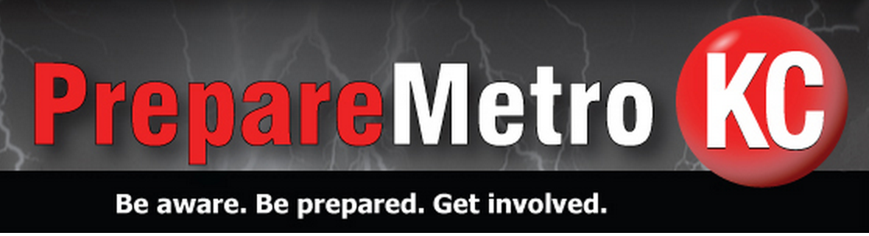
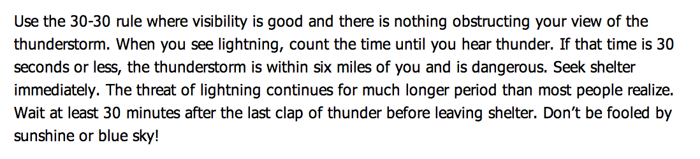
Just when you thought it was “safe” to use the “30-30” rule… (6 mi=30 sec/30 minute)
Notes:
30-30 rule was so successful that people don’t want to give it up!

Slide 23
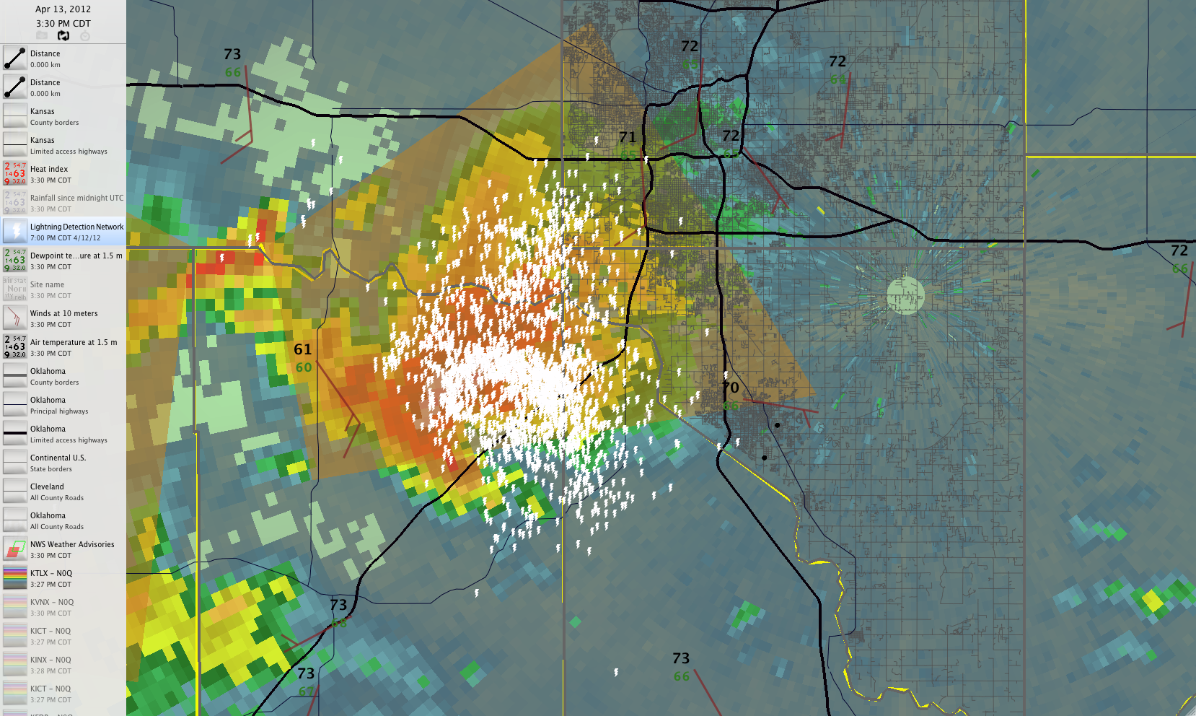
Central Oklahoma 3:30 pm Central Time Friday 13 April 2012
OU
Lightning is now within six miles of the University of Oklahoma campus.
Notes:
At 3:30 lightning reaches inside the 6 mile radius

Slide 24
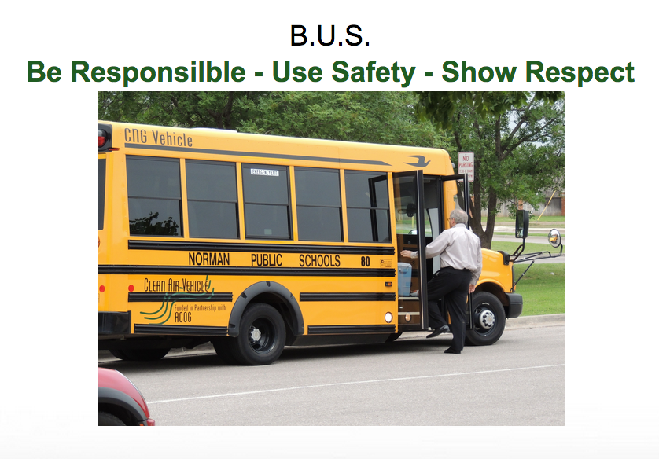
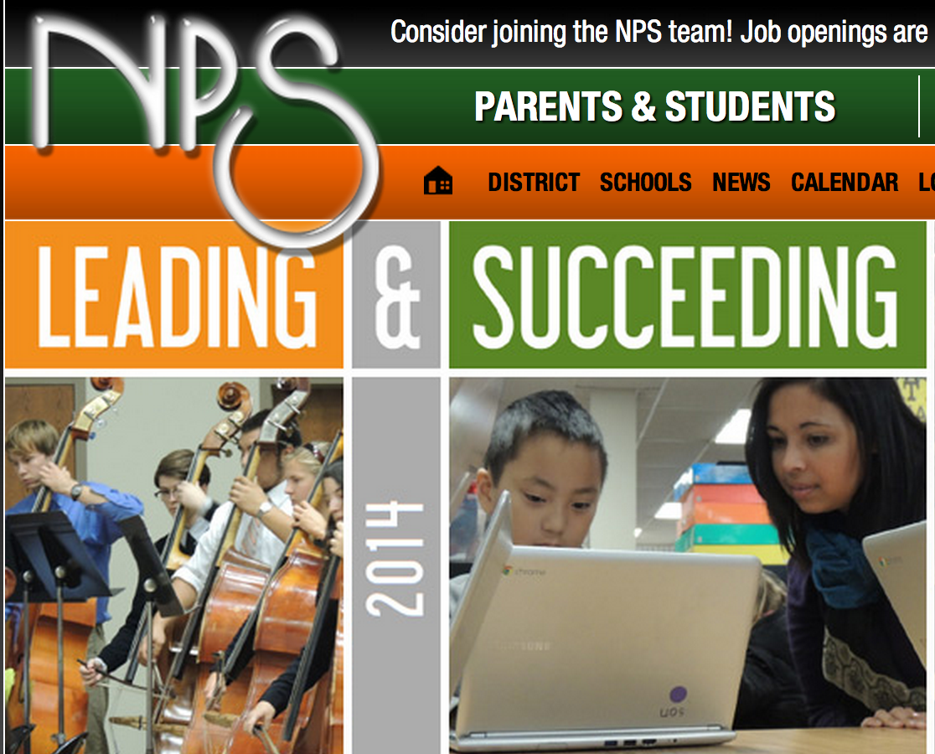
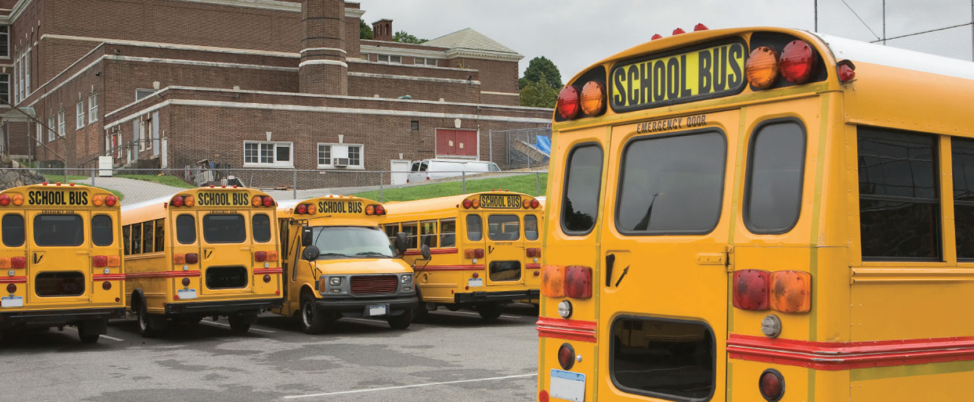
Norman OK April 13, 2012
Norman Public Schools Dismissal 3:40 PM
Be Responsible – Use Safety – Show Respect
Notes:
At 3:40 NPS dismissal is slated to begin

Slide 25
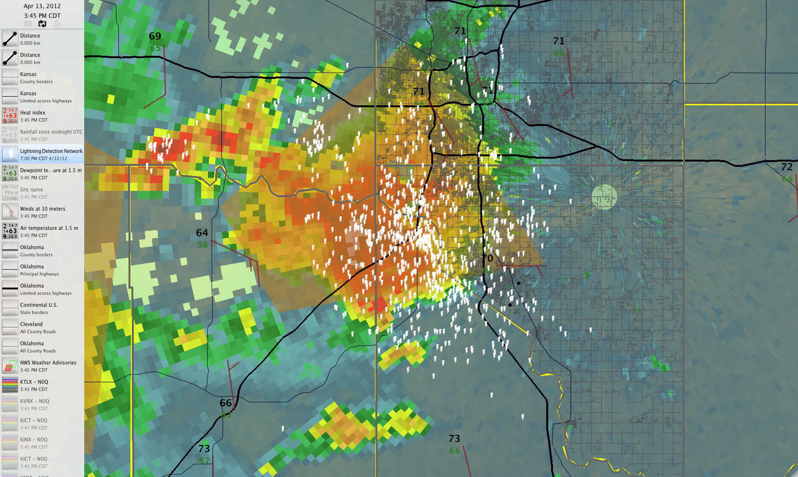
Central Oklahoma 3:45 pm Central Time Friday 13 April 2012
OU
School dismissal in progress across Norman, 15,819 students (also OU classes out 3:50-4:00pm)
Notes:
At 3:45, there is no warning for Norman, if you are watching radar, the storm is to the NW and moving NE, and school dismissal proceeds. Almost 16,000 kids head outdoors in Norman. Not to mention class change is about to occur on the OU campus

Slide 26
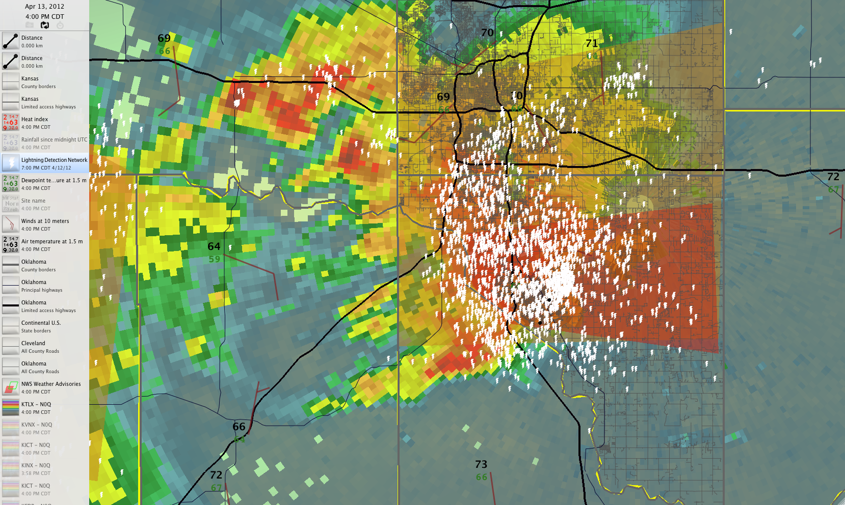
Central Oklahoma 4:00 pm Central Time Friday 13 April 2012
OU
Tornado Warning has now been issued by NWS.
(dark orange shading)
Thunderstorms are NEVER “steady state.” They are ALWAYS evolving.
Notes:
35 CGs within 15 miles of campus in the 1 minute period between 4:02CDT and 4:03CDT; we had 1879 CGs within 15 miles of campus in 170 minutes as these storms went through from 3:15pm to 6:05pm not to mention an EF1 tornado that is now entering the west side of Norman

Slide 27
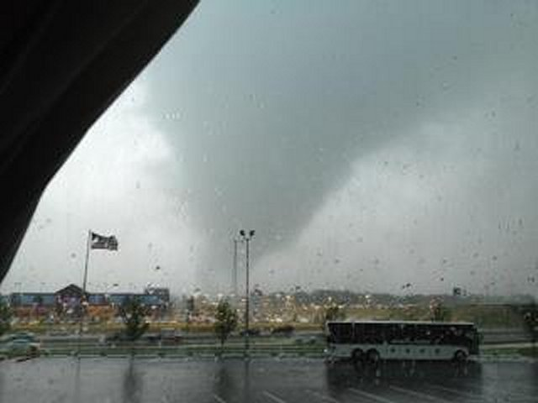


Norman OK April 13, 2012
NPS Dismissal 3:40 PM
NPS Buses left 3:50-3:55 PM
Tornado Developed 3:59 PM
EF1, 20 injuries, 0 fatalities
The three blue dots are schools.
Notes:
Recap of tornado time line… but had we been proactive with all of the possible hazards, including lightning, we would have already been sheltered when the tornado occurred

Slide 28

The NOAA National Weather Service (NWS) is taking a leadership role for lightning safety issues.
http://www.lightningsafety.noaa.gov/
Notes:
NWS is awesome 1

Slide 29




Lightning Safety “Toolkits”
(NOAA/NWS)
Notes:
NWS is awesome 2

Slide 30

Lightning Safety “Toolkits” (NOAA/NWS)
Notes:
NWS is awesome 3, but unintentionally advocates for a resource that usually doesn’t exist.. It is the officials/umpires/referees that make the weather call at sporting events. Therefore, this recommendation makes an assumption that is not currently adopted practice. Will require significant changes across the event landscape… which is GREAT We need the change!

Slide 31


149,820
142,582
Cloud to Ground Lightning Strokes
within 15 miles of OU, OSU, TU campuses
from May 2009 - October 2014
(data courtesy Earth Networks/Weather Decision Technologies, Inc.)
140,603
Notes:
We get a lot of lightning though… we may be cancelling/postponing a lot, and our leaders DO NOT like that.. It costs $$$

Slide 32
149,820
142,582
34 - 40 days with CGs so far in 2014 (variable!)
Cloud to Ground Lightning Strokes
within 15 miles of OU, OSU, TU campuses
from May 2009 - October 2014
(data courtesy Earth Networks/Weather Decision Technologies, Inc.)
140,603
Notes:
Could be as many as 5-6 weeks worth a year in Oklahoma.. Probably more in Florida

Slide 33





Notes:
Lots of things happening that are great!! New policies, new checklists, new decision matrices, new products for users, proactive text for evacuating venues so people don’t wing it

Slide 34
Significant Challenges for Public Safety Moving Forward
Education/Utility: Undoing ‘there wasn’t a warning” and the “pretty color” mindset.
Detection: Ground? LMA? Satellite?
Forecasting: First CG strike still kills more than any other.
Alerting: What is the right buffer radii of influence against venue size/type of crowd/etc. (it’s likely larger than 6 miles). Will sports entities allow local/different policies?
Compliance: How do you get event to stop/people to evacuate? (Lightning safety is still at its’ root a social science problem.)
Bottom Line:
Lightning data is now a necessary item in any public safety decision support toolkit.
Notes:
This was fun. I had a great time.

