Slide 1
AMS Capitol Hill Briefing on Seasonal Forecasting
Nick Keener, Director of Meteorology

Slide 2
Business Segments
Regulated Utilities
Commercial Businesses
Regulated Utilities
(percent owned capacity)
Commercial Power
International Energy
  Regulated generation,
  electric and gas transmission
  distribution systems
Duke Energy Carolinas
Duke Energy Progress
Duke Energy Indiana
Duke Energy Ohio/Kentucky
Duke Energy Florida
Duke Energy Renewables
Duke Energy International
(primarily Latin American assets)
Coal 38%
Natural Gas/Fuel Oil 38%
Nuclear 17%
Hydro/Renewables 7%

Slide 3
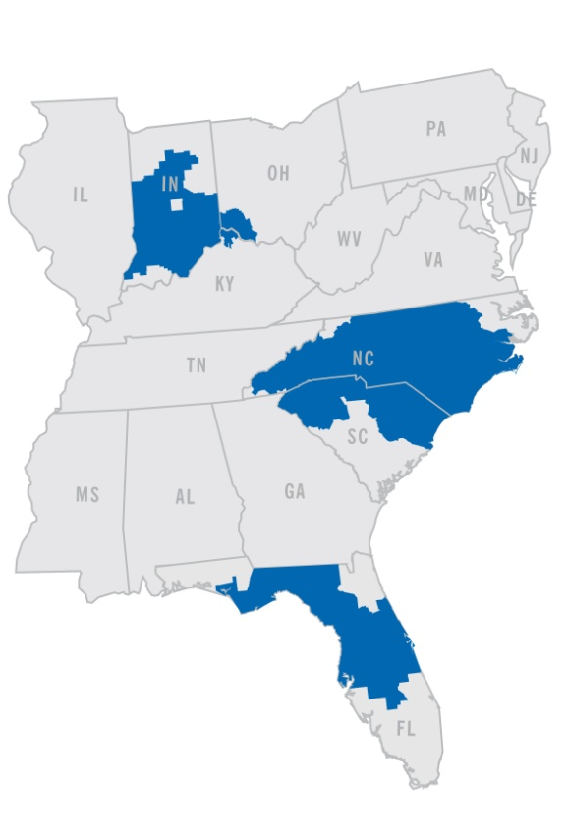
Regulated Utilities
Largest business segment and primary source of earnings growth
6 states: North Carolina, South Carolina, Florida, Indiana, Ohio, Kentucky
95,000 square miles of service area
49,600 MW of generation capacity
7.3 million retail electric customers
500,000 retail natural gas customers
Renewable and energy efficiency programs

Slide 4

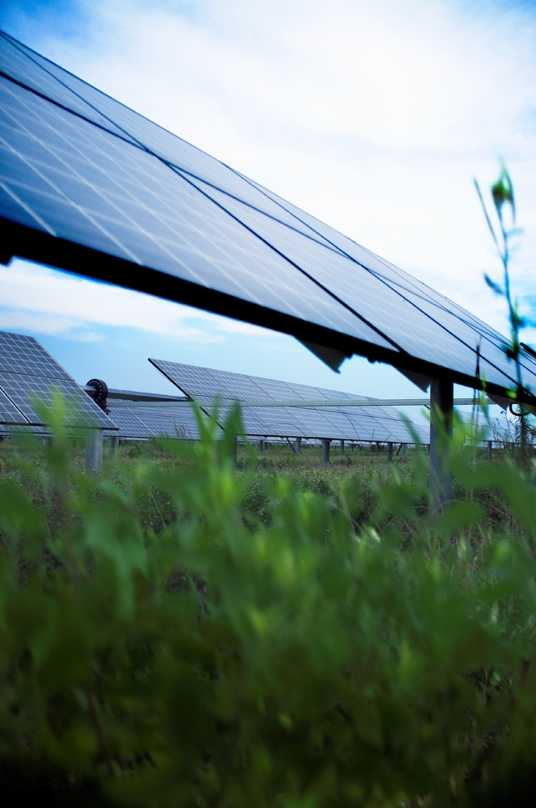
Commercial Businesses
Duke Energy Renewables
  Approximately 1,800 MW of wind and solar projects operating in 12 states
  Significant pipeline of development projects
  Since 2007, invested more than $3 billion to grow
  wind and solar business
4

Slide 5
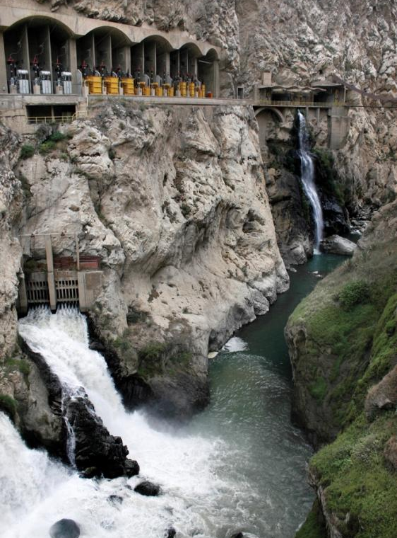
Commercial Businesses
Duke Energy International
Owns approximately 4,300 gross MW of electric generation outside the U.S.
Operations located in Latin American countries of Argentina, Brazil, Chile, Ecuador, El Salvador, Guatemala and Peru
Approximately two-thirds of DEI’s generating capacity is hydroelectric
Equity investment in National Methanol Co.,
a Saudi Arabian regional producer of MTBE,
a gasoline additive
5

Slide 6
Daily to Seasonal Operational Uses of Weather Forecasts/Data
Generation System Dispatch/Load Forecasting-Energy Demand
Precipitation Forecast for Daily Hydro Planning/Dispatch
Renewables – Solar/Wind
Fuel Supply
Storm Prediction – Resource modeling for storm impacts
Extreme weather impacts for generation planning/maintenance and grid operations
Transmission Line ratings
High bill analysis
Earnings
Monthly and seasonal forecasts for system planning/operations-Generation Outage scheduling
Thermal modeling

Slide 7
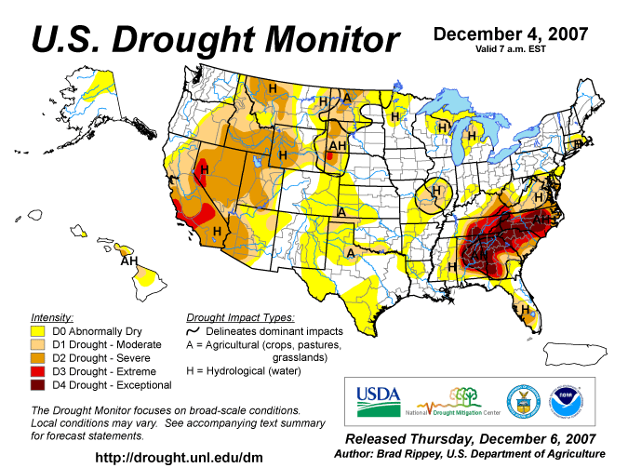
Hydroelectric Impacts from Drought

Slide 8
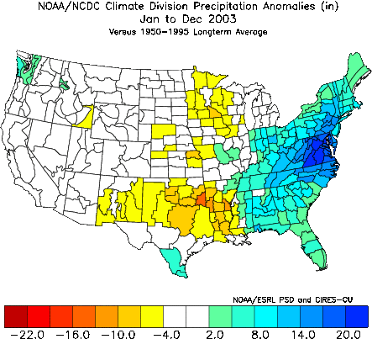
2003 Above Normal
Eastern Precipitation

Slide 9
Rainfall and Hydro-Generation

Slide 10
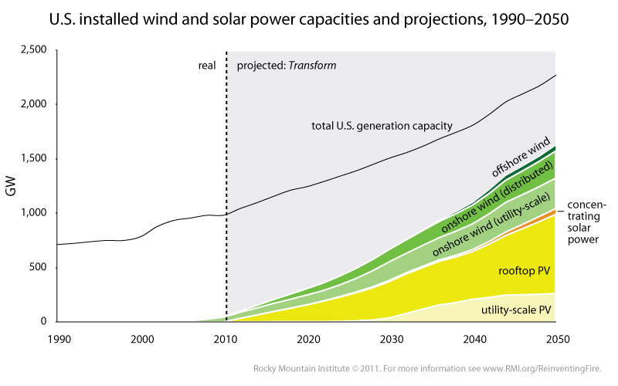
Renewables and
Seasonal Weather Trends
Seasonal weather trends will become increasingly important as Renewable Energy expands.
Regional long term cloudy/stormy patterns will impact solar generation.
Large scale ridge patterns may impact wind generation
Close correlation with hydro-power and droughts

Slide 11
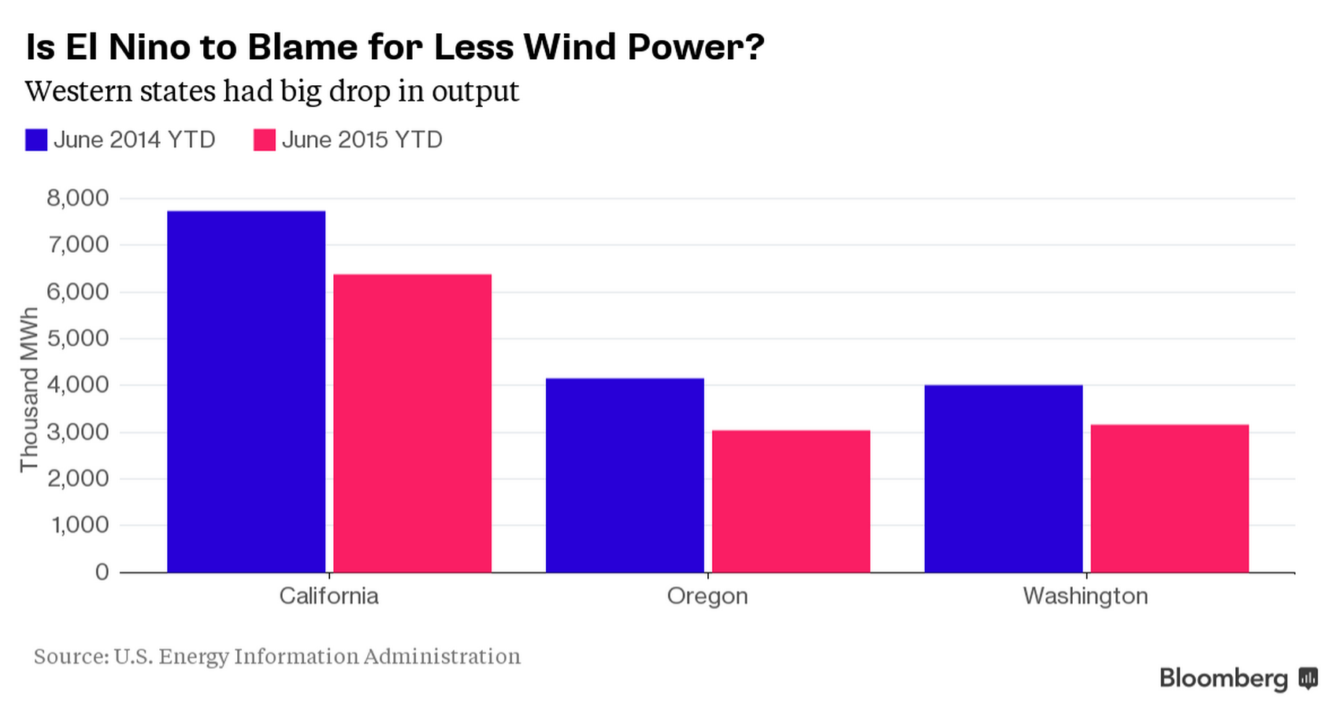
Wind Energy Seasonal Impacts
Bloomberg Magazine 9/1/2015:

Slide 12
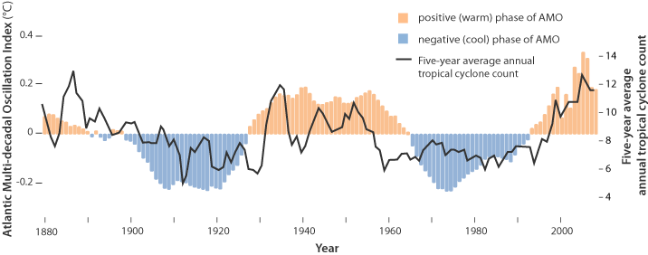
Seasonal Hurricane Variation

Slide 13
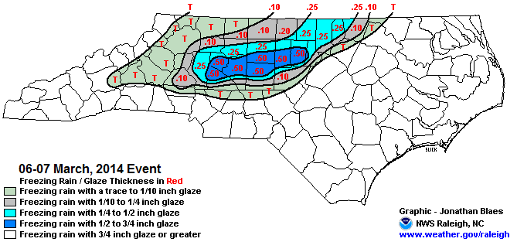
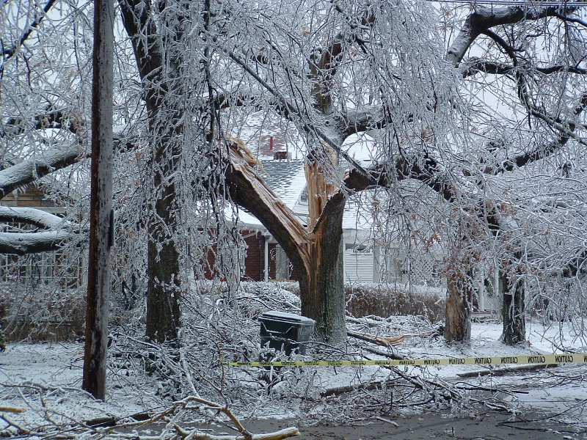
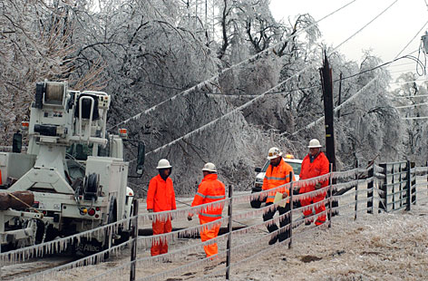
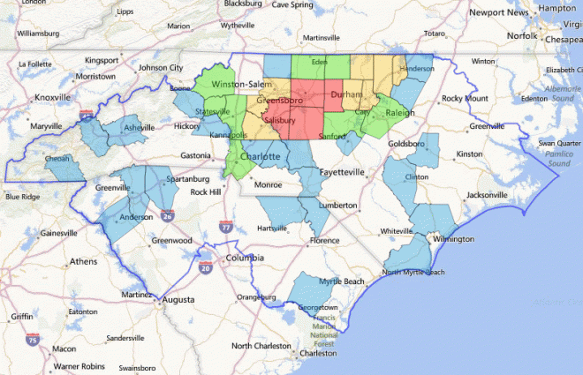
Winter Storms

Slide 14
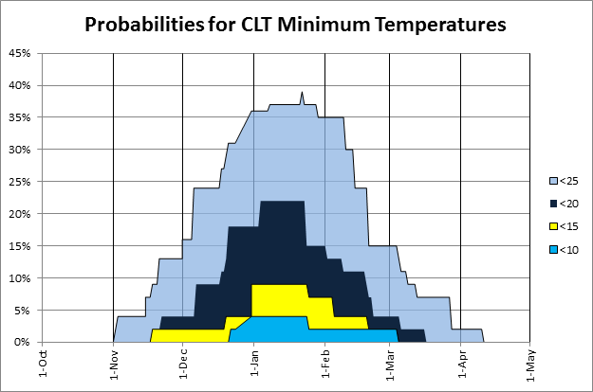
Plant Maintenance Planning
Extreme Cold

Slide 15
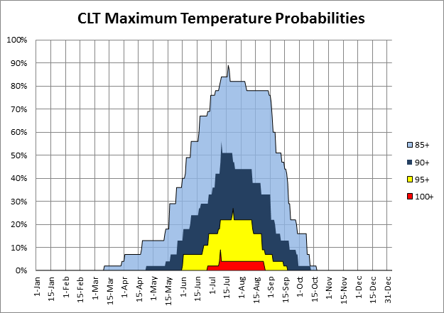
Plant Maintenance Planning
Extreme Heat

