Slide 1
Seasonal forecasting and ecosystem-based fishery management
Sarah Gaichas
Northeast Fisheries Science Center
Seasonal Weather Forecasting for Agriculture, Energy, and Fisheries
AMS Capitol Hill Briefing Series
September 15, 2015

Slide 2
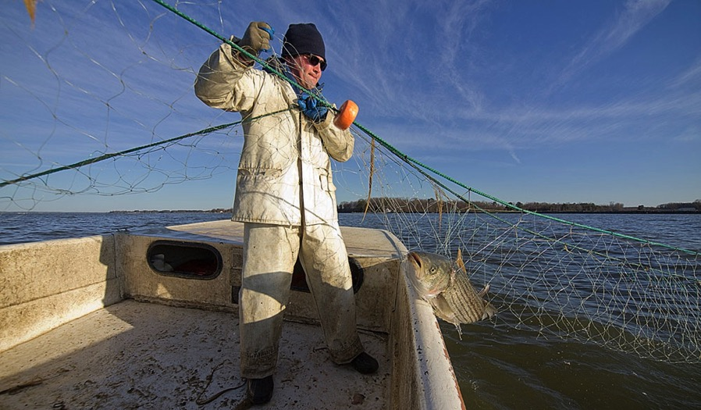
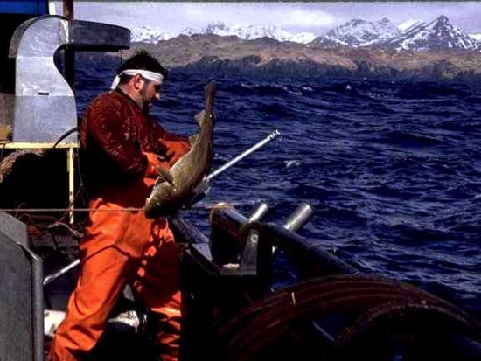
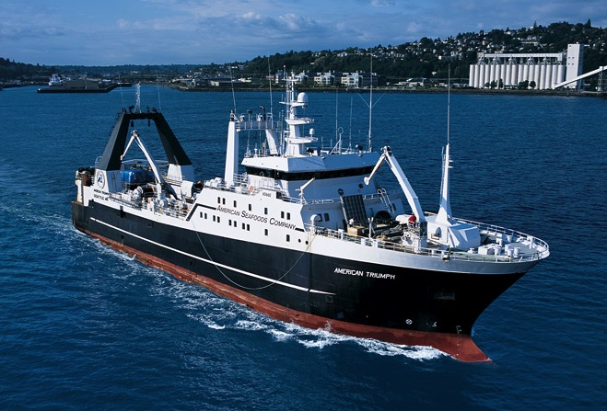
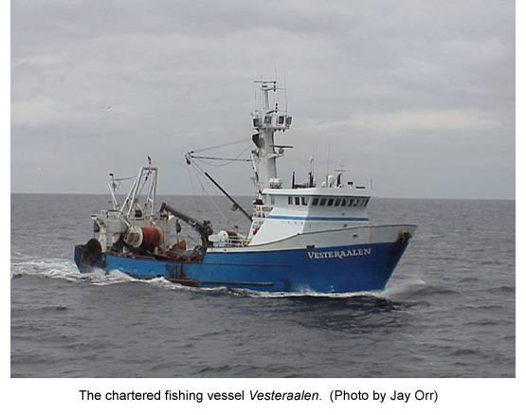
Fisheries are diverse

Slide 3




Changing weather patterns affect fisheries
Climate Changes
Physical Chemical Impacts
Biological Impacts
Social Economic Impacts
↑ Temperature
↑ Ocean temperature
Δ Productivity
Δ Fishing activities
Δ Precipitation
Sea ice
Δ Phenology & survivorship
Δ Revenues & economies
↑ Atmospheric Carbon Dioxide
↑ Sea level
Δ Species distribution
Δ Industries
Δ Freshwater
Δ Species abundance
Δ Subsistence use
↑ Ocean Acidification
Δ Community composition
Δ Community health

Slide 4
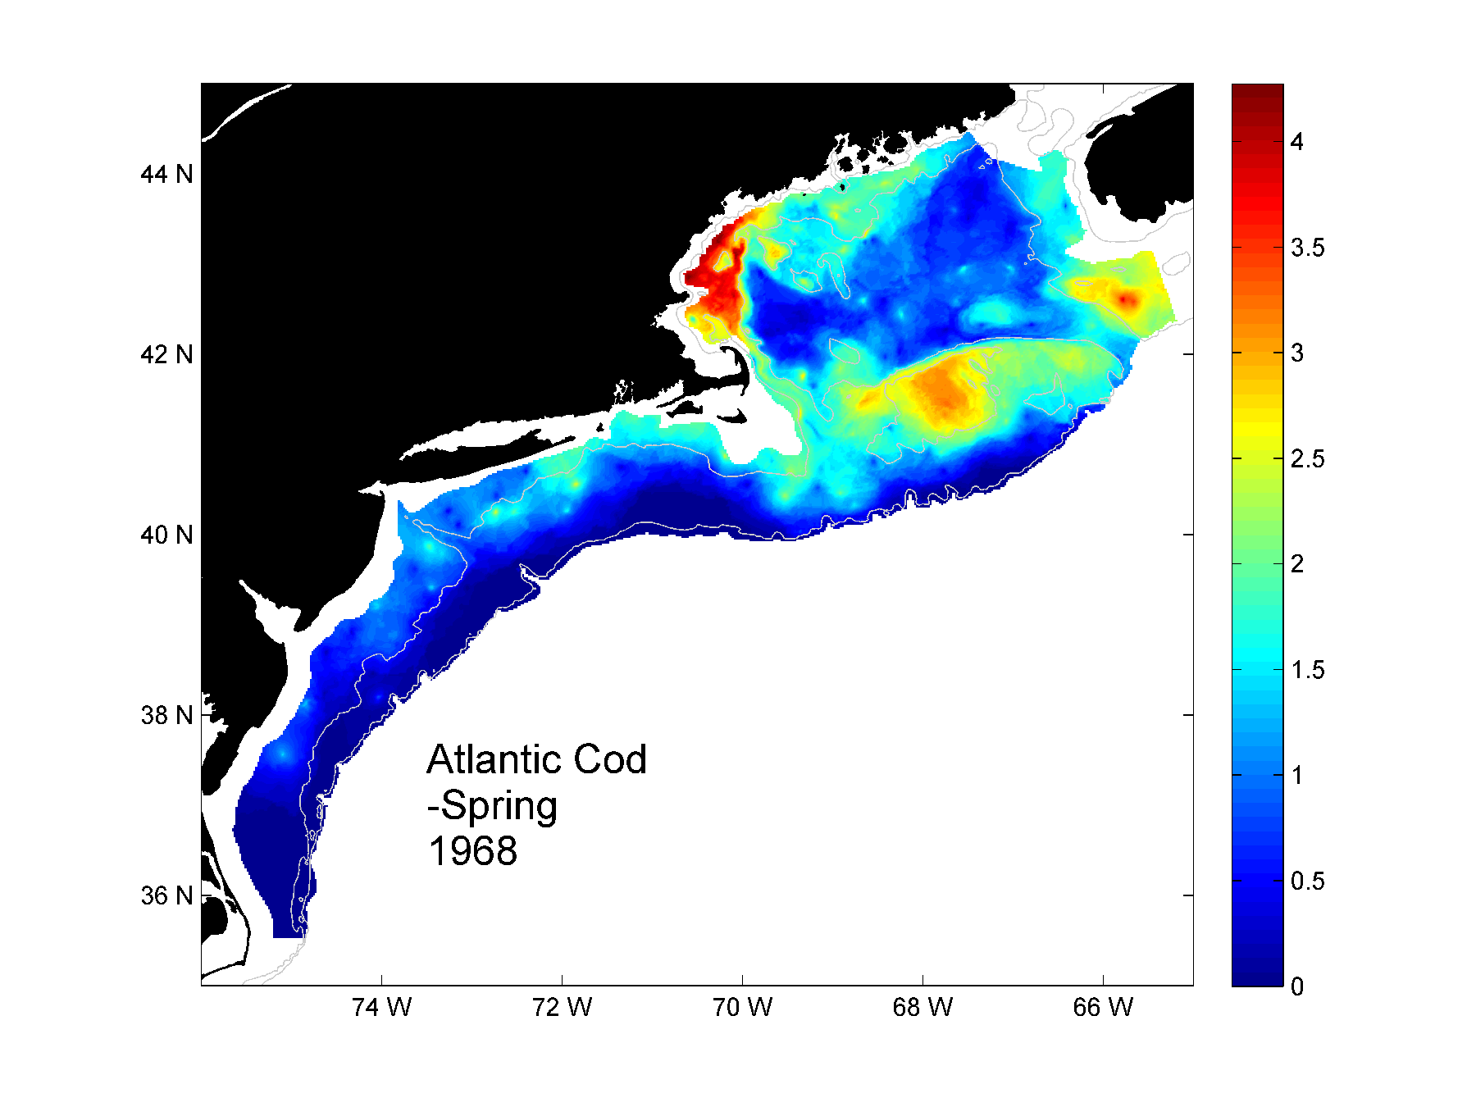
http://www.nefsc.noaa.gov/ecosys/

Slide 5
How can seasonal forecasts help with decisions about fishing?
Industry, Management, Science

Slide 6
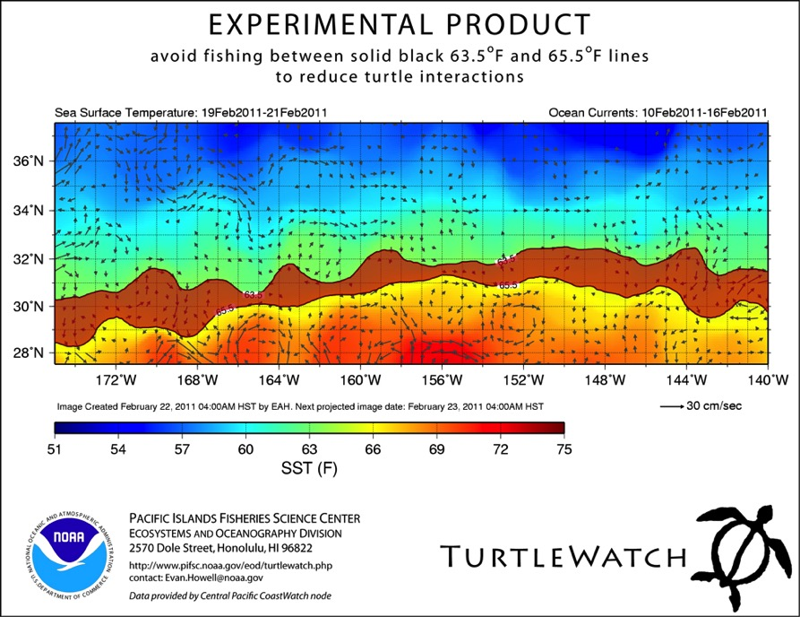
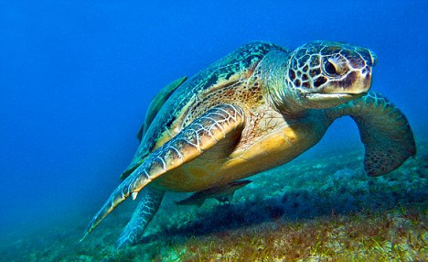
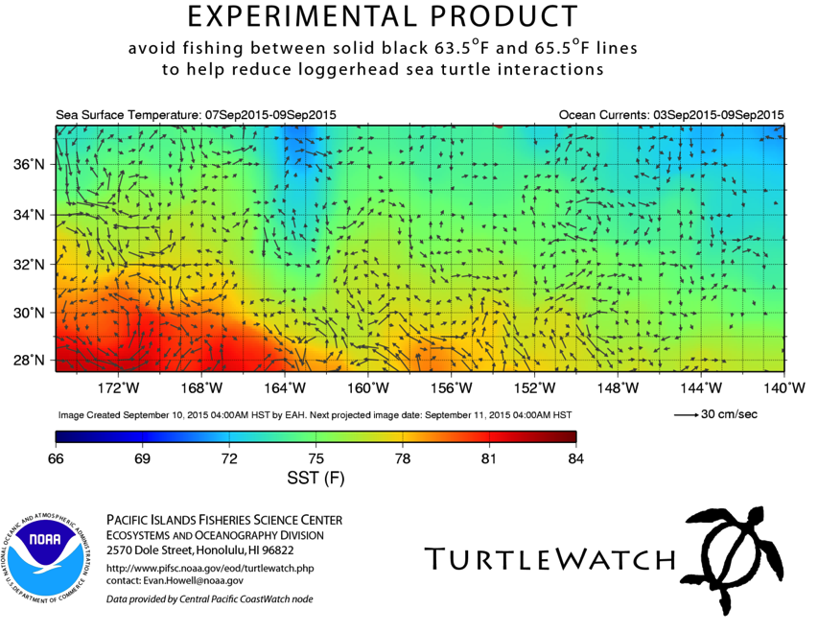
Where should I fish today?
http://www.pifsc.noaa.gov/qrb/2011_06/article_01.php

Slide 7
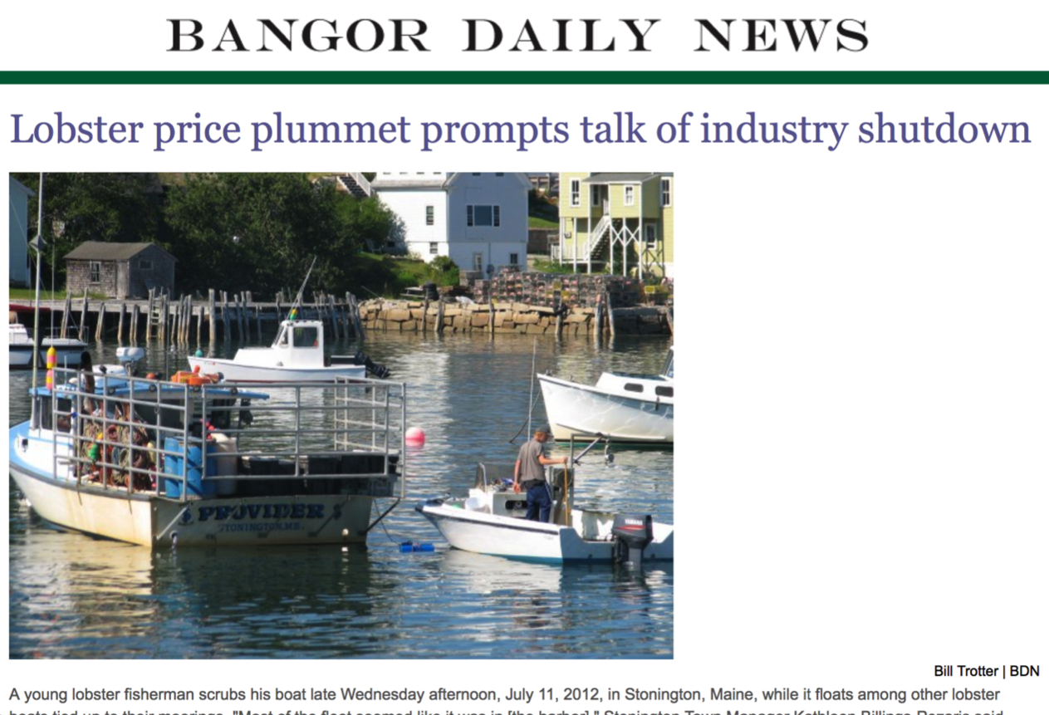
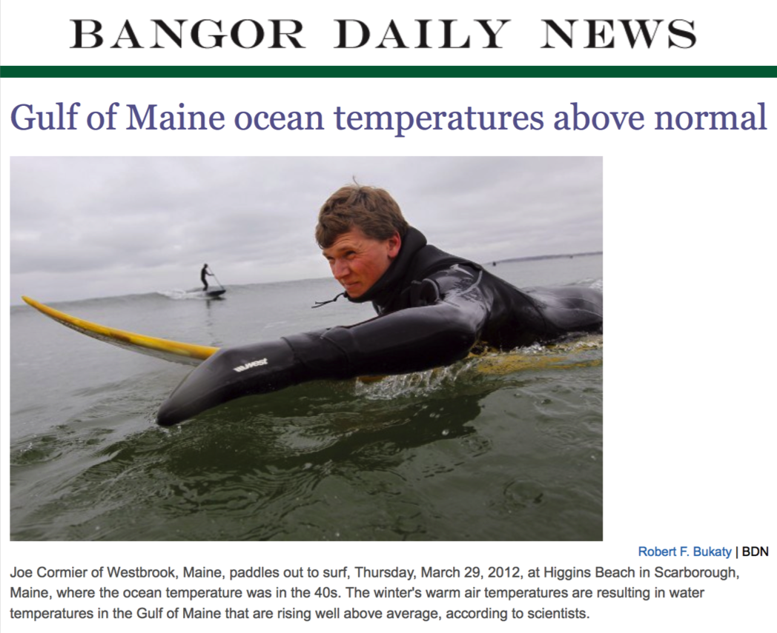
When should we be ready for fish?

Slide 8
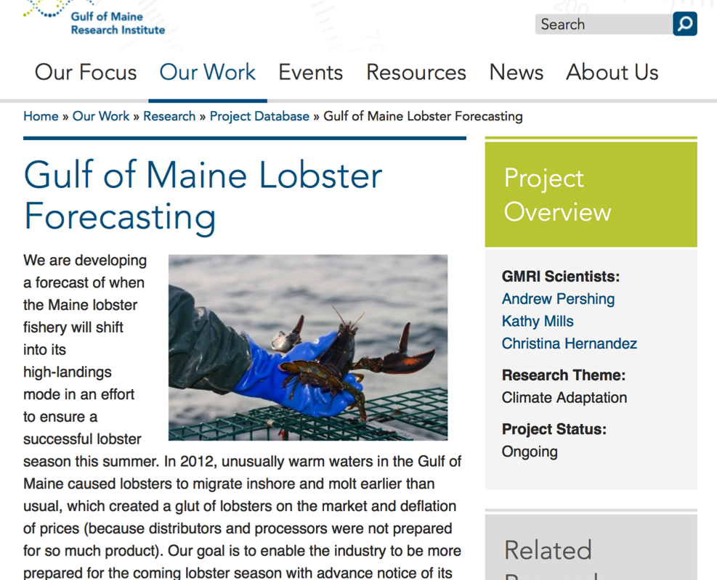
When should we be ready for fish?
http://www.gmri.org/our-work/research/projects/gulf-maine-lobster-forecasting

Slide 9
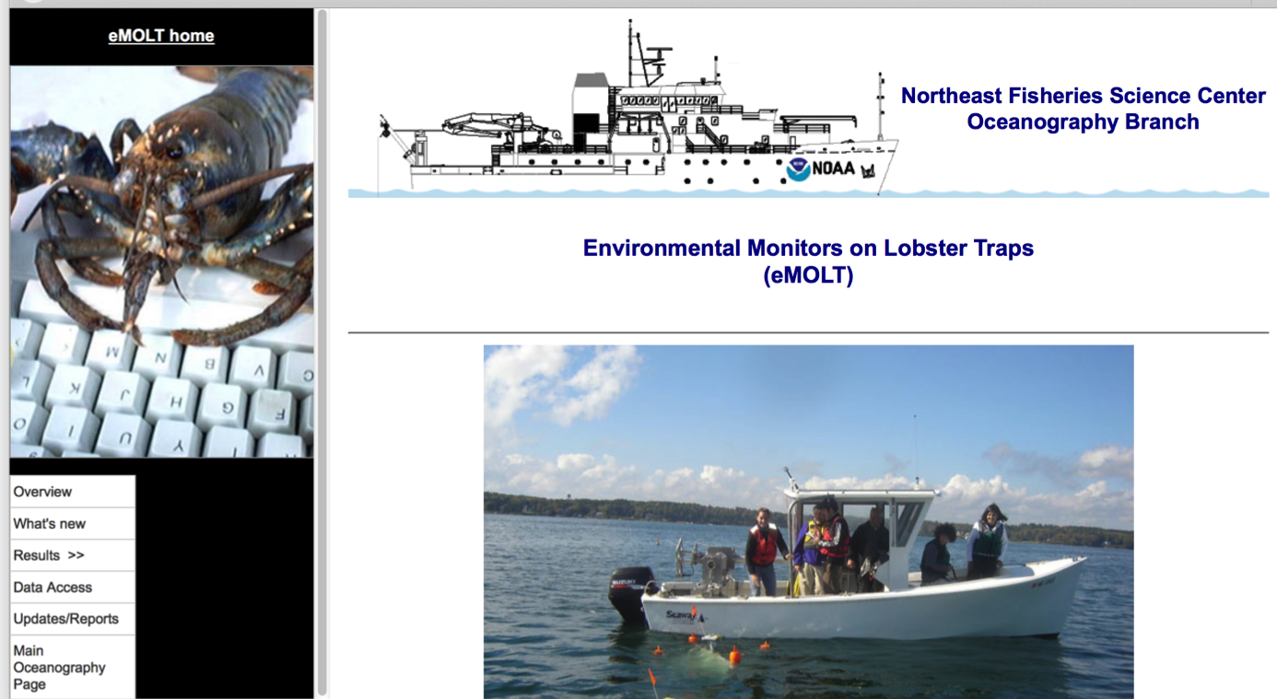
Cooperative data collection
http://www.nefsc.noaa.gov/epd/ocean/MainPage/emolt.html

Slide 10
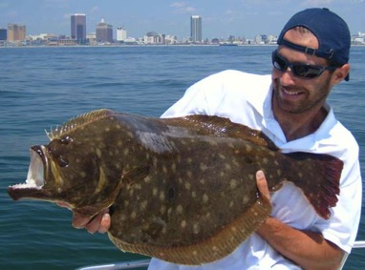
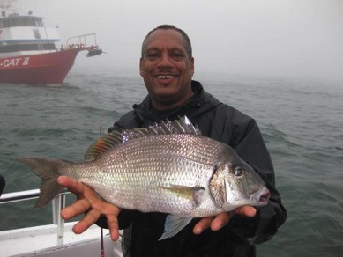
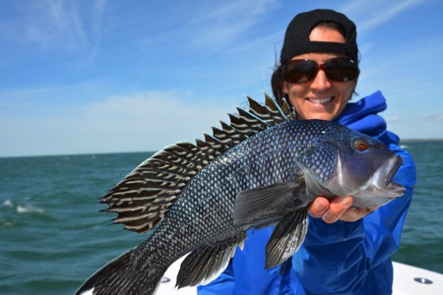
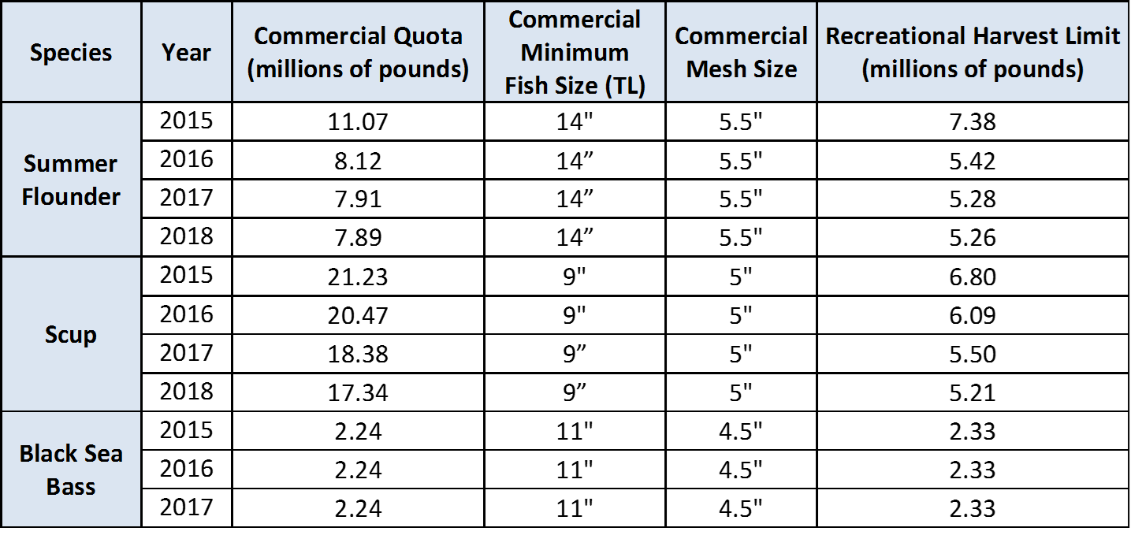
How many fish will there be next year? (and for the next two?)
http://www.mafmc.org/newsfeed/2015-08-17/demersal-specifications

Slide 11
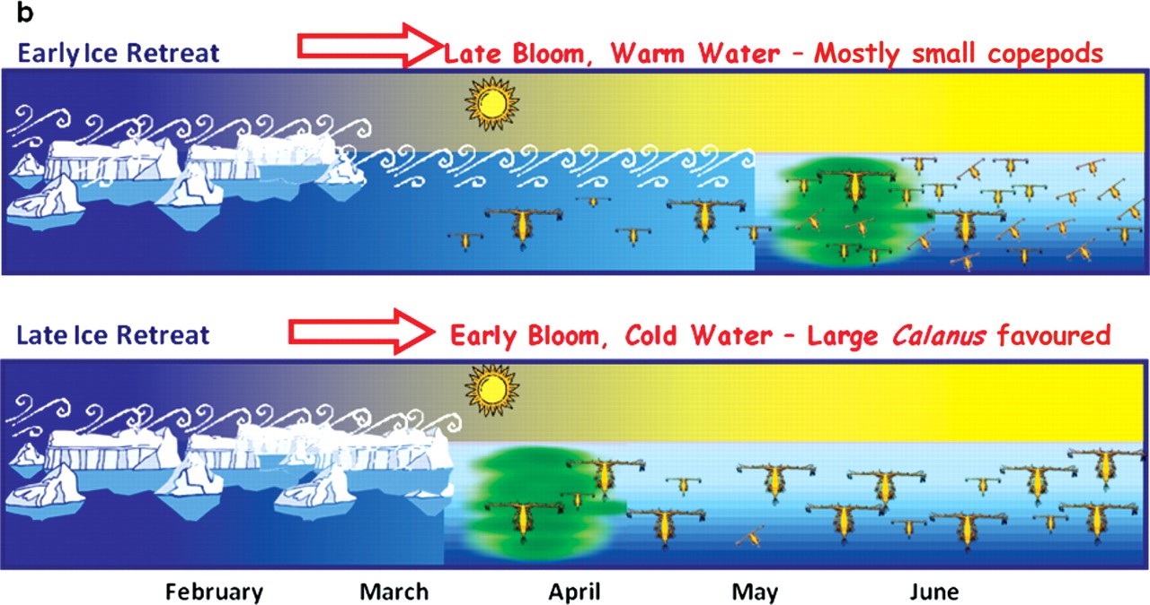
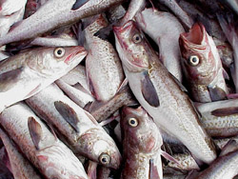

Could we improve 1-2 year fish forecasts?
George L. Hunt, Jr et al. ICES J. Mar. Sci. 2011;68:1230-1243
© 2011 International Council for the Exploration of the Sea. Published by Oxford Journals. All rights reserved. For Permissions, please email: journals.permissions@oup.com
Notes:
Cartoon illustrating the revised relationships among the timing of ice retreat, the bloom, and the production of copepods of different size classes. When there is an early ice retreat, the bloom occurs late in relatively warm water. These conditions favour small neritic copepods over mid- to large-sized C. marshallae. When the ice retreats late, the bloom occurs early, in association with the ice, and C. marshallae constitutes a major portion of the copepod biomass produced. Modified from Hunt et al. (2002a).

Slide 12
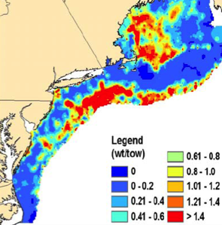
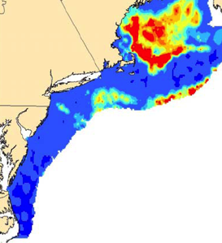
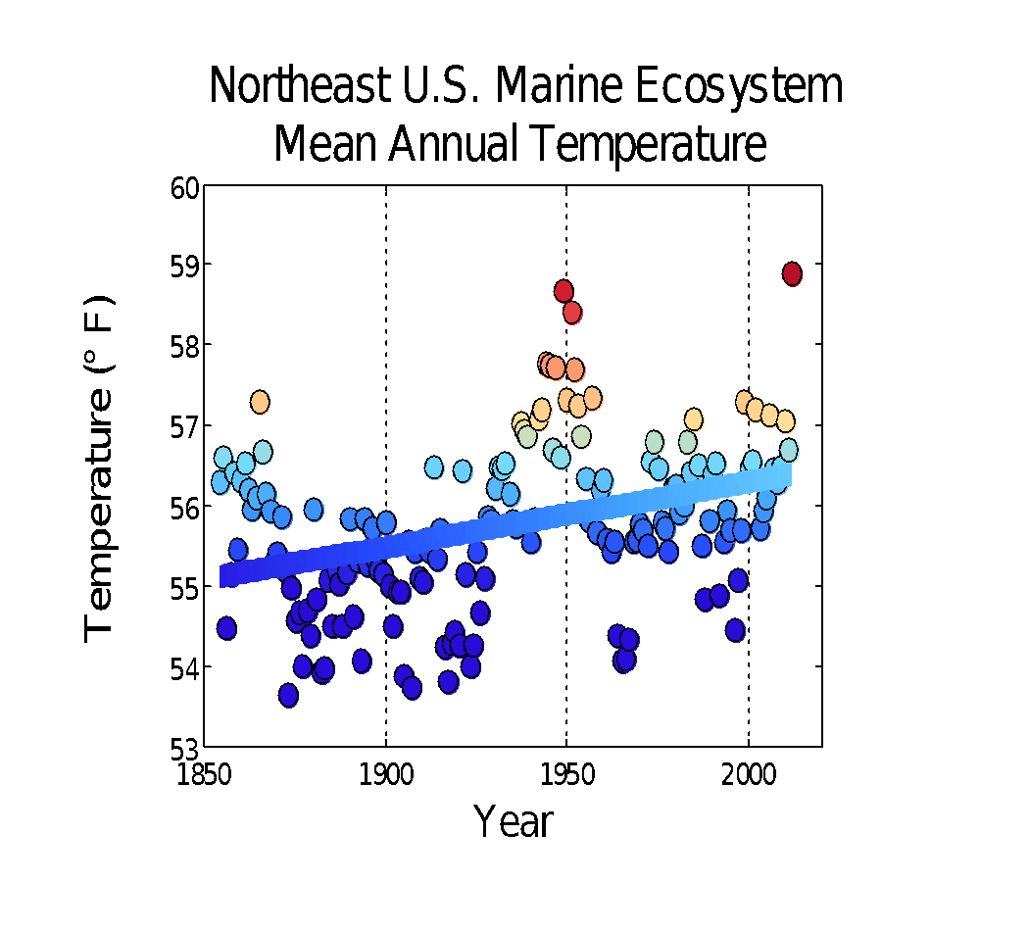
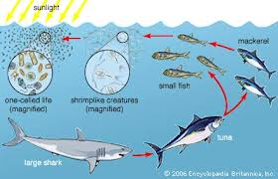
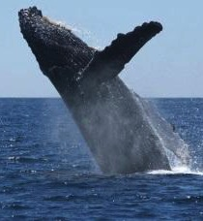
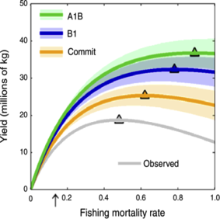
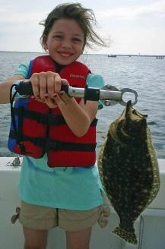
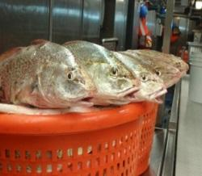
Key Information Requirements
WHAT IS CHANGING?
WHY IS IT CHANGING?
1970’s
2000’s
Red Hake
West Atlantic SST
HOW WILL IT CHANGE?
HOW TO RESPOND?
Notes:
Growing information demands from ……
What is changing? (OBSERVATIONS TO TRACK THE PULSE OF CHANGE)
What is vulnerable? Why is it changing? (RESEARCH TO UNDERSTAND MECHANISMS OF CHANGE)
How will it change? (MODELING TO PROJECT FUTURE CHANGES…..ACROSS NEAR, MID AND LONGER TERM TIME FRAMES)
How to respond? (EVALUATION OF MANAGEMENT OPTIONS ……)

Slide 13
We are moving beyond previously observed ranges
NEED seasonal to two year forecasts to model system responses and adjust management for the unknown

Slide 14
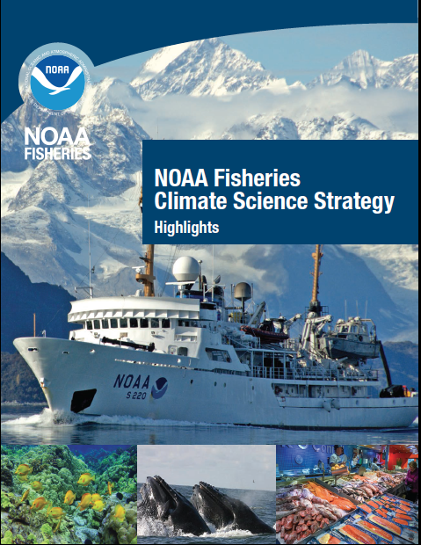
Our plans…
http://www.st.nmfs.noaa.gov/ecosystems/climate/national-climate-strategy

Slide 15
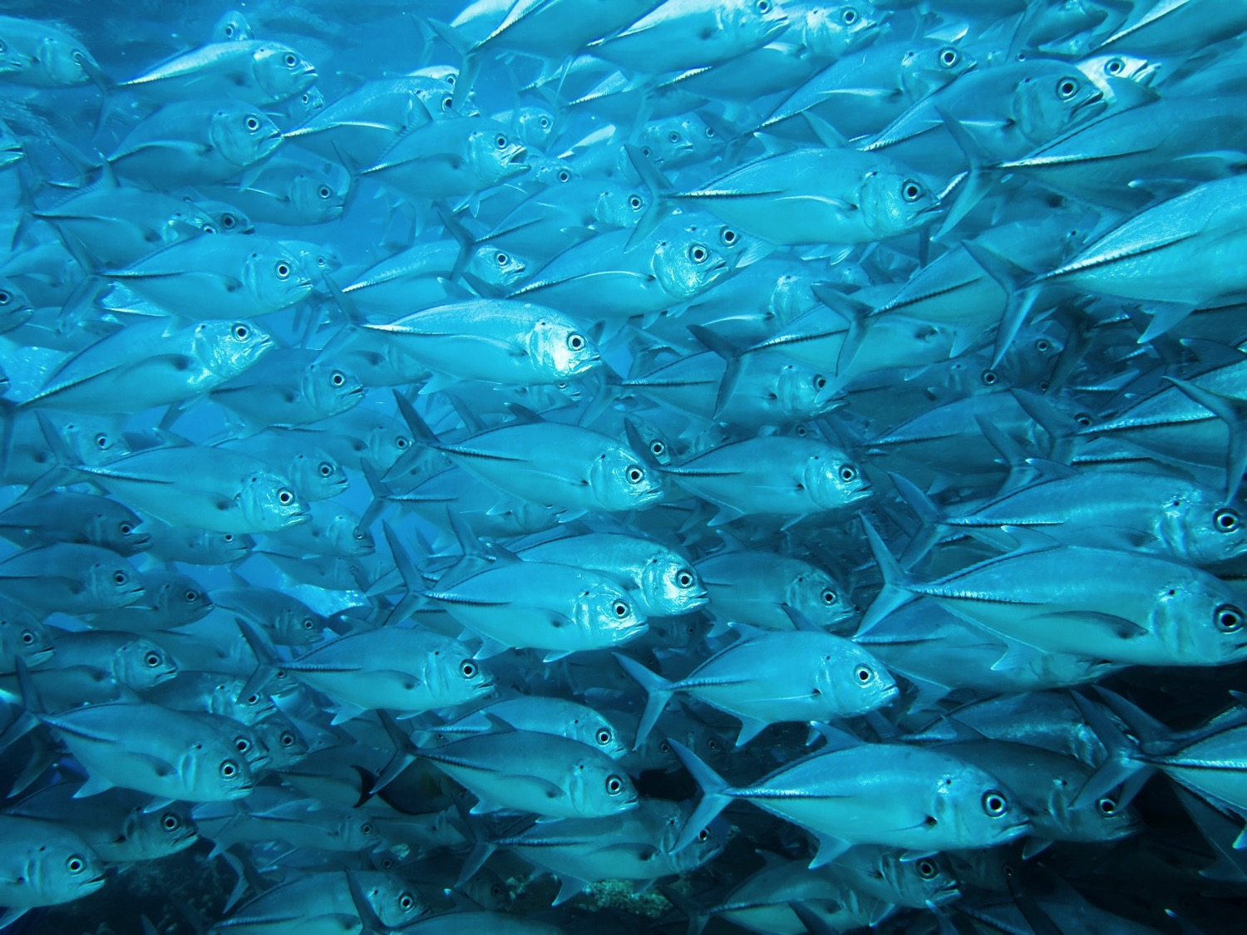
Thank you

