Slide 1
AMS Capitol Hill Briefing on Winter Weather Impact
Nick Keener, Director of Meteorology

Slide 2
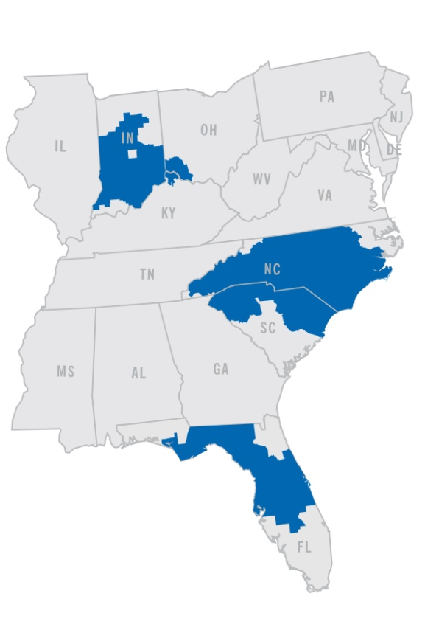
Regulated Utilities
Largest business segment and primary source of earnings growth
6 states: North Carolina, South Carolina, Florida, Indiana, Ohio, Kentucky
95,000 square miles of service area
49,600 MW of generation capacity
7.3 million retail electric customers
500,000 retail natural gas customers
Renewable and energy efficiency programs

Slide 3
Daily to Seasonal Operational Uses of Weather Forecasts/Data
Generation System Dispatch/Load Forecasting-Energy Demand
Precipitation Forecast for Daily Hydro Planning/Dispatch
Renewables – Solar/Wind
Fuel Supply
Storm Prediction – Resource modeling for storm impacts
Extreme weather impacts for generation planning/maintenance and grid operations
Transmission Line ratings
High bill analysis
Earnings
Monthly and seasonal forecasts for system planning/operations-Generation Outage scheduling
Thermal modeling

Slide 4
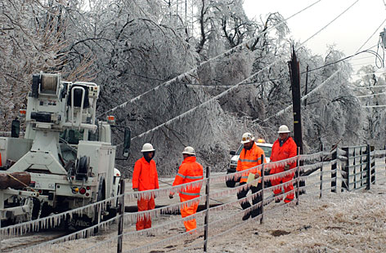
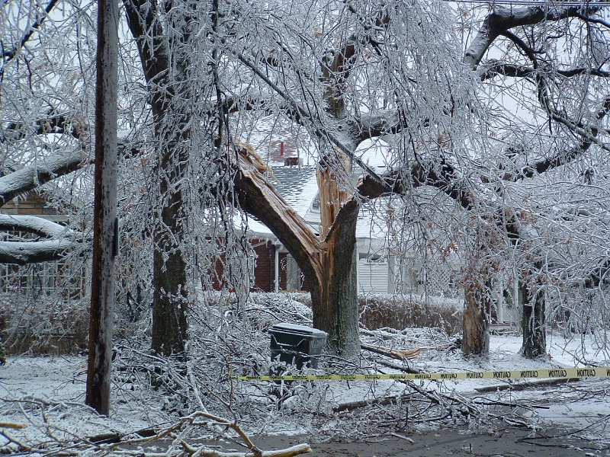
WINTER WEATHER IMPACTS TO ELECTRIC UTILITY OPERATIONS

Slide 5
Types of Winter Weather that Impact Utility Operations and Planning
Ice Storms
Snow Storms
Wind Storms
Severe Weather including Straight Line wind damage and Tornadoes
Extreme Outbreaks of Arctic Cold (so called Polar Vortex)

Slide 6
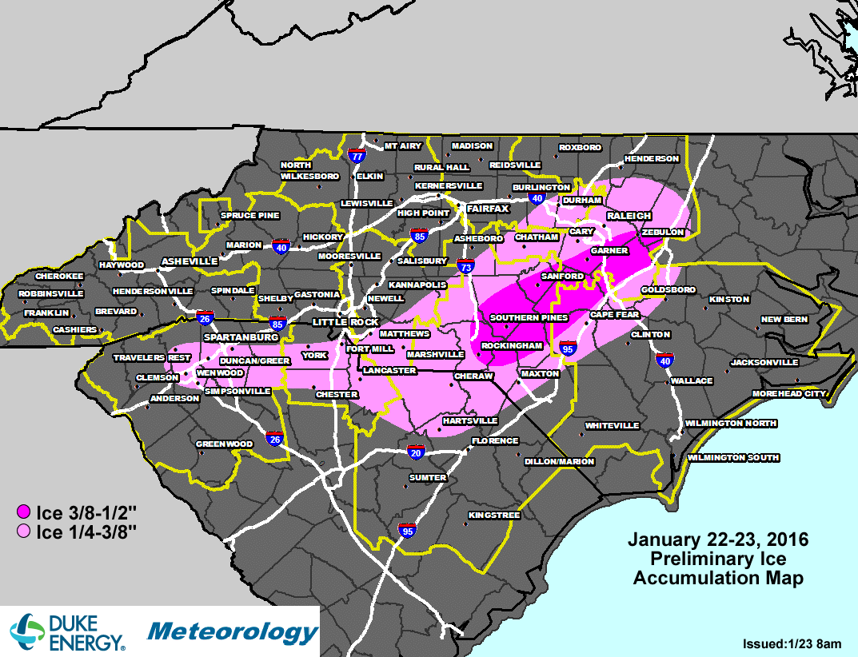
January 2016 Carolinas Ice Storm – $43 Million costs in Restoration

Slide 7
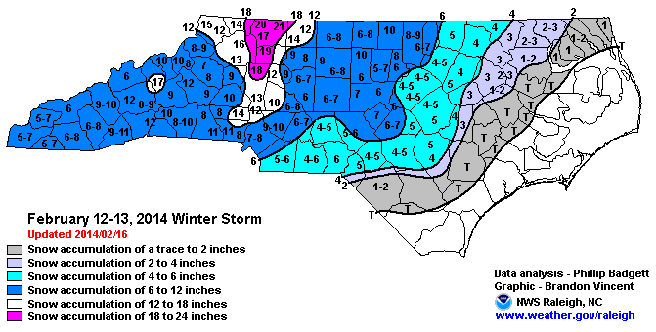
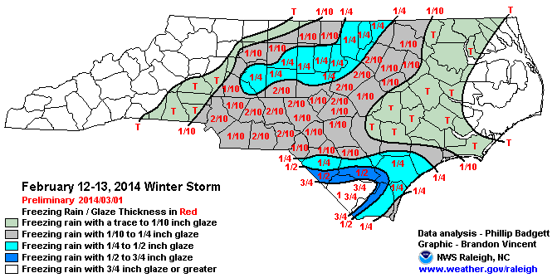
February 12-14th, 2014 Winter Storm
Peak Outages ~875,000
Total Storm costs $40 million

Slide 8
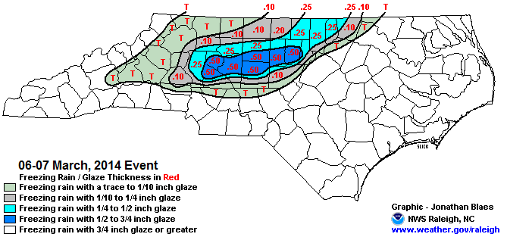
March 3-4th, 2014 Major Ice Storm
Peak Outages ~450,000
Total Storm Costs $45 Million

Slide 9

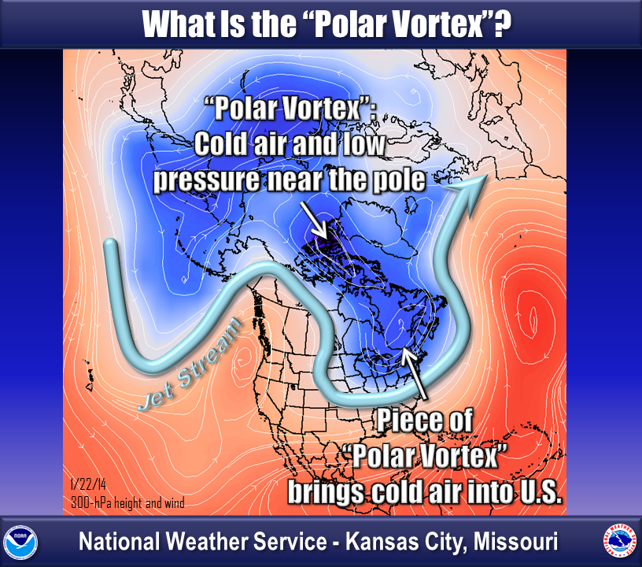
What is a “Polar Vortex”?
Large region of low pressure that resides near the North Pole (vortex refers to the counter-clockwise motion) that translates to extreme cold at the Earth’s surface
Often, pieces of the PV slide southward, buckling the jet stream, allowing cold, polar airmass to dip into the northern and eastern US
The winter forecast supports risks of PV intrusions into the eastern US, especially in the January-Feb period.

Slide 10
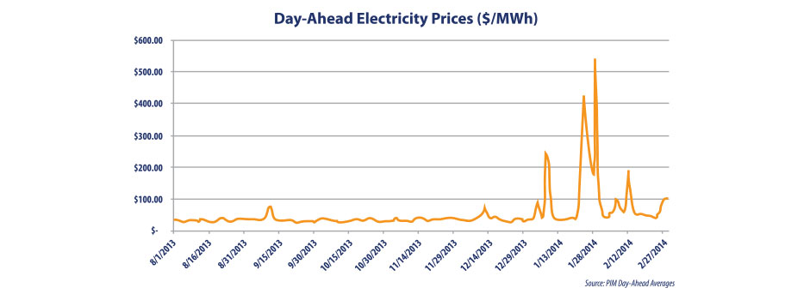
Impact of Extreme Temperatures to Day-Ahead Electricity Prices

Slide 11
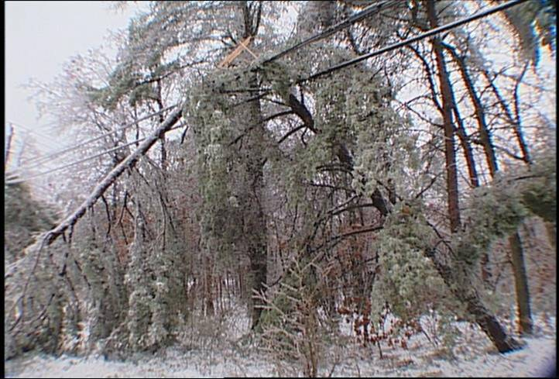
Accurate Weather Forecasts with longer lead times can save millions of dollars
Importance of Accurate Forecasts
Better pre-storm planning for resource decisions including pre-storm resource modeling (saves dollars and reduces customer outage times)
Better economic decisions for generation portfolio optimization (improved system load forecasting)
Longer lead times for mitigating extreme cold impacts to generation stations
Better supply chain decisions

