Slide 1
Briefing on Winter Weather Forecasting and Impacts
   
The Highway Perspective
Paul Pisano
Team Leader
Road Weather and Work Zone Management
Federal Highway Administration

Slide 2
Average Annual Fatalities
Under Adverse Weather
Sources:
NOAA Hazard Statistics: http://www.nws.noaa.gov/om/hazstats.shtml
Road Weather Management Program, Table: Weather-Related Crash Statistics (Annual Averages), Available at: http://www.ops.fhwa.dot.gov/weather/q1_roadimpact.htm

Slide 3
Weather-Related Crashes
Total Annual Crashes
Average = 5,748,564
Weather Related Crashes
By Road Weather Condition*
*Crashes that occurred under adverse conditions; additional factors such as rain, snow, and fog are not disaggregated from pavement conditions in this graphic. The percentage due to fog is for those crashes that occur under foggy conditions, but not wet, icy, or snowy pavement conditions.
Source: Road Weather Management Program, Table: Weather-Related Crash Statistics (Annual Averages), Available at: http://www.ops.fhwa.dot.gov/weather/q1_roadimpact.htm

Slide 4
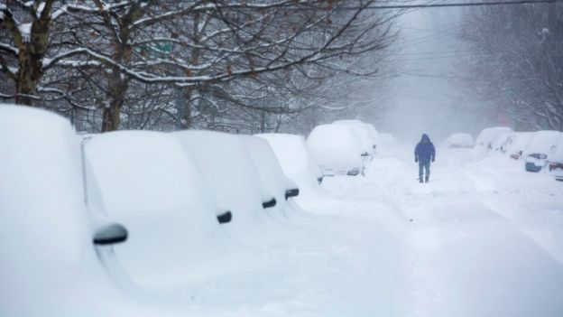
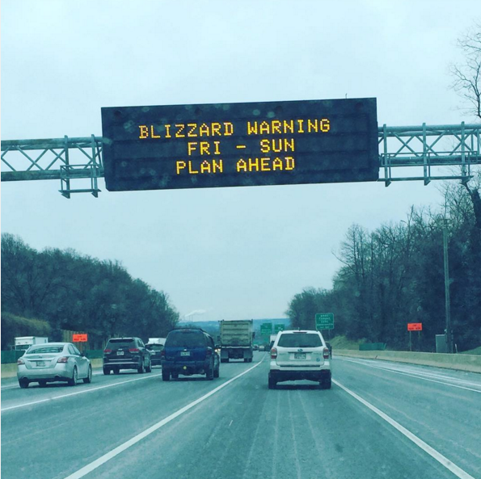
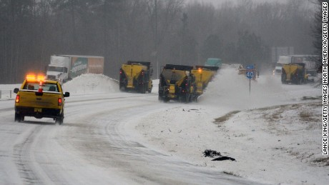
When We Think of Winter, We Think of Big Storms
Blizzard of January, 2016
Source: BBC
Source: Brett Yoh
Source: CNN
Notes:
Trucking companies lose ~ 32.6 billion(B) vehicle hours due to weather-related congestion at a cost of ~$ 2.2B - $3.5B annually

Slide 5
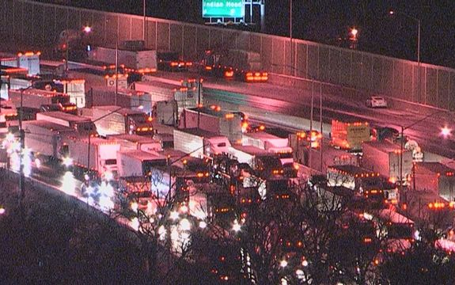
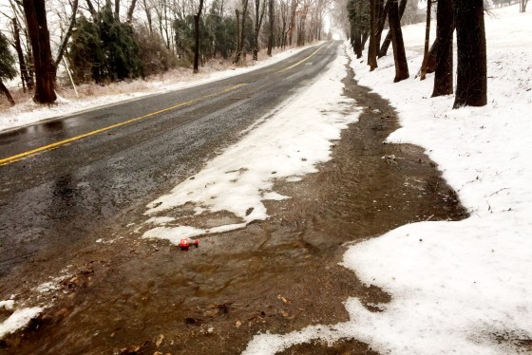
But It Doesn’t Have to Be Big to Have an Impact
Source: WTOP
Source: Fox5
January 20, 2016
March 3, 2016
Notes:
It’s all about the pavement temperature (along with precipitation & humidity)

Slide 6
Avoiding the Disasters
It’s a combination of managing the roads:
  Winter Maintenance
  Traffic Management
  Emergency Management
And alerting the traveling public via…
  National Weather Service
  TV/Radio/Mobile Devices
  State DOTs’ Traveler Information Systems
Notes:
At this point I’m going to focus on Winter Maintenance, but I also want to mention that we’re working very closely with the NWS and State DOTs to improve upon the messaging to the traveling public

Slide 7
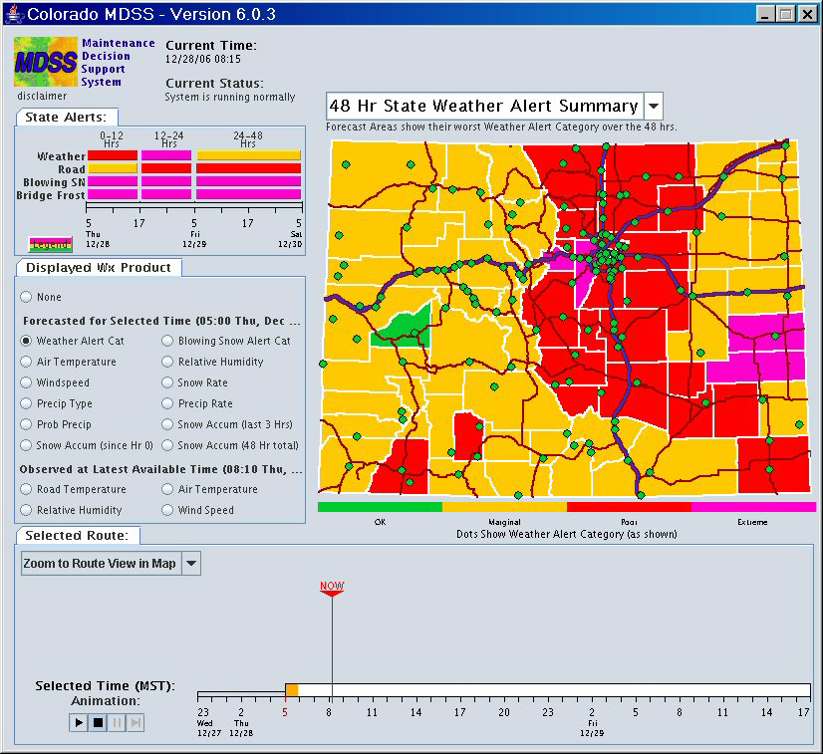
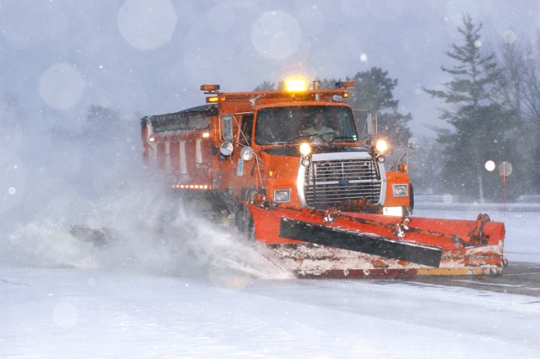
From Forecast to Action
1
2
3
4
Weather Forecast (National Weather Service)
Pavement Forecast
(State DOT contractors)
Road Condition Model
(State DOT contractors)
Treatment Recommendations (State DOT contractors)
Source: NCAR
Source: Minnesota DOT

Slide 8
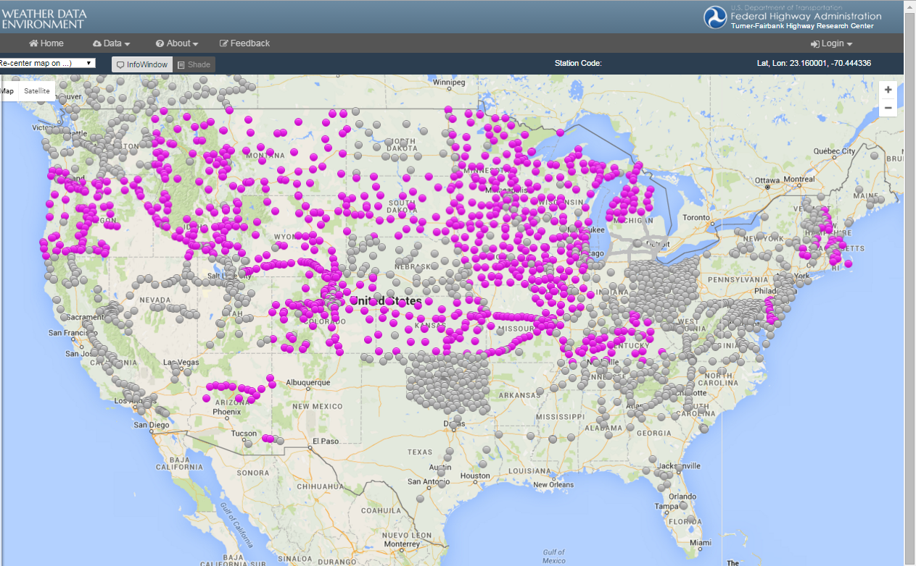
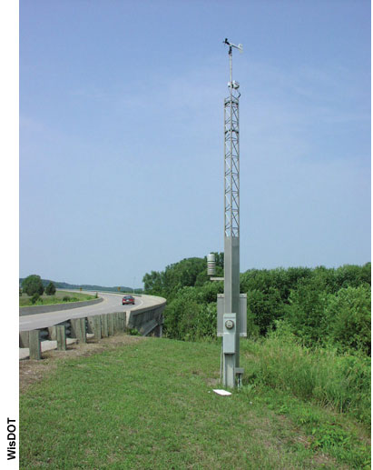
Road Weather Information Systems
Source: Wisconsin DOT
Source: FHWA, Weather Data Environment (https://wxde.fhwa.dot.gov)

Slide 9
The Road Weather Enterprise
National Weather Service
Road Weather Contractor
State DOT
The Traveling Public

Slide 10
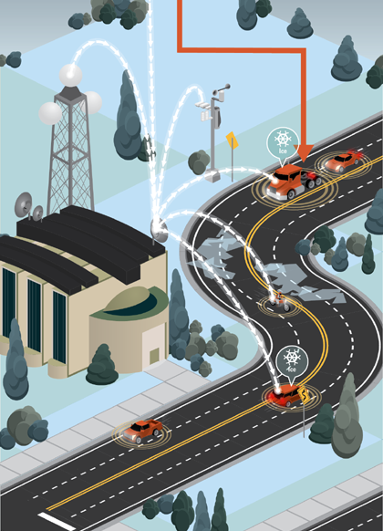
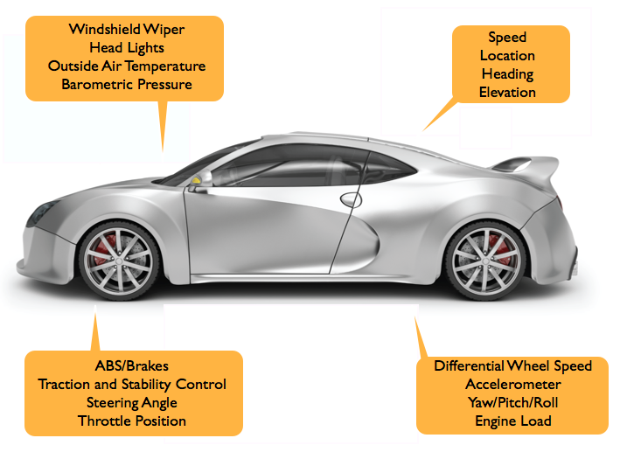
What’s Next?
Connected and Automated Vehicles
Source: NCAR
Source: USDOT

Slide 11
Summary
Impact-based Decision Support is essential
It starts with a timely and accurate weather forecast…
But translating that into an impact is not trivial
  “Weather” versus “Road Weather” Information
We continue to look for ways to better manage the highway system

