Slide 1

Integrated Systems since 1990
US Commercial Prospects in India’s Private Forecasting and Climate Prediction Industry
BKC WeatherSys Pvt. Ltd. New Delhi, India
Corporate Office: 32/33, Kusal Bazar, Nehru Place, New Delhi, India www.weathersysbkc.com
Project Office: H-135, Sector 63, Noida, Uttar Pradesh, India www.weatherindia.net

Slide 2
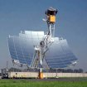
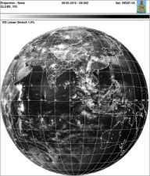

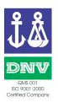
Core Competencies
A 20 year old Knowledge-based Company
Instruments
Turnkey installations & support of Weather Monitoring Systems and devices including radars & satellite data reception systems , including devices for climate resilient agriculture
Forecasting Software Development
Customized software for meteorology and development of systems for met data reception, analysis and visualization , including GIS Systems (IMD, IAF, Navy, DRDO)
Weather Forecasting
Agro
Solar
Customized Operational Weather Data to print, electronics and end users in Energy, Oil & Agro sectors. (Spun-off in 2011 as Skymet Pvt. Ltd).
ISO 9001:2008 Certified by DNV and NABCB (QMS 001) for Design, Development, Supply & Installation of
IT Enabled Turn Key Solutions including software related to Meteorological & Environmental requirements

Slide 3
Indian Weather Enterprise
The Time is Right
Demand + Dissemination Technologies
                Consumer
                Businesses
                National Agencies
2. Stable Governance = Infrastructure Investment
Radars
                Lidars
                Solar Radiation Monitoring Networks
                Satellites
                Lightning Detection
                AWOS
                AWS/ARG/AgroMet

Slide 4
Indian Weather Enterprise
What Will it Take:
Technology Transfer
Knowledge Sharing with Global Centers of Excellence
Climate cannot be separated from Weather
India as Specialized Software Hub for Weather
……and Investment!

Slide 5
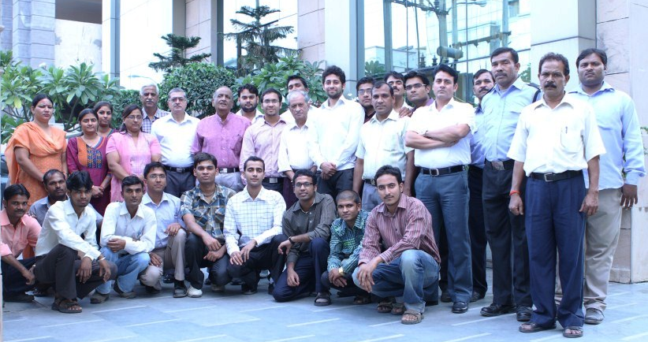
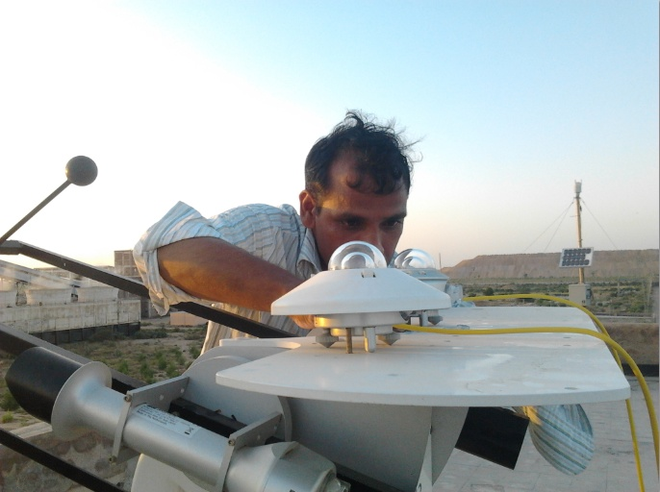
Thank You!
jaya@weathersysbkc.com

