Slide 1
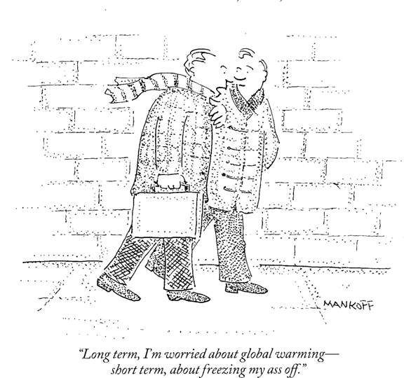


Climate Information and the Water Sector
Kristen Averyt
University of Colorado at Boulder, NOAA,
Western Water Assessment
kristen.averyt@noaa.gov
AMS Webinar
September 16, 2009
Notes:
Western Water Assessment is one of the 9 NOAA-funded Regionally integrated sciences and assessment Programs
Mission is to identify and characterize regional vulnerabilities to, and impacts of, climate variability and change, and to develop information, products, and processes that assist decision-makers throughout our region
in the west Many of the impacts of climate change will be delivered through changes in the hydrologic cycle, consequently, the WWA has traditionally worked with the water sector to develop climate adaptation strategies
Briefly share some of the lessons we have learned about engaging the water sector on climate issues and how this ties into identifying their informational needs.
Mention that there is additional information on some of these slides; won’t go into details because of time

Slide 2
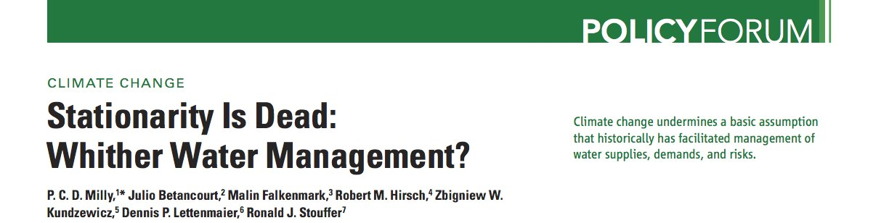
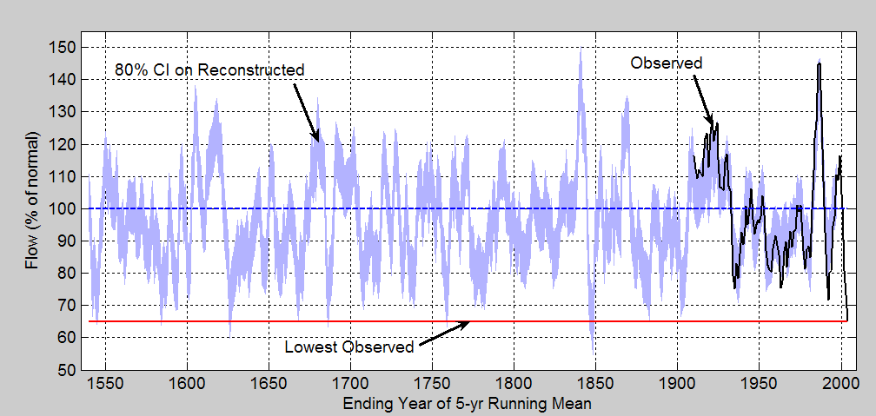
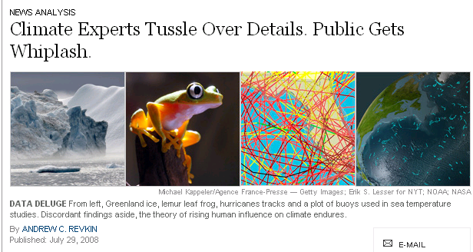
Cognitive Challenges
Within the water resources engineering community, the stationarity assumption is a fundamental element of professional training
Time scales of climate change exceed typical planning and infrastructure design horizons and are remote from human experience
Confusion in conceptually melding the burgeoning climate change impacts literature
CCSP SAP 5.1, Chapter 5, “Decision Support for Water Resources Management”
Notes:
One thing we have learned about working with the water sector is that before we can identify the specific informational needs, we really have to recognize cognitive challenges that hinder incorporation of climate information in water resource decision making.
Of these, the most important is that Climate variability and climate change undermine the basic assumption of “stationarity” that really is the paradigm of water management.
Simply put, for many water managers, future scenarios used in planning are defined by what a water manager has experienced in his/her lifetime– so long term variability (such as illustrated in this tree-ring record on the Colorado River) and concomitant changes in water resources are neglected.
This ties into the second challenge, where the time scales of climate change exceed typical planning horizons; water is managed on a seasonal basis and generally little thought beyond the next year or so, so difficult to grasp the ties between climate change time frames and related impacts
Lastly, is how to deal with and sort though all the scientific discussion playing out in the media and figure out what is the best climate information available. For those not directly involved in the science, it’s sometimes tough to understand that science is messy and the climate debate is just science playing out in a public theater. The example I like to give people is that there is no real consensus on gravity– but I know that when I spill a glass of water it falls on the ground.

Slide 3
Integrated Frameworks
Develop an ongoing, iterative process between developers and users
Identify Current AND Potential Users of Water Information
Know the User: Climate Literacy
Assess User Needs: What and Why?
Informational Gaps
Sources of Uncertainty
Decision-Making Context: Exacerbating Factors
EXAMPLES
Dealing with Drought in Colorado, Informing the Governor’s Climate Action Plan, Governor’s Drought Plan, and the Colorado Impacts and Adaptation Report
NOAA NWS River Forecast Centers, Engaging Current and New Users in Developing Online Climate Tools for CBRFC; Developing a framework for engaging water resource users
Department of Interior Climate Training, Scoping a Process for Engaging Federal Resource Managers and Technical Users of Climate Information with Climate Scientists
Notes:
One way we have found to breakdown the barriers creating these cognitive challenges is to implement a process that brings together product, tool and data developers with users.
Such a framework is built around an iterative process that facilitates ongoing, long-term engagement between those developing climate information and those using the information.
It takes decades to built credibility and legitimacy with stakeholders so that they can trust the information you provide, and integrated frameworks like this are meant to build sustained stakeholder networks.
Here, listed several key elements that we have identified, and that are identified in the literature, as being critical to building successful integrated research programs and scientifically-based tools and products.
Not going to go through these individual elements, but suffice it to say that we have and are currently using different combinations of these components to construct integrated frameworks for different users with varying degrees of technical sophistication:
One example:
Example 2: we were approached by the Colorado Basin River Forecast Center to help them engage new web interface geared toward water managers; using the process we develop with them and extrapolating it to all the RFCs to provide a process for iteration
We have found that by building sustained processes of interaction we are able to:
1- generate new ideas for climate research and tools
2- AND novel adaptive approaches for resource managers.
These ongoing interactions also allow us to identify the science relevant to an audience and to introduce new science as it is produced.
enhance literacy reduce the uncertainty associated with decision-making, thereby reducing vulnerability and risk
Several of the RISAs are doing, including our own, is developing a framework for engagement; right now, we’re working with the NOAA river forecasts center to test a process for…
1- public engagement: series of workshops beginning in Oct across Colorado aimed at assessing user needs for drought-related information in support of Governor’s new drought plan
2- NOAA product development: initiated a collaboration with NOAA Western River Forecast Center to help them engage water managers in evaluation of their new online forecast tools; this also includes efforts to expand their user base and generate products and tools that will attract and
produce guidelines for how to manage an iterative process that any RFC can follow to identify, engage, and build relationships with a diversity of users. WWA will produce a guidance document that specifically outlines how to identify and initiate collaborations with users, how to expand a user base, and how to respond to user needs; as well as packaged evaluation tools. The goal is to use the integrated process to improve the efficacy of climate information products.

Slide 4
Climate Information Needs
Manage for climate variability and climate change
Need seasonal and short-term climate forecasts: 2-mos, 12-mos, 24-mos
Downscaled data
Information tailored to regions
Streamflow volume forecasts conditioned on climate forecasts
Water is managed for extremes: Worst-case, Best-case, Median and Mean; percentiles and terciles don’t mean as much
Demand projections
CAUTION: User needs change as climate literacy evolves; and different users need different things
Lowrey et al., In Press, JAWRA
Notes:
Based on the interactions we have had with stakeholders and water information users, these are the major climate information needs we have identified…
Now as you read through these, need to recognize a couple things– this is just a smattering of informational needs, and these needs change rapidly as the climate literacy of the user base changes
Bottom line is that different users need different things even when all involved in the same sector; this is why user integration into product and information development is so important.

